Slide 1

COVID-19 Impact on Navajo Nation

Slide 2
COVID-19 Impact on Navajo Nation
Since January of 2020 Covid-19 has become a Global Pandemic
One of the hardest hit groups
people effected by the
pandemic in the United States
has been the Navajo Nation
Indian Tribe.
In this presentation we are going to look
at a Data Science point of view of how and why.

Slide 3

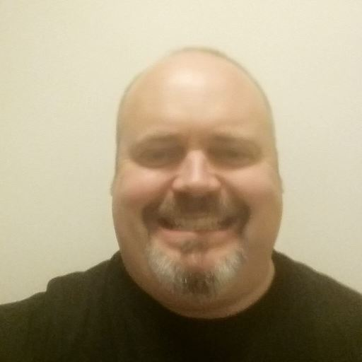
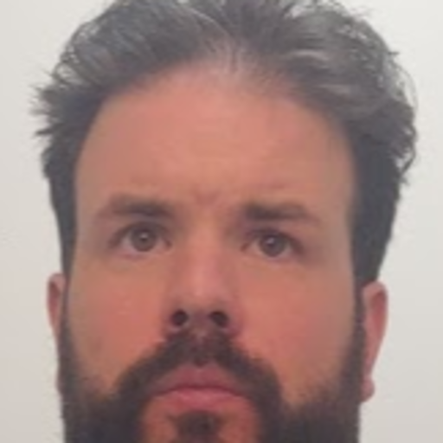
COVID-19 Impact on Navajo Nation
The Presenters
Craig Costenbader
Matt McMahon
Richard Brown

Slide 4
Bio: Richard Brown
COVID-19 Impact on Navajo Nation
Richard to come to Woz- U following of 9 years of teaching middle and high school science.
7 years of teaching on the Navajo (Diné) Nation teaching middle and high school Earth Science and head wrestling coach for both high school and middle schools
Lived on the Navajo (Dine) Nation, in Window Rock (Navajo Nation Capital) and lived in Sanders, Arizona.

Slide 5
Bio: Craig Costenbader
COVID-19 Impact on Navajo Nation

Slide 6
Bio: Matt McMahon
COVID-19 Impact on Navajo Nation
Matt comes to Woz-U following six years working as a salesperson for The Men’s Wearhouse in Manhattan. He currently resides in the Lower Hudson Valley. Following the fallout from the COVID-19 pandemic Matt decided to join the data science program at Woz-U. What interested him about the data science program is its application to many fields with promise of continued growth and learning in any career path. Matt took interest in this topic because of it dealing with real world issues and his interest in advocacy for disenfranchised or marginalized groups – especially now as our focus seems to be continually on how to better organize ourselves to help communities in need.

Slide 7
HistoryCOVID-19 Impact on Navajo Nation

Slide 8
COVID-19 Impact on Navajo Nation
Water is Life
On the Navajo Nation about 30% of home do not have running water
Most Navajo have to hull in water just to live.
The Navajo Nation is sprawling. It’s roughly the size of West Virginia and for some people that means driving as much as two hours to get water.

Slide 9
COVID-19 Impact on Navajo Nation
Navajo Believe the land to be scared land, most of the culture is around stories that they share among them
They called the Covid an monster, they used the story of creation story tell this story
“The creation story for the Navajo people is one where twin warriors slay monsters that are hurting our people. The virus is another monster that we will overcome,” Young says in the opening of the video.
They have been looking at this virus through Navajo Culture Lens
But the pandemic has given her people a change to show a commitment to culture and resiliency.

Slide 10
COVID-19 Impact on Navajo Nation

Slide 11
COVID-19 Impact on Navajo Nation

Slide 12
COVID-19 Impact on Navajo Nation

Slide 13
COVID-19 Impact on Navajo Nation

Slide 14
COVID-19 Impact on Navajo Nation

Slide 15
COVID-19 Impact on Navajo Nation

Slide 16
COVID-19 Impact on Navajo Nation

Slide 17
COVID-19 Impact on Navajo Nation

Slide 18
COVID-19 Impact on Navajo Nation

Slide 19
COVID-19 Impact on Navajo Nation

Slide 20
COVID-19 Impact on Navajo Nation

Slide 21
Conclusion
COVID-19 Impact on Navajo Nation

Slide 22
Questions & answers
COVID-19 Impact on Navajo Nation

