Slide 1

COVID-19 Impact on Navajo Nation in Arizona & New Mexico

Slide 2
COVID-19 Impact on Navajo Nation in Arizona & New Mexico
Since January of 2020 Covid-19 has become a Global Pandemic
One of the hardest hit groups
people effected by the
pandemic in the United States
has been the Navajo Nation
Indian Tribe.
In this presentation we are going to look
at a Data Science point of view of how and why.

Slide 3


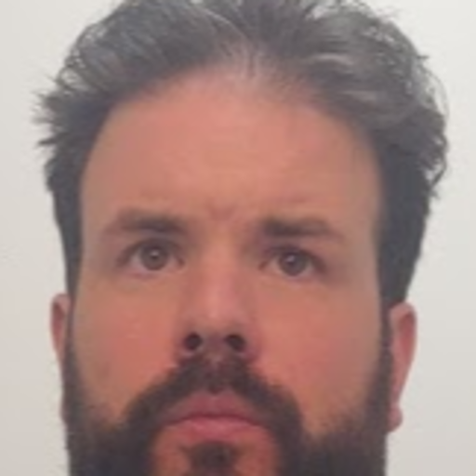
HistoryCOVID-19 Impact on Navajo Nation in Arizona & New Mexico
The Presenters
Craig Costenbader
Matt McMahon
Richard Brown

Slide 4
Bio: Richard Brown
COVID-19 Impact on Navajo Nation in Arizona & New Mexico

Slide 5
Bio: Craig Costenbader
COVID-19 Impact on Navajo Nation in Arizona & New Mexico

Slide 6
Bio: Matt McMahon
COVID-19 Impact on Navajo Nation in Arizona & New Mexico
Matt comes to Woz-U following six years working as a salesperson for The Men’s Wearhouse in Manhattan. He currently resides in the Lower Hudson Valley. Following the fallout from the COVID-19 pandemic Matt decided to join the data science program at Woz-U. What interested him about the data science program is its application to many fields with promise of continued growth and learning in any career path. Matt took interest in this topic because of it dealing with real world issues and his interest in advocacy for disenfranchised or marginalized groups – especially now as our focus seems to be continually on how to better organize ourselves to help communities in need.

Slide 7
COVID-19 Impact on Navajo Nation in Arizona & New Mexico
No race data for 42,000 COVID deaths. Believed to be 700 missing deaths from Native American toll nationally.
Feb 2^{nd,} former Navajo president and Arizona state representative died from COVID, making death toll 1,038 or a rate of 1 out of 160 in the tribe.

Slide 8
COVID-19 Impact on Navajo Nation in Arizona & New Mexico
Language barriers – initial COVID-19 translation into Dine meant “flu with dry cough”
Multi-generational housing. Young and old sharing homes.
Culturally nomadic. Especially the young, accustomed to driving far distances.
Food shopping also far from chapter centers.

Slide 9
COVID-19 Impact on Navajo Nation in Arizona & New Mexico
Underlying health issues with Navajo due to residual and generational effects of uranium mining.
Unreliable access to water. Running water is uncommon and is brought into homes by five-gallon tanks.
No access to quality healthcare facilities. Trauma 1 or Trauma 2 (highest levels of care) are hundreds of miles from chapter centers.

Slide 10
COVID-19 Impact on Navajo Nation in Arizona & New Mexico

Slide 11
COVID-19 Impact on Navajo Nation in Arizona & New Mexico

Slide 12
HistoryCOVID-19 Impact on Navajo Nation in Arizona & New Mexico

Slide 13
COVID-19 Impact on Navajo Nation in Arizona & New Mexico

Slide 14
COVID-19 Impact on Navajo Nation in Arizona & New Mexico

Slide 15
HistoryCOVID-19 Impact on Navajo Nation in Arizona & New Mexico

Slide 16
HistoryCOVID-19 Impact on Navajo Nation in Arizona & New Mexico

Slide 17
HistoryCOVID-19 Impact on Navajo Nation in Arizona & New Mexico
Scott Momaday was the first person of Native American heritage to win the Pulitzer Prize for Fiction.
John Herrington was the first person of Native American heritage to fly in space.
Jim Thorpe was the first person of Native American heritage to win an Olympic gold medal for the United States.

Slide 18
HistoryCOVID-19 Impact on Navajo Nation in Arizona & New Mexico

Slide 19
HistoryCOVID-19 Impact on Navajo Nation in Arizona & New Mexico

Slide 20
HistoryCOVID-19 Impact on Navajo Nation in Arizona & New Mexico

Slide 21
HistoryCOVID-19 Impact on Navajo Nation in Arizona & New Mexico
Make a timeline of important historical events or list historical contributions made by people of Native American heritage.
1st Event | 2nd Event | 3rd Event | 4th Event | 5th Event | 6th Event
Date | Date | Date | Date | Date | Date
Description | Description | Description | Description | Description | Description

Slide 22
HistoryCOVID-19 Impact on Navajo Nation in Arizona & New Mexico
Make a timeline of important historical events or list historical contributions made by people of Native American heritage.
1st Event | 2nd Event | 3rd Event | 4th Event | 5th Event | 6th Event
Date | Date | Date | Date | Date | Date
Description | Description | Description | Description | Description | Description

Slide 23
HistoryCOVID-19 Impact on Navajo Nation in Arizona & New Mexico

Slide 24
HistoryCOVID-19 Impact on Navajo Nation in Arizona & New Mexico

Slide 25
Conclusion
HistoryCOVID-19 Impact on Navajo Nation in Arizona & New Mexico
Provide a brief summary of your presentation. Remind the audience what you covered in the previous slides.
Take the Bing quiz and test your knowledge about the contributions of some amazing Hispanic/Latino people, past and present.

Slide 26
HistoryCOVID-19 Impact on Navajo Nation in Arizona & New Mexico

Slide 27
Questions & answers
HistoryCOVID-19 Impact on Navajo Nation in Arizona & New Mexico
Invite questions from the audience

Slide 28
HistoryCOVID-19 Impact on Navajo Nation in Arizona & New Mexico

Slide 29
HistoryCOVID-19 Impact on Navajo Nation in Arizona & New Mexico

Slide 30
The Presenters
HistoryCOVID-19 Impact on Navajo Nation in Arizona & New Mexico
Richard Brown
Craig Costenbader
And
Matt McMahon

Slide 31
Questions & answers
HistoryCOVID-19 Impact on Navajo Nation in Arizona & New Mexico
Invite questions from the audience

Slide 32
Questions & answers
HistoryCOVID-19 Impact on Navajo Nation in Arizona & New Mexico
Invite questions from the audience

Slide 33
HistoryCOVID-19 Impact on Navajo Nation in Arizona & New Mexico

Slide 34
HistoryCOVID-19 Impact on Navajo Nation in Arizona & New Mexico

Slide 35
HistoryCOVID-19 Impact on Navajo Nation in Arizona & New Mexico

Slide 36
HistoryCOVID-19 Impact on Navajo Nation in Arizona & New Mexico

Slide 37
HistoryCOVID-19 Impact on Navajo Nation in Arizona & New Mexico

Slide 38
HistoryCOVID-19 Impact on Navajo Nation in Arizona & New Mexico

Slide 39
HistoryCOVID-19 Impact on Navajo Nation in Arizona & New Mexico

Slide 40
HistoryCOVID-19 Impact on Navajo Nation in Arizona & New Mexico

Slide 41
HistoryCOVID-19 Impact on Navajo Nation in Arizona & New Mexico

Slide 42
HistoryCOVID-19 Impact on Navajo Nation in Arizona & New Mexico

Slide 43
HistoryCOVID-19 Impact on Navajo Nation in Arizona & New Mexico

Slide 44
HistoryCOVID-19 Impact on Navajo Nation in Arizona & New Mexico

Slide 45
HistoryCOVID-19 Impact on Navajo Nation in Arizona & New Mexico

