Slide 1

COVID-19 Impact on Navajo Nation in Arizona & New Mexico

Slide 2
COVID-19 Impact on Navajo Nation in Arizona & New Mexico
Since January of 2020 Covid-19 has become a Global Pandemic
One of the hardest hit groups
people effected by the
pandemic in the United States
has been the Navajo Nation
Indian Tribe.
In this presentation we are going to look
at a Data Science point of view of how and why.

Slide 3


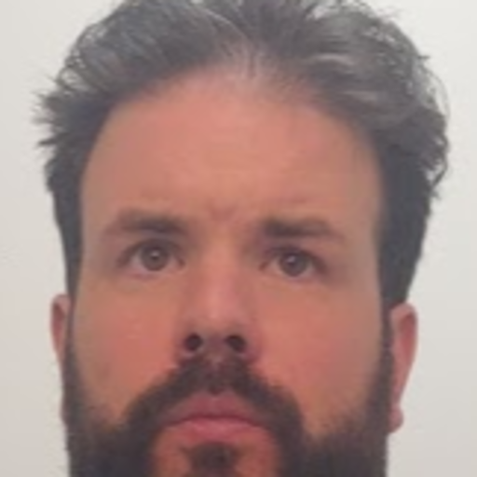
HistoryCOVID-19 Impact on Navajo Nation in Arizona & New Mexico
The Presenters
Craig Costenbader
Matt McMahon
Richard Brown

Slide 4
Bio: Richard Brown
COVID-19 Impact on Navajo Nation in Arizona & New Mexico

Slide 5
Bio: Craig Costenbader
COVID-19 Impact on Navajo Nation in Arizona & New Mexico

Slide 6
Bio: Matt McMahon
COVID-19 Impact on Navajo Nation in Arizona & New Mexico

Slide 7
HistoryCOVID-19 Impact on Navajo Nation in Arizona & New Mexico
Make a timeline of important historical events or list historical contributions made by people of Native American heritage.
1st Event | 2nd Event | 3rd Event | 4th Event | 5th Event | 6th Event
Date | Date | Date | Date | Date | Date
Description | Description | Description | Description | Description | Description

Slide 8
HistoryCOVID-19 Impact on Navajo Nation in Arizona & New Mexico

Slide 9
HistoryCOVID-19 Impact on Navajo Nation in Arizona & New Mexico

Slide 10
HistoryCOVID-19 Impact on Navajo Nation in Arizona & New Mexico

Slide 11
HistoryCOVID-19 Impact on Navajo Nation in Arizona & New Mexico

Slide 12
HistoryCOVID-19 Impact on Navajo Nation in Arizona & New Mexico

Slide 13
HistoryCOVID-19 Impact on Navajo Nation in Arizona & New Mexico

Slide 14
HistoryCOVID-19 Impact on Navajo Nation in Arizona & New Mexico

Slide 15
HistoryCOVID-19 Impact on Navajo Nation in Arizona & New Mexico

Slide 16
HistoryCOVID-19 Impact on Navajo Nation in Arizona & New Mexico

Slide 17
HistoryCOVID-19 Impact on Navajo Nation in Arizona & New Mexico

Slide 18
HistoryCOVID-19 Impact on Navajo Nation in Arizona & New Mexico
Scott Momaday was the first person of Native American heritage to win the Pulitzer Prize for Fiction.
John Herrington was the first person of Native American heritage to fly in space.
Jim Thorpe was the first person of Native American heritage to win an Olympic gold medal for the United States.

Slide 19
HistoryCOVID-19 Impact on Navajo Nation in Arizona & New Mexico

Slide 20
HistoryCOVID-19 Impact on Navajo Nation in Arizona & New Mexico

Slide 21
HistoryCOVID-19 Impact on Navajo Nation in Arizona & New Mexico

Slide 22
HistoryCOVID-19 Impact on Navajo Nation in Arizona & New Mexico
Make a timeline of important historical events or list historical contributions made by people of Native American heritage.
1st Event | 2nd Event | 3rd Event | 4th Event | 5th Event | 6th Event
Date | Date | Date | Date | Date | Date
Description | Description | Description | Description | Description | Description

Slide 23
HistoryCOVID-19 Impact on Navajo Nation in Arizona & New Mexico
Make a timeline of important historical events or list historical contributions made by people of Native American heritage.
1st Event | 2nd Event | 3rd Event | 4th Event | 5th Event | 6th Event
Date | Date | Date | Date | Date | Date
Description | Description | Description | Description | Description | Description

Slide 24
HistoryCOVID-19 Impact on Navajo Nation in Arizona & New Mexico

Slide 25
HistoryCOVID-19 Impact on Navajo Nation in Arizona & New Mexico

Slide 26
Conclusion
HistoryCOVID-19 Impact on Navajo Nation in Arizona & New Mexico
Provide a brief summary of your presentation. Remind the audience what you covered in the previous slides.
Take the Bing quiz and test your knowledge about the contributions of some amazing Hispanic/Latino people, past and present.

Slide 27
HistoryCOVID-19 Impact on Navajo Nation in Arizona & New Mexico

Slide 28
Questions & answers
HistoryCOVID-19 Impact on Navajo Nation in Arizona & New Mexico
Invite questions from the audience

Slide 29
HistoryCOVID-19 Impact on Navajo Nation in Arizona & New Mexico

Slide 30
HistoryCOVID-19 Impact on Navajo Nation in Arizona & New Mexico

Slide 31
The Presenters
HistoryCOVID-19 Impact on Navajo Nation in Arizona & New Mexico
Richard Brown
Craig Costenbader
And
Matt McMahon

Slide 32
Questions & answers
HistoryCOVID-19 Impact on Navajo Nation in Arizona & New Mexico
Invite questions from the audience

Slide 33
Questions & answers
HistoryCOVID-19 Impact on Navajo Nation in Arizona & New Mexico
Invite questions from the audience

Slide 34
HistoryCOVID-19 Impact on Navajo Nation in Arizona & New Mexico

Slide 35
HistoryCOVID-19 Impact on Navajo Nation in Arizona & New Mexico

Slide 36
HistoryCOVID-19 Impact on Navajo Nation in Arizona & New Mexico

Slide 37
HistoryCOVID-19 Impact on Navajo Nation in Arizona & New Mexico

Slide 38
HistoryCOVID-19 Impact on Navajo Nation in Arizona & New Mexico

Slide 39
HistoryCOVID-19 Impact on Navajo Nation in Arizona & New Mexico

Slide 40
HistoryCOVID-19 Impact on Navajo Nation in Arizona & New Mexico

Slide 41
HistoryCOVID-19 Impact on Navajo Nation in Arizona & New Mexico

Slide 42
HistoryCOVID-19 Impact on Navajo Nation in Arizona & New Mexico

Slide 43
HistoryCOVID-19 Impact on Navajo Nation in Arizona & New Mexico

Slide 44
HistoryCOVID-19 Impact on Navajo Nation in Arizona & New Mexico

Slide 45
HistoryCOVID-19 Impact on Navajo Nation in Arizona & New Mexico

Slide 46
HistoryCOVID-19 Impact on Navajo Nation in Arizona & New Mexico

