Slide 1

COVID-19 Impact on Navajo Nation

Slide 2
COVID-19 Impact on Navajo Nation
Since January of 2020 Covid-19 has become a Global Pandemic.
One of the hardest hit groups
people affected by the
pandemic in the United States
has been the Navajo Nation
Indian Tribe.
This presentation will attempt to use data science as a method to understand why.

Slide 3


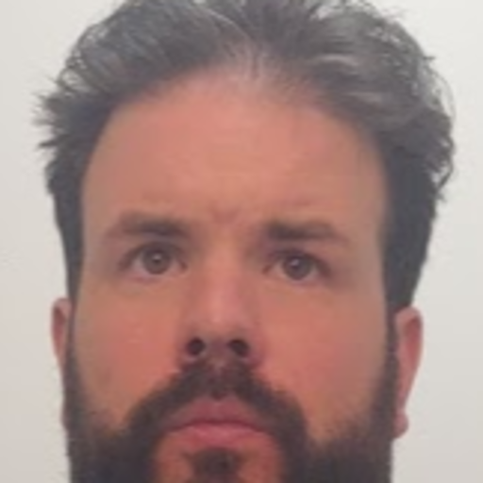
COVID-19 Impact on Navajo Nation
The Presenters
Craig Costenbader
Matt McMahon
Richard Brown

Slide 4
Bio: Matt McMahon
COVID-19 Impact on Navajo Nation in Arizona & New Mexico
Matt comes to Woz-U following six years working as a salesperson for The Men’s Wearhouse in Manhattan. He currently resides in the Lower Hudson Valley. Following the fallout from the COVID-19 pandemic Matt decided to join the data science program at Woz-U. What interested him about the data science program is its application to many fields with promise of continued growth and learning in any career path. Matt took interest in this topic because of it dealing with real world issues and his interest in advocacy for disenfranchised or marginalized groups – especially now as our focus seems to be continually on how to better organize ourselves to help communities in need.

Slide 5
Bio: Craig Costenbader
COVID-19 Impact on Navajo Nation
Before becoming a student at Southern Careers Institute / Woz U in the Data Science Program.
I was born and raised in Seattle WA.
I have worked in the service industry for 25 years.
Including 11 years with Enterprise Rent A Car, 7 years of which were in Car Sales, personally delivering over 3000 vehicles.
I also drove for Uber in Seattle and completed 22000 trips in 4 years.
I also have my own sales and marketing consulting business since 2012, where I share my experience and help other people run their small businesses to improve their customer service and profitability.
I love working with people and have a lifelong love of all things technology.
I have always been a numbers guy.
Covid-19 in March of 2020 brought all my businesses to a grinding halt, so I decided to go back to school.
I decided on Data Science because I literally could not find an industry in all the ones that I looked at being re-trained to work in, that did not use DATA.
The online learning program with Woz-U ended up being a perfect fit!

Slide 6
Bio: Richard Brown
COVID-19 Impact on Navajo Nation
Richard comes to Woz- U following of 9 years of teaching middle and high school science.
7 years of teaching on the Navajo (Diné) Nation teaching middle and high school Earth Science and head wrestling coach for both high school and middle schools
Lived on the Navajo (Dine) Nation, in Window Rock (Navajo Nation Capital) and lived in Sanders, Arizona.

Slide 7
COVID-19 Impact on Navajo Nation
Water Is Life
On the Navajo Nation about 30% of homes do not have running water
Most Navajo must “haul in” their own water just to live.
The Navajo Nation is sprawling. It’s roughly the size of West Virginia and for some that means driving as much as two hours to get water or food.

Slide 8
COVID-19 Impact on Navajo Nation
Navajo Believe the land to be sacred land, most of the culture is based around stories that they share among the Navajo People.
They called the Covid a monster, they used the story of creation story to tell this story
“The creation story for the Navajo people is one where twin warriors slay monsters that are hurting our people. The virus is another monster that we will overcome,”
They have been looking at this virus through Navajo Culture Lens
Source: People vs The Pandemic
https://www.navajocovid19.com

Slide 9
COVID-19 Impact on Navajo Nation
FACTS ABOUT THE NAVAJO NATION
The Navajo Nation is an American Indian Territory covering over 27,000 square miles occupying portions of Northeastern Arizona, Southeastern Utah, and Northwestern New Mexico
This is the largest land area retained by an indigenous tribe in the United States
https://www.navajo-nsn.gov/history.htm
The Navajo Nation is famous for many things, most notably was the Navajo Code Talkers, who took part in every assault the U.S. Marines conducted in the Pacific from 1942 to 1945 during WWII, they were instrumental in defeating the Japanese.
Excerpts taken from a Fact Sheet prepared by the Navy & Marine Corps WWII Commemorative Committee.II.

Slide 10
Additional Facts
COVID-19 Impact on Navajo Nation
POPULATION/DEMOGRAPHICS:
(As recorded in the 2010 U.S. Census on Navajo)
(As recorded in the 2010 U.S. Census on Navajo)
Total Enrollment 332,129
Total Navajos (living on the Navajo Nation) 156,823 or 47%
Unemployment Rate 55.9%
Avg. Household Income $27,389
Source: https://www.census.gov/

Slide 11
COVID-19 Impact on Navajo Nation
For the purposes of this exercise, this presentation will speak on the effects of COVID-19 in the states of Arizona and New Mexico.
The following questions are the central thrust of this presentation:
Is there a significant difference in the number of cases and deaths from the spread of COVID-19 effecting the population in the states of AZ and NM by comparing the Navajo Nation vs. Non-Navajo Nation lands?
What were the biggest contributing factors to the number of confirmed cases and deaths resulting from COVID-19?

Slide 12
Methods
COVID-19 Impact on Navajo Nation
Important data limitations on Navajo and COVID reporting-
Many websites with information on COVID-19
Limited data on the Navajo Nation
Two primary sources for this presentation as of 2/27/2021 were
Johns Hopkins University Center for Systems Science and Engineering
(JHU CSSE) Source: https://github.com/mattrm8/COVID-19/blob/master/README.md
Citing an article that was written on www.thelancent.com regarding the original discovery and outbreak when it stated in Wuhan China in December of 2019.
Source: https://www.thelancet.com/journals/laninf/article/PIIS1473-3099(20)30120-1/fulltext
New Mexico Highland University
Source: Dr Gil Gallegos, Computer Science Professor and Dr Orit Tamir, Anthropology Professor. As well as several of their students in Masters Program. (NMHU) Source: https://www.appliedanthro.org/publications/news/august-2020/grant-help-navajo-nation-covid-19-data

Slide 13
Tools and Methods (Summary)
COVID-19 Impact on Navajo Nation
Github was used to download the data from JHU CSSE, store the data, and share among team members.
www.github.com
Trello KanBan Board used to organize project, assign roles and tasks
www.trello.com
Statistical Analysis using R programming language and Rstudio GUI
www.rstudio.com
Data wrangling, manipulation and visualization processed through Tableau.
www.tableau.com
Naturally Google was used
www.google.com

Slide 14
Statistical Analysis in R
COVID-19 Impact on Navajo Nation
Data research, analysis, and exploration:
Data WRANGLING: loaded dataset .csv file from John Hopkins GitHub and ran analysis through RStudio
Original sample size included data compiled from 3982 locations around the world.
Data cross referenced with FIPS Codes which is a system developed (US only) and is Federal Information Processing Standards code that uniquely identify counties within the USA..
Source: https://www.policymap.com/2012/07/tips-on-fips-a-quick-guide-to-geographic-place-codes/
FIPS codes were then split into a binary 0 for Non-Navajo counties then 1 for Navajo Nation containing counties.
Data WRANGLING resulted in information from 48 locations. These locations from here forward will be referred to as our SAMPLE SIZE.

Slide 15
Statistical Analysis in R (Continued)
COVID-19 Impact on Navajo Nation
ANOVAS run on several variables-
An ANOVA is an analysis of variance and is used to compare two variables against each other.
The variables compared were four variables from the dataset:
CONFIRMED (Cases)
DEATHS
CASE_FATALITY_RATIO = Number recorded deaths / Number cases
INCIDENT_RATE = cases per 100,000 persons

Slide 16
The Analysis – Running the ANOVAs
COVID-19 Impact on Navajo Nation
The following libraries in R were used to complete the analyses:
library("dplyr")
library("rcompanion")
library("car")
library("fastR2")
library("IDPmisc")
ANOVAs run on each of the variables comparing them and sorting them as a binary variable that was either NAVAJO (1) or NON-NAVAJO (0) land locations.
Information converted into a .xlsx file to upload into a TABLEAU PUBLIC
The results are as follows:

Slide 17
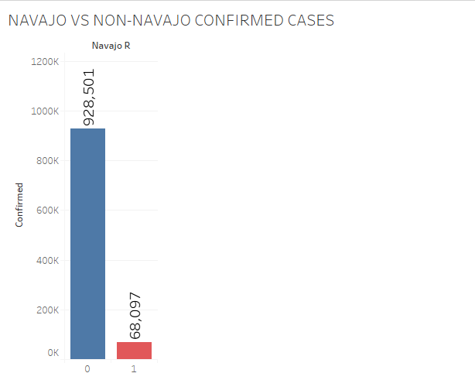
Analysis / Reporting
COVID-19 Impact on Navajo Nation
For the variable CONFIRMED of 48 locations in AZ and NM confirmed the number of cases.
Non-Navajo Nation
928,501 cases
Navajo Nation
68,097 cases
The analysis:
The Welch’s One Way ANOVA shows the
P-VALUE = 0.001 < .05 and is significant
Columns show that two amounts were significantly different.

Slide 18
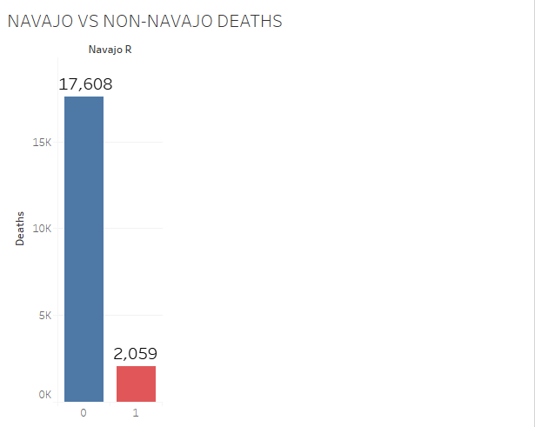
The Analysis / Reporting
COVID-19 Impact on Navajo Nation
For the variable DEATHS of 48 locations in AZ and NM confirmed
Non-Navajo Nation
17,608 DEATHS
Navajo Nation
2059 DEATHS
Naked eye assessment shows significant differences between the two variables
This analysis and chart confirms that there was a significant difference between the two.
The Welch’s one way ANOVA shows the
P-VALUE = 0.001 < .05 and is significant
Analysis and graph show that there is a significant difference between the two groups

Slide 19
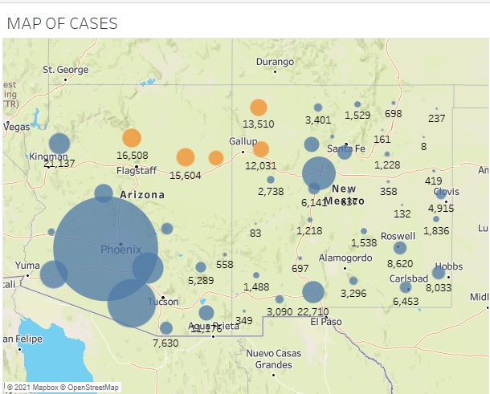
Analysis / Reporting
COVID-19 Impact on Navajo Nation
Map of CONFIRMED cases.
Blue Dots are NON-NAVAJO cases
Orange is NAVAJO NATION cases
The map confirms the analysis as well as showing locations and significantly more NON-NAVAJO CONFIRMED Cases.

Slide 20
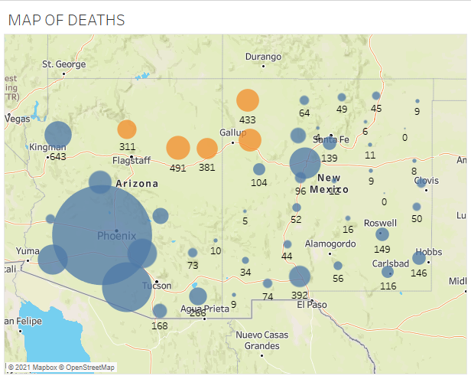
The Analysis / Reporting
COVID-19 Impact on Navajo Nation
Map of DEATHS
Blue Dots are NON-NAVAJO DEATHS
Orange is NAVAJO NATION DEATHS
The map confirms the analysis as well as showing locations and significantly more
NON-NAVAJO DEATHS.

Slide 21
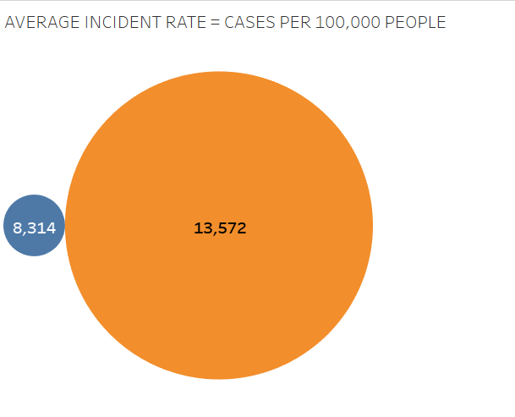
The Analysis / Reporting
COVID-19 Impact on Navajo Nation
For the variable INCIDENT_RATE of 48 locations in AZ and NM average incident rate confirmed
Non-Navajo Nation
8314 = CASES PER 100,000 PEOPLE
Navajo Nation
13,572 = CASES PER 100,00 PEOPLE
Notable difference and disproportionate rate of cases
This analysis and chart confirms that there was a significant difference between the two.
The ANOVA shows that:
P-VALUE = 0.01 < .05 and is significant
The analysis and graph provide significant difference between the two groups
The difference is 5258 or 63.24% Greater NAVAJO NATION CONFIRMED cases PER 100,000 PEOPLE

Slide 22
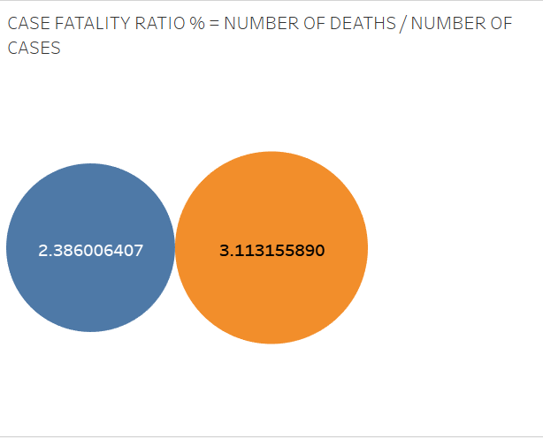
The Analysis / Reporting
COVID-19 Impact on Navajo Nation
Looking at CASE_FATALITY_RATIO
Number of deaths / Number of cases.
Blue is NON-NAVAJO 2.39%
Orange is NAVAJO NATION 3.11%
Running the ANOVA on this variable shows that the difference between the two is not significant as a percentage.
CONCLUSION: Looking at the previous slide, if NAVAJO NATION DEATHS per 100,000 people is 63.24% greater than NON-NAVAJO areas, it can be assumed that the death rate is at least that much greater as well.
The people of the NAVAJO NATION are getting crushed by COVID-19 compared to the surrounding population!

Slide 23
COVID-19 Impact on Navajo Nation
Underlying Factors
The “Whys” of how this population has been particularly decimated by the COVID pandemic are still being studied. During the research for this project several factors repeatedly showed in research, anecdotal evidence, etc.
The following section will attempt to partition several prominent factors into three groups -
Health
Cultural
Government / Institutional

Slide 24
Health Factors
Underlying health issues with Navajo due to residual and generational effects of uranium mining on their land.
No access to quality healthcare facilities. Trauma 1 or Trauma 2 (highest levels of care) are hundreds of miles from chapter centers.

Slide 25
Cultural Factors
Language barriers – initial COVID-19 translation into Dine meant “flu with dry cough”
Multi-generational housing. Young and old sharing homes.
Culturally nomadic. Especially the young; accustomed to driving far distances.

Slide 26
Government / Institutional Factors
No race data for 42,000 COVID deaths. Believed to be 700 missing deaths from Native American toll nationally.
Feb 2^{nd,} former Navajo president and Arizona state representative died from COVID, making death toll 1,038 or a rate of 1 out of 160 in the tribe.
Food shopping also far from chapter centers.
Unreliable access to water. Running water is uncommon and is brought into homes by five-gallon tanks.
Poor to no internet access in Navajo Nation.
Surrounding state lockdown procedures inadequate.

Slide 27
Conclusions
Research and data science analysis has shown that the Navajo Nation community has been dramatically underserved and blighted by the COVID-19 pandemic. While deaths and cases as a standalone variable within and without Navajo Nation counties remain significantly proportionate due to crowded urban centers the startling fact remains that Navajo Nation containing counties have a vastly higher and astounding case rate than that of their neighboring non-Navajo counties.
With only a few examples of reasons why these people have been hit so hard the research continues to this very day what makes this region and its people so uniquely susceptible to this disease.
Fortunately at the time of this project the Navajo Nation has received a federal declaration making the Navajo Nation a disaster area giving them additional funding. To date the Navajo Nation has administered 92% of its nearly 150k vaccine doses
Source:
https://navajotimes.com/reznews/navajo-outpacing-states-in-rate-of-vaccinations/

