Slide 1
Machine Learning on Trading Strategy
By Chan Chun Pang

Slide 2
Motivation
Nowadays there are many trading strategies with different technical indicators
E.g. Moving average, Support and Resistant level
Each strategy usually depends on one type of indicator
Can we “combine” those strategies and improve our performance?
In this project, a Q-learning algorithm is constructed to answer this question

Slide 3

Q-Learning
Consider the problem:
A finite set of states $S$
A finite set of actions $A$. An action is a map $a:S→S$
A (current) reward function $r:S×A→ℝ$
We want to best policy $π:S→A$ to maximize the profit
Construct $Q_{opt}:S×A→ℝ$, representing the expected reward by applying action $a$ on state $s$

Slide 4


Finding $Q_{opt}$
There is recursive rule to approximate $Q_{opt}$ ($Q_{n}→Q_{opt}$)
$$Q_{n+1}\left(s,a\right)=\left(1−α_{n}\right)Q_{n}\left(s,a\right)+α_{n}\left(r\left(s,a\right)+γ\max_{a′}{Q_{n}\left(a\left(s\right),a^{′}\right)}\right) \\ α_{n}=\frac{1}{1+visits\left(s, a\right)}$$
$visits\left(s, a\right)$ is number of visits during the training.

Slide 5

Training Policy
Due to limited training time, we want to sample $\left(s,a\right)$ that leads to optimal strategy
Exploitation: Sample $\left(s,a\right)$ from current estimated optimal strategy
Exploration: Sample $\left(s,a\right)$ randomly to seek global optimal strategy
A good training policy should give good balance between exploitation and exploration
In this project, I use Boltzmann distribution policy
$$π_{tr}\left(a^{′} | s\right)=\frac{\exp\left(Q_{n}\left(s,a^{′}\right)/τ\right)}{\sum_{a}{\exp\left(Q_{n}\left(s,a\right)/τ\right)}}$$

Slide 6

General Procedure
Initialization: set $s=s_{0}$, $Q_{0}\left(s,a\right)=0$ for all $s,a$
Loop until convergent:
Select $a$ based on training policy
Update $Q_{n}$ based on the result of $\left(s,a\right)$
Set $s=a\left(s\right)$
The optimal strategy is simply
$$π\left(s\right)=\arg{\max_{a}{Q_{n}\left(s,a\right)}}$$

Slide 7

Model Specification
Mimic serval common trading strategies
Moving Average Strategy
Support and Resistance Level
RSI
$RSI∈\left[0,100\right]$ here basically a number that can be determined by the price history
$$RS=\frac{average gain during time period d}{average loss duringtime period d}$$
$$RSI=100−\frac{100}{1+RS}$$
If $RSI$ is too low => buy. If $RSI$ is high => sell

Slide 8

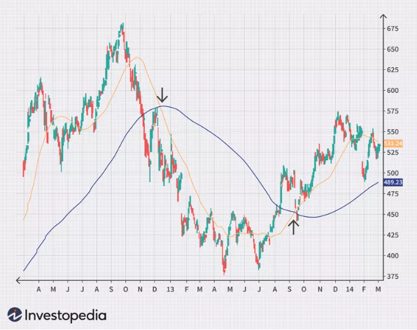






State: $\vec{s}=\left[s_{MA},s_{RS},s_{RSI},s_{I}\right]$
Definition of $s_{MA}$:
$$s_{MA}=4$$
$$s_{MA}=3$$
$$s_{MA}=2$$
$$s_{MA}=1$$
$$s_{MA}=3$$

Slide 9


Definitions of $s_{RS}$, $s_{RSI}$
$$s_{RS} =\left\{\begin{matrix}1 & \text{, }\text{when} \text{it} \text{rises} \text{above} \text{resistance} \text{level} \\ 2 & , \text{when} \text{it} \text{falls} \text{below} \text{support} \text{level} \\ 3 & , otherwise\end{matrix}\right.$$
$$s_{RSI} =\left\{\begin{matrix}1 & \text{, }when it is low enough (e.g. lower than 20\%) \\ 2 & , when it is high enough (e.g. higher than 80\%) \\ 3 & , otherwise\end{matrix}\right.$$

Slide 10


Definition of $s_{I}$
To simplify the strategy, we allow the agent to hold only 1 stock
$$s_{I}=\left\{\begin{matrix}1 & if agent is not holding a stock \\ 2 & if agent is holding a stock\end{matrix}\right.$$
If $s_{I}=1$, the possible actions of agent are $\left\{buy, do nothing\right\}$
If $s_{I}=2$, the possible actions of agent are $\left\{sell, do nothing\right\}$

Slide 11

Policy related to simple trading policy
$$π_{MA}\left(\vec{s}\right)=\left\{\begin{matrix}buy & if s_{MA}=1, s_{I}=1 \\ sell & if s_{MA}=2, s_{I}=2 \\ do nothing & otherwise\end{matrix}\right.$$
$$π_{RS}\left(\vec{s}\right)=\left\{\begin{matrix}buy & if s_{RS}=1, s_{I}=1 \\ sell & if s_{RS}=2, s_{I}=2 \\ do nothing & otherwise\end{matrix}\right.$$
$$π_{RSI}\left(\vec{s}\right)=\left\{\begin{matrix}buy & if s_{RSI}=1, s_{I}=1 \\ sell & if s_{RSI}=2, s_{I}=2 \\ do nothing & otherwise\end{matrix}\right.$$

Slide 12
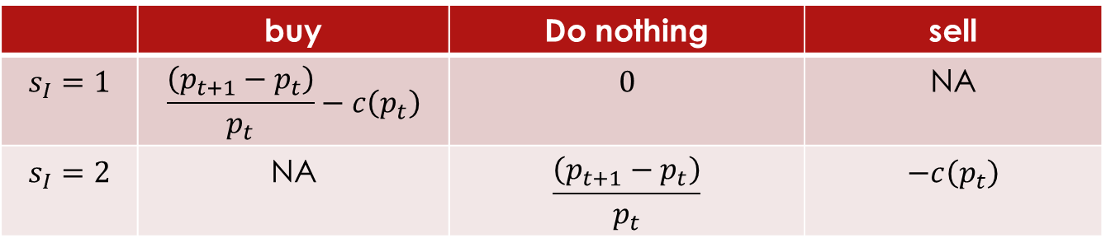

Reward Function
Let $p_{t}$ be the price of stock that we are considered. The reward function can be summarized by the following table:
Here $c(p_{t})$ is the transaction cost
 | buy | Do nothing | sell
$$s_{I}=1$$ | $$\frac{\left(p_{t+1}−p_{t}\right)}{p_{t}}−c\left(p_{t}\right)$$ | $$0$$ | NA
$$s_{I}=2$$ | NA | $$\frac{\left(p_{t+1}−p_{t}\right)}{p_{t}}$$ | $$−c\left(p_{t}\right)$$

Slide 13

Hypothesis Test
Follows the hypothesis test from William brock:
Define daily return $r_{t}=\log\left(p_{t+1}\right)−\log\left(p_{t}\right)$
Perform $t$-test on the daily return between un-conditional and buy/sell signal to see performance
We can construct another $t$-test on the profit of full buy-sell cycle to compare the performance for different strategies

