Slide 1

Bad UX examples
Cretu Claudia

Slide 2
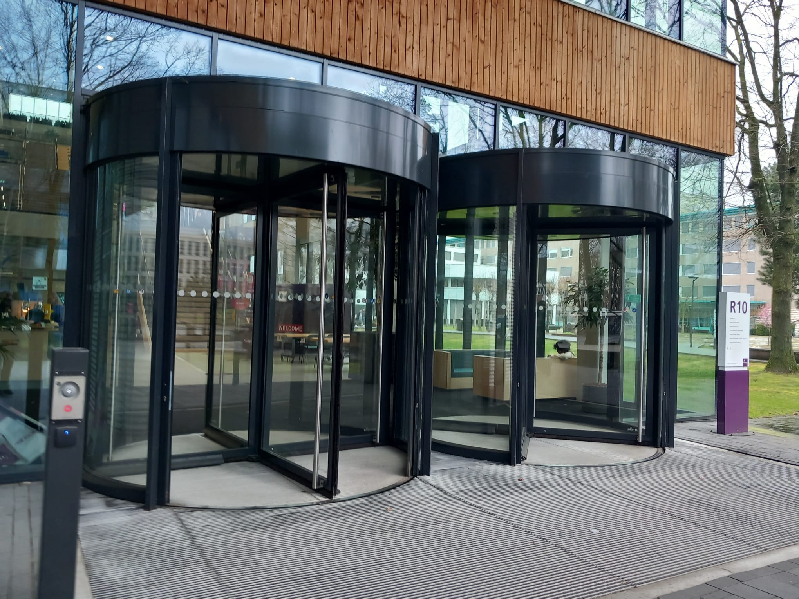
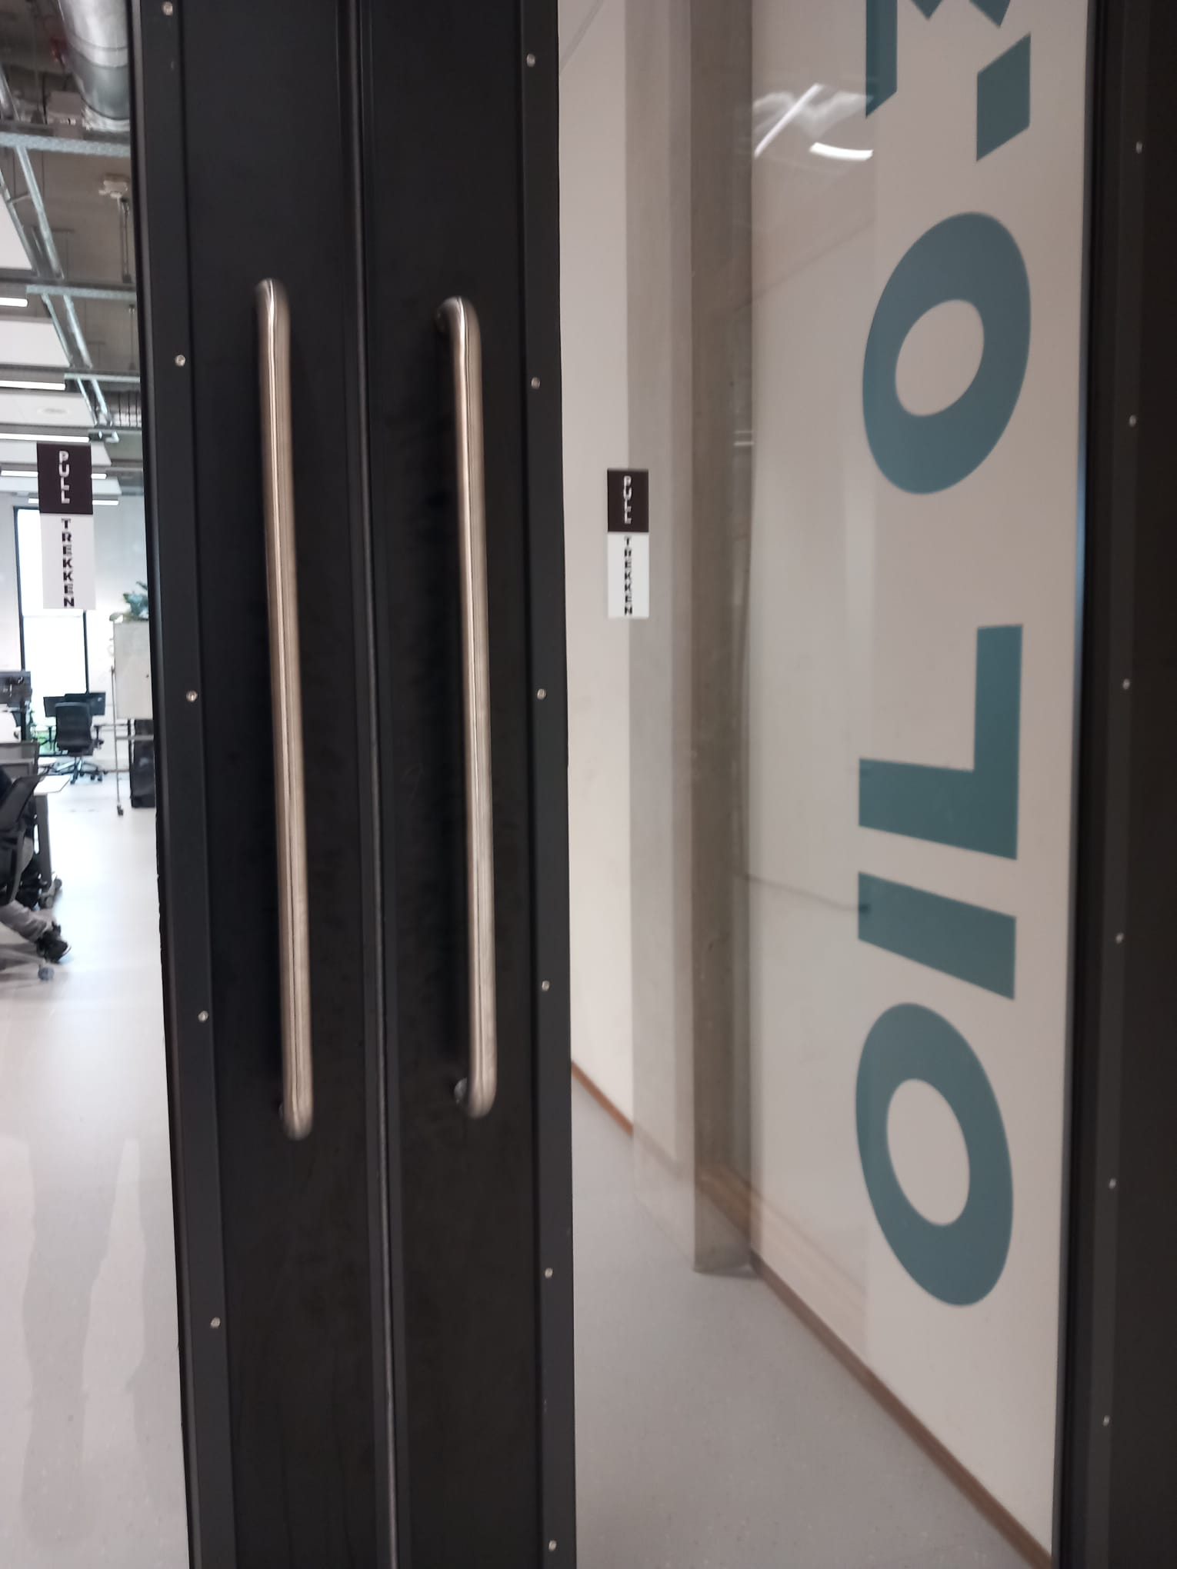
Fontys doors
R10 entrance door
Oil 0.30 doors

Slide 3
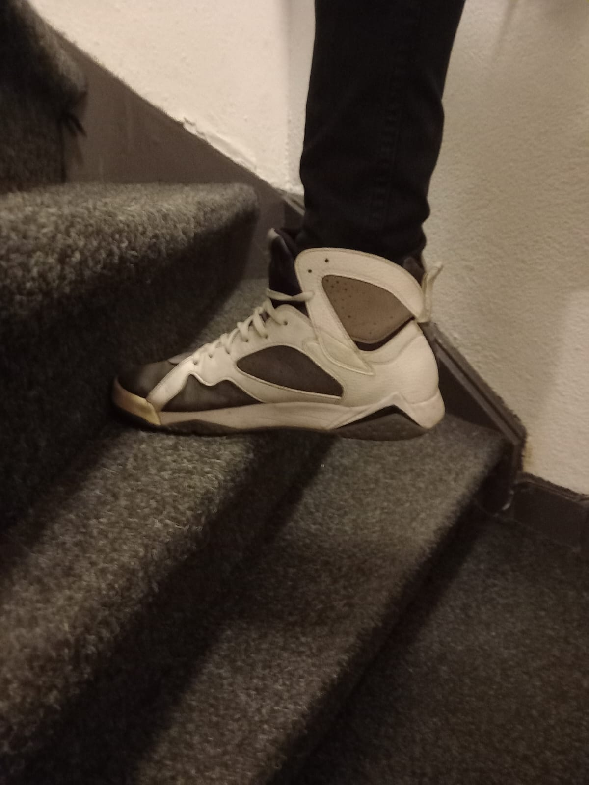
Dutch stairs

Slide 4
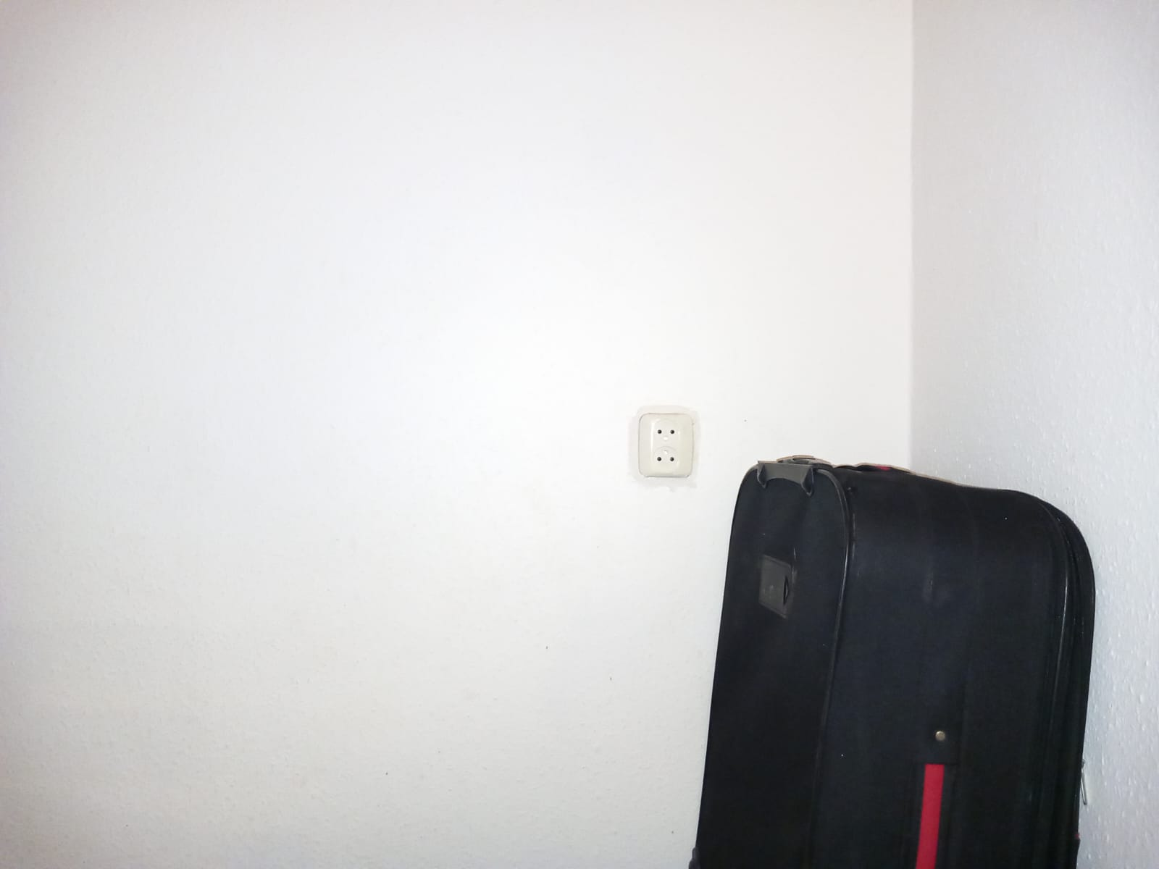
This socket in the wall

