Slide 1
Packages
Jim Fawcett
Copyright © 1994 – 2010
CSE687 – Object Oriented Design
Spring 2010

Slide 2
Package Definition
A Package is a physical packaging of source code into files.
A server Package provides services to higher level Packages.
An executive Package coordinates the activities of the program’s server Packages.
Chapter 1 - Packages

Slide 3
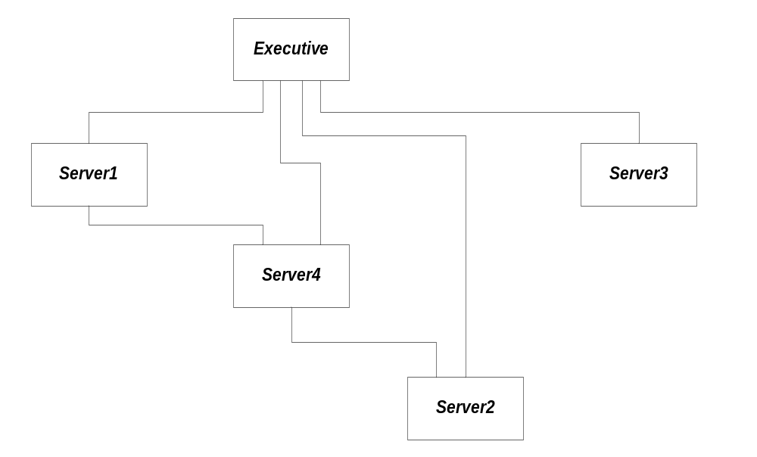
A Typical Structure
Chapter 1 - Packages

Slide 4
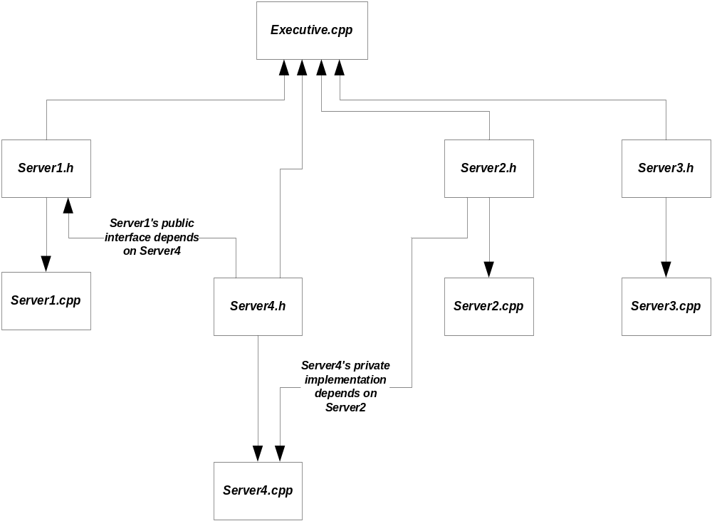
Include Relationships
Chapter 1 - Packages

Slide 5
Package Definition
A Package is a physical package of source code into files.
  Each reusable Package should focus on a single activity, e.g., it is cohesive. Most server Packages should attempt to be reusable.
  Not all Packages should try to be reusable. Executive Packages are not - they must focus on all of the program’s responsibilities – but at a very high level.
A server Package provides services to higher level Packages. A C++ Package consists of:
  A header file (.h extension)
    Has a typed interface, provided to ensure type consistency with all Packages using its services.
    Announces the services of the Package to potential users through a manual page and function and class declarations.
  An implementation file (.cpp extension) that provides the Package’s services through global function and class member function implementations.
    This file provides a prologue, the Package’s definitions, and a test stub.
    Test stubs are used for construction tests to quickly check the correctness of recently added or modified code.
An executive Package coordinates the activities of the program’s server Packages.
  Often an executive Package only has an implementation file since it has no need to announce it’s services.
Chapter 1 - Packages

Slide 6
A Note about this Definition
In all of the design courses covered by this web site, we use the definition for Packages provided on the previous page, and you are expected to implement all of your submitted projects in this modular fashion.
I often use the term Module as a synonym for Package. However, not everyone uses this definition. For example, throughout Microsoft’s .Net literature they use the term Module to mean a binary file that becomes part of an assembly, e.g., a dll or an exe.
Some others use the preceding definition in a looser way, for example, allowing multiple header files for a single implementation file. This is expressly forbidden by our definition.
Chapter 1 - Packages

Slide 7
Why Two Files?
Why not allow a Package to consist of just a header file?
  You often see this done to define macros and inline functions.
Header files announce services which, occasionally, can be implemented as inline functions or macros.
  Even if everything a header declared is implemented inline, the Package should provide a test stub.
  If the services are important enough to place in their own Package, then they are important enough to be tested before including in a larger system.
The only time a Package with only a header file is permitted in this course is when the header defines an interface, but no more.
  Interfaces have no implementation.
  They just declare a contract for services, provided by other Packages.
Chapter 1 - Packages

Slide 8
Limitation of Single File Program
What’s wrong with a single file program?
  Nothing, but as programs grow larger, this format becomes very limiting.
  Programs grow too large to comprehend as a single entity.
  Eventually, as file size grows, a compiler can not swallow the whole file.
Chapter 1 - Packages

Slide 9
Limitation of Single File Program
Solution:
  break programs up into Packages
  Packages allow a program to be decomposed into smaller units of understanding, test, release, and configuration management.
  In C++ each server Package consists of two files:
    A header file contains all public declarations so other Packages know how to use this Package’s services
    an implementation file contains all data and function definitions; that is, it provides the services that the header file announces
Chapter 1 - Packages

Slide 10
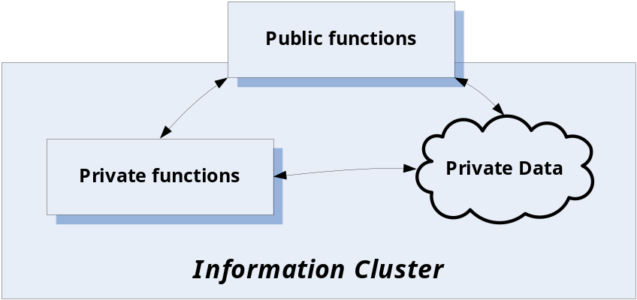
Information Cluster
Logical View:
An information cluster encapsulates complex, sensitive, global, or device dependent data, along with functions which manage the data, in a container with internals not accessible to client view.
Public access is provided by a series of accessor and mutator functions. Clients don’t have access to private functions or data.
Implementation:
C Package using file scope for encapsulation. All private functions and global data are qualified as static.
C++ class using public, protected, and private keywords to implement public and protected interfaces. Each class (or small, intimately related group of classes) should be given its own Package.
Each Package implementing an information cluster contains a manual page and maintenance page which describe the logical model for the cluster and its chronological modification history.
Chapter 1 - Packages

Slide 11
Package Structure
Header File: modname.h
#ifndef PKGNAME_H
#define PKGNAME_H
- manual page goes here
- maintenance page goes here
- declarations go here
#endif
Implementation File: modname.cpp
- prologue goes here
#include “pkgname.h”
- function definitions go here
#ifdef TEST_PKGNAME
void main() {
- test code goes here
}
#endif
Package Header File
These preprocessor directives are essential. They prevent a header file from being compiled more than once, even though it is included multiple times in headers included in the cpp file being compiled.
Package Implementation File
This preprocessor directive allows a designer to compile the Package alone, for test, but to then remove the main test stub for compilation as part of a larger program.
Chapter 1 - Packages

Slide 12
What goes in a Package’s Files?
Elements of header file:
  Manual page
    Prologue listing file name, platform, and author.
    Description of Package operation
    Illustration of its public interface
  Maintenance page
    Build process
    Maintenance history
  Declarations of the Package’s public classes and public global functions
  Definitions of inline functions, e.g., inline function bodies
  Function bodies of public template-based member functions and global functions
  Definitions for public constant data items
  Includes of other header files with declarations of types used in this header
  – no other files should be included.
Chapter 1 - Packages

Slide 13
What Goes in a Package’s Files?
Elements of Implementation File
  Prologue, e.g., top part of the manual page, listing file name, platform, and author. This should be a clone of the prologue inserted at the beginning of the header’s manual page, except that the file name is changed.
  Includes of header files declaring types needed by the code in this implementation – no other files should be included.
  Implementation of the Package’s global and member functions.
  Test stub – a main function which tests each function implemented in this file. It is also used to illustrate how a client would use the Package and what its outputs look like.
  The test stub must be enclosed by compilation guards which enable compilation only when TEST_PKGNAME is defined.
Chapter 1 - Packages

Slide 14
Include Rules
Syntax:
  Include system headers with angle brackets, e.g.,
  #include <iostream>.
  Include local headers with quotes, e.g.,
  #include “server1.h”
  Never, ever, include implementation (.cpp) files. That makes managing build processes very difficult.
Semantics:
  Always include header files at the lowest possible level:
    If a Package’s implementation depends on another Package, include the other’s header file in the implementation file, not the header.
    Do not include a header simply to pass it on to another file.
Chapter 1 - Packages

Slide 15
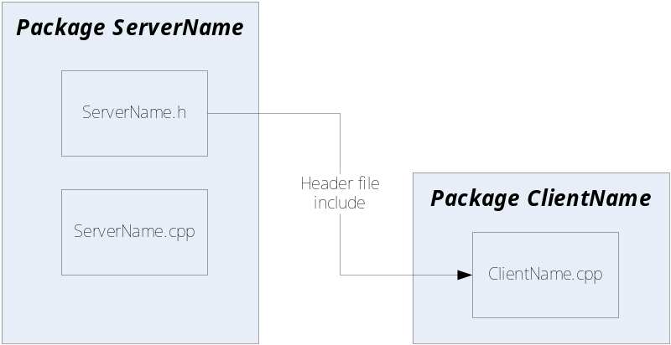
Modularity
“In object oriented languages classes and objects form the logical structure of the system; we place these abstractions in Packages to produce the system's physical architecture.”
Grady Booch, Object Oriented Design with Applications,
Benjamin/Cimmings, 1991
Modularization consists of dividing a program into Packages which can be compiled separately. C++ performs type checking across Package boundaries, using included header file declarations.
Packages in C and C++ are simply separately compiled files.
We place Package interface declarations in header files.
Package implementations are placed in separate files which include the header file at compilation time via a preprocessor #include “pkg_name.h” directive.
Chapter 1 - Packages

Slide 16
Incremental Development Model
Begins with requirements analysis, development of architecture and preliminary design. Result should be a design concept and partitioning into Packages.
As soon as Packages are defined, one is selected that has no dependencies on other Packages (at least one almost always exists). This Package’s development proceeds by implementing one or two functions, adding tests of the new capabilities to the test stub, and verifying nominal operation.
This process continues iteratively until Package is complete. Detailed unit test then begins. Its goals are to exercise all paths and predicates in code to find all latent errors, correct them, and verify.
Next a Package is selected which depends at most on the tested Package. It is subjected to same process to develop a complete and verified Package. It is then integrated with the first Package.
This continues until all the Packages have been integrated. Development completes by carrying out product test to demonstrate that software meets all its contractual obligations.
The outstanding virtue of this approach is that only a small amount of new code is brought into a throughly tested baseline at each stage of development.
Chapter 1 - Packages

Slide 17
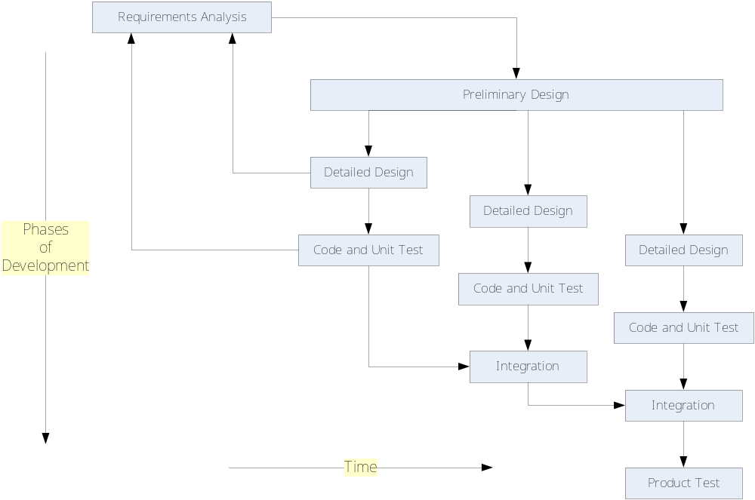
Incremental Development
Chapter 1 - Packages

Slide 18
Modular System
Logical Model:
collection of information clusters communicating through public interfaces.
Implementation:
One executive client Package and a series of server Packages.
One C or C++ server Package for each major program activity.
The executive Package is the coordinator.
Each server Package has:
  an implementation file containing a test stub, with conditional compilation controls for stand-alone testing.
  a header file which announces the Package’s services to clients, e.g., the other servers and/or the client Package.
Chapter 1 - Packages

Slide 19
Limitations of Packages
What’s wrong with modular decomposition?
  nothing, but this format alone is not very flexible
  Packages are defined statically (at compile time)
  new instances can not be created at run time
  this means that the flexibility afforded by run-time creation of data does not extend to Packages which contain both functions and data
Chapter 1 - Packages

Slide 20
Limitations of Packages
Solution:
  classes support declaration of objects which can be defined either statically or dynamically
  classes define both functions and data. An object, which is simply an instance of a class, can be defined statically in static memory, in local memory (on the stack), or dynamically on the heap, just like any intrinsic data type
  a program can define as many objects as it needs up to the amount that your computer memory can hold
  The classes you define will, of course, be packaged in Packages.
Chapter 1 - Packages

Slide 21
Package Example
The following slide shows the decomposition of a Catalogue program.
  Catalog simply walks a directory sub-tree and collects an ordered list of directories and their contents.
    When it completes, it holds the catalog information in an STL data structure for any subsequent processing the designer might like to add.
  It nicely illustrates the use of classes and Packages for the logical and physical packaging of the program.
  Besides being a nice illustration of a modular program, it also provides a lot of functionality you will need in Project #1.
Chapter 1 - Packages

Slide 22
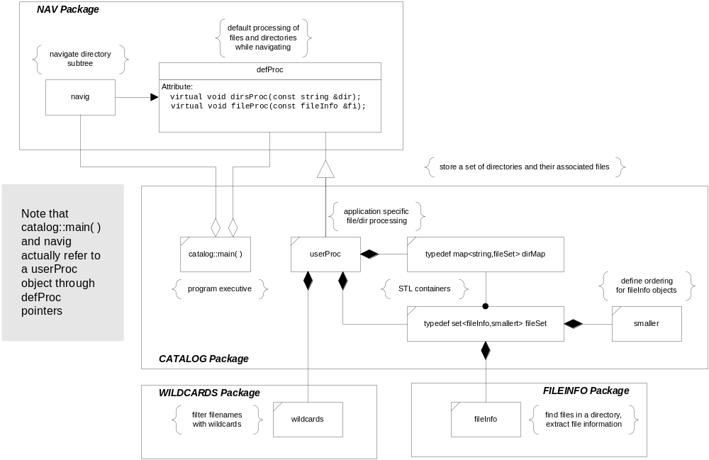
CATALOG Classes
Chapter 1 - Packages

Slide 23
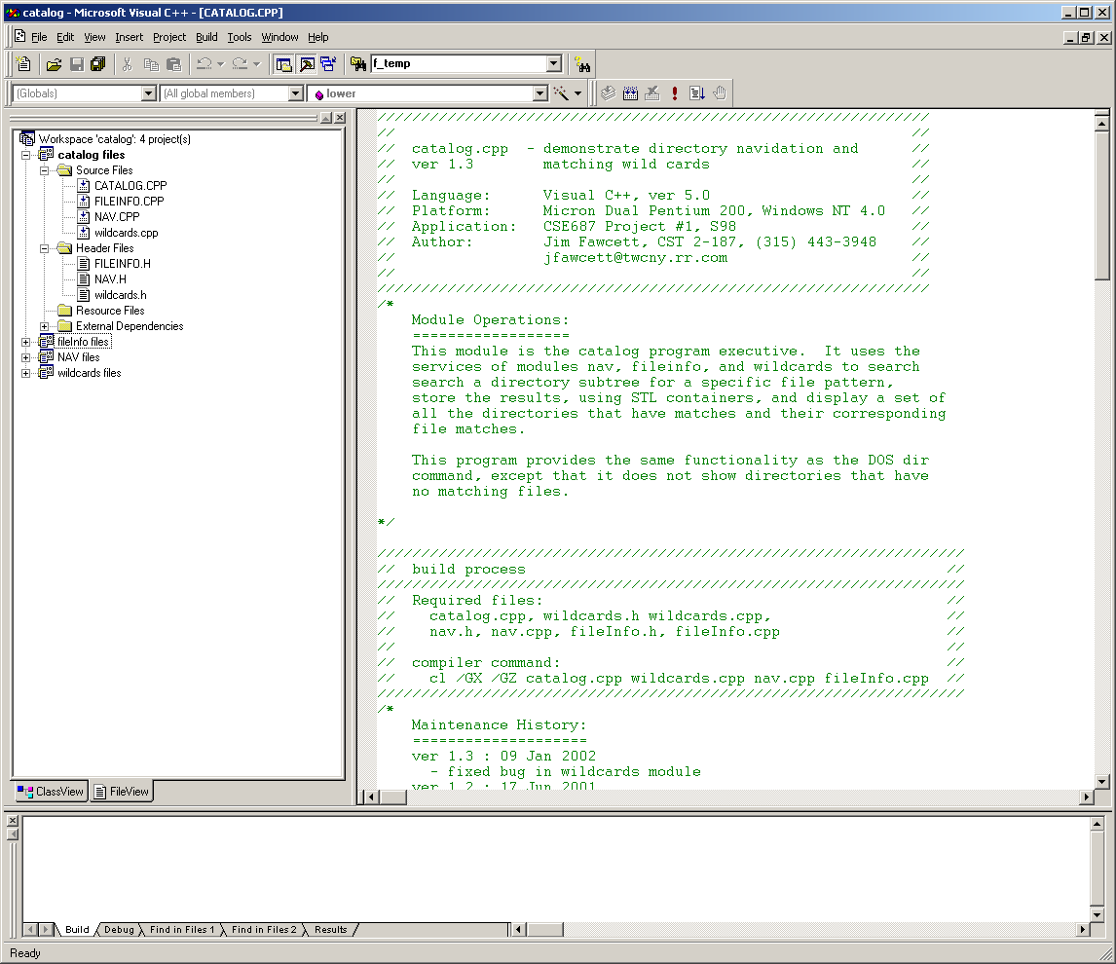
CATALOG Program
Prologue, part of the Manual Page
Manual
Page
Description of how to build Package.
Maintenance
Page
Description of Package’s operation.
Chapter 1 - Packages

Slide 24
End of Packages Presentation
Chapter 1 - Packages

