Slide 1
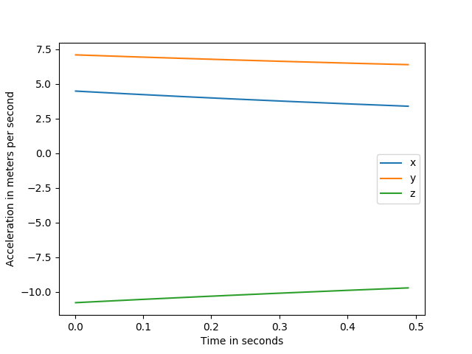
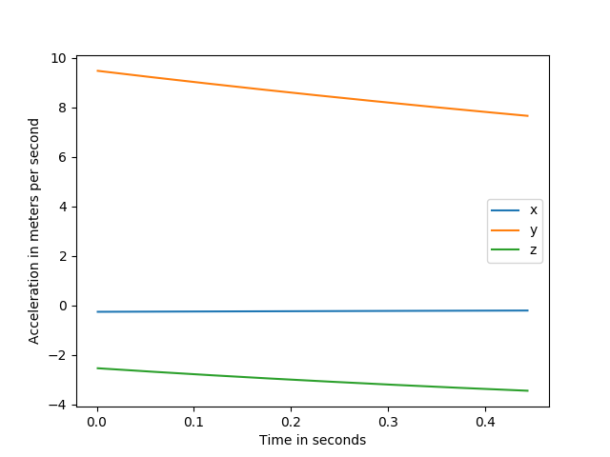
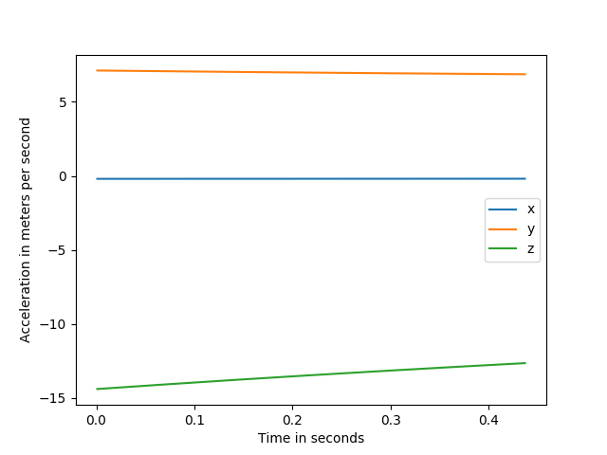
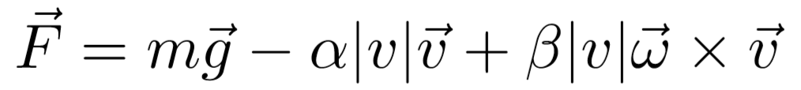
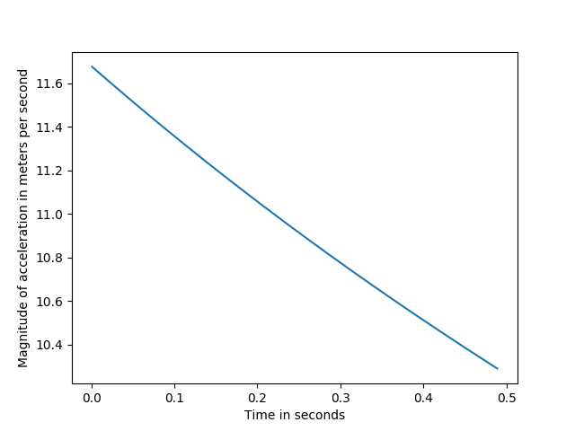
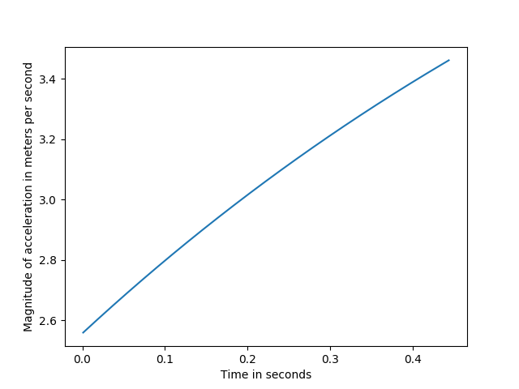
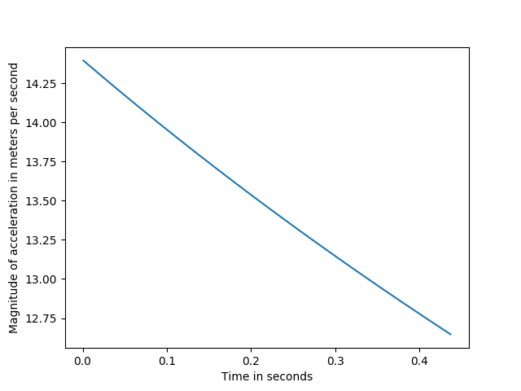
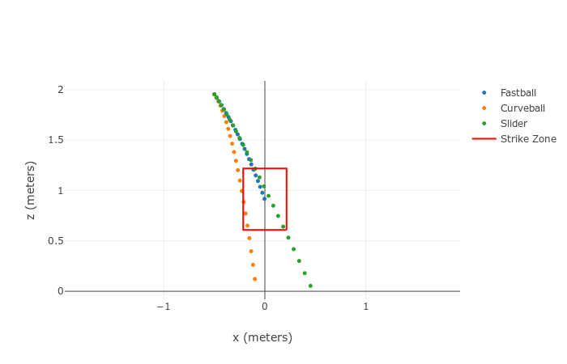
Explaining the Optical Illusion of a Curveball with Physics Simulations
June Jung, Richard Whitehill, and C.D. Clark III, PhD
Introduction
Figure 1
Results and Discussion
In baseball, pitchers often throw breaking balls, for example a curveball, in order to trick the batter. It is often said that batters see a “break,” a sudden spike in the ball’s trajectory, when they encounter a curveball. However, the three dimensional trajectory of the curveball is still a smooth curve, and it is widely assumed that the “break” is an optical illusion. This study’s goal is to find out how, when, and where the “break” is observed in a curveball with a physics simulation.
The first hypothesis was the following: the “break” is a spike in acceleration that occurs when the three dimensional trajectory is projected on the batter’s two dimensional plane of vision.
One dimensional acceleration along x, y, and z axes of a slider, a fastball, and a curveball.
The one dimensional accelerations are shown in Fig 1. The two dimensional projection accelerations are shown in Fig 2. In both Fig. 1 and Fig. 2, a sudden spike in acceleration or a sharp turn in acceleration is not seen. Hence, the first hypothesis of the study is rejected.
However, it is still noteworthy to take a look at the two dimensional projection of the actual trajectory, as shown in Fig. 3. For a given pitch, each dot in Fig. 3 is 0.02 seconds apart from the closest dot. A human batter would observe the ball for approximately 0.2 seconds before starting the swing. In Fig. 3, the batter would therefore see about ten dots before the swing starts.
For the first ten dots, a fastball and a slider almost seems identical, but the slider does not follow the curvature of the fastball after around 10 dots. It quickly stretches into a long, relatively straight line.
The curveball, compared to the fastball, initially has a noticeably larger curvature. However, starting at around the ninth dot, it also stretches into a long, relatively straight line. The increase in gaps between the dots imply high velocity, as also seen in the slider.
1(a)
Acceleration from a slider
1(b)
Acceleration from a fastball
1(c)
Acceleration from a curveball
Methods
Figure 2
The ball’s motion is expressed with the following equation:
where g is the gravitational acceleration constant, α is an unknown coefficient for the air drag term, β is an unknown coefficient for the magnus force term, and ω is the ball’s angular velocity. This gives us a differential equation of the ball’s acceleration in terms of the ball’s velocity. To solve this equation for position, a numerical estimation script was written in python, using the Runge-Kutta method, RK4 for short.
The rest of the simulation scripts were written in a way that the user could configure details such as the pitcher’s arm length, the release point, or the ball’s launch profile. Optimization scripts were written in order to extract the values for the two unknown coefficients from experimental data, both from our own high-speed camera footage and literature studies (Briggs, 1959).
Once the simulation was ready and tested, the first hypothesis of this study was tested:
Three pitches, a fastball, a curveball, and a slider were simulated.
For each pitch, one dimensional accelerations along x, y, and z axes were plotted.
For each pitch, the magnitude of acceleration on the xz plane was plotted, where the x axis points from the home plate to the pitcher’s mound, and the z axis is vertical. In other words, the three dimensional trajectory of the ball was projected onto a plane parallel to the front of the home plate and perpendicular with the ground.
Magnitude of acceleration on the batter’s plane of vision of a slider, a fastball, and a curveball. Note that although the breaking balls have a decreasing trend due to air drag, the magnitude is much larger compared to the fastball.
Current and Future Work
The study is now focusing on the numerical interpretation of the optical illusion. This new task is approached with machine learning models. Machine learning models differ from physics implementation scripts in that they are not given an explicit method to use, but they “learn” their own optimal function for their given task.
Using the existing simulation scripts, machine learning models are trained to imitate how a human batter would react to a pitch.
A trained model would be given the initial portion of a trajectory, or any portion of the trajectory, and be able to predict what follows.
Curveballs would be given to a model that is not anticipating a curveball. A model that is trained heavily on fastballs would be a good example.
When a significant numerical error repeatedly occurs at a certain portion or point of the trajectory, that place would be interpreted as where the “break” is observed. Further numerical study should be done regarding that location.
1(a)
Acceleration from a slider
1(b)
Acceleration from a fastball
1(c)
Acceleration from a curveball
Figure 3
Two dimensional projection of the following three pitches: a fastball, a curveball, and a slider. The red rectangle represents the average size of a strike zone. All three pitches were simulated with the same initial direction of the velocity vector, with which a fastball would land at the center of the strike zone, as seen in the figure. The position of the ball is recorded on the plot every 0.02 seconds for each pitch.
References
Briggs, L. J. (1959). Effect of Spin and Speed on the Lateral Deflection (Curve) of a Baseball; and the Magnus Effect for Smooth Spheres. American Journal of Physics, 27(8), 589–596. doi: 10.1119/1.1934921

