Slide 1
CDAC STUDENTS APP Final Project Demo
Group 1
Hardik Agarwal, 220340120083
Joy Pahari, 220340120092
Kamana Mathur, 220340120097
Udit Keskar, 220340120100
Mayank Sachan, 220340120120

Slide 2
PROBLEM STATEMENT
Major manual efforts in overall modus operandi of the different courses at CDAC-ACTS, Pune and no single platform for the students to fulfil their day to day demands for a overall smooth learning experience.

Slide 3
OBJECTIVE
“A web application for every student joining CDAC ACTS, Pune as a portal to facilitate all the day to day activities and reducing major manual effort of the Course Coordinators by introducing automation at various levels.”

Slide 4
UI MOCKUP

Slide 5
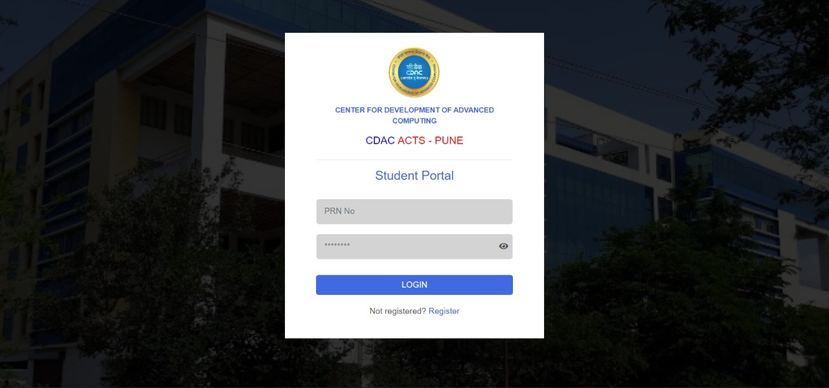
SCREEN – 1 (Login Page)

Slide 6
1. Student Flow

Slide 7
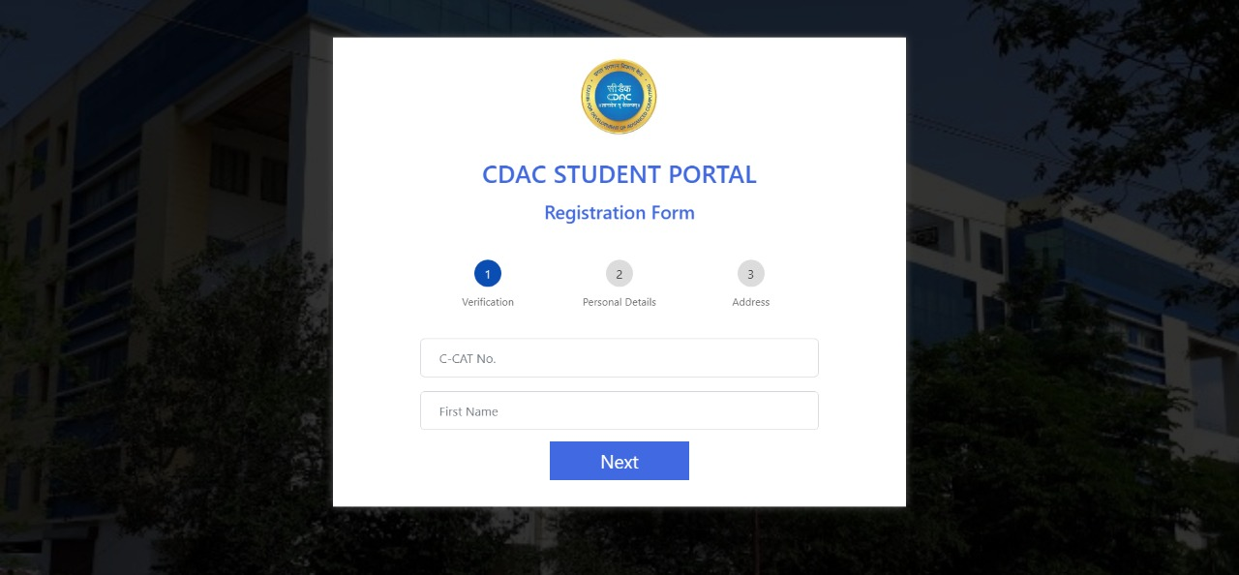
SCREEN – 2 (Registration Page)

Slide 8
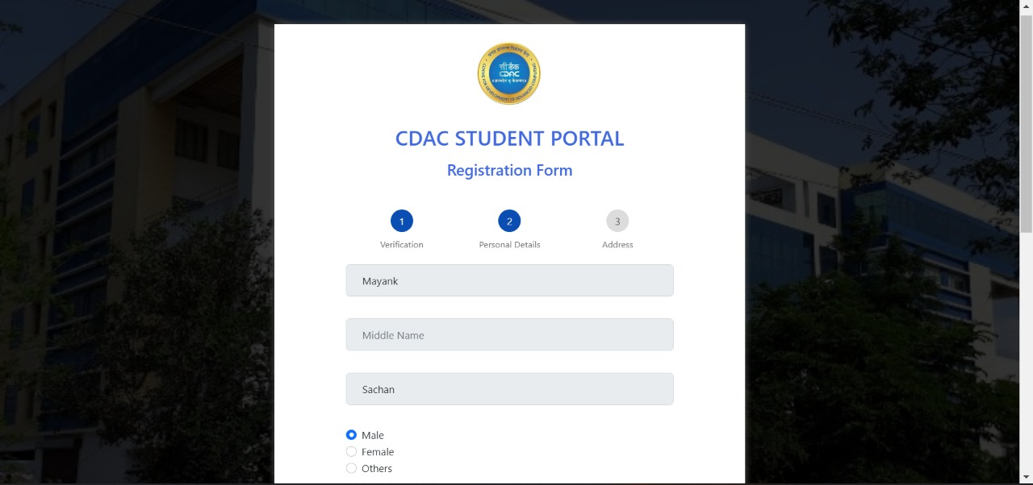

Slide 9
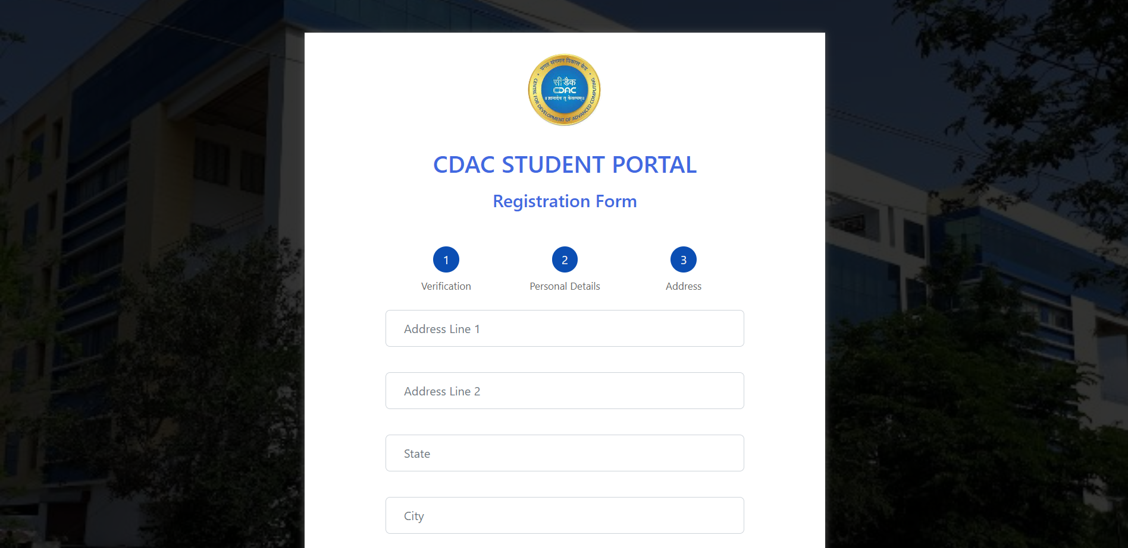

Slide 10
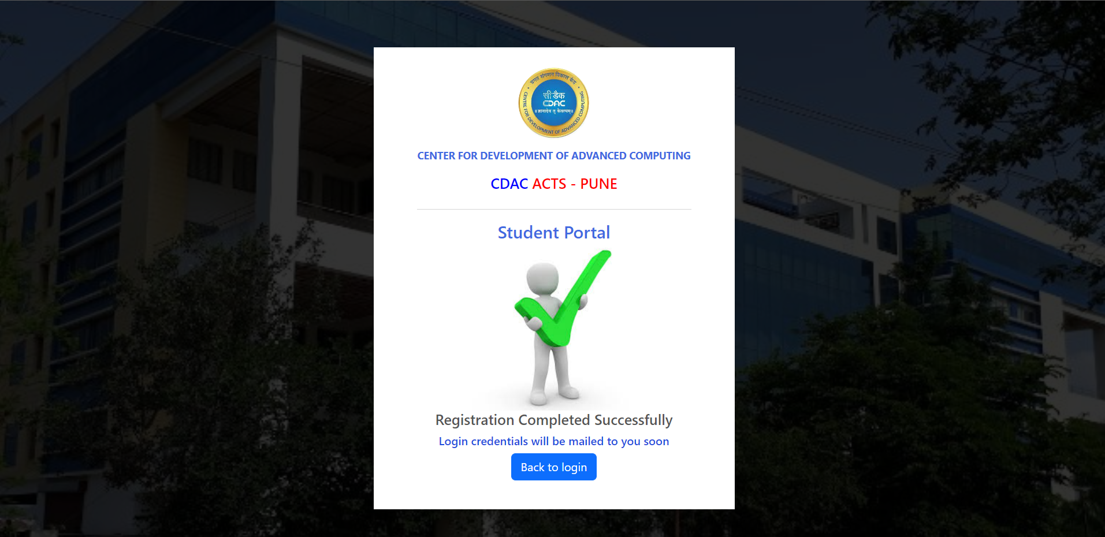

Slide 11
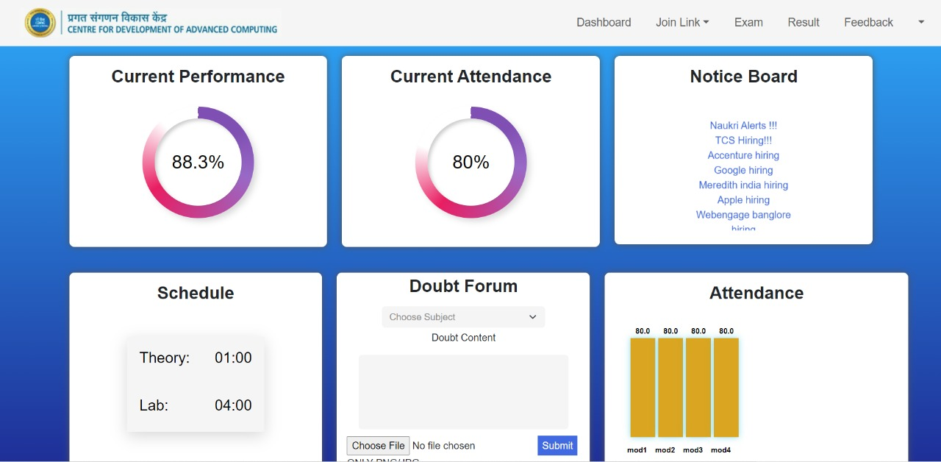
SCREEN – 3 (Student Dashboard)

Slide 12
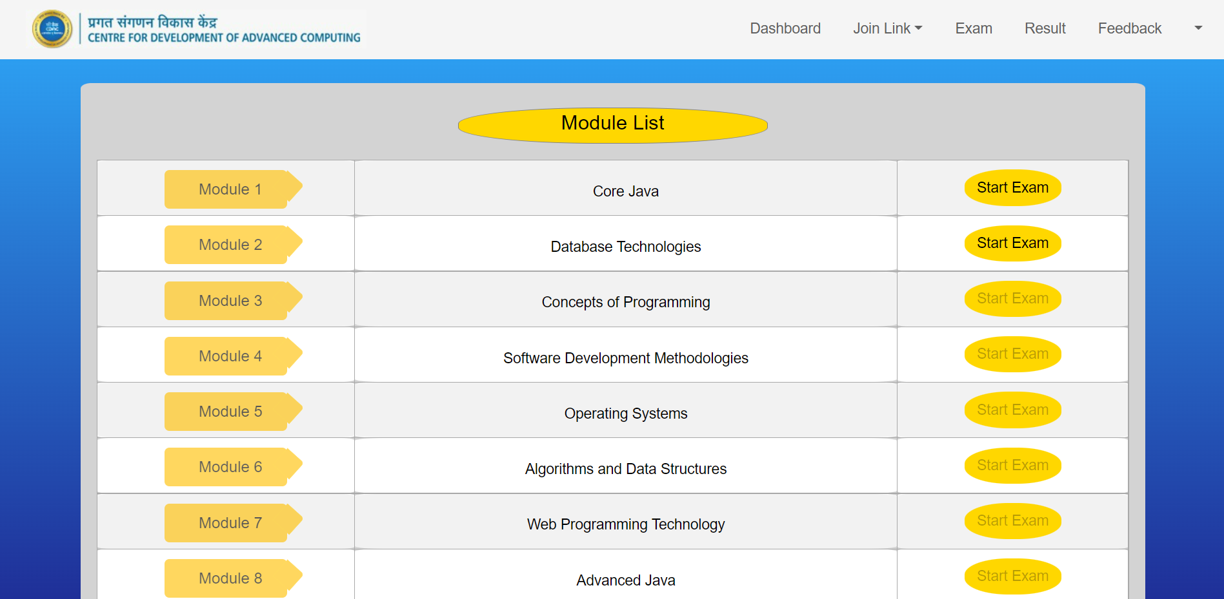
SCREEN – 4 (Exam Page)

Slide 13
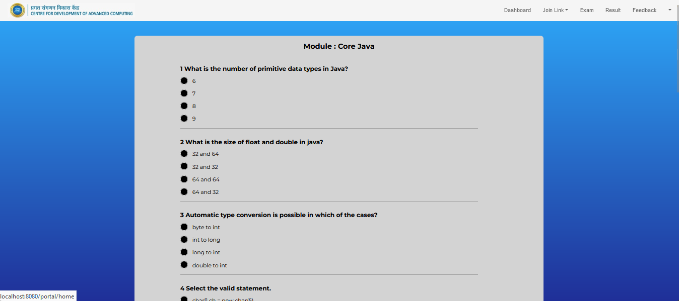
SCREEN – 5 (Question Paper)

Slide 14
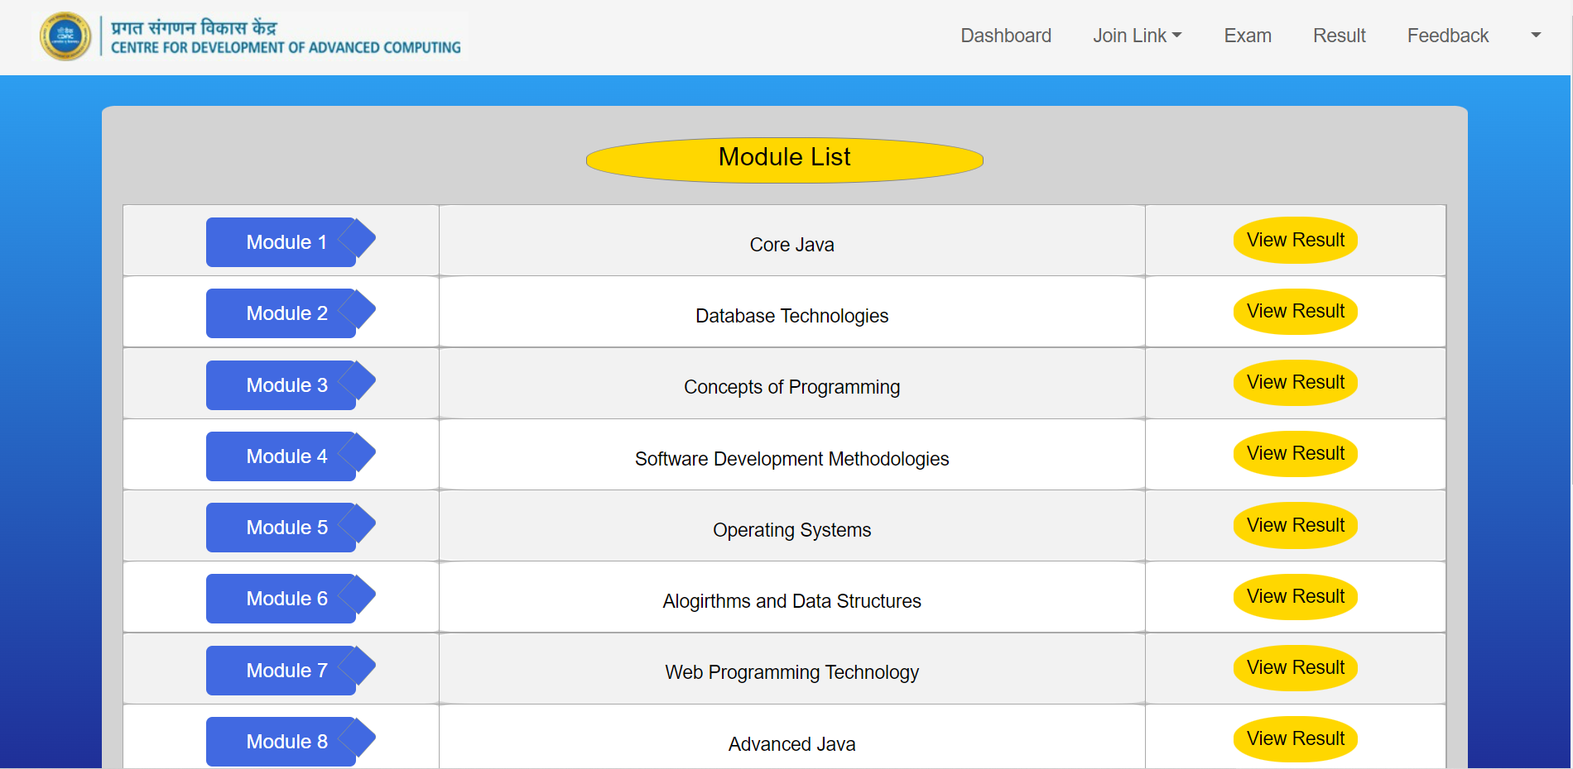
SCREEN – 6 (Result Page)

Slide 15
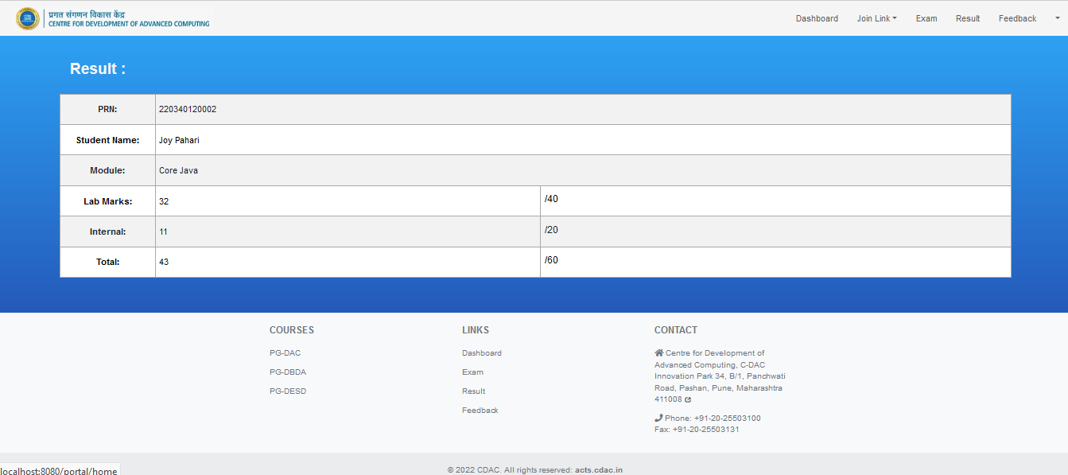
SCREEN – 7 (Student Result)

Slide 16
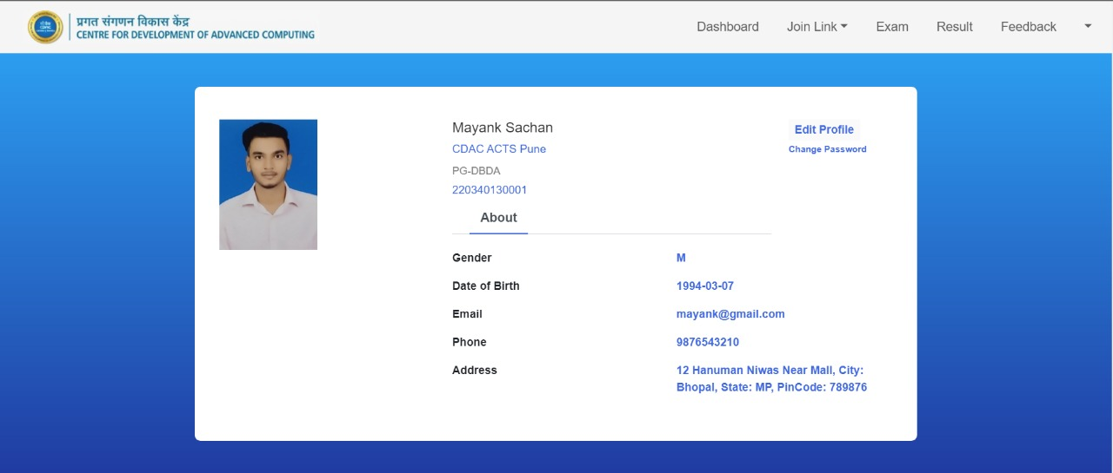
SCREEN – 8 (MY PROFILE)

Slide 17
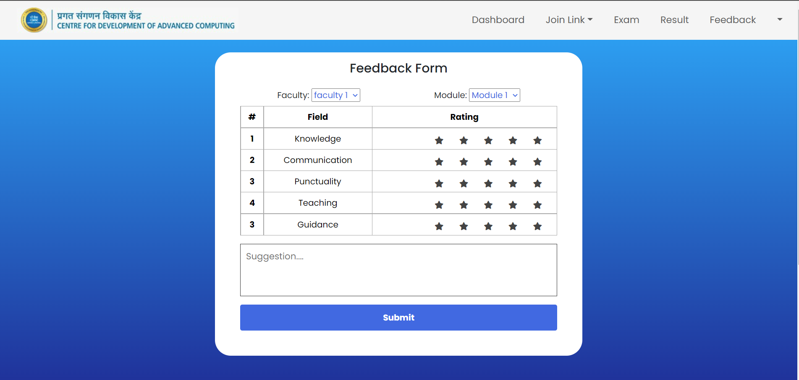
SCREEN – 9 (FEEDBACK PAGE)

Slide 18
2. Admin Flow

Slide 19
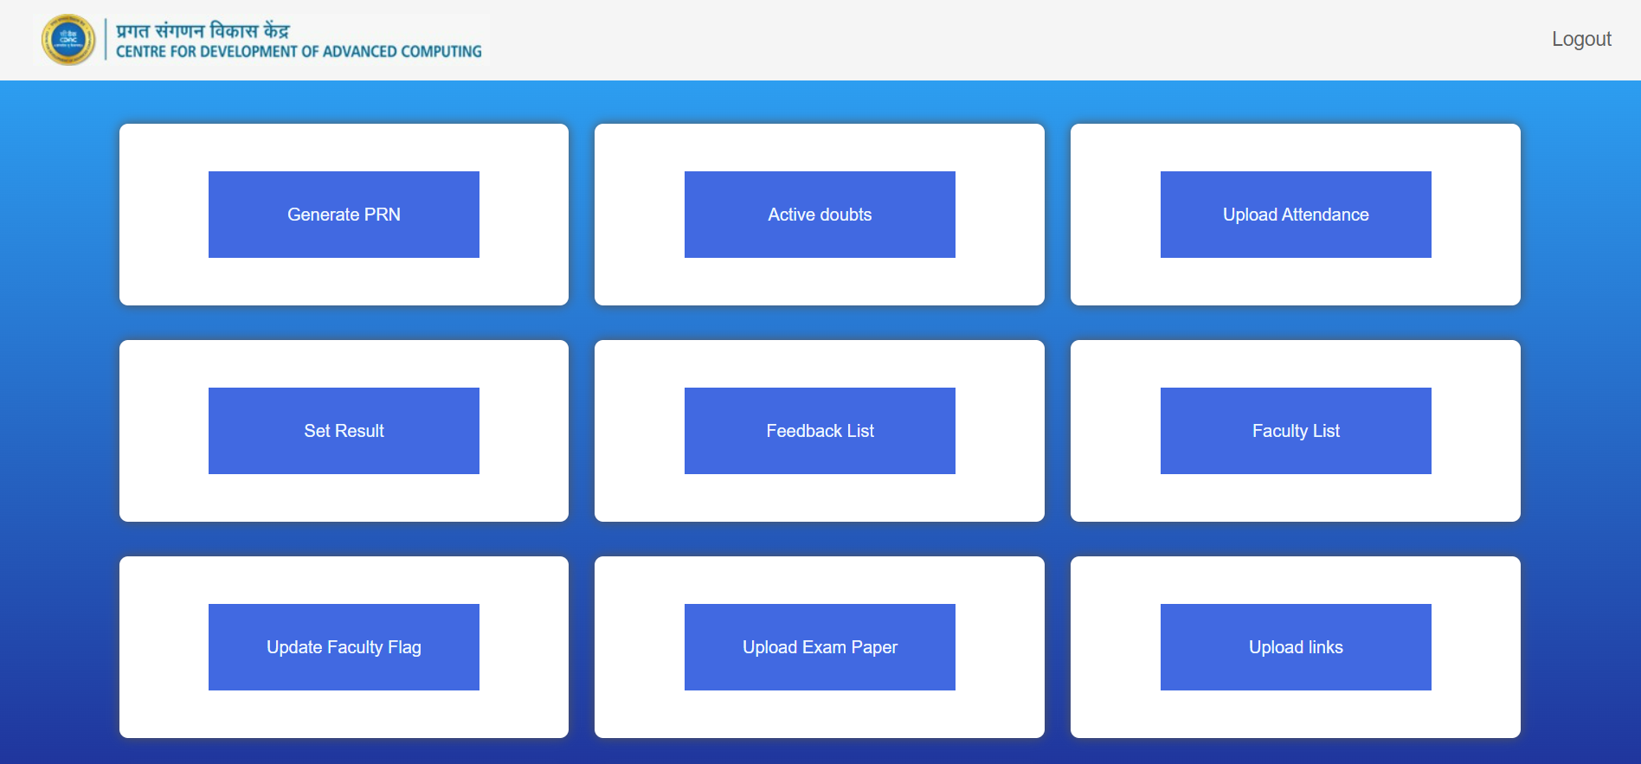
SCREEN – 2 (ADMIN)

Slide 20
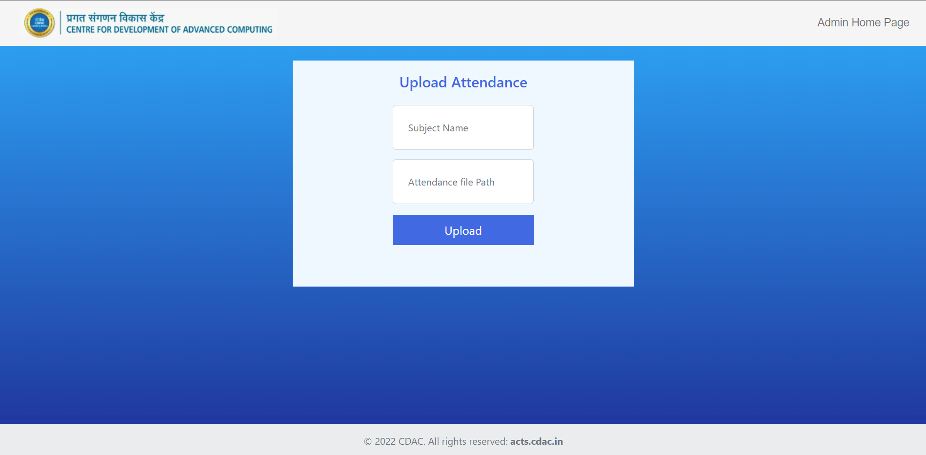
SCREEN – 3 (Example of a functionality)

Slide 21
CHALLENGES
Step wise registration form
Bearer Token implementation
Navigation as a single page application
CSV import (input type = file, HTML5 Security)
Adding attachment and solve button in active doubt page
Handling AJAX success but empty result scenario

Slide 22
Image upload
Password Encryption
Centralized Header and Footer
Setting cards in dashboard UI
Animations in dashboard screen
Drawing question paper and its validations
Performance Calculation Logic
ResponseEntity as return type of Controller Methods
Java Mail API and Mockito API integration

Slide 23
Sending and receiving data through AJAX
JScript injection in JSP pages
Update query in JPA

Slide 24
FUTURE ASPECTS
Deployment over cloud
Setting it up in actual production environment (CDAC ACTS, Pune)

Slide 25
THANK YOU !!!
Photo upload karni hai

