Slide 1
Advanced data manipulation

Slide 2
CDAT architecture
Scripts / VCDAT
Grid
Axis
Variable
Dataset
VCS
CDMS
MA
array
Numeric
Python
Cdunif.so
Canvas
Graphics method
_vcs.so

Slide 3
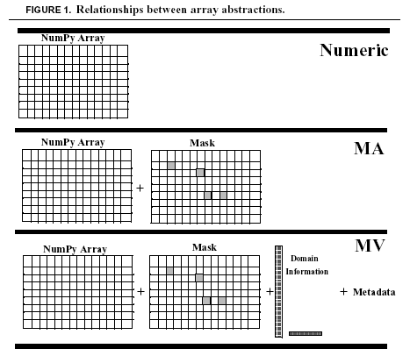
3 Types of Array

Slide 4
Numeric Arrays
>>> import Numeric
>>> a=Numeric.array([1,2,3,4,5])
>>> b=Numeric.array([[1.0,2.0,3.0,4.0],
... [1.5,2.5,3.5,4.5]])
>>> a
array([1, 2, 3, 4, 5])
>>> b
array([[ 1. , 2. , 3. , 4. ],
[ 1.5, 2.5, 3.5, 4.5]])
a
1 | 2 | 3 | 4 | 5
b
1.0 | 2.0 | 3.0 | 4.0
1.5 | 2.5 | 3.5 | 4.5

Slide 5
Basic arithmetic
>>> from Numeric import *
>>> a+10
array([11, 12, 13, 14, 15])
>>> b*array([[5,5,5,5],[2,2,2,2]])
array([[ 5., 10., 15., 20.],
[ 3., 5., 7., 9.]])
>>> sin(a)
array([ 0.84147098, 0.90929743, 0.14112001, -0.7568025 , -0.95892427])
a
1 | 2 | 3 | 4 | 5
b
1.0 | 2.0 | 3.0 | 4.0
1.5 | 2.5 | 3.5 | 4.5

Slide 6
Indexing and slicing
>>> b[0]
array([ 1., 2., 3., 4.])
>>> b[0,2]
3.0
>>> b[0][2]
3.0
>>> b[1,-2]
3.5
>>> a[1:3]
array([2, 3])
>>> a[:5:2]
array([1, 3, 5])
>>> b[:2,:2]
array([[ 1. , 2. ],
[ 1.5, 2.5]])
>>> b[:2,::2]
array([[ 1. , 3. ],
[ 1.5, 3.5]])
a
1 | 2 | 3 | 4 | 5
b
1.0 | 2.0 | 3.0 | 4.0
1.5 | 2.5 | 3.5 | 4.5

Slide 7
Array Properties
>>> a.shape
(5,)
>>> b.shape
(2, 4)
>>> b.typecode()
'd'
>>> b.typecode() == Float
True
>>> b.itemsize()
8
>>> a.byteswapped()
array([16777216, 33554432, 50331648, 67108864, 83886080])
a
1 | 2 | 3 | 4 | 5
b
1.0 | 2.0 | 3.0 | 4.0
1.5 | 2.5 | 3.5 | 4.5

Slide 8
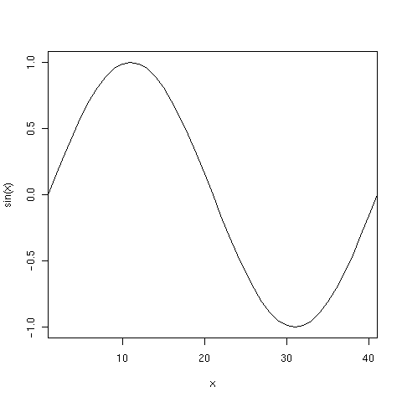
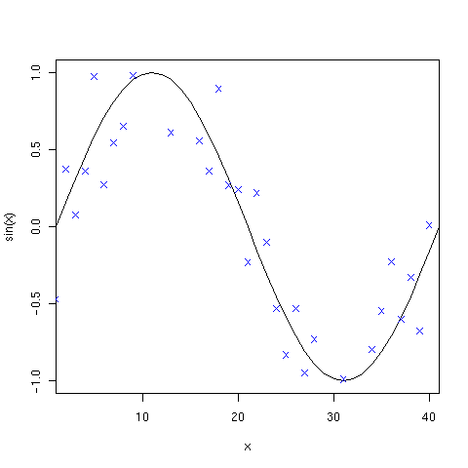
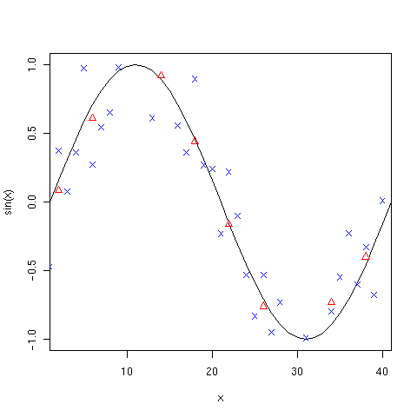
A non trivial example
>>> from Numeric import *
>>> sin_x =
sin(arrayrange(0, 2*pi, pi/20))
>>> from RandomArray import *
>>> sin_x_r = (sin_x +
... random(sin_x.shape) - 0.5)
>>> bins = zeros(10)
>>> for x in range(4):
... bins = bins + sin_x[x::4]
...
>>> bins = bins / 4

Slide 9
Numeric functions
Too many to mention
  http://numeric.scipy.org/numpydoc/numdoc.htm
take | put | putmask | transpose | fromstring
choose | ravel | nonzero | where | compress
diagonal | trace | product | outerproduct | argsort
argmax | argmin | repeat | array_repr | matrixmultiply
clip | indices | swapaxes | concatenate | innerproduct
sort | dot | array_str | resize | convolve
cumsum | identity | sum | cross_correlate | searchsorted
cumproduct | alltrue | sometrue | allclose

Slide 10
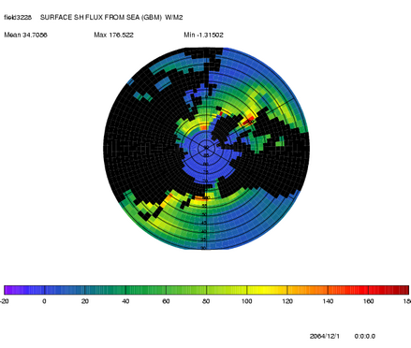
Why we need masks
Notes:
Unfortunately in our field, most of the time the dataset we’re dealing with is “incomplete” either because it contains observations or simply because no data exist at a specific point (interpolation below ground, ocean model not computing over land, …)
In order to overcome this deficiency, the Numeric module is supplemented with a similar Package: MA which stands for Masked Array.
MA has most of numeric functionalities but also knows how to handle missing values.

Slide 11
Creating masked arrays
>>> import MA
>>> x = MA.array([1, 2, 3])
>>> y = MA.array([1, 2, 3],
... mask = [0, 1, 0])
>>> z = MA.masked_values([1.0, 1.e20, 3.0, 4.0], 1.e20)
>>> z.mask()
[0,1,0,0,]
Use MA as a replacement for Numeric:
To create an array with the second element invalid, we would do
To create a masked array where all values "near" 1.e20 are invalid, we can do
The mask is stored as a separate array.

Slide 12
Anatomy of a CDAT Masked Variable
Masked Variable
array
mask
axis1
axis2
array metadata
axis1 metadata
axis2 metadata
key | value
key | value
key | value

Slide 13
3 Types of variables
File System
Memory
Transient variable
  All data copied to memory
File variable
  Metadata copied to memory
  Data accessed in situ
  Read or Read/Write access
Dataset variable
  Data distributed between multiple files
  Read access only
Notes:
A variable can be obtained either from a file, a collection of files (a dataset), or as the result of computation. Correspondingly there are three types of variables in CDAT:
A file variable is a variable associated with a single data file. Interaction involves I/O operations.
A dataset variable is a variable associated with a collection of files or dataset (normally described by one CDML file). Dataset variables are read-only.
A transient variable is an ‘in-memory’ object not associated with a file or dataset. You can compute transient variables from other variables or build them yourself.

Slide 14
Transient variables
>>> f = cdms.open(‘afile’, ‘a’)
>>> var = f(‘tas’)
>>> var.listattributes()
['comment', 'units', 'level_description', 'subgrid', 'long_name', 'grid_name', ...
>>> var.long_name
'Surface (1.5m) air temperature'
>>> var.shape
(4, 73, 96)
>>> var[3,0:2,0:2]
tas
array(
[[ 245.2923584 , 245.2923584 ,]
[ 246.42282104, 246.51434326,]])
Use ( ) to create a transient variable from a file.
List metadata
Behaves like an array

Slide 15
File Variables
>>> f = cdms.open(‘afile’, ‘a’)
>>> var = f[‘tas’]
>>> var.long_name
'Surface (1.5m) air temperature'
>>> var.shape
(4, 73, 96)
>>> var[3,0:2,0:2]
tas
array(
[[ 245.2923584 , 245.2923584 ,]
[ 246.42282104, 246.51434326,]])
>>> var[3,0:2,0:2] = array([[1.,2.],[3.,4.]])
>>> f.close()
Use [ ] to create a file variable.
Standard MV.array features are accessible.
Assigning to a slice will change data on disk
Notes:
Note: Most functions will create a transient variable before manipulating it, therefore in situ data manipulation requires careful coding.
Remember to close the file if you want to update the file.

Slide 16
MV Example with masks
>>> import cdms, MV
>>> f_surface = cdms.open('sftlf_ta.nc')
>>> surf = f_surface('sftlf')
# Designate land where "surf" has values
# not equal to 100
>>> land_only = MV.masked_not_equal(surf, 100.)
>>> land_mask = MV.getmask(land_only)
# Now extract a variable from another file
>>> f = cdms.open('ta_1994-1998.nc')
>>> ta = f('ta')
# Apply this mask to retain only land values.
>>> ta_land = cdms.createVariable(ta, mask=land_mask,
... copy=0, id='ta_land')

Slide 17
Axes
>>> lat = f['latitude']
OR
>>> lat = var.getLatitude()
>>> lat
id: latitude
Designated a latitude axis.
units: degrees_north
Length: 73
First: 90.0
Last: -90.0
Other axis attributes:
long_name: latitude
axis: Y
Python id: b707d38c
Like CF NetCDF, axes are stored as variables.
Variables know their axes.
Axes have some but not all MV.array features
Notes:
Like CF-NetCDF, axes are stored as variables. However CDAT has a special interface for them

Slide 18
Creating a good axis from scratch
>>> values=range(0,360,5)
>>> lon=cdms.createAxis(values)
>>> lon.designateLongitude()
>>> lon.id=“longitude”
>>> lon.standard_name=“longitude”
>>> lon.units=“degrees_east”
>>> lon.comment=“This really is longitude!”
Create an array from a list or Numeric
You could stop here, but we like metadata! So designate it
And name, units…

Slide 19
Creating a CDMS variable
You need to use cdms.createVariable():
  cdms.createVariable(array, typecode=None, copy=0, savespace=0, mask=None, fill_value=None, grid=None, axes=None, attributes=None, id=None)
See the CDMS manual for a full explanation of the options:
    http://www-pcmdi.llnl.gov/software-portal/cdat/documentation/manuals/cdms.pdf

Slide 20
Many ways to subset
With MV we have two ways of referencing subsets
  "index space", [start:stop:stride]. Just like standard arrays.
  "coordinate space". Using axis names and values.
var[start:stop:stride]
var(time=slice(start, stop, stride))
var(time=(min, max))
var(latitude=(min,max),
longitude=(min, max))
file(varname, time=(min,max))
Standard "index space" subsetting
"index space" subsetting with axis selection.
"coordinate space" with axis range.
select on multiple axes
Direct subsetting from dataset object.

Slide 21
Selectors – another way of sub-setting
Define a selector that can then be re-used in code:
  from cdms.selectors import Selector
  sel1 = Selector(time=(’1979-1-1’,’1979-2-1’), level=1000.)
  x1 = v1(sel1)
  x2 = v2(sel1)
Pre-defined selector slices for axes:
  from cdms import timeslice, levelslice
  x = hus(timeslice(0,2), levelslice(16,17))
Or you can use the domain selectors in cdutil:
  from cdutil.region import *
  NH=NorthHemisphere=domain(latitude=(0.,90.))
  SH=SouthHemisphere=domain(latitude=(-90.,0.))

Slide 22
A Tip for diagnosing problems
Sometimes it's not obvious which type of object you are using
>>> a = pr.getValue()
>>> a
array(
array (12,73,96) , type = f, has 84096 elements)
>>> type(a)
<class 'MA.MA.MaskedArray'>
>>> type(pr)
<type 'instance'>
>>> pr
<Variable: pr, dataset: none, shape: (12, 73, 96)>
Use type(obj) to discover what you have.
This isn't very helpful for fileVariable and Dataset objects
Datasets have a "dataset" property, files a "file property.

