Slide 1
Binding python to other languages (Fortran and C)

Slide 2
Overview
One of the beauties of python is the ease with which you can bind it to low-level programming languages.
Allows python to be a scripting interface on top of optimised CPU-intensive processing code.
Examples are CDAT and MetPy developed by ECMWF.
Numerous packages are available to do this.
Here we present Pyfort, F2PY for Fortran bindings and a quick look at C bindings (using SWIG).

Slide 3
Locating and installing the packages
You can freely download the packages at:
  Pyfort - http://pyfortran.sourceforge.net
  F2PY - http://cens.ioc.ee/projects/f2py2e
Installation:
  Both Pyfort and F2PY are now installed as part of CDAT and so is already available on a number of our linux machines under the directory:
<your_cdat>/bin/[pyfort|f2py]
*Much of the information in this document was stolen from:
http://www.prism.enes.org/WPs/WP4a/Slides/pyfort/pyfort.html

Slide 4
Pyfort Usage: Overview (1)
The interface to pyfort is relatively simple:
  Pyfort takes a file or number of files holding Fortran functions and/or subroutines.
  These are compiled and linked to a library.
  The user then hand edits a Pyfort (.pyf) text file describing the interface to each function/subroutine.

Slide 5
Pyfort Usage: Overview (2)
  The pyfort command is then run with the necessary arguments to produce some C code to describe the Fortran interface to python. Pyfort automatically compiles this C code into what is called a Python Extension Module (.so).
  The Python Extension Module can then be imported directly into python with the functions/subroutines visible as module level python functions.

Slide 6
Pyfort Usage: Overview (3)
Once you have created a Python Extension Module using Pyfort:
  you will always have access to it at the Python level
  from the user’s perspective it is imported just like any other Python function.

Slide 7
Pyfort: A simple example (1)
Below is a basic Fortran subroutine that has been connected to python. It demonstrates the use of the Pyfort interface without any complex code to confuse you:
The itimes.f file contains the subroutine itimes which takes in two Numeric arrays (x and y) of length n and returns an array (w) of the same length where w(i)=x(i)*y(i).
    subroutine itimes(x,y,n,w)
    integer x(*)
    integer y(*)
    integer w(*)
    integer n
    integer i
    do 100 i=1,n
    w(i) = x(i) * y(i)
    100 continue
    return
    end

Slide 8
Pyfort: A simple example (2)
The “itimes.f” file is compiled as follows:
$ g77 -c itimes.f # or use your compiler
The compiled subroutine is then linked into a fortran library called libitimes.a:
$ ld -r -o libitimes.a itimes.o

Slide 9
Pyfort: A simple example (3)
Must then write a Pyfort script declaring the parameters involved called itimespyf.pyf:
SUBROUTINE ITIMES(X, Y, N, W)
! times (x,y,n,x) sets (i)=x(i)*y(i), i=1,n
integer, intent(in):: x(n), y(n) ! must have size n
integer, intent(out)::w(n)
integer n
END SUBROUTINE itimes
Finally, run Pyfort with the following arguments to produce the C code that glues it all together (this allows you to call the module and functions from python):
$ pyfort -c g77 -i -l./itimes itimespyf.pyf

Slide 10
Pyfort: A simple example (4)
The output of this compilation was the production of a Python Extension Module called itimespyf.so located at:
./build/lib.linux-i686-2.2/itimespyf.so
You can then import this module directly into python and call the subroutine as python functions:
  >>> import sys
  >>> sys.path.append('build/lib.linux-i686-2.2')
  >>> import itimespyf, Numeric
  >>> x=Numeric.array([1,2,3])
  >>> y=Numeric.array([4,5,6])
  >>> n=len(x)
  >>> print "itimes", x, y
  itimes [1,2,3] [4,5,6]
  >>> print testpyf.itimes(x,y,n)
  [4,10,18]

Slide 11
F2PY Usage: Overview (1)
F2PY demonstrates greater functionality than Pyfort, for example you can return character arrays, deal with allocatable arrays and common blocks, which pyfort does not allow.
The F2PY interface is potentially simpler than that for Pyfort, but there are various methods you can choose from. The F2PY documentation takes you through these methods.

Slide 12
F2PY: A simple example (1)
Create a fortran file such as hello.f:
  C File hello.f
  subroutine foo (a)
  integer a
  print*, "Hello from Fortran!"
  print*, "a=",a
  end
Run F2PY on the file:
    $ f2py -c -m hello hello

Slide 13
F2PY: A simple example (2)
Run python and import the module, then call the subroutine as a function:
    $ python
    >>> import hello
    >>> hello.foo(34)
    ‘Hello from Fortran!’
    a= 34

Slide 14
Choosing between Pyfort and F2PY
F2PY is the more comprehensive of the two packages (providing support for returning character arrays, simple F90 modules, common blocks, callbacks and allocatable arrays) but if pyfort does what you want, it may be easier to get to grips with.
Both Pyfort and F2PY are useful tools and deciding on which one to use will depend on a number of issues. In theory, using either tool should be a quick (less than 1 hour) job but determining the duration will depend on issues such as:

Slide 15
How to choose
Which package am I experienced with?
Which package is available already on my platform?
How long does it take to install (if not already present)?
Which Fortran compiler am I using?
Can I get away with the quick F2PY solution that involves no hand editing of files?
Do I need to return character arrays from my subroutine (in which case you need to use F2PY)?
Am I using callbacks (need F2PY again)?
Do I need to handle F90 modules (need F2PY again)?
Do I need to use Common Blocks (need F2PY again)?
Does my code use Allocatable Arrays (need F2PY again)?

Slide 16
Python to C/C++ binding with SWIG
(Simplified Wrapper and Interface Generator)
SWIG is a useful tool that allows you to create python wrappers for C code with very little knowledge of the Python C API (but it might not always work).
It works by taking the declarations found in C/C++ header files and using them to generate the wrapper code that scripting languages need to access the underlying C/C++ code.
The SWIG interface compiler also connects programmes written in C and C++ with other languages including Perl, Ruby, and Tcl.
*Much of the information in this document was stolen from the official
python documentation at:
http://www.swig.org/papers/PyTutorial98/PyTutorial98.pdf

Slide 17
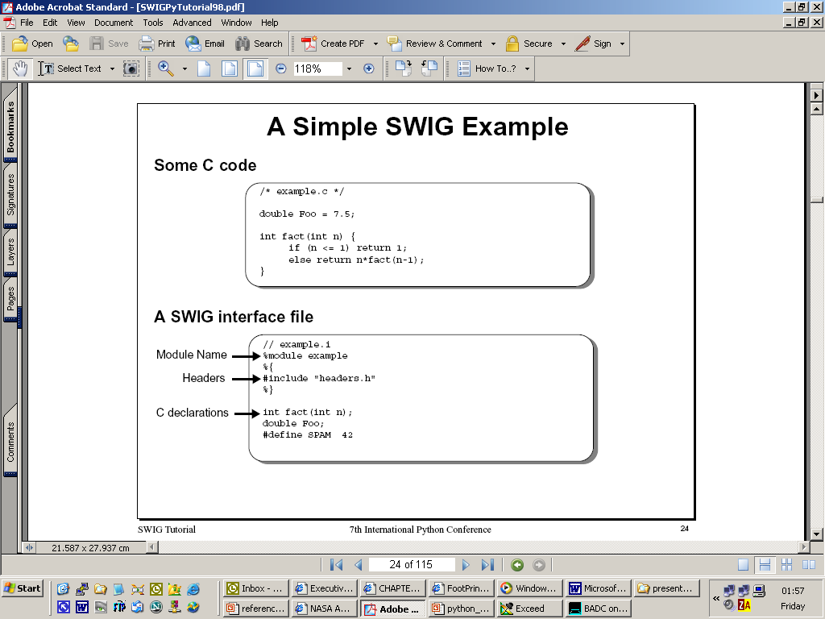
SWIG Example (1)
*Much of the information in this document was stolen from the official
python documentation at:
http://www.swig.org/papers/PyTutorial98/PyTutorial98.pdf

Slide 18
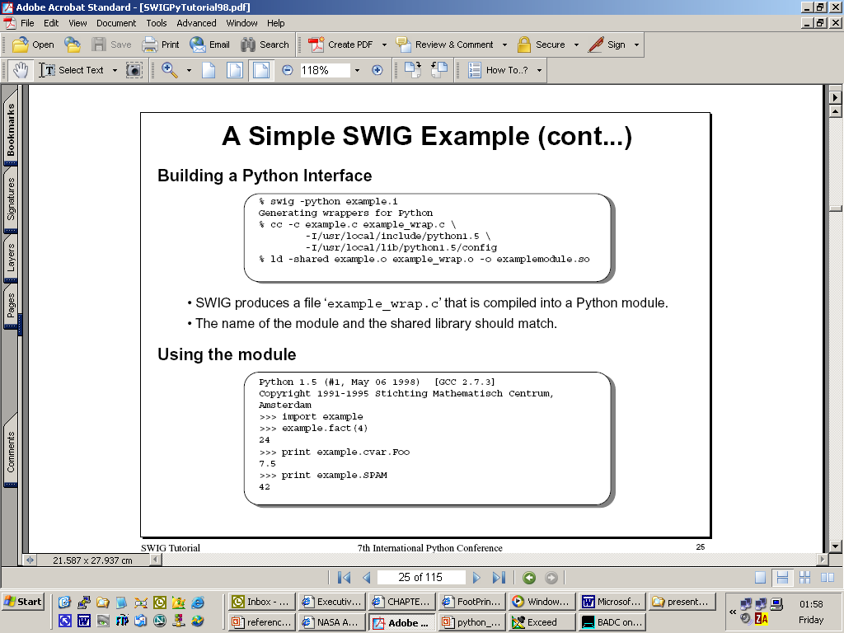
SWIG Example (2)
*Much of the information in this document was stolen from the official
python documentation at:
http://www.swig.org/papers/PyTutorial98/PyTutorial98.pdf

