Slide 1
Averaging, Grids and Interpolation

Slide 2
Averaging
There are many ways…
  Simple user-defined averages
  Averaging functions in MA(.average)
  Averaging functions in cdutil(.averager)
This session presents some details on:
  Averaging over axes
  Weighted averaging

Slide 3
Simple user-defined averaging
You can create your own simple averages using arrays, slabs or variables in the usual way:
  Averaging over 4 time steps:
    >>> t.shape
    (4, 181, 360)
    >>> av=(t[0]+t[1]+t[2]+t[3])/4
Drawbacks:
  Doesn’t retain your metadata.
  Cannot average simply across axes within a variable.

Slide 4
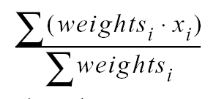
MA Averaging
The MA module has an averaging function:
  MA.average(x, axis=0, weights=None, returned=0)
  computes the average value of the non-masked elements of x along the selected axis. If weights is given, it must match the size and shape of x, and the value returned is:
  elements corresponding to those masked in x or weights are ignored. If returned, a 2-tuple consisting of the average and the sum of the weights is returned.

Slide 5
MA Averaging: example
To calculate a set of zonal means:
  >>> import MA
  >>> # data is some array
  >>> arr=MA.array(data)
  >>> print arr.shape
  (1,181,360)
  >>> zm=MA.average(arr, axis=2)
  >>> print zm.shape
  (1,181)

Slide 6
The cdutil “averager” function
The “cdutil.averager()” function is the key to spatial and temporal averaging in CDAT.
Masks are dealt with implicitly.
Powerful area averaging function.
Provides control over the order of operations (i.e. which dimensions are averaged over first).
Allows weightings for the different axes:
  pass your own array of weights for each dimension, use the default (grid) weights or specify equal weighting.

Slide 7
Usage of cdutil.averager
result = averager( V, axis=axisoptions, weights=weightoptions, action=actionoptions, returned=returnedoptions, combinewts=combinewtsoptions)
axisoptions has to be a string. You can pass axis='tyx', or '123', or 'x (plev)’.
weightoptions is one of 'generate’ | ‘weighted’ | 'equal' | ‘unweighted’ | array | Masked Variable
actionoptions is 'average' | 'sum‘ [Default = 'average‘].
You can either return the weighted average or the weighted sum of the data.

Slide 8
weightoptions: ‘generate’ or ‘weighted’ option
Weights are generated using the bounds for the specified axis.
For latitude and longitude, the weights are calculated using the area (see grid.getWeights()).
For other axes weights are the difference between the bounds (when the bounds are available).
If the bounds are stored in the file being read in, then those values are used. Otherwise, bounds are generated as long as cdms.setAutoBounds('on') is set (the default setting).
If cdms.setAutoBounds(‘off’) is set then an Error is raised.

Slide 9
cdutil.averager – basic usage (1)
>>> import cdms, cdutil
>>> f=cdms.open(‘myvars.xml’)
>>> var=f(‘no10u’, time=slice(0,10))
>>> print var
no10u
array( array(10,181,360), type=f, has 651600 elements)
>>> lon_average=cdutil.averager(var, axis=“x”)
>>> lon_average.shape
(10, 181)
>>> time_average=av(var, axis=“t”)
>>> time_average.shape
(181, 360)

Slide 10
cdutil.averager – Weights
Use auto generated weights based on bounds for area averaging:
  >>> av=cdutil.averager
  >>> area_av=av(var, axis=“yx”, \
  weights=[“generate”, “generate”])
  >> area_av.shape
  (10,)
  >>> all_av=av(var, axis=“tyx”, \
  weights=[“generate”, “generate”, “generate”])
  >>> all_av.shape
  ()
You can use the “area_weights” function to generate a set of weights before averaging.
  >>> gen_weights = cdutil.area_weights(x)

Slide 11
Temporal averaging
Averaging over time is a special problem in climate data analysis.
cdutil makes the extraction of time averages and climatologies simple.
Functions for annual, seasonal and monthly averages and climatologies
User-defined seasons (such as “FMA”).
Dealt with in detail in the climate-specific tools session.

Slide 12
Grids in CDAT
Why grids?
The CDMS RectGrid class
Regridding (interpolation)
Horizontal regridding
Vertical regridding
SCRIP – regridding Generic grids

Slide 13
Why grids?
Horizontal grid is very common domain description for a measured/modelled phenomenon.
A HorizontalGrid represents a latitude-longitude coordinate system. In addition, it optionally describes how lat-lon space is partitioned into cells. Specifically, a HorizontalGrid:
  consists of a latitude and longitude coordinate axis.
  may have associated boundary arrays (bounds) describing the grid cell boundaries.
  may optionally have an associated logical mask.

Slide 14
The CDMS RectGrid class and its operations.
CDMS includes support for grids, commonly we encounter RectGrids.
Reading a grid from a variable:
  >>> grd=var.getGrid()
  >>> lat=grd.getLatitude()
Creating a RectGrid:
cdms.createRectGrid(lat, lon, order, type="generic", mask=None)
For example:
  >>> lat=cdms.createAxis([1,2,3])
  >>> lat.designateLatitude()
  >>> lon=cdms.createAxis([0,2,4])
  >>> lon.designateLongitude()
  >>> grd=cdms.createRectGrid(lat, lon)

Slide 15
More useful grid operations
Support for Gaussian grids:
  >>> cdms.createGaussianGrid(nlats, xorigin=0.0, order=”yx”)
  Creates a Gaussian grid, with shape (nlats, 2*nlats).
  nlats is the number of latitudes.
  xorigin is the origin of the longitude axis.
  order is either “yx” (lat-lon, default) or “xy” (lon-lat)
Support for diagnostic grids:
  >>> createZonalGrid(grid)
  Creates a zonal grid. The output grid has the same latitude as the input grid, and a single longitude. This may be used to calculate zonal averages via a regridding operation. grid is a RectGrid.
  >>> createGlobalMeanGrid(grid)
  Generate a grid for calculating the global mean via a regridding operation. The return grid is a single zone covering the range of the input grid. grid is a RectGrid.

Slide 16
Support for other grid types
RectGrid - Associated latitude and longitude are
1-D axes, with strictly monotonic values.
CurveGrid - Latitude and longitude are 2-D coordinate axes (Axis2D).
GenericGrid - Latitude and longitude are 1-D auxiliary coordinate axes (AuxAxis1D)

Slide 17
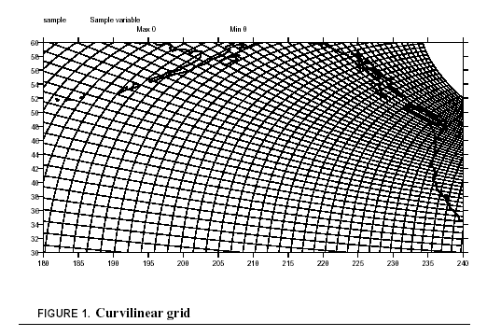
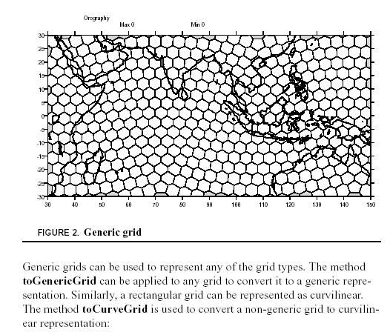
Curvilinear and Generic Grids
Curvilinear and Generic Grids!

Slide 18
Interpolation (re-gridding)
T regrid variable u (from a rectangular grid) to a 96 x 192 rectangular Gaussian grid:
>>> import cdms
>>> f=cdms.open(‘mydata.nc’)
>>> var = f(’temp’)
>>> var.shape
(3, 72, 144)
>>> n48_grid = cdms.createGaussianGrid(96)
>>> var48 = var.regrid(n48_grid)
>>> var48.shape
(3, 96, 192)

Slide 19
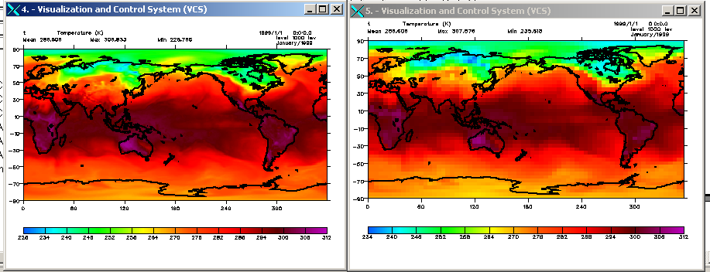
Using createUniformGrid()
#!/usr/local/cdat/bin/python
import cdms
from regrid import Regridder
f = cdms.open('temp.nc')
t= f.variables['t']
ingrid = t.getGrid()
outgrid = cdms.createUniformGrid(-90.0, 46, 4.0, 0.0, 72, 5.0)
regridFunc = Regridder(ingrid, outgrid)
newt = regridFunc(t)
import vcs
vcs.init().plot(t)
vcs.init().plot(newt)

Slide 20
Using the Regridder class
If you are going to use a regridding function repeatedly it is more efficient to create your own regridding function using the Regridder class:
  >>> import cdms, regrid
  >>> f=cdms.open(‘myfilio.nc’)
  >>> var1=f(‘surface_temperature’)
  >>> var2=f(‘no2t’)
  >>> grid1=var1.getGrid()
  >>> grid2=var2.getGrid()
  >>> regridFunc=regrid.Regridder(grid1, grid2)
  >>> regriddedVar1=regridFunc(var1)
  >>> diff=regriddedVar1-var2 # gives difference

Slide 21
Vertical regridding
You can regrid pressure-level coordinates in the vertical axis using the pressureRegrid() method.
You need to define, or use an existing, vertical axis.
Then use the pressureRegrid method on the variable you wish to regrid, passing it the new level as the argument:
If var is the variable to regrid and the newlevs is the vertical axis to regrid to:
  >>> var_on_new_levels = var.pressureRegrid(levout)

Slide 22
Vertical regridding: an example
>>> import MV, cdms
>>> f=cdms.open('temp.ctl')
>>> t=f('t')
>>> t.getLevel()[:]
[ 1000., 925., 850., 775., 700., 600., 500., 400., 300., 250., 200., 150., 100., 70., 50., 30., 20., 10., 7., 5., 3., 2., 1.,]
>>> t.shape
(1, 23, 181, 360)
>>> nl=cdms.createAxis(MV.array([976.0, 831.0, 221.0]))
>>> nl.designateLevel()
>>> t_regridded=t.pressureRegrid(nl)
>>> t_regridded.shape
(1, 3, 181, 360)
>>> t_regridded.getLevel()[:]
[ 976., 831., 221.,]

Slide 23
SCRIP – regridding irregular grids (1)
CDAT now supports irregular grids that can be interpolated using the SCRIP (Spherical Coordinate Re-mapping and Interpolation Package) package (not provided with CDAT) as follows:
  Obtain or generate the source and target grids in SCRIP NetCDF format. Write a CDMS grid using the writeScripGrid() method.
  Edit the input name list file scrip_in to reference the grids and select the method of interpolation, either conservative, bilinear, bicubic, or distanceweighted.
  See the SCRIP documentation for detailed instructions:
  http://climate.lanl.gov/Software/SCRIP/SCRIPusers.pdf

Slide 24
SCRIP – regridding irregular grids (2)
At the command line, the SCRIP executable generates a re-mapping file containing the transformation coefficients.
In CDMS, open the re-mapping file and create a regridder function with the readRegridder() method.
Call the regridder function on the input variable, defined on the source grid.

