Slide 1
Basic plotting and animation with VCS

Slide 2
What is VCS
Visualisation and Control System
VCS came before CDAT
Python interface
Only 1D or 2D graphics
Plots or animations
Outputs to screen, GIF, EPS, PS etc.

Slide 3
VCS Concepts and Terminology
Basic concepts:
VCS Canvas – where the plots are drawn
Graphic Methods – how the data is rendered (the plot type). E.g. “boxfill”, “isofill”, “isoline”, “vector”, etc,. Multiple projections may be available for a given Graphic Method.
Templates – define the location where things are drawn on the canvas (data, legend, title, comments, units, etc..)
Primitives – additional secondary items such as lines, polygons, text, markers, etc.,

Slide 4
The VCS Canvas
VCS canvas needs to be initialized (created)
  >>> x=vcs.init() # without any arguments
Up to 8 Canvases at once.
Canvas as “magic board”, can clean or destroy it:
>>> x.clear()
>>> x.close()
Can have multiple plots on a single Canvas (not covered here)

Slide 5
VCS Help
Basic help on VCS can be obtain inline via: >>> vcs.help()
This will list available function in vcs, notably functions to create/get/query vcs objects…

Slide 6
VCS First Help
This also can be used to get help on a specific command:
>>> vcs.help(‘createboxfill’)
Function: createboxfill
# Construct a new boxfill graphics method
Description of Function:
Create a new boxfill graphics method given the name and the existing boxfill graphics method to copy the attributes from. If no existing boxfill graphics method name is given, then the default boxfill graphics method will be used as the graphics method to which the attributes will be copied from.
If the name provided already exists, then a error will be returned. Graphics method names must be unique.

Slide 7
Graphic Methods Concepts (1)
Essentially a graphic method represents HOW data are going to be plotted (the WHERE will be determined via templates, see later)
There are 13 type of graphic methods in VCS:
  2D Graphic Methods
    Boxfill, Isofill, Isoline, Meshfill, Vector, Outfill, Outline, Continents , (Taylordiagrams)
  1D Graphic Methods
    Yxvsx, Xyvsy, XvsY, Scatter

Slide 8
Specifying a Graphic Method
To specify a graphic method use a “create” function, then use plot:
For example, for a boxfill:
  >>> gm = x.createboxfill(‘name’)
  >>> x.plot(data, gm)
If a graphic method already exists, use “get” functions:
  >>> gm = x.getboxfill(‘name’)
  >>> x.plot(data, gm)
Replace ‘boxfill’ in the above for other methods.

Slide 9
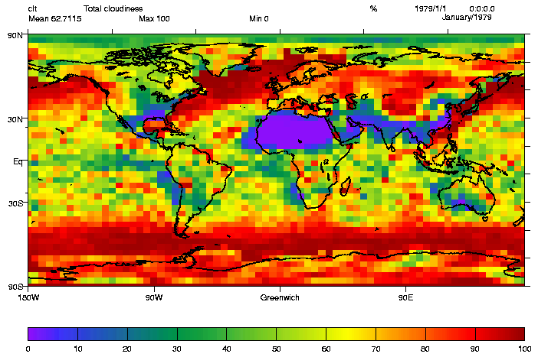
2D - “boxfill”
The boxfill graphic method takes a 2D array and represents it by filling a “box” (determined by the bounds on each axis values) with a color linked to the array’s value at this location:
>>> box=x.createboxfill(‘new’)
    >>> x.plot(data,box)

Slide 10
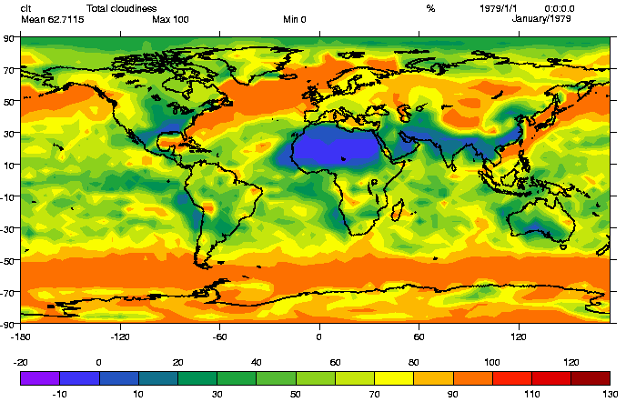
2D -“isofill”
Isofill graphic methods draws filled isocontour
They are extremely similar to boxfill “custom” type
Known Limitation:
  No control on labels position
  No control on isolines “Smoothness”
>>> iso=x.createisofill(‘new’)

Slide 11
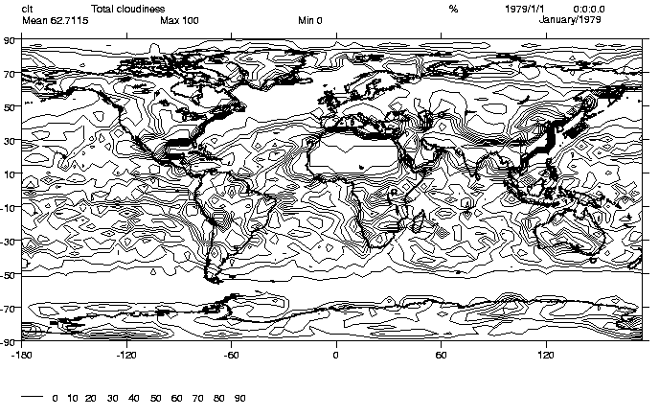
2D - “isoline”
Isoline, draws isocontours, color, style, can be controlled.
Limitation:
  No control on the labels location
  No control of “smoothness”
  >>> iso=x.createisoline(‘new’)

Slide 12
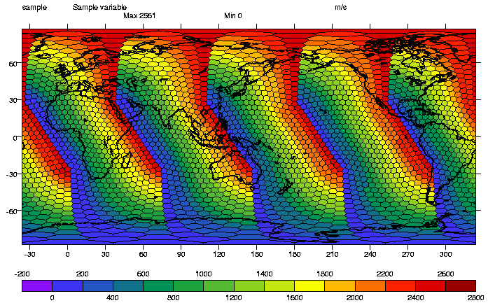
2D – “meshfill” – for generalised grids
Meshfill is similar to boxfill “custom” but allows representation of generalized grids, i.e. instead of filling a box, “meshfill” fills cells, of “n” points
Requires an additional array to be passed to represents the “mesh”
This array is generated automatically for Transient Variables recognized by cdms.
Allows very creative 2D plots.

Slide 13
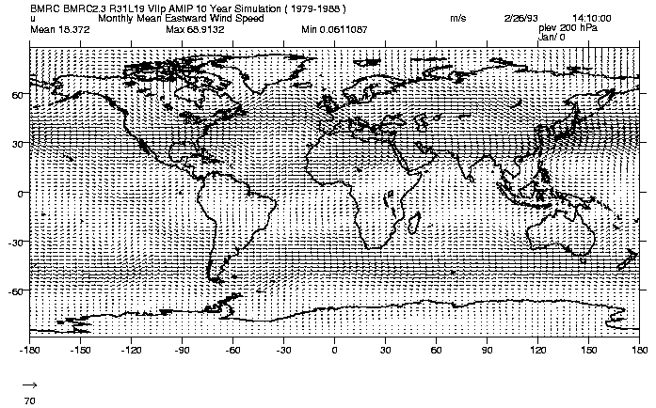
2D - “vector”
The “Vector” graphic method represents the combination of 2 arrays, via “vector” the first array representing the “X” axis component and the second array representing the “Y” axis component.
>>> f=cdms.open(’sample_data/clt.bc’)
  >>> u=f(‘u’)
  >>> v=f(‘v’)
  >>> vec=x.createvector(‘new’)
  >>> x.plot(u,v,vec)

Slide 14
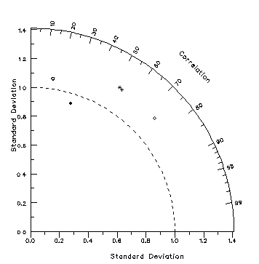
Taylor Diagram – comparing climate runs
With the right set up you can create Taylor diagrams:
See the on-line tutorial: taylordiagram_tutorial.py

Slide 15
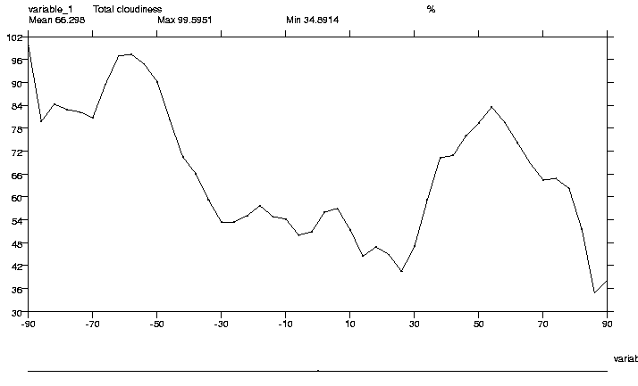
1D – Y(x) vs x
All 1D plots in VCS basically work the same way. There are 4 types of 1D graphic method, we’ll start with the basic: Yxvsx, which stands for Y(x) vs x
This graphic method draws a 1D array (Y) as a function of its 1D axis (x)
Example zonal mean of the first time point of our data array
  >>> zm=MV.average(data[0],1) # Zm.shape is (46,)
  >>> x.plot(zm) # knows to plot 1D with yxvsx
  >>> yx=x.createyxvsx(‘new’)
  >>> x.plot(zm,yx) # same

Slide 16
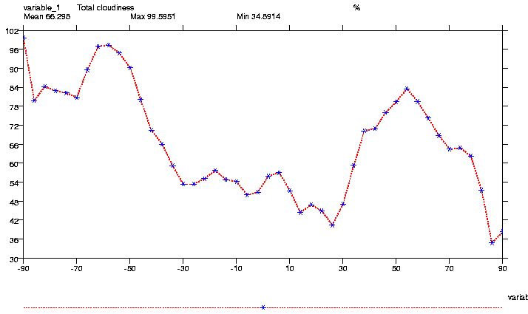
1D - “VCS” Yxvsx attributes
As in isoline, or vector, line, linecolor, linewidth, determine the line.
marker, markercolor, markersize, determine the markers to be drawn:
>>> yx.line='dot'
>>> yx.linecolor=242
>>> yx.linewidth=2
>>> yx.marker='star’
>>> yx.markercolor=244

Slide 17
1D - “VCS” Xyvsx, Xvsy, scatter
Other 1D graphic method, work very similarly:
Xyvsy does the same thing except the X and Y axes are flipped relatively to a Yxvsx.
XvsY is the same thing as YxvsX except it takes 2 data arrays (X and Y) as arguments, therefore the values on the horizontal axis are not taken from the “axis” definition of the Y array but from the values of a first (X) array.
Scatter basically works as XvsY except both X and Y MUST have the same Axis!

Slide 18
Graphic Methods Attributes
>>> b=x.createboxfill(‘new_one’)
>>> b.list()
----------Boxfill (Gfb) member (attribute) listings ----------
Canvas Mode = 1
graphics method = Gfb # indicates the graphic method type: Graphic Filled Boxes (Gfb)
name = new # Name of the specific graphic method
projection = linear # projection to use (see projection section)
xticlabels1 = * # 1st set of tic labels, ‘*’ means ‘automatic’
xticlabels2 = * # 2nd set of labels (pos determined by template)
xmtics1 = # 1st set of sub ti for details)
xmtics2 =
yticlabels1 = *
…
…

Slide 19
Graphic Methods plot functions
Graphic methods may also be selected by replacing the ‘plot’ method with the graphic method name:
>>> x.boxfill(data)
>>> x.isofill(data)
>>> x.isoline(data)
>>> x.vector(data)
>>> x.yxvsx(data)
etc...
Note: an error is returned if the data structure(s) incompatible with method.

Slide 20
The importance of squeezing data
A common problem is confusion about the shape of a data slab:
  You think you have 1D data but you have 4D data
  shape is (1, 1, 1, 4)
  array is [ [ [ [13,15,18,14] ] ] ]
  VCS uses first index of every leading dimension until it gets a 2D array (if 2D specified)
  Squeeze is the key:
  >>> data=data(squeeze=1) # OR MAYBE...
  >>> data=bigdata(lat=(90,0), squeeze=1)
  >>> x.plot(data)

Slide 21

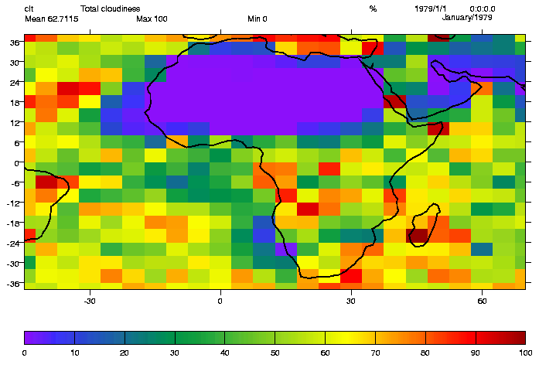
2D - World Coordinates – example attributes
worldcoordinate attributes are present on all graphic methods.
can select a subset area.
for example to visualise Africa:
>>> b.datawc_x1 = -45.
>>> b.datawc_x2 = 70.
>>> b.datawc_y1 = -38.
>>> b.datawc_y2 = 38.
>>> x.plot(s,b)

Slide 22
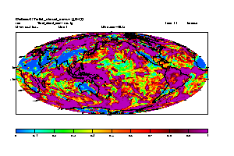
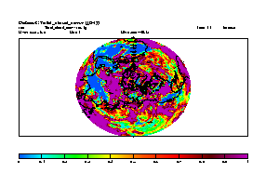
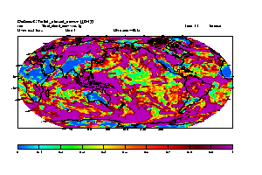
Projection attributes of Graphic Methods
Each graphic method may have a number of projections, the full list is available from:
>>> v.show('projection')
************************Projection Names List*************************
( 1): default linear mollweide
( 4): robinson polyconic polar
( 7): lambert orthographic mercator
************************End Projection Names List*********************
mollweide polar robinson

Slide 23
Selecting a projection
>>> import vcs
>>> x=vcs.init()
>>> iso=x.createisofill(‘newone’, 'ASD')
>>> iso.projection="polar"
>>> x.plot(var1, iso)

Slide 24
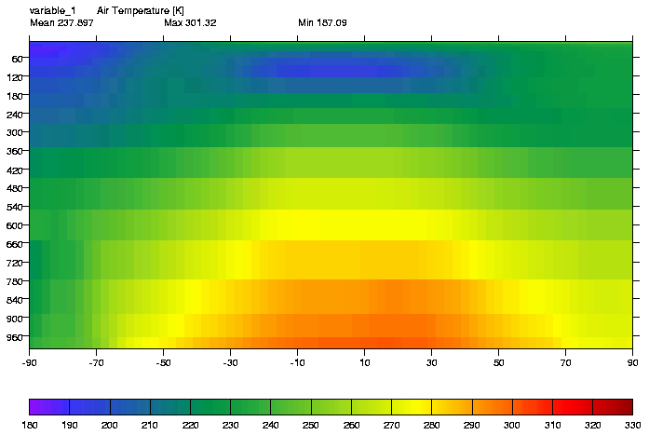
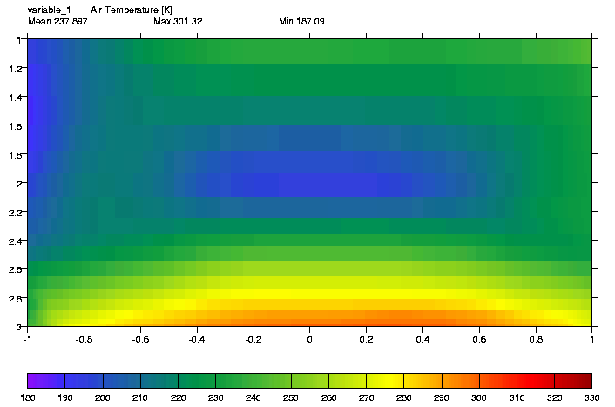
2D - Axes Transformations
Axis transformations allowed are:
    area-weighted, ln, log10, exp.
>>> box=x.createboxfill(‘new’)
>>> x.plot(data2, box)
>>> box.xaxisconvert=‘area_wt’ # Area weighted representation of latitudes
>>> box.yaxisconvert=‘log10’ # Log of P repres of Pressure dim
>>> x.plot(data2, box)

Slide 25
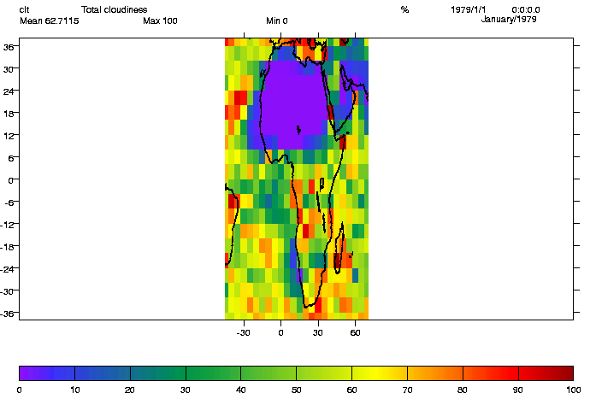
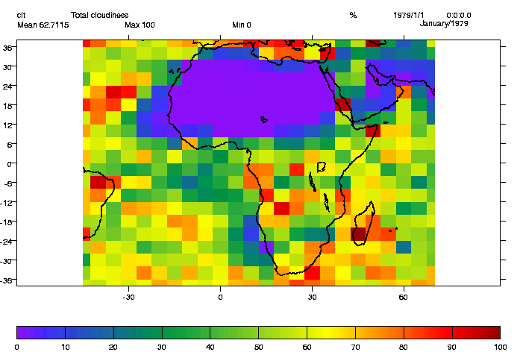
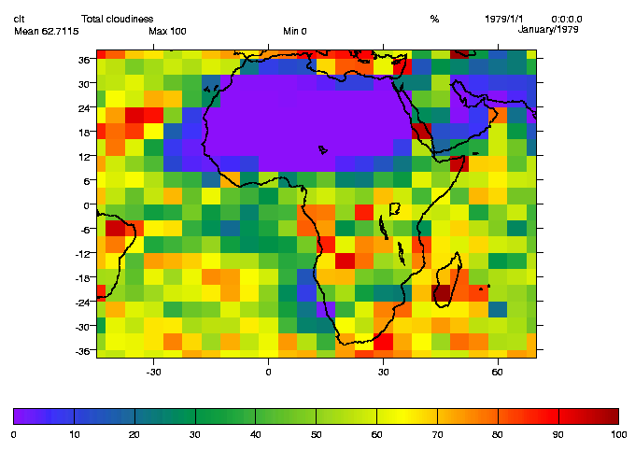
2D - Controlling the Y/X ratio of a plot
ratio controls the Y ratio relative to X
ratio=2 means Y will be twice X
For data with spatial grids, the
‘auto’ value can be passed.
To adjust the box and tick marks
use ‘autot’
x.plot(data,b,ratio=2) x.plot(data,b,ratio=‘auto’) x.plot(data,b,ratio=‘autot’)

Slide 26
Colormaps
The colormap is the range of colours used in any plot or animation.
Colormap in VCS consist of 256 colors.
Each colormap has a unique name associated with itself.
VCS is currently limited to ONE colormap at a time, but if you clear your plot, you can use multiple colormaps during the same session.

Slide 27
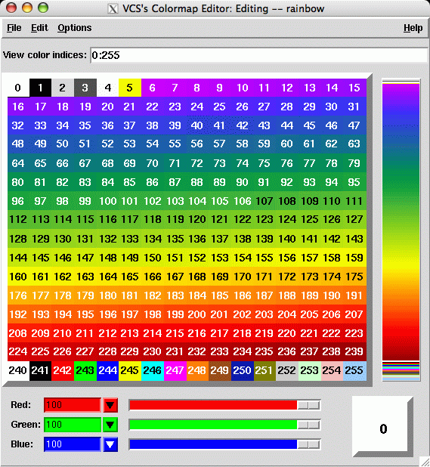
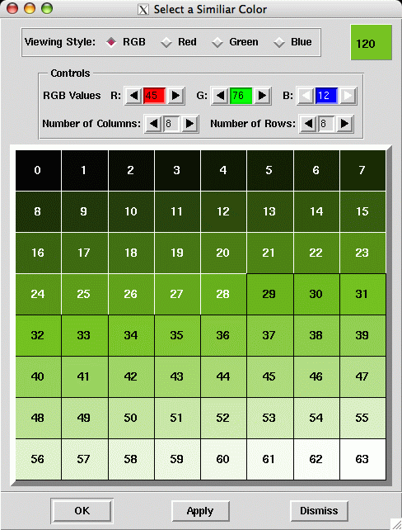

Colormaps from VCDAT
The Colormap GUI let you easily pick/change colors and color model

Slide 28
Introducing Templates (1)
Template tell VCS WHERE to draw objects on the canvas (whereas Graphic Methods specify HOW to draw them).
4 aspects of the plot controlled templates:
  Text location for things like title, comments, name, etc..
  Data area
  Tick marks and label locations
  Legend

Slide 29
Introducing Templates (2)
Each element of the template (e.g “data”) can be turned on/off or moved on top/below other elements on the page via its “priority” attribute
Template object are created via the “createtemplate” command
  >>> t=x.createtemplate(‘new’)
All elements of a template object can be listed via the list() function
  >>> t.list()
Alternatively, a single elements’s attributes can be listed, e.g.:
  >>> t.data.list()
  member = data
  priority = 1
  x1 = 0.78400000234
  y1 = 0.92734249999 ...

Slide 30
VCS Templates – useful methods
Command line manipulation of entire templates:
>>> templ.move(percent, axis)
>>> templ.moveto(x,y) # move the data.x1,data.x2 corner to x/y
>>> templ.scale(scale,axis=‘xy’,font=-1) # scale the template along x,y,xy can also scale fonts (automatic for xy direction only)

Slide 31
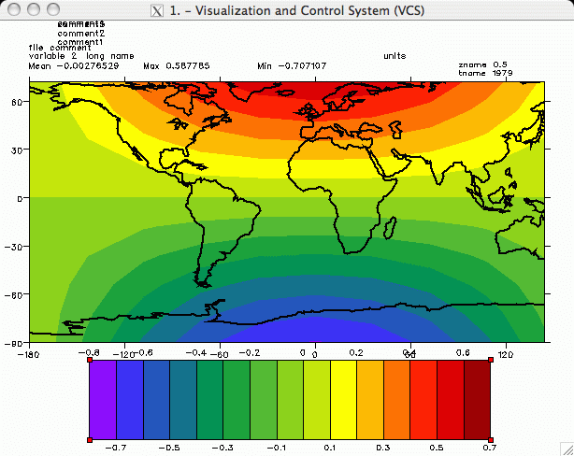
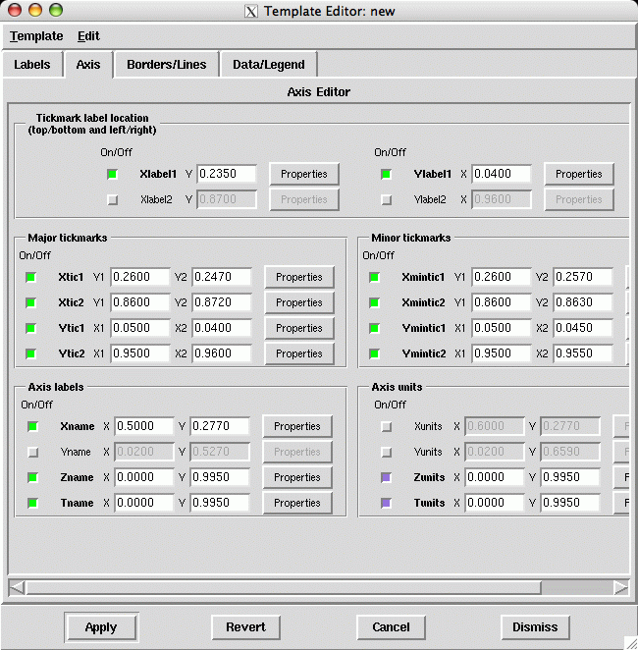
VCS Templates
Simplifying your life!
Setting up templates can be tedious!
Recommend that you construct your template once, save it and reuse it for ever.
Use the VCDAT template editor to create them!

Slide 32
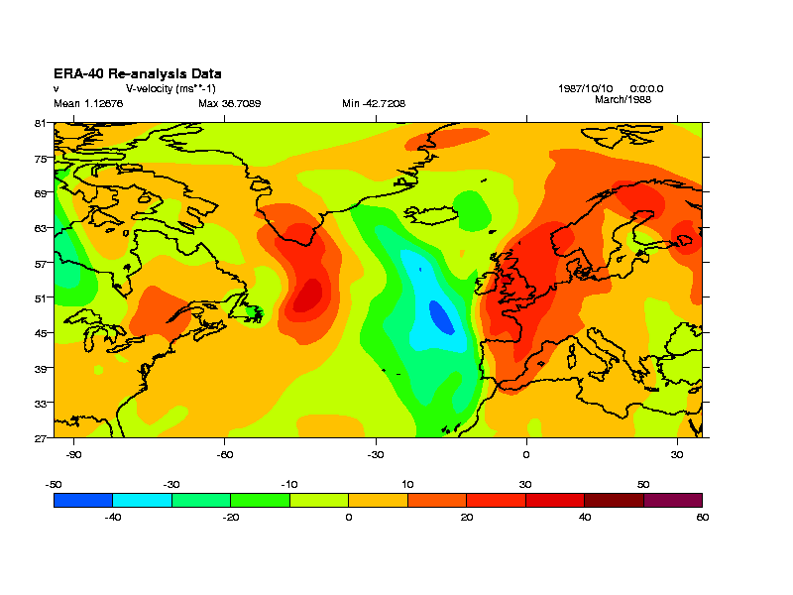
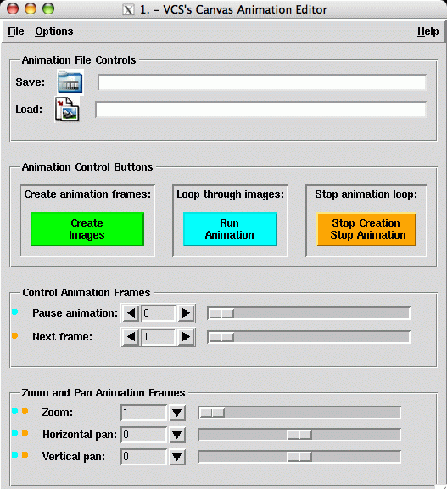
Animating at the command line
Just keep write a frame to a canvas, to gif and clear, then do all over again…
>>> x=vcs.init()
>>> templ=canvas.gettemplate('BADC_ERA40')
>>> plot_type=canvas.getisofill(‘ASD’)
>>> for i in range(loop_num):
... x.clear()
... x.plot( data( time=slice(i,i+1) ), templ, \ plot_type)
... x.gif(outfile) # Second arg of merge="a"
# needed on some versions
Or call up GUI with x.animate.gui()

Slide 33
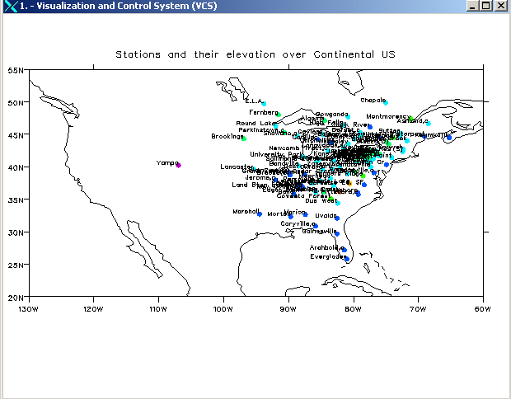
“Secondary” VCS Objects
Secondary VCS objects (primitives) consist of:
Fillarea : polygons
Lines
Text
Marker
An example use is using markers to plot station data…

Slide 34
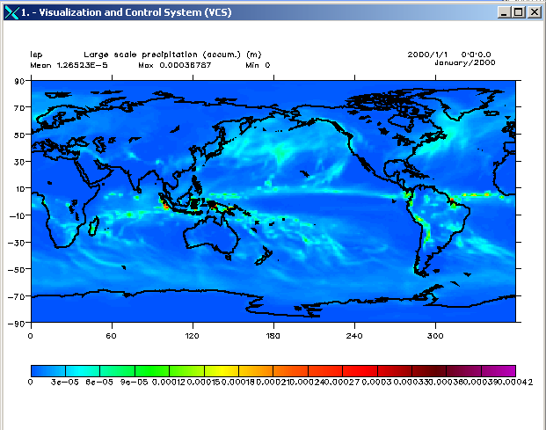
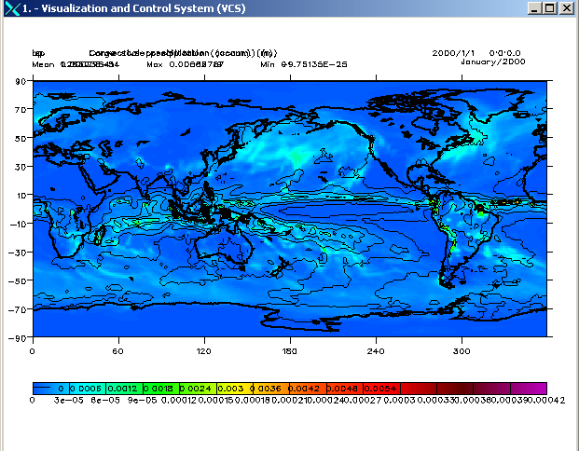
Overlaying images
Overlaying is simple, just don’t clear the canvas between plots, templates may need modifying…
Don’t really want 2 legends and titles overlayed!!!

Slide 35
Other graphics packages
CDAT/Python objects can also be visualised in:
xmgrace (1D plots) – ships with CDAT
PyNCL (NCAR Command Language)
PyNGL (NCAR Graphics Language)
MatPlotLib (MatLab equivalent for Python)
IAGraph (which is a layer on top of VCS)

