Slide 1
Building on CDAT:
Application development

Slide 2
Why build on top of CDAT?
It has a standard and universal scripting language interface (our old friend Python).
It provides access to a range of useful packages such for data plotting, I/O, manipulation, processing etc,.
Python binds easily to other languages and software packages.
A critical mass of scientists working on CDAT packages will result in a suite of fantastic freely available routines that can be distributed in future releases.

Slide 3
What would you build on top of CDAT?
Some examples are:
  The CF-checking utility (Hadley Centre/BADC)
  BADC ERA-40 delivery and caching system & LAS
  The BADC’s Data Extractor web-interface
  IaGraph
  and VCDAT of course!

Slide 4
The CF-Checker (1)
Code developed in Python calling CDAT for NetCDF interface.
BADC sub-classed the main version and bound it to a web application.
Allowing users to upload a file to be checked for CF-compliance.
Available at:
    http://titania.badc.rl.ac.uk/cgi-bin/cf-checker.pl

Slide 5
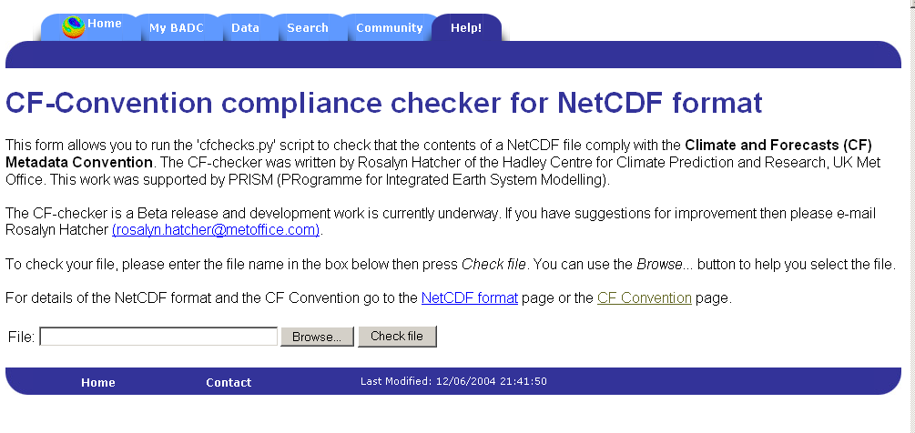
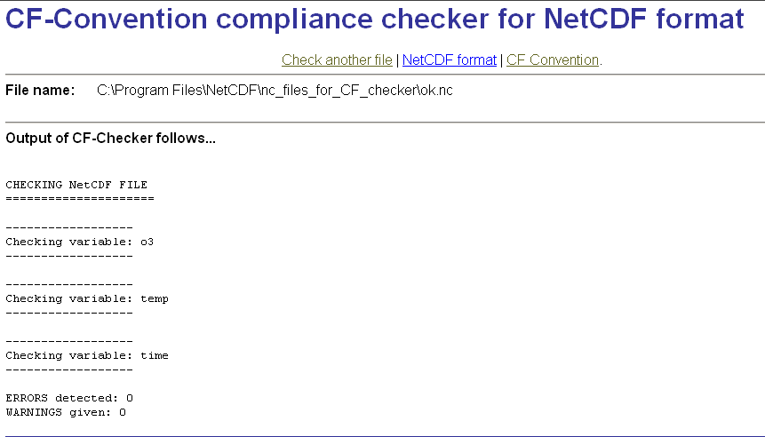
The CF-Checker (2)

Slide 6

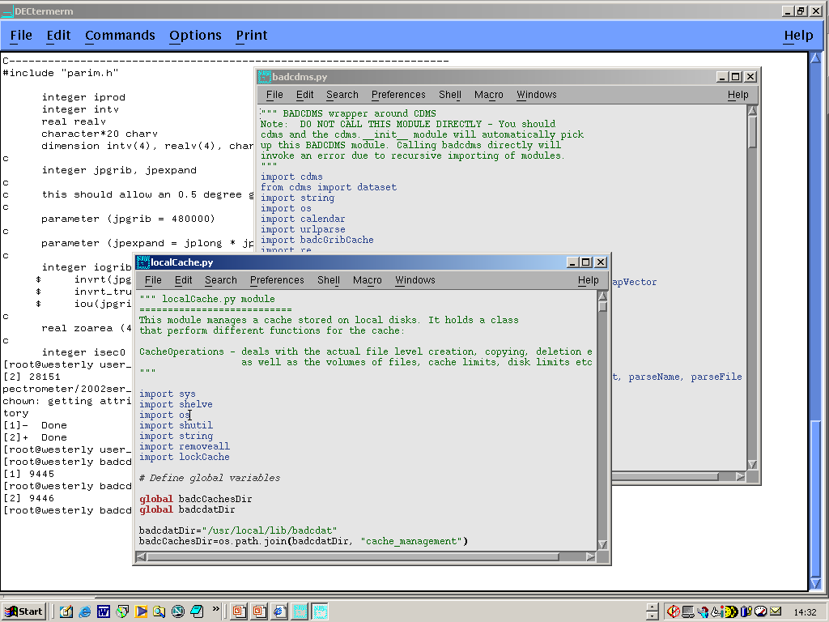
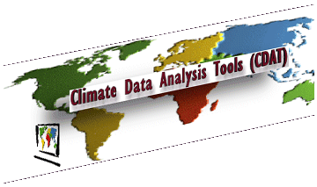

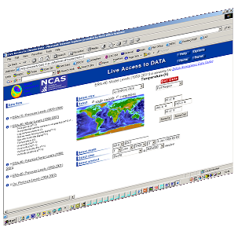
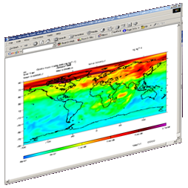
BADC ERA-40 delivery system
BADC/CDAT
localCache.py
ERA-40 < 1TB
Grid Cache
YES
Locks access to cache. Checks if regular gridded file is in cache list.
BADC/CDAT intercepts command and checks cache
NO
Cache unlocked. New cdms.open command sent to CDAT and cache file opened.
LAS
Spectral file is converted on-the-fly and placed in cache.
ERA-40
4 TB Spectral Archive
CDAT
Calls cdms.open to open data file.
Data object delivered to LAS.
Internet User
18 TB virtual dataset
Notes:
Here is how the caching works behind the scenes with our Live Access Server and CDAT.
It is important to note that the Object Oriented nature of Python has made it relatively easy to create our own modifications to CDAT without changing the actual source code itself. Python allows sub-classing of class objects. These sub-classes inherit the attributes and methods of its parent class. We have therefore only needed to recode two lines of one CDAT module in order to point to relevant sub-classes in our own parallel code.

Slide 7
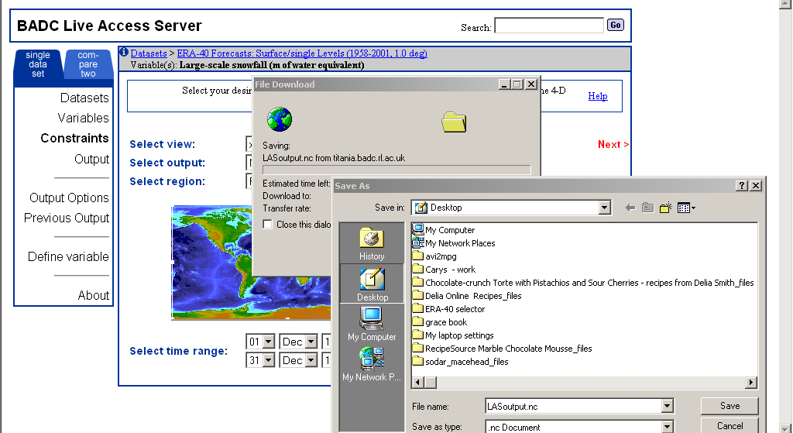
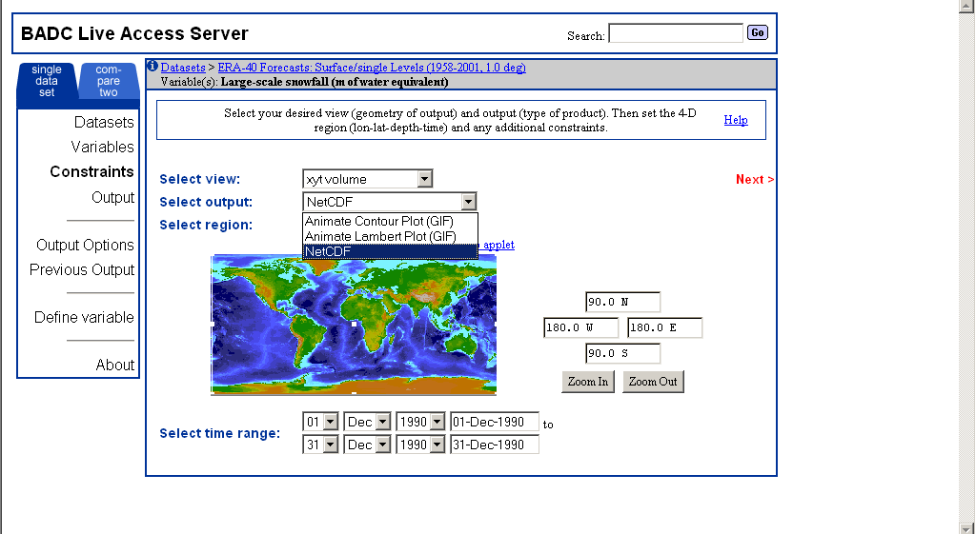
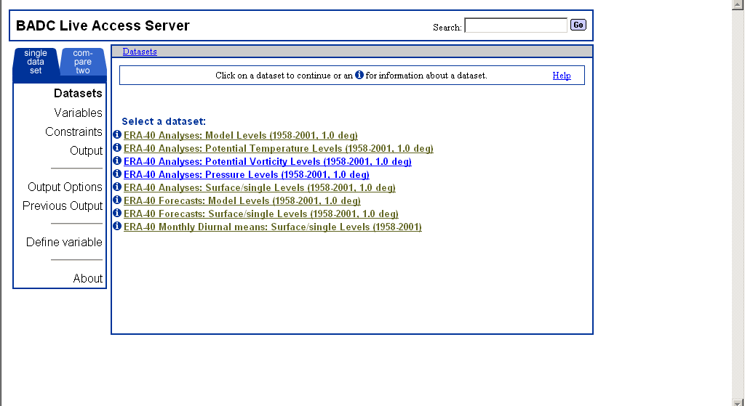
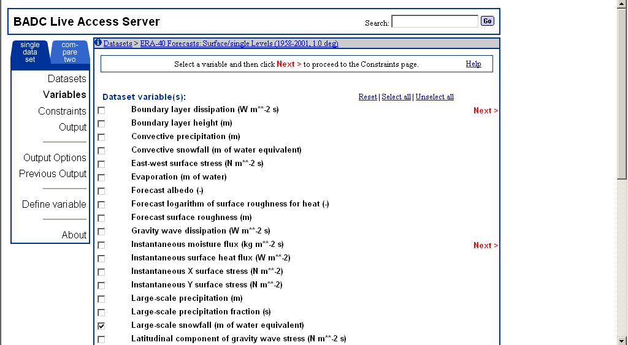
BADC’s LAS Demo: 1 month to NetCDF
Notes:
So, here is an example of how one might use the BADC’s ERA-40 LAS. Firstly, I must log in. This system stores a cookie so that the user does not have to repeatedly log in during one session.
You then select your dataset, in this case we have divided the ERA-40 data into analyses and forecasts on each level type. As a simple example you might be interested in the forecast of large scale snowfall for all time steps available in December 1990. You can select your requirements and click ‘Next’. This data was delivered within a minute of making the request. You download your file and off you go.

Slide 8
The BADC’s Data Extractor web-interface (1)
We found it hard to make progress with the LAS, due to:
  dependence on many other software products (such as MySQL and Tomcat)
  complex multi-language code – very hard to locate where to modify code for minor changes.
So, we built our own…using all-Python of course…

Slide 9
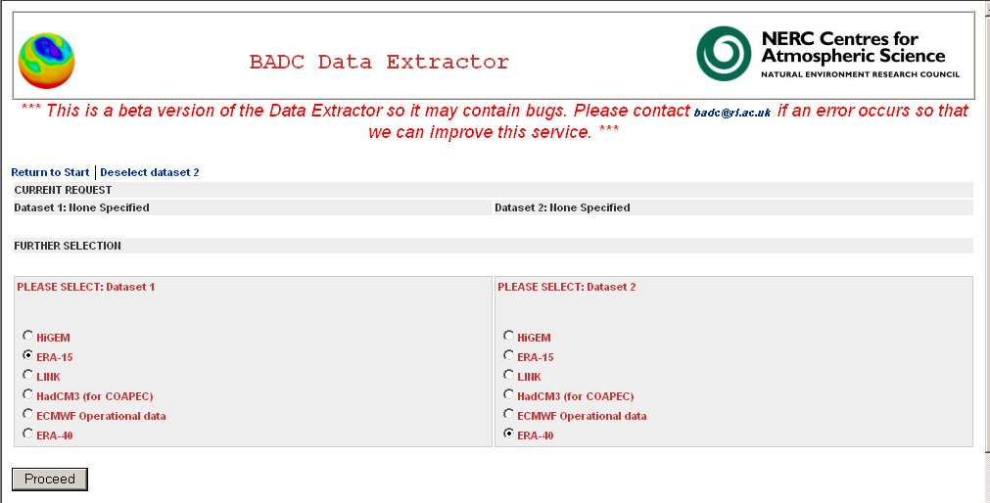
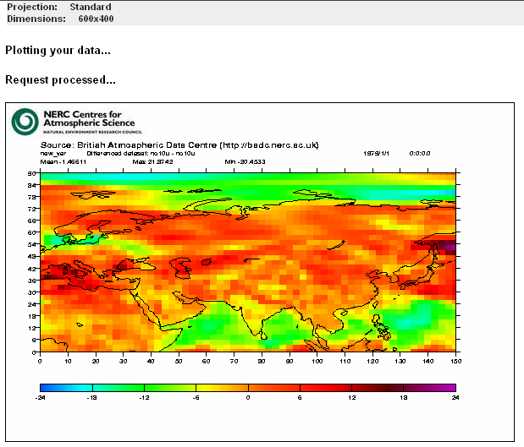
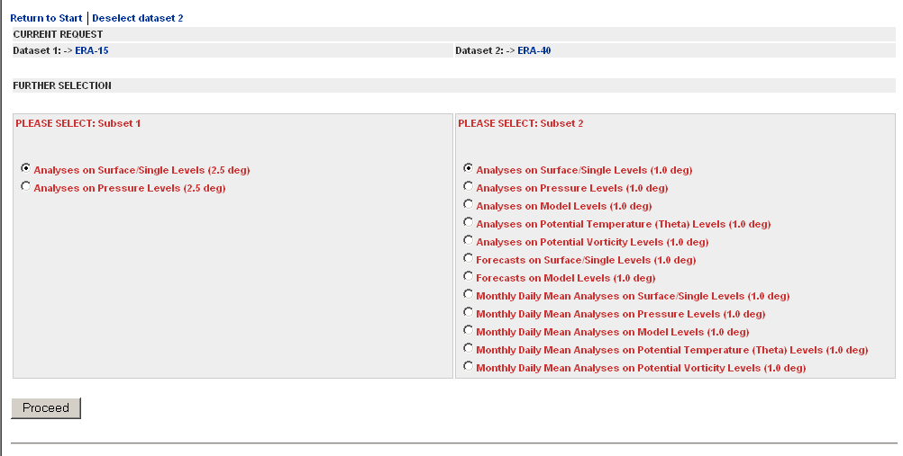
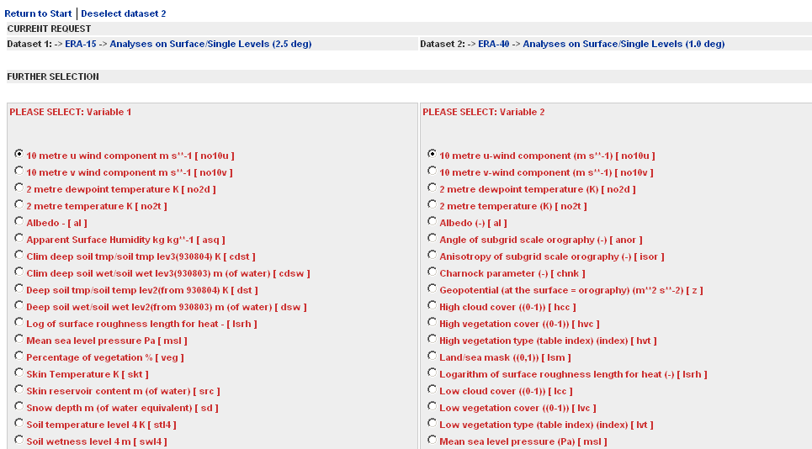
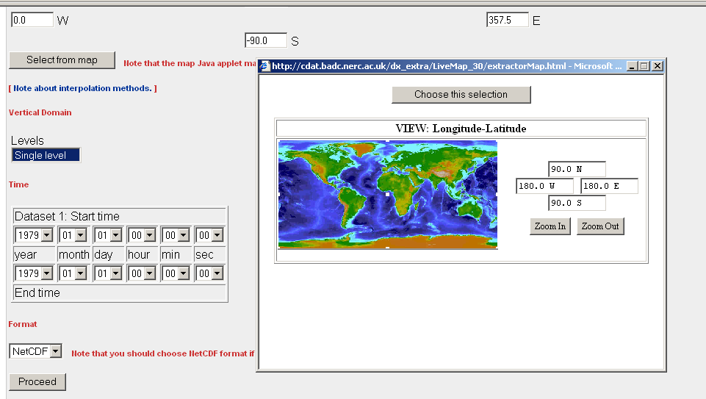
The BADC’s Data Extractor web-interface (2)

Slide 10
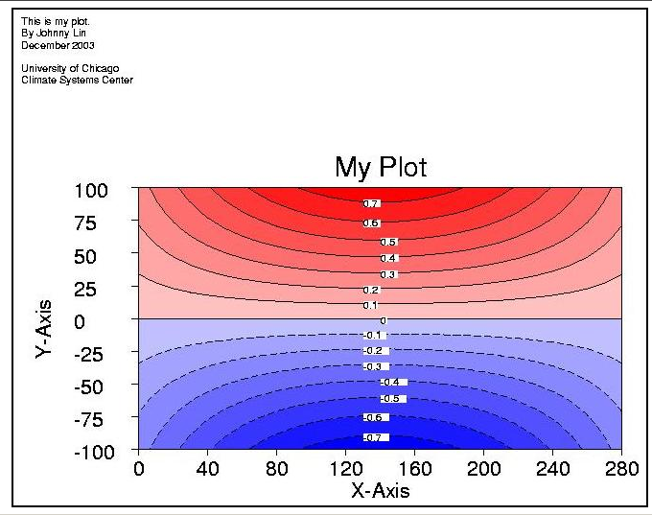
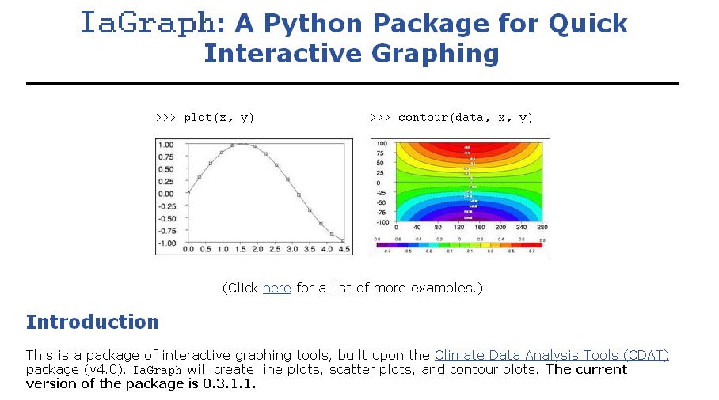
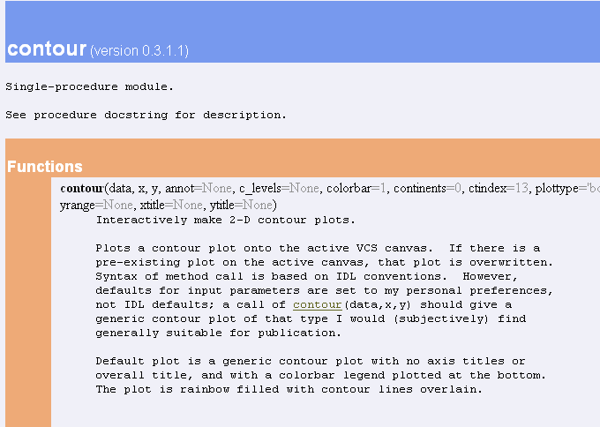
IaGraph - A Python Package for Quick Interactive Graphing

