Slide 1
NetCDF and the
CF metadata convention

Slide 2
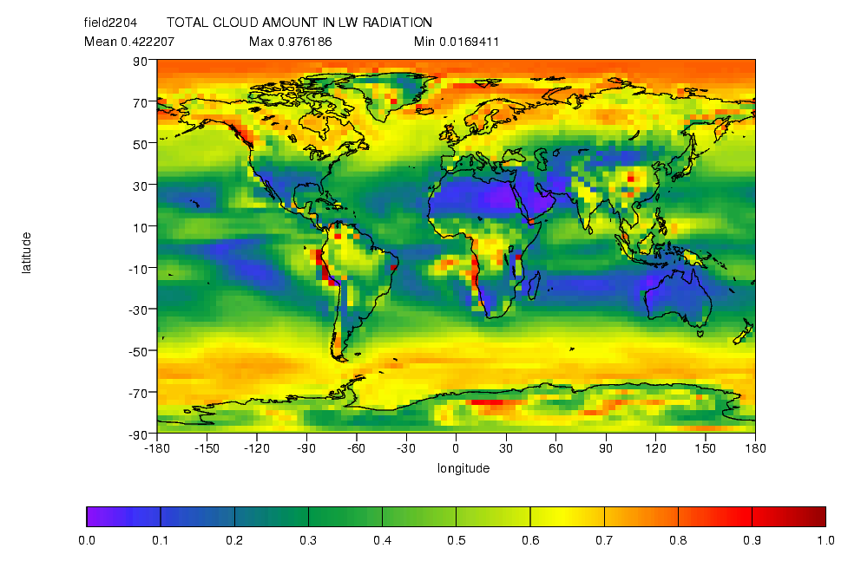
Some geophysical data

Slide 3
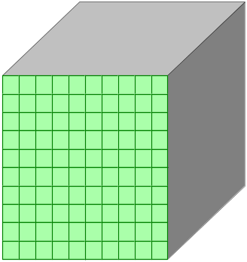
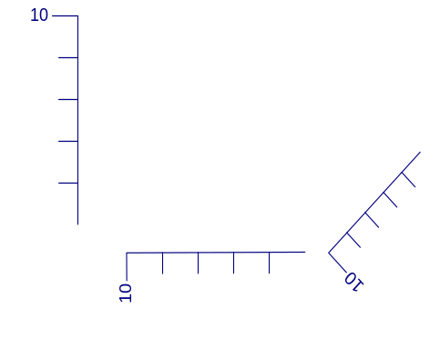
Modelling geophysical data
Name
TAS
Units
K
…
Name
Latitude
Units
Degrees
Bounds
…

Slide 4
Modelling geophysical data 2
10
10
10
Title
Institution
History

Slide 5

NetCDF goals
http://my.unidata.ucar.edu/content/software/netcdf/index.html
Portable: byte order neutral.
Efficient: random access
Appendable
Simple

Slide 6
NetCDF data model
Three types of object
  dimension: The length of an array dimension. One dimension can have unlimited length (i.e. the file is appendable along that dimension).
  variable: An array of data. Variables are composed of:
    A list of dimensions (e.g. time, latitude, longitude).
    A datatype (e.g. float)
  attribute: A named property of a variable or the whole file.
    attributes have a datatype
    attributes can be one dimensional arrays (to support strings).

Slide 7
Example
netcdf example.nc {
dimensions:
lat=90;
lon=180;
time=1;
variables:
float TS_var(time,lat,lon);
TS_var:long_name="surface air temperature variance"
TS_var:units="K2";
float time(time);
time:units="days since 1990-01-01 00:00:00";
...
}
Extra information is supported by conventions
  Variables with the same name as a dimension => axis
  Standard attributes, e.g. "units"

Slide 8
CF convention
A Domain specific NetCDF convention
  Climate & Forecast
Self describing
  The metadata is sufficiently standardised to be understandable by humans and applications.
Main features
  Standard global and variable attributes
  Standard names for variables and units
  Indirect coordinate and grid descriptions

Slide 9
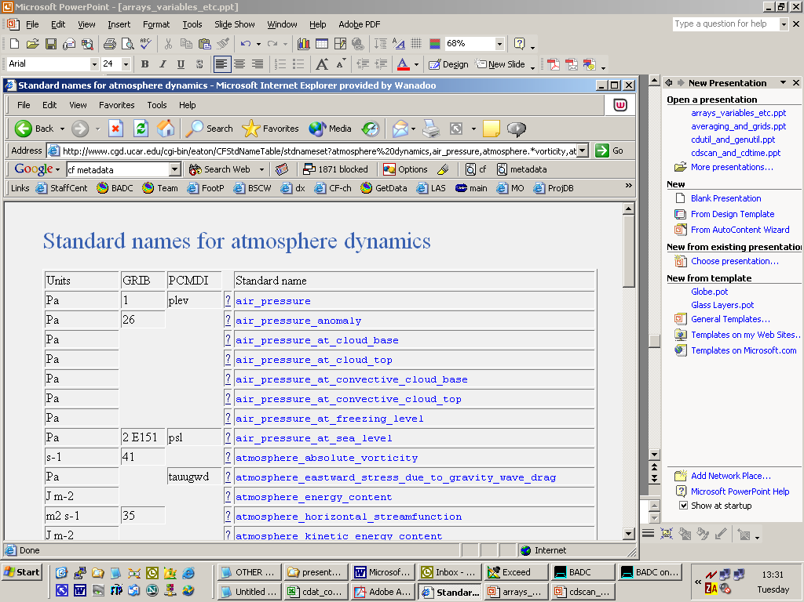
CF standard names

Slide 10
Parameterised coordinate variables
float lev(lev) ;
lev:long_name = "sigma at layer midpoints" ;
lev:positive = "down" ;
lev:standard_name = "atmosphere_sigma_coordinate" ;
lev:formula_terms = "sigma: lev ps: PS ptop: PTOP" ;
float PS(n,j,i) ;
float PTOP(single) ;
float field1(lev, lat, lon) ;
"atmospheric_sigma_coordinate" is defined in the standard as:
  p(n,k,j,i) = ptop + sigma(k)*(ps(n,j,i)-ptop)
PS and PTOP are auxiliary coordinate variables parametising the pressure coordinate.

Slide 11
NetCDF and CF future
NetCDF4
  An extended data model (hierarchal)
  Internally based on HDF4
  Externally consistent interface
CF
  Work on new grid descriptions
  Community evolving

