Slide 1
A quick guide to reading, manipulating, plotting and writing data in CDAT

Slide 2
Outline
Reading data from files
Basic file/data manipulation
Basic plotting
Writing output to files

Slide 3
CDAT-compatible data formats (1)
But the best way to read data in CDAT is to use the “cdms” module. Recognised formats are:
  NetCDF (standard for input and output) – CDMS follows the Climate and Forecasts (CF) Metadata Convention for NetCDF.
  HDF4 – currently incompatible with the NetCDF option due to library conflicts. CDAT can be built with either, not both. There is a hope ahead with a merger planned of NetCDF4 and HDF5 libraries (http://my.unidata.ucar.edu/content/software/netcdf/netcdf-4/index.html).

Slide 4
CDAT-compatible data formats (2)
More recognised format are:
  GRIB – is handled via the GrADS/GRIB interface, a slightly convoluted but effective way to get data into CDAT.
  PCMDI DRS format – not covered here as relatively little UK usage.
  CDML (Climate Data Markup Language) – the internal CDAT XML representation that points to multiple binary files.

Slide 5
Other self-describing formats of interest in the UK
You can also get support for:
  PP-format – the BADC has developed code for reading the Met Office proprietary field data format. This should soon be included in the I/O layer beneath CDMS (known as cdunif – a C-layer that provides read access to multiple formats, and write access to NetCDF). Ask for details.
  NASA Ames – a group of ASCII formats developed at NASA for field experiments and data exchange. Used extensively in UK atmospheric research. The BADC has developed a Python package to bridge NASA Ames data into CDAT (http://home.badc.rl.ac.uk/astephens/software/nappy).

Slide 6
CDMS (The heart of CDAT!)
CDMS is the python package at the core of CDAT. It provides the best way to read and write data:
Opening a file for reading:
  >>> f=cdms.open(file_name)
  will open an existing file protected against writing
Opening a new file for writing:
  >>> f=cdms.open(file_name, ’w’)
  will create a new file even if it already exists
Opening an existing file for writing:
  >>> f=cdms.open(file_name, ’r+’) # or ‘a’
  will open an existing file ready for writing or reading

Slide 7
Reading data from a file
Multiple ways to retrieve data:
  All of it:
  >>> data=f(‘var’)
  Specifying dimension name and values:
  >>> s=f(‘lnsp’, time=(“1999-1-1”, “2000-12-31”), \
  level=1000, lon=5)
  can use time, level, latitude, longitude, t, z, y, x, lat and lon.
  can provide either two values in a tuple “()” or just one.
  times are strings whereas others are just values (int or float)
  Or use “slice” and indices instead of values:
  >>> s=f(‘tco3’, lat=slice(index1,index2,step))
  - “step” is useful if you want to get every n^{th} value in a dataset.

Slide 8
Interrogating a CDAT file/dataset
Before extracting data you can find out about the dataset or file with:
>>> f.id # returns the file/dataset name
>>> f.listvariables() # returns a list of variables in the file
>>> f.variables # is a dictionary of variables in the file
>>> f.axes # returns the axes in the file
>>> f.attributes # returns all the file attributes (including axes)
>>> f.getVariable(‘temp‘) # same as f(‘temp’)
>>> f.listglobal() # returns a list of global file attributes
Remember: you can list the methods using “dir(<object>)”.

Slide 9
Interrogating the variable metadata (1)
From your variable object you might want to find out:
  What axes is this variable defined against?
  >>> var.getAxisList() # to see all of them
  >>> var.getLongitude() # longitude axis only
  >>> var.getLongitude()[:] # longitude values
  # var.getTime(), var.getLevel() – similar
  >>> var.getGrid() # grid (if appropriate)
  What shape is the variable?
  >>> var.shape
  What is the size (number of values) and rank of this variable?
  >>> var.size()
  >>> var.rank()

Slide 10
Interrogating the variable metadata (2)
  What is the missing value?
  >>> var.getMissing()
  What attributes exist for this variable?
  >>> var.listattributes()
  What is the value of attribute ‘name’?
  >>> var.getattribute(‘name’) # = var.name
  What is the axis order of this variable?
  >>> var.getOrder()
  What is all the metadata for this variable?
  >>> var.attributes

Slide 11
Interrogating axes (1)
From your axis object you might want to find out:
  What does this axis look like?
  >>> ax=var.getAxis(2)
  >>> print ax
  id: latitude
  Designated a latitude axis.
  units: degrees_north
  Length: 73
  First: -90.0
  Last: 90.0
  Other axis attributes:
  axis: Y
  Python id: 40ba476c

Slide 12
Interrogating axes (2)
  What are the units?
  >>> ax.units
  What are the actual values?
  >>> ax.getValue() # or ax[:]
  Is it time? Is it latitude?
  >>> ax.isTime() ; ax.isLatitude()
  What are the bounds (if they exist)?
  >>> ax.getBounds()
  What is the key metadata for this axis?
  >>> ax.listall()
  Is it a circular axis (i.e. longitude wraps around itself)?
  >>> ax.isCircular()

Slide 13
Sub-setting and squeezing the actual data
As we’ve already seen, when you want to subset data you can just specify the spatial and temporal region you want (and you can keep doing it…):
  >>> import cdms
  >>> f=cdms.open(‘file1.nc’)
  >>> var=f(‘temp’, time=(“1999-1”, “1999-2”))
  >>> slab1=var(level=16, latitude=(0, 90))
  >>> slab2=slab1(latitude=(30,40))
  >>> slab3=slab2(longitude=2)
  # Note that you still have a 4-D variable,
  # You might want to remove the singleton axes:
  >>> slab4=slab3(squeeze=1)
  # squeeze also comes in handy when plotting

Slide 14
Mathematical manipulation of data arrays
Manipulating arrays (i.e. variables) is simple as the whole thing can be included in your equations:
  >>> var4=(var1**0.5)+(var2/var3)
  >>> var2=var1*2.5
  >>> import MV.cos
  >>> cosvar=MV.cos(var1)
Note: mathematical functions for arrays are in MV, for basic mathematical functions import the “math” module. E.g. math.pi, math.cos etc.

Slide 15
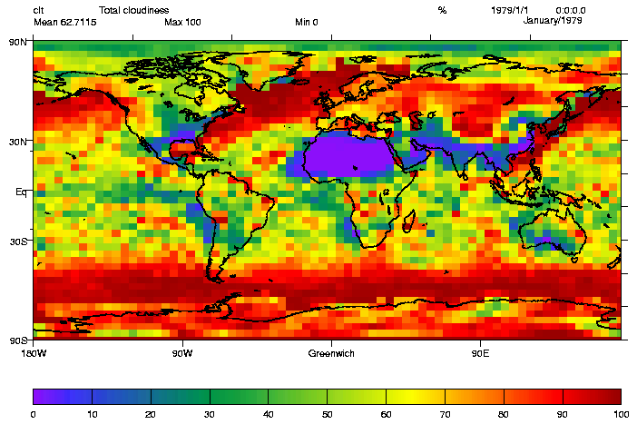
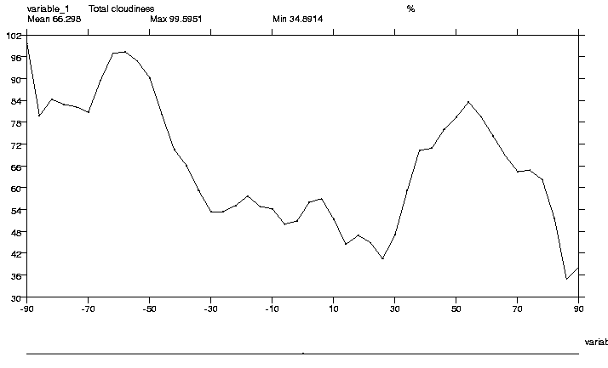
Creating simple plots with VCS
All plotting requires the VCS module and a canvas to be created:
>>> import vcs
>>> x=vcs.init()
You then use methods on the canvas object (‘x’):
>>> x.plot(data) # plots default plot for data shape
>>> x.plot(2Dfield)
>>> x.plot(1Ddata)
Note: for 3D (or 4D) data VCS will find the first 2-D field and plot that.
>>> x.plot(2Dfield)
>>> x.plot(2Dfield)

Slide 16
Saving a VCS plot
Once you have created a plot you can save it in one of various formats, examples are:
>>> x.plot(data)
>>> x.gif(“myfile.gif”) # writes a GIF file
>>> x.ps(“mypostscript.ps”) # writes a PS file

Slide 17
Opening a file for writing
To write a new CDMS file:
    >>> outfile=cdms.open(‘myfile.nc’, ‘w’)
    >>> # and to close:
    >>> outfile.close()
Note: Data may not be written to a file until you close it, so make sure you do!
Same grammar as the built-in open function! This can be a reason to not import everything from CDMS because “ from cdms import * ” will overload the built-in ‘open’ function.

Slide 18
Writing file variables and attributes
Writing CDMS variables, Numeric arrays or Masked Arrays to a CDMS file object is very easy:
  >>> outfile.write(myvar)
  >>> outfile.write(a_numeric_array)
Writing file attributes (file level metadata) corresponds to setting global attributes in a NetCDF file and is simply done by setting class attributes:
  >>> outfile.source=“Data from Galaxy 4B02”
  >>> outfile.sauce=“Ketchup”
  >>> outfile.version=“3.1”

Slide 19
Basic File I/O example
File I/O to NetCDF is simple:
import cdms
  ufile = cdms.open(‘u_wind.nc’)
  vfile = cdms.open(‘v_wind.nc’)
  u = ufile(‘u’)
  v = vfile(‘v’)
  wind_speed = (u**2 + v**2)**0.5
  outfile = cdms.open(‘wspd.nc’, ’w’)
  outfile.write(wind_speed)
  outfile.close()
← cdms.open function binds ufile to an instance of CdmsFile
← u and v are instances of the TransientVariable class.
← wind_speed is a new TransientVariable instance
← outfile is another CdmsFile instance with write permission

