Slide 1
Chapter 1:
A First Program Using C#

Slide 2
Objectives
Learn about programming
Learn about procedural and object-oriented programming
Learn about the features of object-oriented programming languages
Learn about the C# programming language
Write a C# program that produces output
Learn how to select identifiers to use within your programs

Slide 3
Objectives (cont’d.)
Improve programs by adding comments and using the System namespace
Write and compile a C# program using the command prompt and using Visual Studio

Slide 4
Programming
Computer program (also called software)
  A set of instructions that tells a computer what to do
Software comes in two broad categories
  System software – programs that operate the computer
  Application software – allows users to complete tasks
Hardware – The physical devices that make up a computer system
Machine language
  Expressed as a series of 1s and 0s
    1s represent switches that are on, and 0s represent switches that are off

Slide 5
Programming (cont’d.)
High-level programming language
  Uses reasonable keywords such as “read,” “write,” or “add” instead of the sequence of on/off switches that perform these tasks
  Allows you to assign reasonable names to areas of computer memory
  Has its own syntax (rules of the language)
Compiler
  Translates high-level language statements into machine language

Slide 6
Programming (cont’d.)
Programming logic
  Involves executing the various statements and procedures in the correct order to produce the desired results
Debugging
  The process of removing all syntax and logical errors from the program
  Syntax errors are discovered through compilation
  Logical errors are discovered through testing

Slide 7
Procedural and Object-Oriented Programming
Procedural program
  Creates and names computer memory locations that can hold values (variables) that are referenced by using a one-word name (identifier)
  Writes a series of steps or operations to manipulate those values
Procedures or methods
  Logical units that group individual operations used in a computer program
  Called or invoked by other procedures or methods
  The starting method is the Main() method

Slide 8
Procedural and Object-Oriented Programming (cont’d.)
Camel casing
  Typically used for variables
Pascal casing
  Typically used for methods

Slide 9
Procedural and Object-Oriented Programming (cont’d.)
Object-oriented programming (OOP)
  An extension of procedural programming
Objects
  Similar to concrete objects in the real world
  Contain their own attributes and behaviors
  The attributes of an object represent its characteristics
  The behaviors of an object, or methods, are the things it “does”
  The state of an object is the collective value of all its attributes at any point in time

Slide 10
Procedural and Object-Oriented Programming (cont’d.)
An object-oriented approach to programming means defining the objects needed to accomplish a task and developing classes that describe those objects
Originally used for two types of applications
  Computer simulations
  Graphical user interfaces (GUIs)

Slide 11
Features of Object-Oriented Programming Languages
Class
  A category of objects or a type of object
  Describes the attributes and behaviors of every object that is an instance, or object, of that class
Object
  An instance of a class
  Contains its own set of attribute values (also called the properties of the object)

Slide 12
Features of Object-Oriented Programming Languages (cont’d.)
Encapsulation
  A technique of packaging an object’s attributes and behaviors into a cohesive unit; an undivided entity
  Using a black box to control what behaviors are exposed to calling methods
Interface
  The interaction between a method and an object’s exposed behaviors
  Uses message-passing to request and receive information

Slide 13
Features of Object-Oriented Programming Languages (cont’d.)
Inheritance
  Provides the ability to extend a class to create a more specific class
Polymorphism
  Describes the ability to create methods that act appropriately depending on the context

Slide 14
The C# Programming Language
Developed as an object-oriented and component-oriented language
Part of Microsoft Visual Studio
Allows every piece of data to be treated as an object and to consistently employ the principles of object-oriented programming
Contains a GUI interface that makes it similar to Visual Basic

Slide 15
The C# Programming Language (cont’d.)
Modeled after the C++ programming language
  However, eliminates some of the most difficult features to understand in C++
  C# is easier to learn
Very similar to Java
  In C#, simple data types are objects
  C# is more truly object oriented
Similar to Visual Basic
  C# is more concise than VB

Slide 16
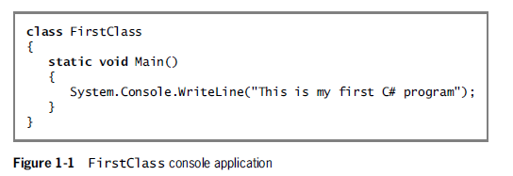
Writing a C# Program that Produces Output
class
literal string
namespace
method
argument

Slide 17
Writing a C# Program that Produces Output (cont’d.)
Namespace
  Provides a way to group similar classes
  Can be used to avoid naming conflicts in large projects
C# method parts
  Method header
    Includes the method name and information about what will pass into and be returned from a method
  Method body
    Contained within a pair of curly braces and includes all the instructions executed by the method

Slide 18
Writing a C# Program that Produces Output (cont’d.)
Whitespace
  Any combination of spaces, tabs, and carriage returns (blank lines)
  Organizes your code and makes it easier to read
Access modifier
  Defines the circumstances under which the method can be accessed
  Public, private, protected, internal

Slide 19
Writing a C# Program that Produces Output (cont’d.)
Keywords
  Predefined and reserved identifiers that have special meaning to the compiler
The name of the method is Main()
  Every application must have a Main() method
  Classes with a Main() method are called application classes; others are non-application classes
The method returns nothing as indicated by the keyword void

Slide 20
Selecting Identifiers
Requirements
  Must begin with an underscore, an at sign (@), or a letter
    Letters include foreign-alphabet letters
  Can contain only letters, digits, underscores, and the at (@) sign
    Not special characters such as #, $, or &
  Cannot be a C# reserved keyword

Slide 21
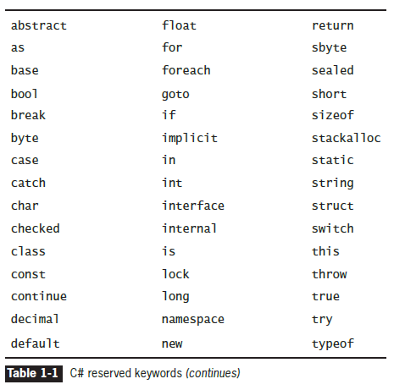
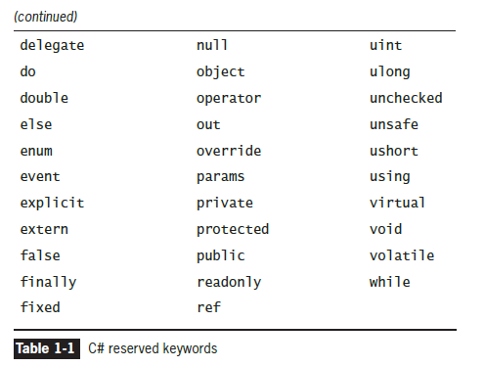
Selecting Identifiers (cont’d.)

Slide 22
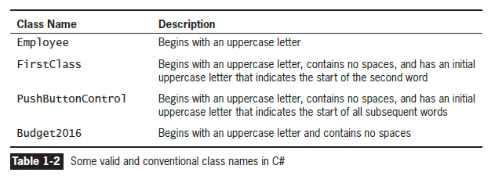
Selecting Identifiers (cont’d.)

Slide 23
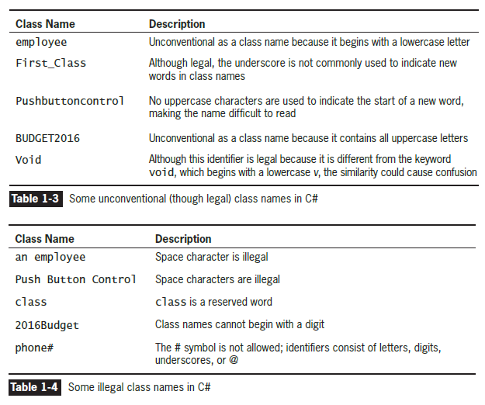
Selecting Identifiers (cont’d.)

Slide 24
Improving Programs by Adding Comments and Using the System Namespace
Adding Program comments
  Nonexecuting statements that document a program
Comment out
  Turn a statement into a comment
Types of comments in C#
  Line comments – start with //
  Block comments – start with /* and end with */
  XML-documentation format comments

Slide 25
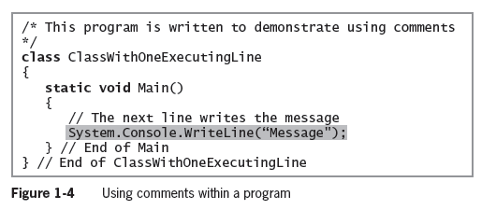
Improving Programs by Adding Comments and Using the System Namespace (cont’d.)

Slide 26
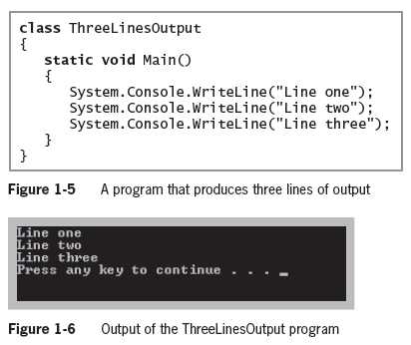
Using the System Namespace

Slide 27
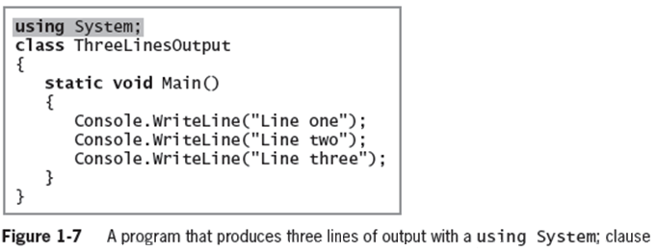
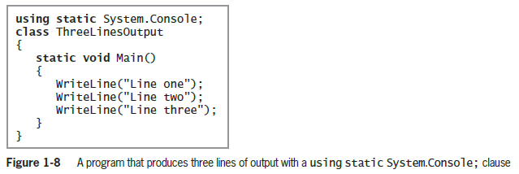
Using the System Namespace (cont’d.)

Slide 28
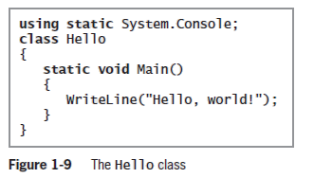
You Do It
Entering a Program into an Editor
Use any text editor to write the following code and save it as Hello.cs

Slide 29
Compiling and Executing a C# Program
Steps for viewing a program’s output
  Compile source code into intermediate language (IL)
  The C# just in time (JIT) compiler translates the intermediate code into executable statements
You can use either of two ways to compile
  The command line
  The Integrated Development Environment (IDE)

Slide 30
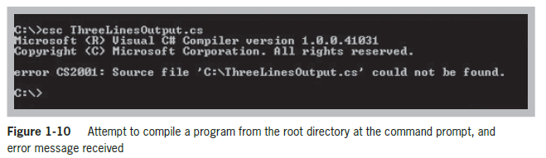
Compiling Code from the Command Prompt
Example of an operating system error message
  Command csc stands for “C Sharp compiler”

Slide 31
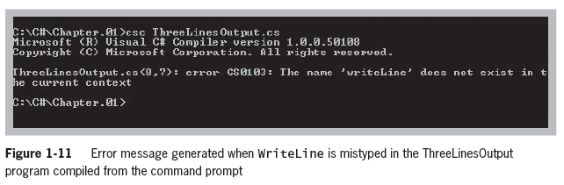
Compiling Code from the Command Prompt (cont’d.)
Example of a command line generated error message
  Program error messages start with the program name followed by the line number and position within the line of the error

Slide 32
Compiling Code Using the Visual Studio IDE
Advantages of using the Visual Studio IDE
  Some of the code you need is already created for you— auto-complete
  The code is displayed in color
  Some syntax errors are caught as you type
  You can double-click an error message and the cursor will move to the line of code that contains the error
  Other debugging tools are available

Slide 33
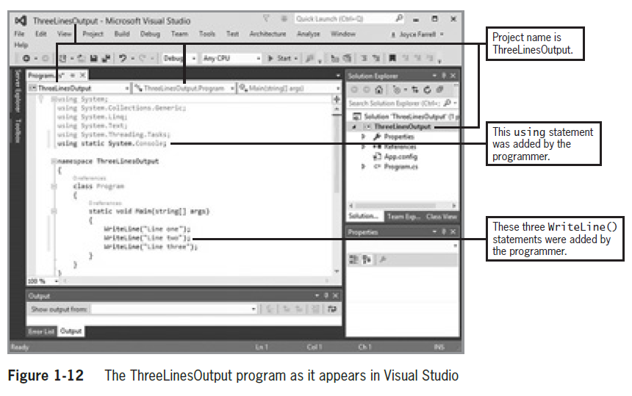
Compiling Code Using the Visual Studio IDE (cont’d.)

Slide 34
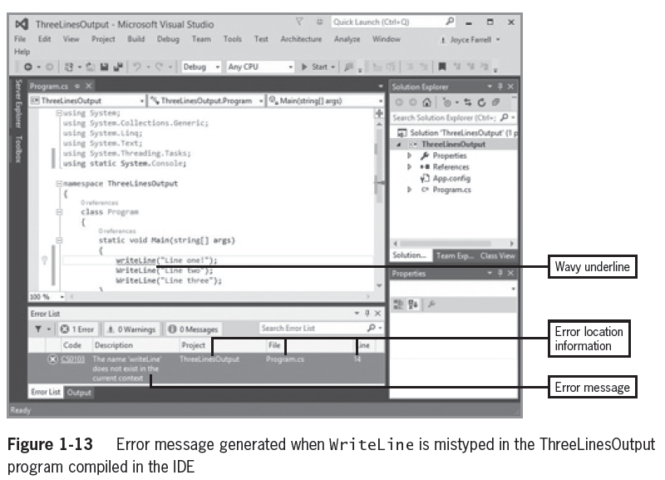
Compiling Code Using the Visual Studio IDE (cont’d.)

Slide 35
Noticing the Differences Between the Programs in the Text Editor and the IDE
Five using statements at the top of the file
A namespace declaration and its opening and closing curly braces
A class named Program
The words string[] args between the parentheses of the Main() method header

Slide 36
Deciding Which Environment to Use
Advantage of using the command line
  Saves disk space
Advantages of using the Visual Studio IDE
  Automatic sentence completion
  Words are displayed using different colors based on their category
  The code automatically generated by the IDE is very helpful when writing a GUI

Slide 37
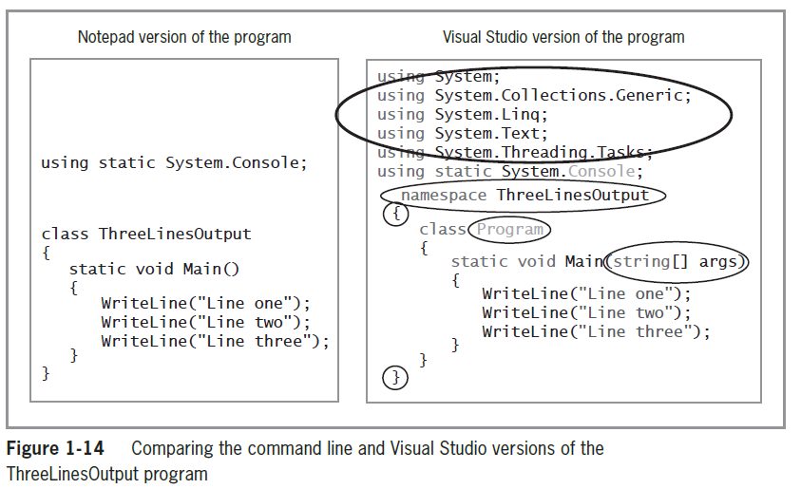
Deciding Which Environment to Use (cont’d.)

Slide 38
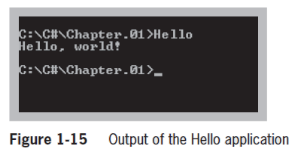
You Do It
Compiling and Executing a Program from the Command Line
Go to the command Prompt on your system
Change to the C# directory
Type the csc Hello.cs command to compile
Type the Dir command
to view the directory
Type Hello and press
Enter to run the
program

Slide 39
You Do It (cont’d.)
Compiling and Executing a Program Using the Visual Studio IDE
Steps
  Create a new project (console application)
  Enter the project name
  Write your program using the editor
  To compile the program, click Build on the menu bar, and then click Build Solution
    As an alternative, you can press F6
  Click Debug on the menu bar and then click Start Without Debugging

Slide 40
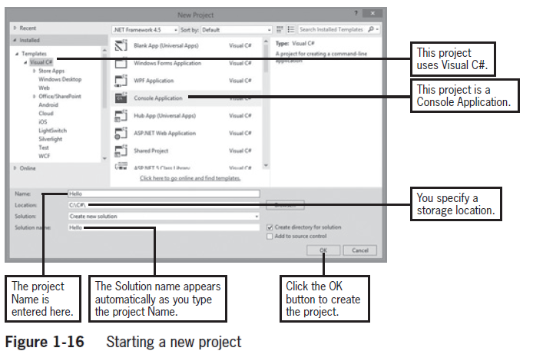
You Do It (cont’d.)

Slide 41
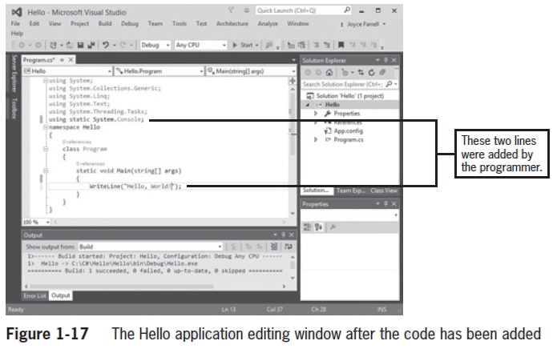
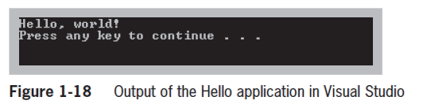
You Do It (cont’d.)

Slide 42
You Do It (cont’d.)
Adding Comments to a Program
Line comment example
  // Filename Hello.cs
  // Written by <your name>
  // Written on <today’s date>
Block comment example
  /* This program demonstrates the use of
  the WriteLine() method to display the
  message Hello, world! */

Slide 43
Summary
A computer program is a set of instructions that tell a computer what to do
Understand the differences between procedural programming and object-oriented programming
Objects are instances of classes and are made up of attributes and methods
The C# programming language is an object-oriented and component-oriented language
The System.Console.WriteLine() method produces a line of console output

Slide 44
Summary (cont’d.)
You can define a C# class or variable by using any name or identifier
Comments are nonexecuting statements that you add to document a program
  Or to disable statements when you test a program
Use namespaces to improve programs
To create a C# program, you can use the Microsoft Visual Studio environment

