Slide 1
Chapter 2:
Using Data

Slide 2
Objectives
Learn about declaring variables
Display variable values
Learn about the integral data types
Learn about floating-point data types
Use arithmetic operators

Slide 3
Objectives (cont’d.)
Learn about the bool data type
Learn about numeric type conversion
Learn about the char data type
Learn about the string data type
Define named constants and enumerations
Accept console input

Slide 4
Declaring Variables
Constant
  Cannot be changed after a program is compiled
Literal constant
  Its value is taken literally at each use
Variable
  A named location in computer memory that can hold different values at different points in time
Data type
  Describes the format and size of (amount of memory occupied by) a data item

Slide 5
Declaring Variables (cont’d.)
Intrinsic Types (list appears on next slide)
  Built-in Date Types
  Alias names for a class in the System namespace
  All of the built-in types except object and string are called simple types
Unicode is the system that provides a numeric value for every character.

Slide 6
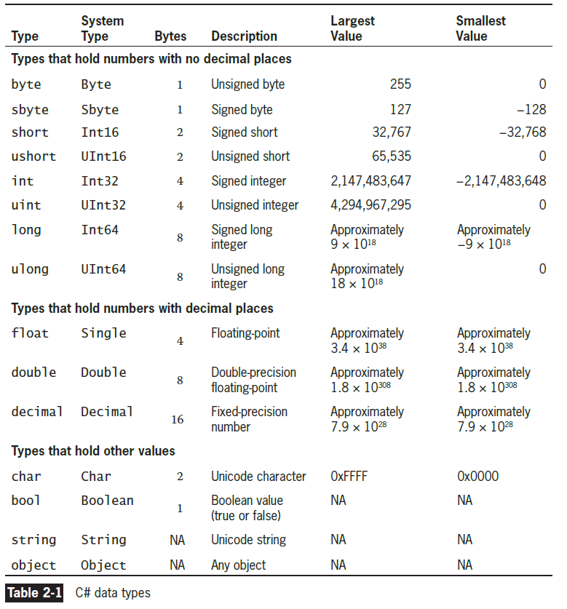

Slide 7
Declaring Variables (cont’d.)
Variable declaration
  A statement that names a variable and reserves storage
  Example: int myAge = 25;
  You can declare multiple variables of the same type in separate statements on different lines – or You can declare two variables of the same type in a single statement by using the type once and separating the variable declarations with a comma

Slide 8
Declaring Variables (cont’d.)
The equal sign (=) is the assignment operator
  Any value to the right of the assignment operator is assigned to the identifier to the left
  An assignment made when a variable is declared is an initialization
  An assignment made later is simply an assignment

Slide 9
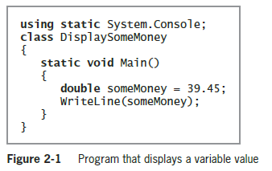
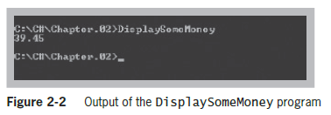
Displaying Variable Values

Slide 10
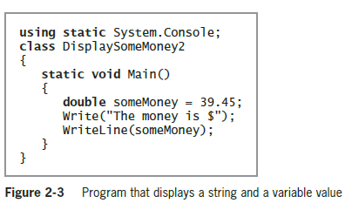
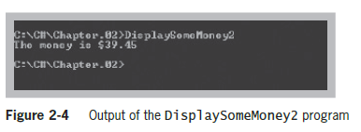
Displaying Variable Values (cont’d.)

Slide 11
Displaying Variable Values (cont’d.)
Format string
  A string of characters that optionally contains fixed text
  Contains one or more format items or placeholders for variable values
Placeholder
  Consists of a pair of curly braces containing a number that indicates the desired variable’s position in a list that follows the string

Slide 12
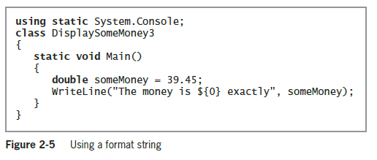
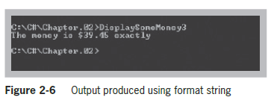
Displaying Variable Values (cont’d.)

Slide 13
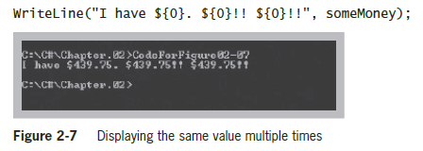
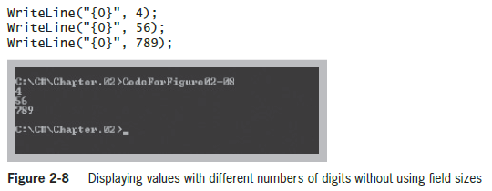
Displaying Variable Values (cont’d.)

Slide 14
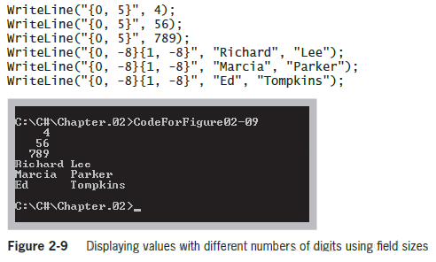
Displaying Variable Values (cont’d.)

Slide 15
Using the Integral Data Types
Integral data types
  Types that store whole numbers
  byte, sbyte, short, ushort, int, uint, long, ulong, and char
Variables of type int
  Store (or hold) integers, or whole numbers
Shorter integer types
  byte, sbyte (which stands for signed byte), short (short int), or ushort (unsigned short int)

Slide 16
Using Floating-Point Data Types
Floating-point number
  Contains decimal positions
  A value’s number of significant digits specifies the mathematical accuracy of the value
Floating-point data types
  float
    Can hold up to 7 significant digits of accuracy
  double
    Can hold 15 or 16 significant digits of accuracy
  decimal
    Can hold 29 significant digits but a smaller range
    Suitable for financial and monetary calculations

Slide 17
Using Floating-Point Data Types (cont’d.)
Float
  can hold as many as seven significant digits of accuracy
  Put an F after a number to make it a float
Double
  can hold 15 or 16 significant digits of accuracy
  Put a D after it to make it a double (default)
Decimal
  Put an M after it to make it a decimal
Scientific notation
  Includes an E (for exponent)

Slide 18
Formatting Floating-Point Values
C# displays floating-point numbers in the most concise way it can while maintaining the correct value
Standard numeric format strings
  Strings of characters expressed within double quotation marks that indicate a format for output
  Take the form X0
    X is the format specifier; 0 is the precision specifier
Format specifiers
  Define the most commonly used numeric format types

Slide 19
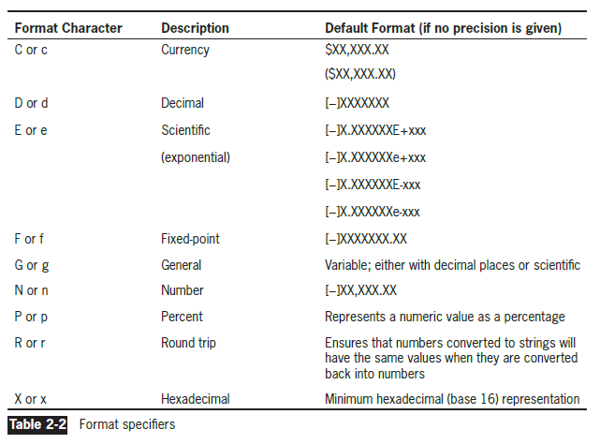
Formatting Floating-Point Values (cont’d.)

Slide 20
Using Arithmetic Operators
Binary operators
  Use two values (operands)
Operator precedence
  Rules that determine the order in which parts of a mathematical expression are evaluated
  Multiplication, division, and remainder (modulus) always take place prior to addition or subtraction in an expression
  You can override normal operator precedence with parentheses
  Expressions are evaluated left to right

Slide 21
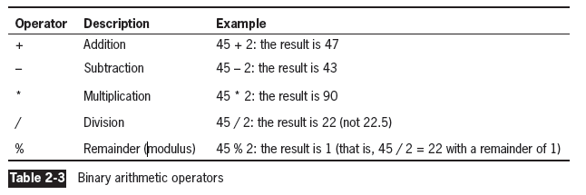
Using Arithmetic Operators (cont’d.)

Slide 22
Using Shortcut Arithmetic Operators
Add and assign operator
  Example: bankBal += bankBal * interestRate;
  Variations: –=, *=, /=, and %=
Prefix increment operator
  Example: ++someValue;
Postfix increment operator
  Example: someValue++;

Slide 23
Using Shortcut Arithmetic Operators (cont’d.)
Unary operator
  Uses only one value (e.g., –123)
Decrement operator (--)
  Can be prefix or postfix
23

Slide 24
Using the bool Data Type
Boolean variable
  Can hold only one of two values—true or false
  Declare a Boolean variable with type bool
Comparison operator
  Compares two items
  An expression containing a comparison operator returns a Boolean value

Slide 25
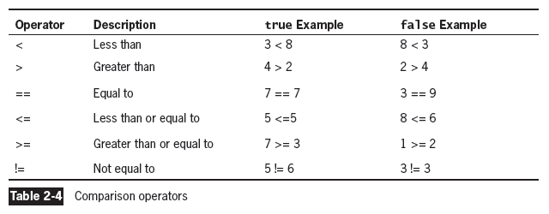
Using the bool Data Type (cont’d.)

Slide 26
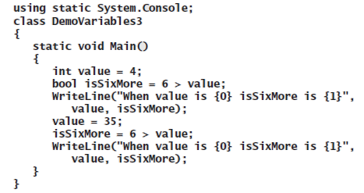
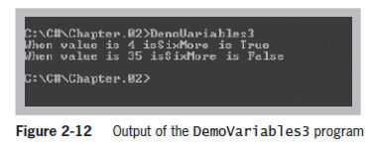
Using the bool Data Type (cont’d.)

Slide 27
Understanding Numeric Type Conversion
Arithmetic with variables or constants of the same type
  Result retains the same type
Arithmetic with operands of dissimilar types
  C# chooses a unifying type for the result
  Implicitly (or automatically) converts nonconforming operands to the unifying type
    Type with the higher type precedence
    Called an implicit conversion or an implicit cast—the automatic transformation that occurs when a value is assigned to a type with higher precedence.

Slide 28

Understanding Numeric Type Conversion (cont’d.)
Implicit cast
  Automatic transformation that occurs when a value is assigned to a type with higher precedence
  Example: aDouble = anInt;
Explicit cast
  Placing the desired result type in parentheses followed by the variable or constant to be cast
  Example: anInt = (int)aDouble;

Slide 29
Using the char Data Type
char data type
  Holds any single character
  Place constant character values within single quotation marks (e.g., 'A')
  char aCharValue = ‘9’ cannot be used in arithmetic statements – the 9 is text, not a number
Escape sequence
  Stores a pair of characters
  Begins with a backslash
  A pair of symbols represents a single character

Slide 30
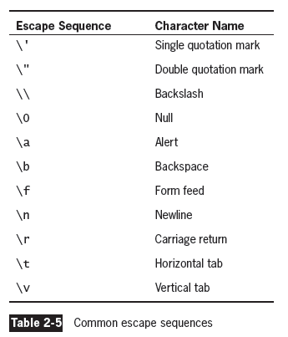
Using the char Data Type (cont’d.)

Slide 31
Using the char Data Type (cont’d.)
Characters used in C# are represented in Unicode, which is a 16-bit coding scheme for characters
  For example, the letter A actually is stored in computer memory as a set of 16 zeros and ones—namely, 0000 0000 0100 0001
  16-bit numbers are difficult to read so programmers often use a shorthand notation called hexadecimal, or base 16. In hexadecimal shorthand, 0000 becomes 0
  0100 becomes 4, and 0001 becomes 1. Thus, the letter A is represented in hexadecimal as 0041
              char letter = 'A';
              char letter = '\u0041';

Slide 32
Using the string Data Type
string data type
  Holds a series of characters
Values are expressed within double quotation marks
Comparing strings
  Use == and !=
  Use the Equals() method, Compare() method, and CompareTo() method
A string is considered equal to, greater than, or less than another string lexically, which in the case of letter values means alphabetically

Slide 33
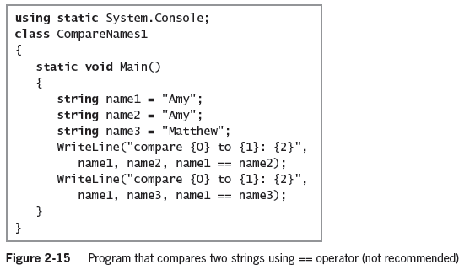
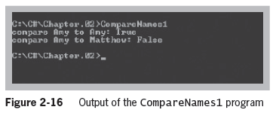
Using the string Data Type (cont’d.)

Slide 34
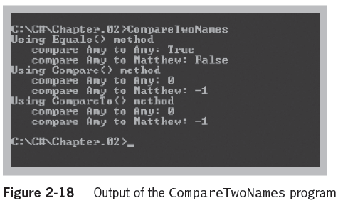
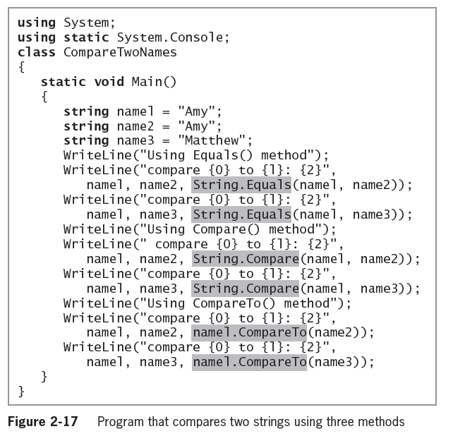

Slide 35
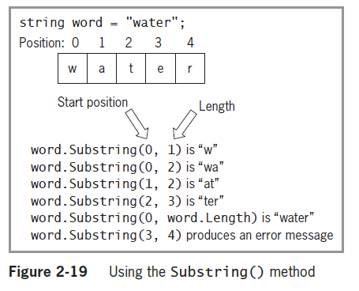
Using the string Data Type (cont’d.)
Use the Substring() method to extract a portion of a string from a starting point for a specific length

Slide 36
Defining Named Constants
Named constant
  Often simply called a constant
  An identifier whose contents cannot change
  Created using the keyword const
Programmers usually name constants using all uppercase letters, inserting underscores for readability
Self-documenting statement
  Easy to understand even without program comments

Slide 37
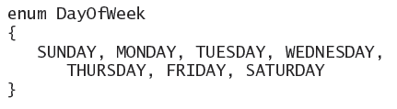
Working with Enumerations
An enumeration is a set of constants represented by identifiers
  Enumeration example named DayOfWeek:
By default, enumeration values are integer
  Can specify otherwise by including a colon and a type name after the enumeration name

Slide 38
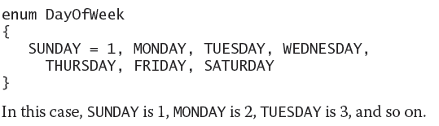
Working with Enumerations (cont’d.)
Often meant to hold consecutive values
  When you don’t supply values, they start at 0 and increment by 1
  Programmers say using enums makes the values type-safe. Type-safe describes a data type for which only appropriate behaviors are allowed

Slide 39
Accepting Console Input
Interactive program
  A program that allows user input
ReadLine() method
  Accepts all of the characters entered by a user input from the keyboard until the user presses Enter
  Characters can be assigned to a string
  Must use a conversion method to convert the input string to the proper type

Slide 40
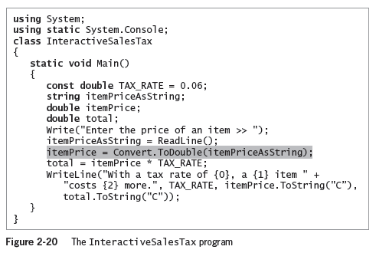
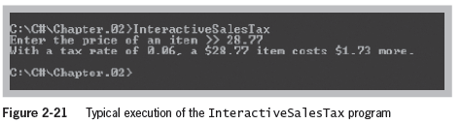
Accepting Console Input (cont’d.)

Slide 41
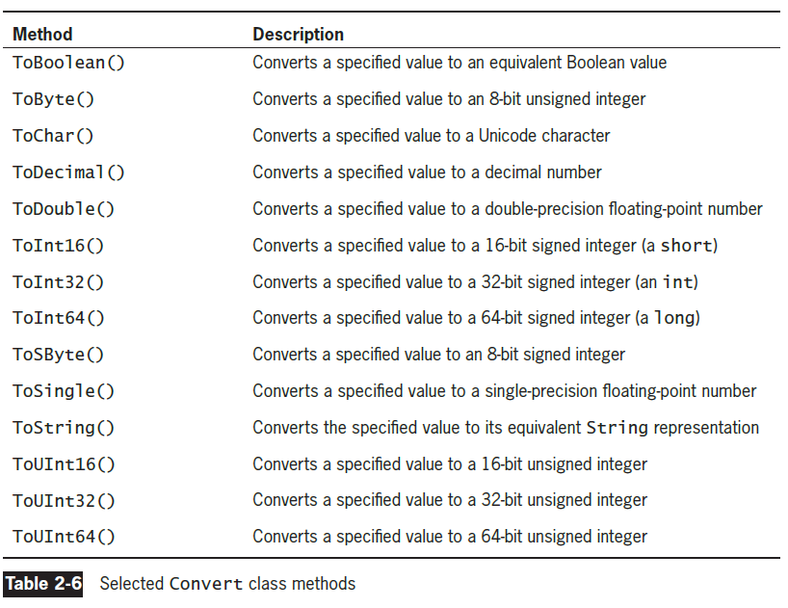

Slide 42
Using the Parse() Methods
Parse() method
  An alternative to the Convert class methods to convert a string to a number
  Parse means to break into component parts
  Parsing a string turns it into its numeric equivalent

Slide 43
Summary
Variables and constants use data types to hold information
A constant cannot be changed after compilation
Display variable values with Write() or WriteLine()
Nine integral data types: byte, sbyte, short, ushort, int, uint, long, ulong, and char
Three floating-point data types: float, double, and decimal
Use the binary arithmetic operators +, –, *, /, and % to manipulate values in your programs

Slide 44
Summary (cont’d.)
Shortcut arithmetic operators
A bool variable can be true or false
Implicit cast versus explicit cast
The char data type holds any single character
The string data type holds a series of characters
Named constants are program identifiers whose values cannot change
The ReadLine() method accepts user input

