Slide 1
Chapter 3:
Using GUI Objects and the Visual Studio IDE

Slide 2
Objectives
Create a Form in the Visual Studio IDE
Use the Toolbox to add a Button to a Form
Add Labels and TextBoxes to a Form
Name Forms and controls
Correct errors
Decide which interface to use

Slide 3
Creating a Form in the IDE
The interface is the environment the user sees
Forms are rectangular graphical user interface (GUI) objects that provide an interface for collecting, displaying, and delivering information
To create a Form:
  Select New Project after starting Visual Studio
  Then choose Windows Forms Application
  After you click OK in the New Project window, you see the IDE main window

Slide 4
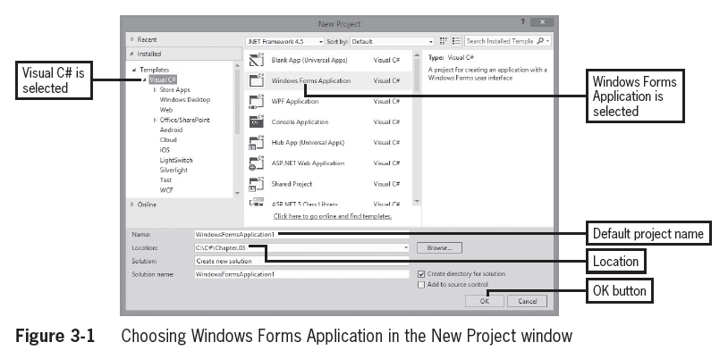
Creating a Form in the IDE (cont’d.)

Slide 5
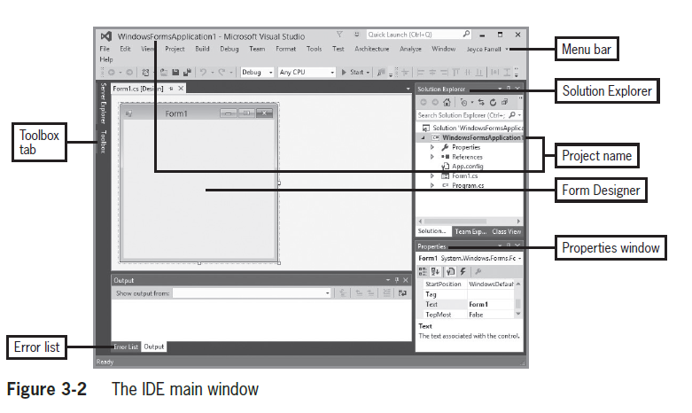
Creating a Form in the IDE (cont’d.)

Slide 6
Creating a Form in the IDE (cont’d.)
The name of the application shows in three places: the title bar, the Solution Explorer, and the Properties window
The main menu lies horizontally across the top
The Toolbox tab provides a list of controls you can drag onto a Form
The Form Designer appears in the center of the screen
The Solution Explorer allows viewing and management of project files and settings

Slide 7
Creating a Form in the IDE (cont’d.)
The Properties window is for configuring properties and events on controls in your user interface
The Error list displays messages about compiler errors in your code

Slide 8
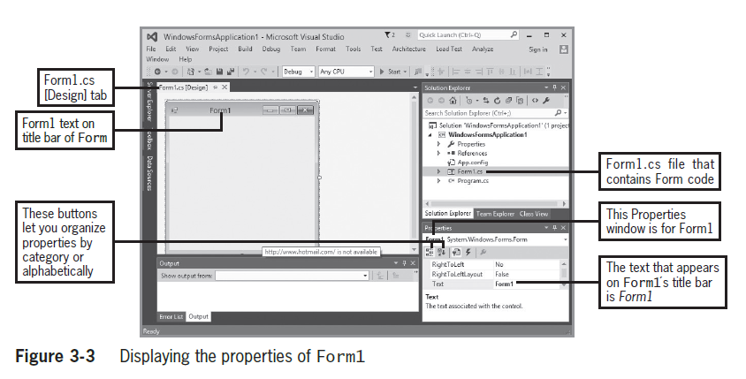
Creating a Form in the IDE (cont’d.)

Slide 9
Creating a Form in the IDE (cont’d.)
In the Properties window, you can change the appearance, size, and color of a window
The Form class contains around 100 properties
Property names appear in alphabetical order in groups (except for Name)

Slide 10
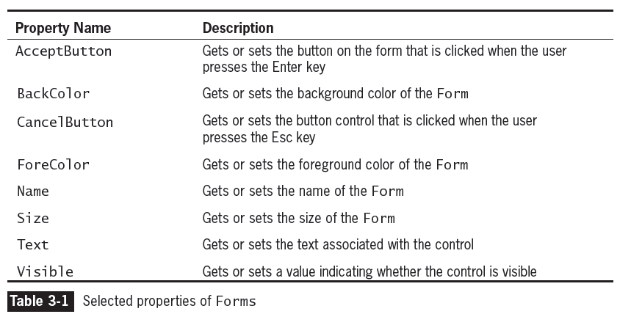
Creating a Form in the IDE (cont’d.)

Slide 11
Creating a Form in the IDE (cont’d.)
The Program.cs file contains the automatically generated Main() method of the application
Form1.cs contains other automatically generated code
  The code describes what tasks you will assign to the controls in your application
When you create a Windows Form project, Visual C# adds a Form to the project and calls it Form1

Slide 12
Using the Toolbox to Add a Button to a Form
When you open the IDE, the left border displays a Toolbox tab
  Open the toolbox, and a list of tool groups is displayed
  The tool groups include the controls you have seen when using a Windows application
You can drag controls (such as a Button) onto a Form
You can relocate a control by dragging it, or delete it by selecting it and pressing the Del key

Slide 13
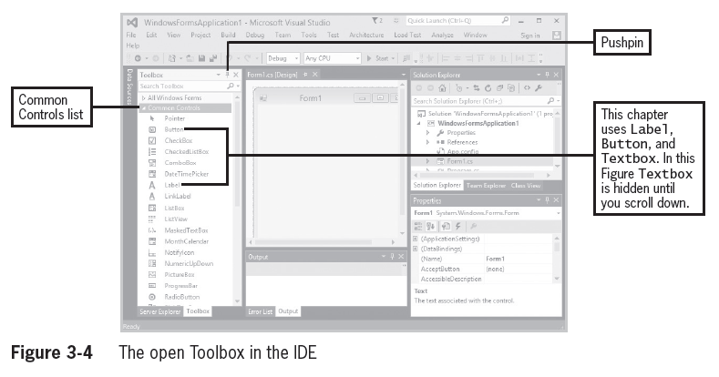
Using the Toolbox to Add a Button to a Form (cont’d.)

Slide 14
Using the Toolbox to Add a Button to a Form (cont’d.)
A Button is a clickable object that allows a user to interact with a GUI program
By default, the first button dragged onto the Form is named button1
  You should probably change the name to something meaningful
When you click on a control, the Properties window shows its properties

Slide 15
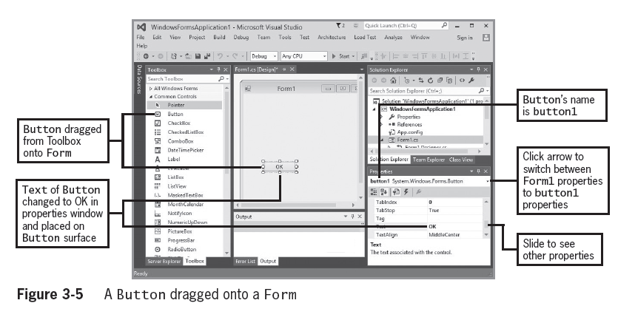
Using the Toolbox to Add a Button to a Form (cont’d.)

Slide 16
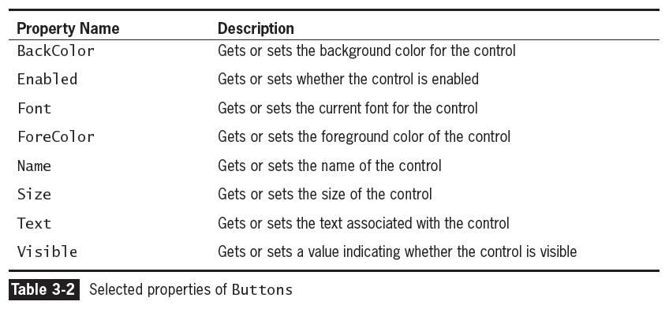
Using the Toolbox to Add a Button to a Form (cont’d.)

Slide 17
Adding Functionality to a Button on a Form
Adding functionality to a Button is easy with the IDE
  After dragging the Button onto a Form, you double-click on it to create a method that executes when the user clicks the Button
You can view the designer by selecting View and then Designer from the menu bar
You can view the code by selecting View and then Code from the menu bar

Slide 18
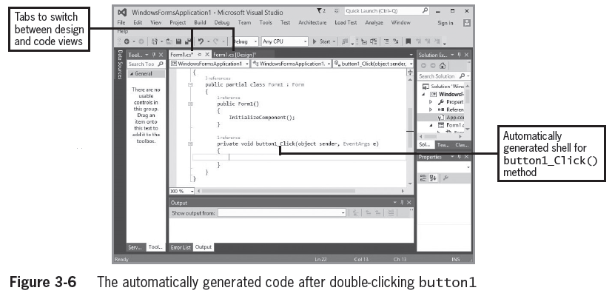
Adding Functionality to a Button on a Form (cont’d.)

Slide 19
Adding Functionality to a Button on a Form (cont’d.)
You will see many generated statements—some confusing, most of which you can ignore
Write code between the curly braces of the button1_Click() method
If you change the Name property of the button1 object, a subsequently created Click() method will have the same name
You can write anything you want in the Click() methods

Slide 20
Adding Functionality to a Button on a Form (cont’d.)
Events are generated to cause the program to perform a task when a user interacts with a GUI Object
The Click Event occurs when a user clicks on an object like a button

Slide 21
Adding Labels and TextBoxes to a Form
Labels are controls that you use to display text to communicate with an application’s user
You can drag a Label onto a Form, just like a Button
You can change its Text property to display any text you like
  Depending on the amount of text, you may need to resize the label
In Figure 3-7, “Enter a number” has been assigned to label1’s Text property

Slide 22
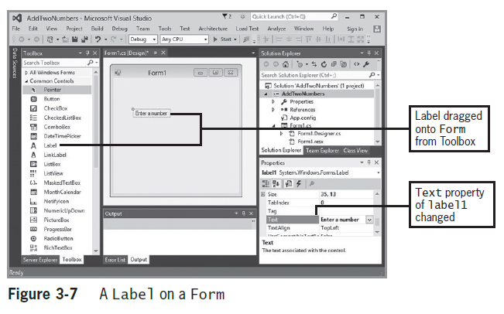
Adding Labels and TextBoxes to a Form (cont’d.)

Slide 23
Adding Labels and TextBoxes to a Form (cont’d.)
TextBoxes are controls through which a user can enter input data in a GUI application
If a user is supposed to enter data in a TextBox, you frequently want to start with its Text property empty
When a user types a value into a TextBox, it becomes the value of the Text property
  It is a string by default
  If the user is supposed to enter a number, you’ll have to convert it, just as in a console application

Slide 24
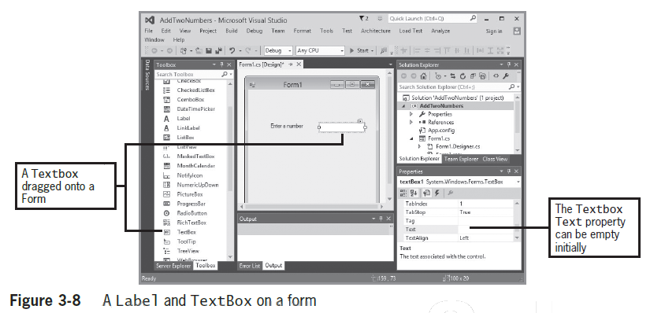
Adding Labels and TextBoxes to a Form (cont’d.)

Slide 25
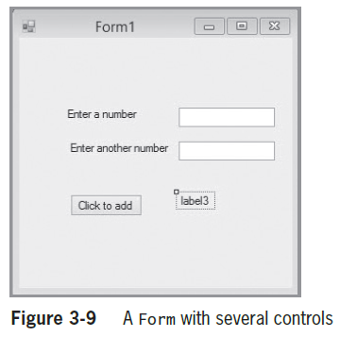
Adding Labels and TextBoxes to a Form (cont’d.)
The form shown here is meant to have the user enter two numbers in the TextBoxes
When the user clicks
the Button, the sum
of the two numbers will
be displayed in label3
You must create the code
to do the addition
  It goes in the
  button1_Click()
  method

Slide 26
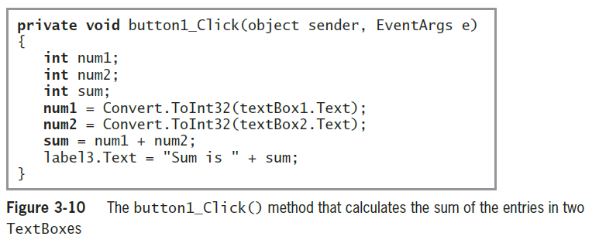
Adding Labels and TextBoxes to a Form (cont’d.)

Slide 27
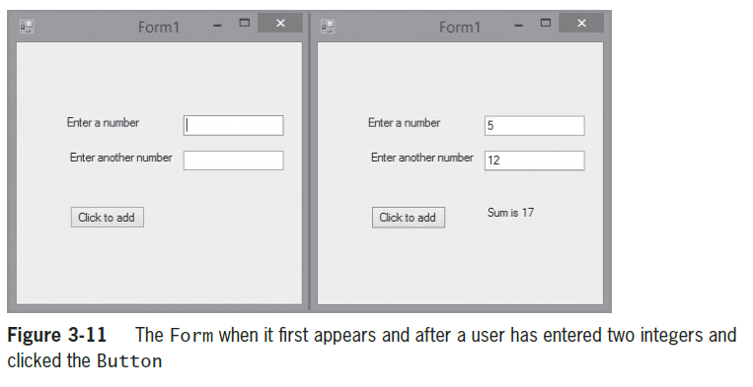
Adding Labels and TextBoxes to a Form (cont’d.)
To execute a program from the IDE, select Debug, and then Start Without Debugging (or press CTRL + F5
The period during which you design a program is called design time
When you execute
a program, the
stage is called
runtime

Slide 28
Understanding Focus and Tab Control
Focus defines which control is active and will accept keyboard input
  A Button that has focus will have a bright line around it
  A TextBox that has focus will have the cursor inside it
A control can be given focus by:
  The user clicking on the control
  The user pressing the Tab key, which will set the focus on the next control as defined by the tab order

Slide 29
Understanding Focus and Tab Control (cont’d.)
Tab order is represented by a sequential number known as the TabIndex
  TabIndexes begin with 0
The default tab order is determined by the order in which the controls are added to the form
Unless otherwise specified, the first control to receive focus will have TabIndex 0

Slide 30
Formatting Data in GUI Applications
You can use the same format strings as described in Chapter 2 to format strings in GUI applications
Use the String.Format() method to do this

Slide 31
Changing a Label’s Font
Every control that can contain text has a Font property
Most fonts are proportional fonts, which means that different characters have different pitches or widths.
  For example, in Microsoft Sans Serif, a w is wider than an i
The opposite of a proportional font is a fixed-pitch font, or a monospaced font, in which each character has the same width
  Courier is an example of a monospaced font

Slide 32
Naming Forms and Controls
Provide reasonable Name property values for all the controls you place on a Form
  Conventionally, start control names with a lowercase letter and use camel casing
  Start Form names with an uppercase letter and use Pascal casing
    A Form is a class, and C# class names conventionally start with an uppercase letter
  Use the type of object in the name
To rename a control after you have generated code for it, use the code refactoring feature

Slide 33
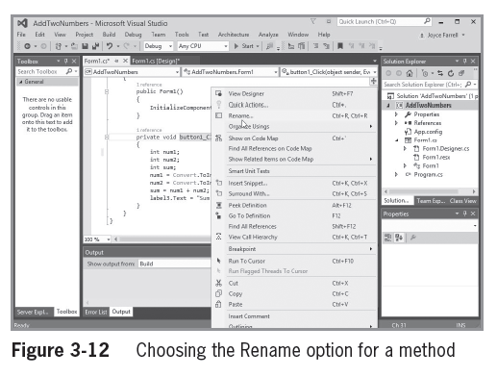
Naming Forms and Controls (cont’d.)

Slide 34
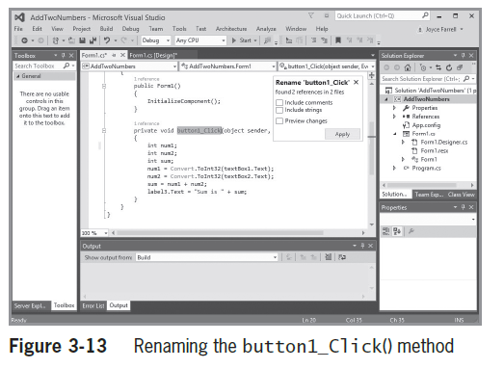
Naming Forms and Controls (cont’d.)
When you click Rename, a dialog box opens
  Type the new method name
A Preview Changes
dialog box will
highlight the
change
  Confirm the change
  by clicking Apply

Slide 35
Correcting Errors
As in console-based programs, you will often generate syntax errors
If you build or run a program with an error, you will see “Build failed” in the lower-left corner of the IDE
You will also see an error dialog box
  Always click No in response to “Would you like to continue and run the last successful build?”
Errors will be listed in the error list at the lower-left corner of the screen
Double-clicking an error message will take you to the location in the code where the error was found

Slide 36
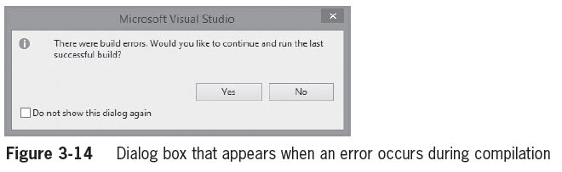
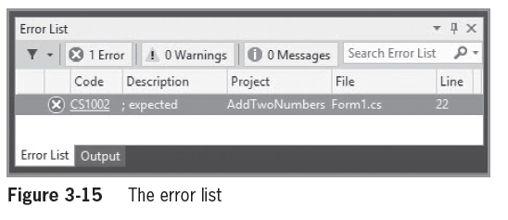
Correcting Errors (cont’d.)

Slide 37
Deleting an Unwanted Event-Handling Method
When you are working in the Form Designer, it is easy to inadvertently double-click a control and create an event-handling method you don’t want
  You can leave the event-handling method empty, but that’s considered bad form
  You cannot just delete the method because, behind the scenes, other code will have been created that refers to the method
  Instead, go to the Properties window of the control, and then click on its Events button, select the button you want to eliminate, and delete the method name

Slide 38
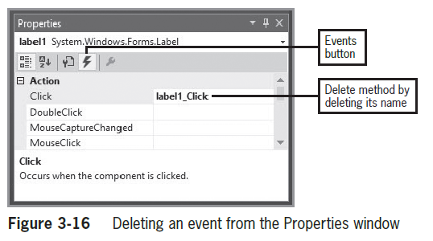
Deleting an Unwanted Event-Handling Method (cont’d.)

Slide 39
Deciding Which Interface to Use
You have learned to create:
  Console applications
  GUI applications
Both types contain basic building blocks
GUI applications:
  Look “snazzier” and are easy to use
  Take longer to develop
Console applications:
  Are simpler
  May be better when learning new logical constructs

Slide 40
Summary
Forms are GUI objects that provide an interface for collecting, displaying, and delivering information
The Toolbox displays a list of available controls you can add to a Form
  This list includes Button, CheckBox, and Label
Labels are controls that you use to display text to communicate with an application’s user
Provide reasonable Name property values for all the controls you place on a Form

Slide 41
Summary (cont’d.)
If you build or run a program that contains a syntax error, you see “Build failed” in the lower-left corner of the IDE and an error dialog box
Both console and GUI applications can contain variables and constants, decisions, loops, arrays, and calls to other methods
  GUI applications:
    Look “snazzier”
    Contain controls that a user can manipulate with a mouse
    Usually take longer to develop

