Slide 1
Chapter 4:
Making Decisions

Slide 2
Objectives
Understand logic-planning tools and decision making
Learn how to make decisions using if statements
Learn how to make decisions using if-else statements
Use compound expressions in if statements
Make decisions using switch statements

Slide 3
Objectives (cont’d.)
Use the conditional operator
Use the NOT operator
Learn to avoid common errors when making decisions
Learn about decision-making issues in GUI programs

Slide 4
Understanding Logic-Planning Tools and Decision Making
Pseudocode
  A tool that helps programmers plan a program’s logic by writing plain English statements
Flowchart
  You write the steps in diagram form as a series of shapes connected by arrows or flowlines
Sequence structure
  One step follows another unconditionally and sequentially
  Sometimes, logical steps do not follow in an unconditional sequence

Slide 5
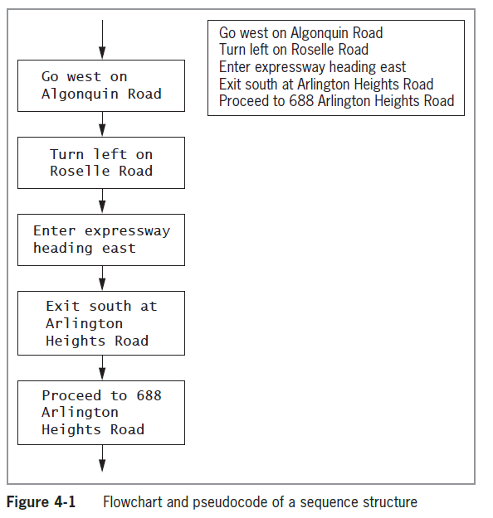
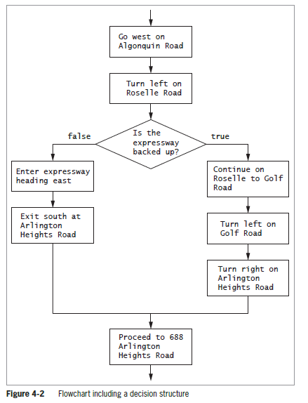
Understanding Logic-Planning Tools and Decision Making (cont’d.)

Slide 6
Understanding Logic-Planning Tools and Decision Making (cont’d.)
Decision structure
  Involves choosing between alternative courses of action based on some value within a program
  All computer decisions are yes-or-no decisions when reduced to their most basic form

Slide 7
Making Decisions Using the if Statement
if statement
  Used to make a single-alternative decision
  Used to determine whether an action will occur
Block
  One or more statements contained within a pair of curly braces { }
The if expression that precedes the block is the control statement for the decision structure

Slide 8
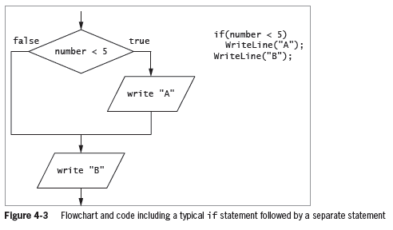
Making Decisions Using the if Statement (cont’d.)

Slide 9
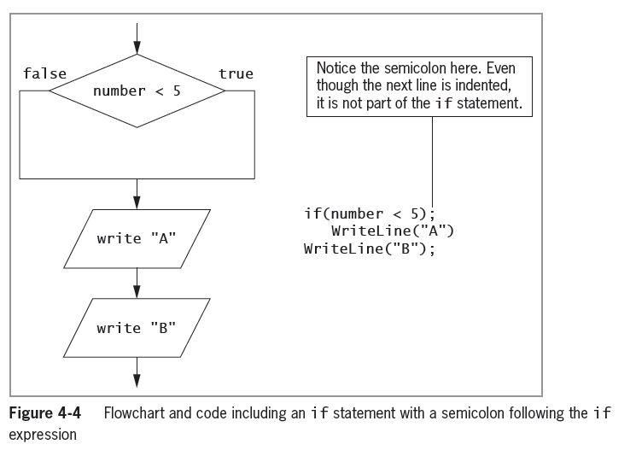
Making Decisions Using the if Statement (cont’d.)

Slide 10
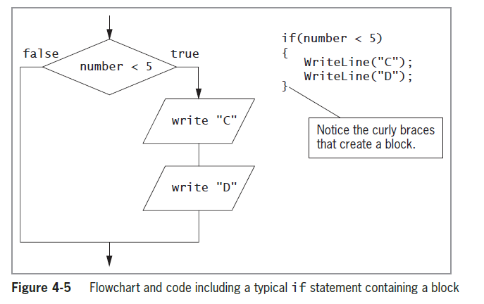
Making Decisions Using the if Statement (cont’d.)

Slide 11
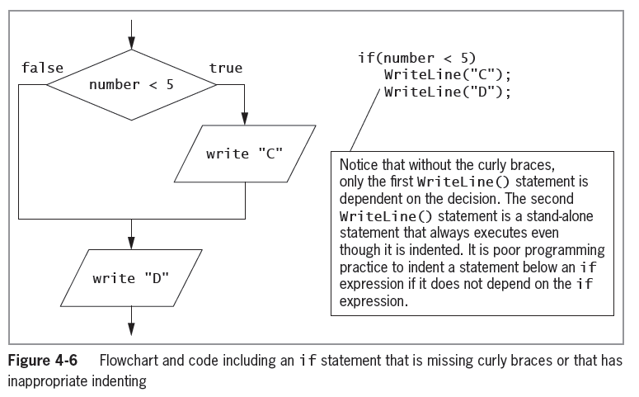
Making Decisions Using the if Statement (cont’d.)

Slide 12
Making Decisions Using the if Statement (cont’d.)
Nested if
  One decision structure, or if statement, is contained within another
  Decision structures can be nested to multiple levels
  If an outer level if statement fails or returns a false result, all inner blocks of code are ignored
  Creating too many levels can result in code that is difficult to understand and maintain

Slide 13
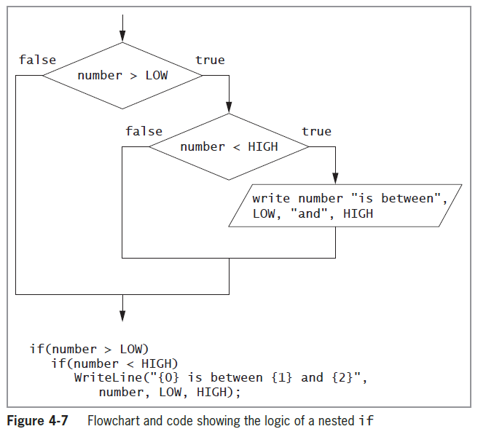
Making Decisions Using the if Statement (cont’d.)

Slide 14
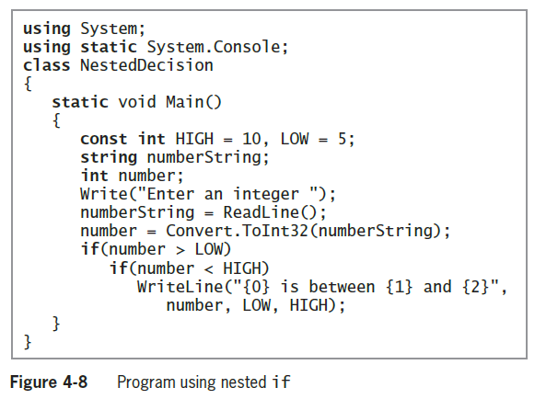
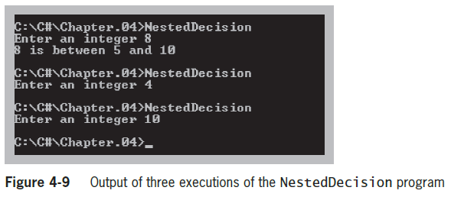
Making Decisions Using the if Statement (cont’d.)

Slide 15
A Note on Equivalency Comparisons
Single equal sign
  Used to Assign a value to a variable
    Number = High
      Does NOT compare Number to High
      It tries to assign the value of High to Number
    if(number = HIGH)
      Illegal assignment … Generates an error
Double Equal Sign
  Used to test for equality
    Correct: if(doesEmployeeHaveDependents == numDependents > 0)...
    Incorrect: if(doesEmployeeHaveDependents = numDependents > 0)...

Slide 16
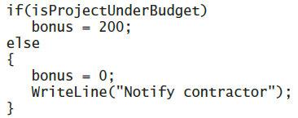
Making Decisions Using the if-else Statement
Dual-alternative decisions
  Have two possible resulting actions
if-else statement
  Used to perform one action when a Boolean expression evaluates as true, and an alternate action when it evaluates as false
  Example:

Slide 17
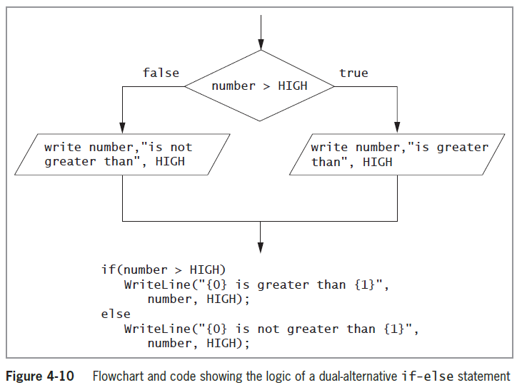
Making Decisions Using the if-else Statement (cont’d.)

Slide 18
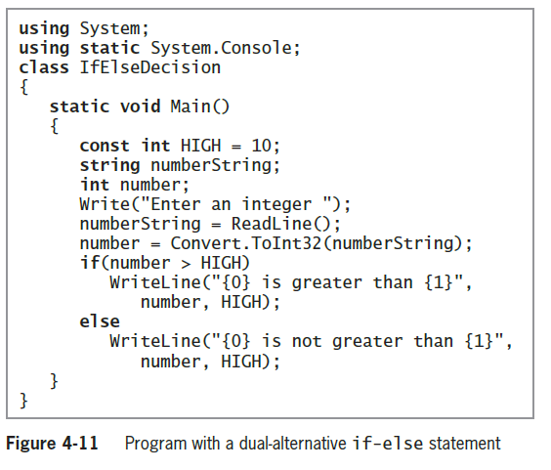
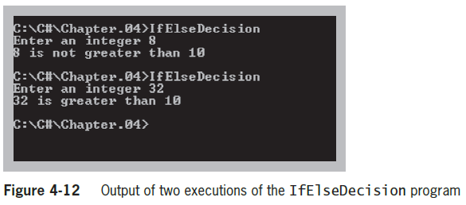
Making Decisions Using the if-else Statement (cont’d.)

Slide 19
Using Compound Expressions in if Statements
You can combine multiple decisions into a single if statement
  Use a combination of AND and OR operators
  For convenience and clarity:
    Combine multiple decisions into a single, compound Boolean expression using a combination of conditional AND and OR operators

Slide 20
Using the Conditional AND Operator
Conditional AND operator
  Determines whether two expressions are both true
  Uses two ampersands (&&) and ust include a complete Boolean expression on each side of the operator
Truth tables are diagrams used in mathematics and logic to help describe the truth of an entire expression based on the truth of its parts
Short-circuit evaluation
  Expressions in each part of an AND expression are evaluated only as much as necessary to determine whether the entire expression is true or false

Slide 21
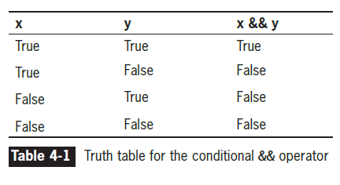
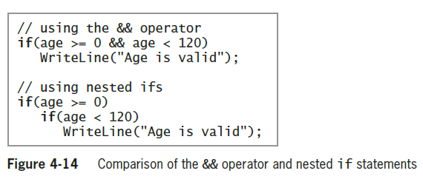
Using the Conditional AND Operator (cont’d.)

Slide 22
Using the Conditional OR Operator
Conditional OR operator
  Used when you want some action to occur even if only one of two conditions is true
  Written as two pipes ||
  You must include a complete Boolean expression on each side of the operator
Short-circuit evaluation
  Expressions in each part of an OR expression are evaluated only as much as necessary to determine whether the entire expression is true or false

Slide 23
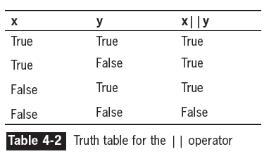
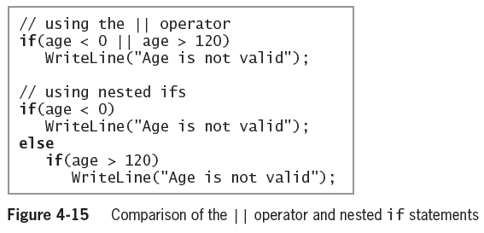
Using the Conditional OR Operator (cont’d.)

Slide 24
Using the Logical AND and OR Operators
Boolean logical AND operator (&) and Boolean logical inclusive OR operator (|)
  Work just like their && and || (conditional AND and OR) counterparts
  Do not support short-circuit evaluation
  Can lead to a side effect (unintended consequence)
Avoid writing expressions that contain side effects

Slide 25
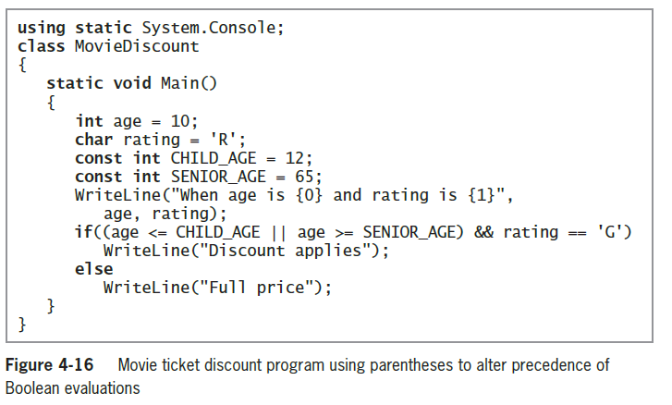
Combining AND and OR Operators (cont’d.)

Slide 26
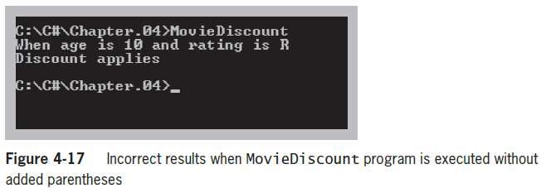
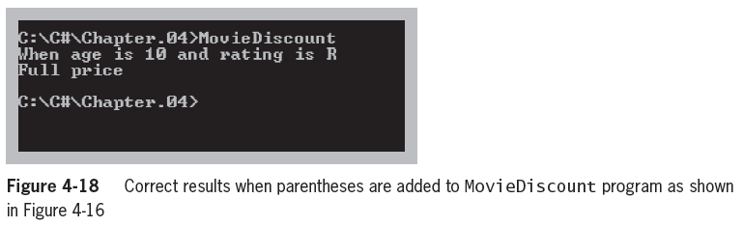
Combining AND and OR Operators (cont’d.)

Slide 27
Making Decisions Using the switch Statement
switch structure
  Tests a single variable against a series of exact matches
Keywords
  switch, case, break, and default
Governing types
  sbyte, byte, short, ushort, int, uint, long, ulong, char, string, and enum
A switch does not need a default case
  Good programming practice to include one

Slide 28
Making Decisions Using the switch Statement (cont’d.)
“No fall through rule”
  Not allowing code to reach the end of a case
  Not allowed in C#
  Use a break statement at the end of each case

Slide 29
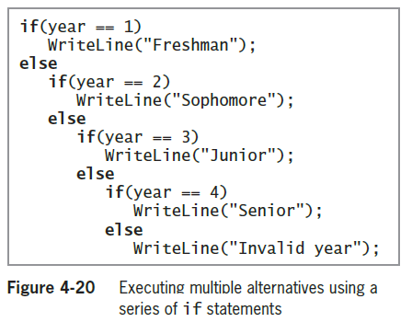
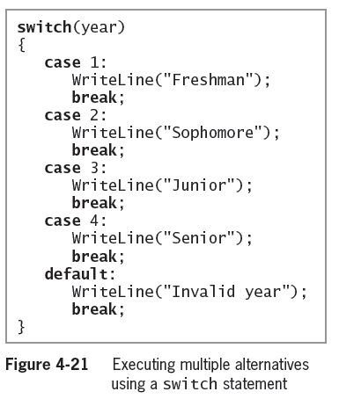
Making Decisions Using the switch Statement (cont’d.)

Slide 30
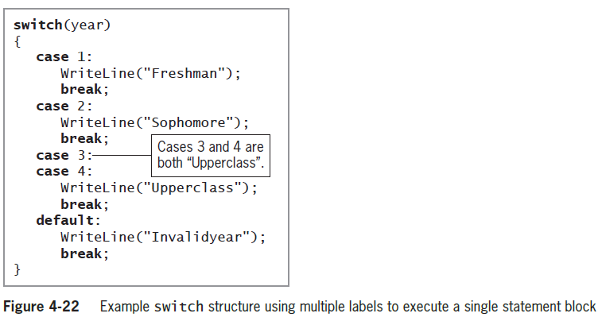
Making Decisions Using the switch Statement (cont’d.)
You can use multiple labels to govern a list of statements

Slide 31
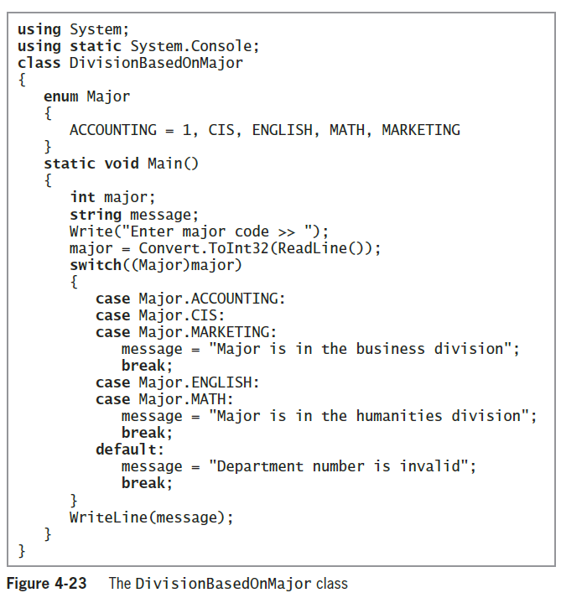
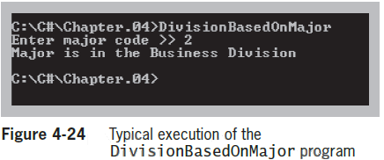
Using an Enumeration with a switch Statement
Using an enumeration with a switch structure is often convenient

Slide 32
Using the Conditional Operator
Conditional operator
  Used as an abbreviated version of the if-else statement
  A ternary operator that takes three parameters
Syntax
  testExpression ? trueResult : falseResult;
Example
  WriteLine((testScore >= 60) ? "Pass" : " Fail");

Slide 33
Using the NOT Operator
NOT operator
  Written as an exclamation point (!)
  Negates the result of any Boolean expression
    If the Boolean expression is true, ! makes it false
    If the Boolean expression is false, ! makes it true
  Logic using the ! operator can be difficult to read and analyze
  The ! operator has a higher precedence than && and ||

Slide 34
Avoiding Common Errors When Making Decisions
Most frequent errors include:
  Using the assignment operator (=) instead of the comparison operator (==)
  Inserting a semicolon after the Boolean expression in an if statement
  Failing to block a set of statements with curly braces
  Failing to include a complete Boolean expression on each side of an && or || operator

Slide 35
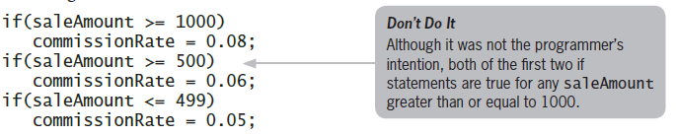
Performing Accurate and Efficient Range Checks
Range check
  A series of if statements that determine whether a value falls within a specified range
Problem

Slide 36
Performing Accurate and Efficient Range Checks (cont’d.)
Solution
    if(saleAmount >= 1000)
    commissionRate = 0.08;
    else if(saleAmount >= 500)
    commissionRate = 0.06;
    else commissionRate = 0.05;

Slide 37
Using && and || Appropriately
Problem
  Print an error message when an employee’s hourly pay rate is less than $5.65 and when an employee’s hourly pay rate is greater than $60
Solution
    if(payRate < 5.65 || payRate > 60)
    WriteLine ("Error in pay rate");

Slide 38
Using the ! Operator Correctly
Problem
  Make sure that if the sales code is not ‘A’ or ‘B’, the customer gets a 10% discount
Solutions
    if(salesCode != 'A' && salesCode != 'B')
    discount = 0.10;
    if(!(salesCode == 'A' || salesCode == 'B'))
    discount = 0.10;

Slide 39
Decision-Making Issues in GUI Programs
Making a decision within a method in a GUI application is no different from making one in a console application
You can use if, if…else, and switch statements in the same ways
GUI programs use controls to make decisions
  The user clicks on a Button, which causes an event to fire
  The user chooses one of several RadioButtons
  The user chooses an item from a ListBox

Slide 40
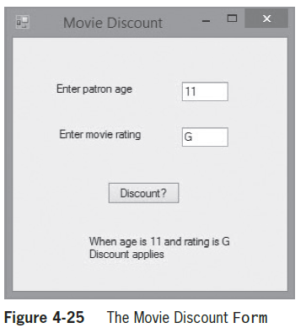
Decision-Making Issues in GUI Programs (cont’d.)

Slide 41
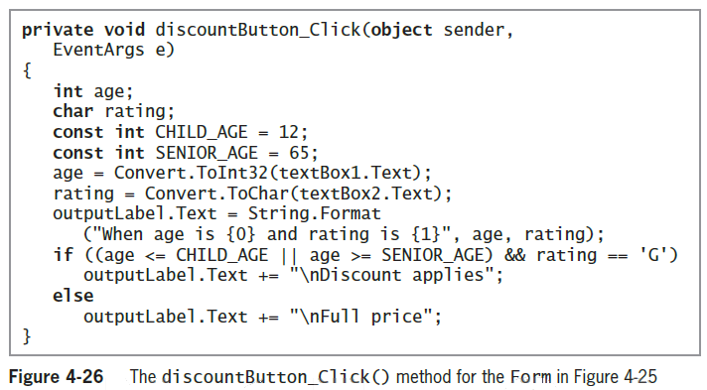
Decision-Making Issues in GUI Programs (cont’d.)

Slide 42
Summary
A flowchart is a pictorial tool that helps you understand a program’s logic
You use an if statement to make a single-alternative decision
When you make a dual-alternative decision, you can use an if-else statement
The conditional AND operator determines whether two expressions are both true

Slide 43
Summary (cont’d.)
Use the conditional OR operator when you want some action to occur when one or both of two conditions are true
AND operators take precedence
The switch statement tests a single variable against a series of exact matches
The conditional operator is used as an abbreviated version of the if-else statement

Slide 44
Summary (cont’d.)
Use the NOT operator to negate the result of any Boolean expression
Errors are common when making decisions
Decisions within GUI methods are just like decisions in console applications

