Slide 1
Chapter 5:
Looping

Slide 2
Objectives
Learn how to create loops using the while statement
Learn how to create loops using the for statement
Learn how to create loops using the do statement
Use nested loops
Accumulate totals
Understand how to improve loop performance
Learn about looping issues in GUI programs

Slide 3
Creating Loops with the while Statement
Loop
  A structure that allows repeated execution of a block of statements
Loop body
  A block of statements within a looping structure
  Executes the Boolean expression to determine whether to continue to execute the loop or exit
  Each execution is an Iteration

Slide 4
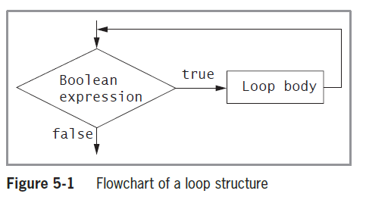
Creating Loops with the while Statement (cont’d.)

Slide 5
Creating Loops with the while Statement (cont’d.)
while loop
  Used to execute a body of statements continuously as long as some condition continues to be true
  Consists of:
    The keyword while
    A Boolean expression within parenthesis
    The loop body
Infinite loop
  A loop that never ends

Slide 6
Creating Loops with the while Statement (cont’d.)
Making a while loop end correctly
  Initialize the loop control variable
  Test the control variable in the while expression
  Alter the value of the control variable in the code block
Loop Control Variable
  A variable initialized before entering the loop
  Tested in the while expression
  Body of the loop alters the value of the variable to eventually exit the loop

Slide 7
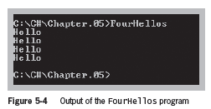
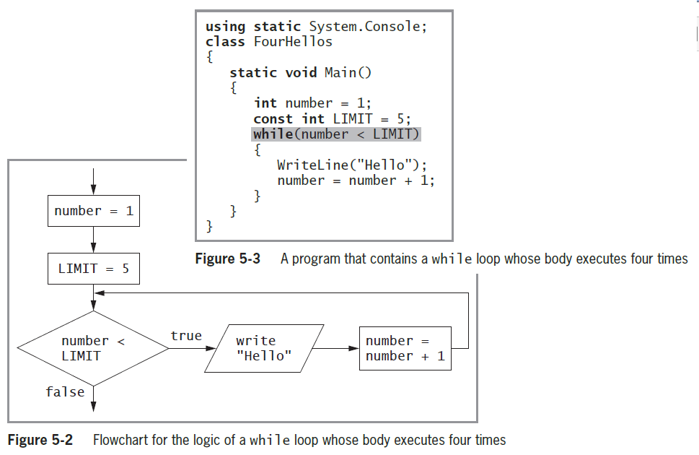
Creating Loops with the while Statement (cont’d.)

Slide 8
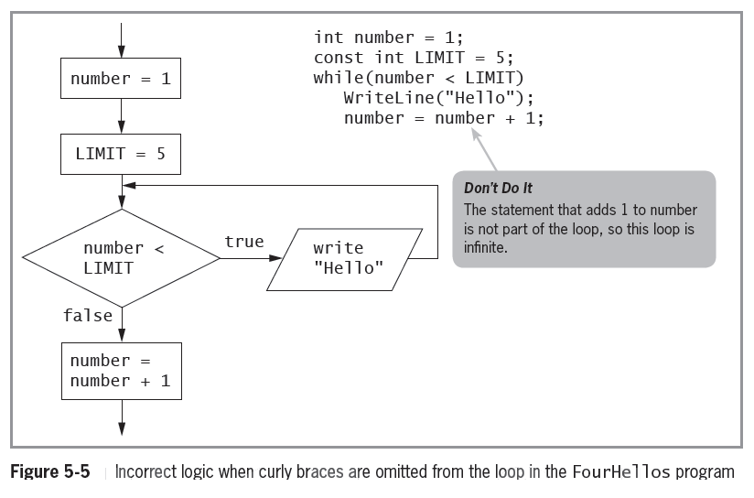
Creating Loops with the while Statement (cont’d.)

Slide 9
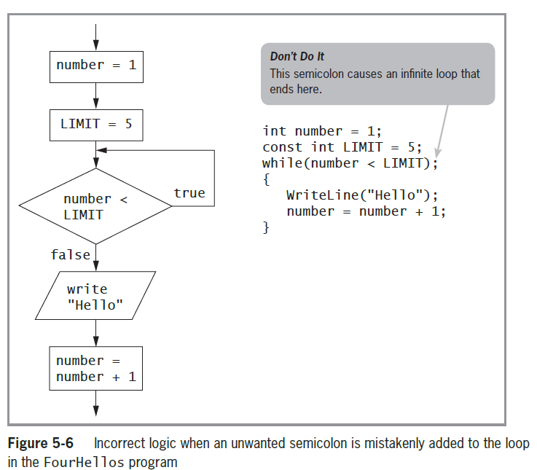
Creating Loops with the while Statement (cont’d.)
Empty body
  A loop with
  no statements
Incrementing
  Adding to the
  loop control
  variable
Decrementing
  Subtracting from
  the loop control
  variable

Slide 10
Creating Loops with the while Statement (cont’d.)
Definite loop or counted loop
  A loop for which the number of iterations is predetermined
Indefinite loop
  The value of a loop control variable is not altered by arithmetic, but instead is altered by user input
Sentinel value
  The value such as ‘Y’ or ‘N’ that a user must supply to stop the loop

Slide 11
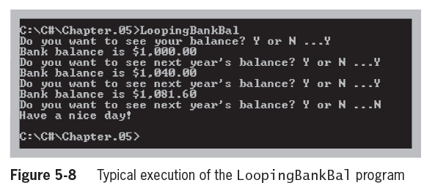
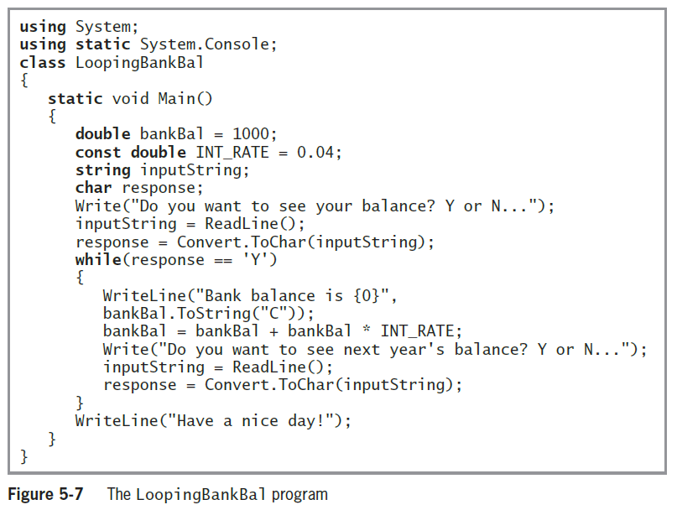
Creating Loops with the while Statement (cont’d.)

Slide 12
Creating Loops with the for Statement
for loop
  Used to create definite loops
  Indicate the starting value for the loop control variable
  Test the condition that controls loop entry
  Allow the expression to alter the loop control variable
    Known as the step value
Sections of the loop
  Control variable initialization, testing and updating
  Variables created inside the loop cease to exist when the loop ends
    Knows as out of scope

Slide 13
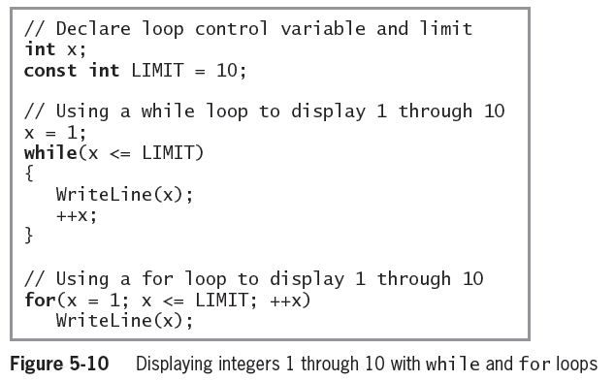
Creating Loops with the for Statement (cont’d.)

Slide 14
Creating Loops with the do Statement
do loop
  Always enters the loop without testing
  Checks at the “bottom” of the loop after one repetition has occurred
  Convenient when you know you want to perform some task at least one time
  Also called a do…while loop
  The while loop and for loop are pretest loops—ones in which the loop control variable is tested before the loop body executes
  The do loop is a posttest loop—one in which the loop control variable is tested after the loop body executes

Slide 15
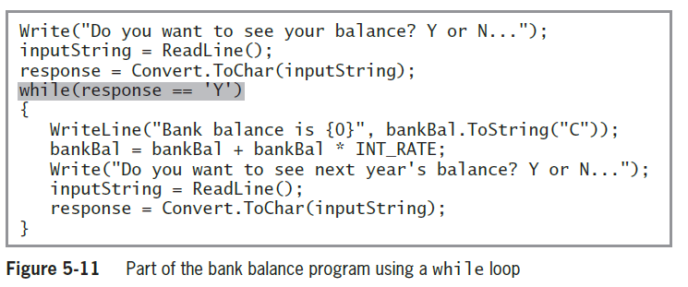
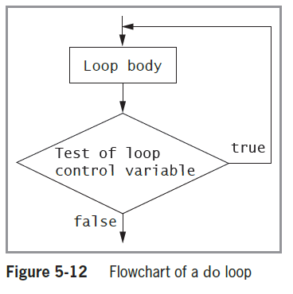
Creating Loops with the do Statement (cont’d.)

Slide 16
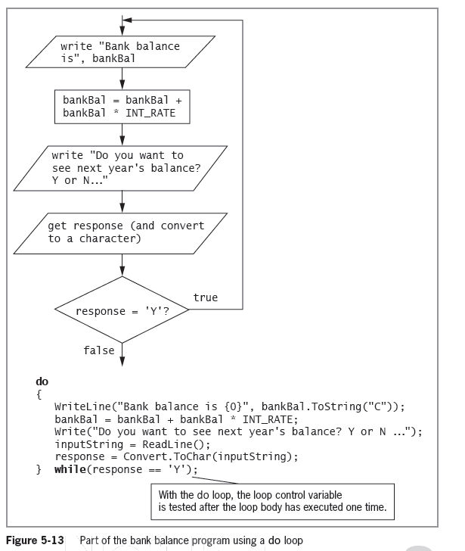
Creating Loops with the do Statement (cont’d.)

Slide 17
Using Nested Loops
When loops are nested, each pair contains an inner loop and an outer loop
  The inner loop must be entirely contained within the outer loop
  Loops can never overlap

Slide 18
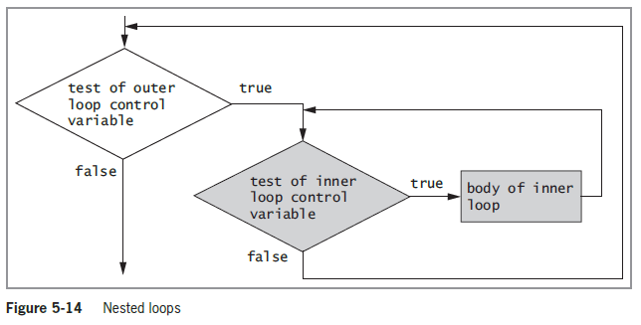
Using Nested Loops (cont’d.)

Slide 19
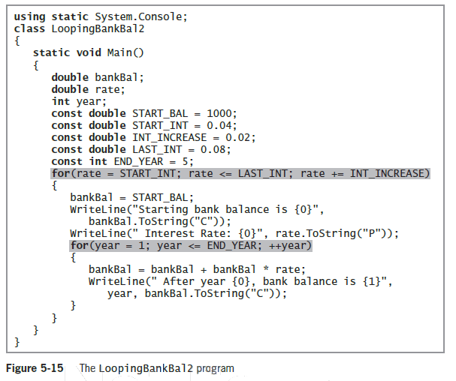
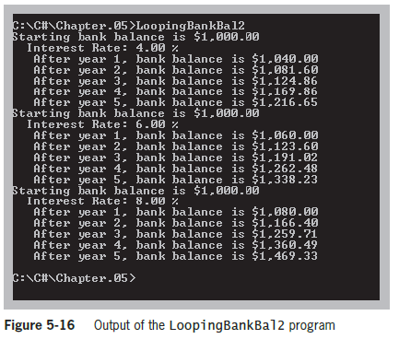
Using Nested Loops (cont’d.)

Slide 20
Accumulating Totals
Totals are accumulated
  Gathered together and added into a final sum by processing individual records one at a time in a loop
Garbage
  An unknown value
  The C# compiler helps to prevent seeing an incorrect total by requiring you to provide a starting value
  C# will not use the garbage value that happens to be stored at an uninitialized memory location

Slide 21
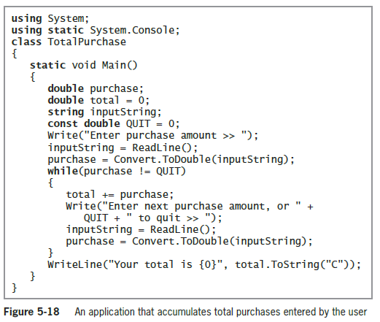
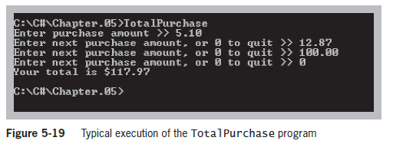
Accumulating Totals (cont’d.)

Slide 22
Improving Loop Performance
Make sure the loop avoids unnecessary operations
Consider the order of evaluation for short-circuit operators
Employ loop fusion
Use prefix incrementing rather than postfix incrementing

Slide 23
Improving Loop Performance (cont’d.)
Avoiding Unnecessary Operations
  A loop should execute while x is less than the sum of two integers a and b, and that neither a nor b is altered in the loop body. The loop could be written as:
    while(x < a + b) - or - int sum = a + b;
// loop body while(x < sum)
// loop body
  In the code on the left this loop executes 1,000 times and the expression a + b is calculated 1,000 times
  In the code on the right, the results are the same, but the arithmetic is performed only once

Slide 24
Improving Loop Performance (cont’d.)
Considering the Order of Evaluation of Short-Circuit Operators
  Remember that the expressions in each part of an AND or OR expression use short-circuit evaluation
  When a loop might execute many times, it becomes increasingly important to consider the number of evaluations that take place
  If you believe that the first Boolean expression is more likely to be true than the second one, you can eliminate testing the second one on more occasions

Slide 25
Improving Loop Performance (cont’d.)
Employing Loop Fusion
  Loop Fusion is the technique of combining two loops into one
  for(int x = 0; x < TIMES; ++x) for(int x = 0; x < TIMES; ++x)
  method1(); { method1();
  for(int x = 0; x < TIMES; ++x) method2();
  method2(); }

Slide 26
Improving Loop Performance (cont’d.)
Using Prefix Incrementing Rather Than Postfix Incrementing
Example: for(int x = 0; x < LIMIT; x++)
  Because incrementing x is a stand-alone statement in the for loop, the result is identical whether you use x++ or ++x
  ++x runs faster than x++
  A timing compared the loops:

Slide 27
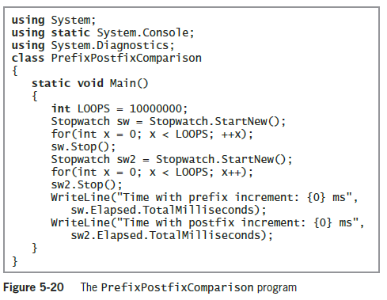
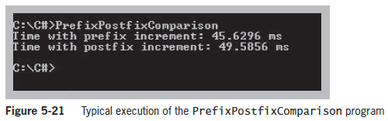
Improving Loop Performance (cont’d.)
Using Prefix Incrementing Rather Than Postfix Incrementing (cont’d.)

Slide 28
Looping Issues in GUI Programs
Using a loop within a method in a GUI application is no different from using one in a console application
Event-driven programs sometimes require fewer coded loops
  Some events are determined by the user’s actions when the program is running, rather than by the programmer’s coding
  You can write an event-driven program so that an action continues as long as the user continues to make an appropriate selection

Slide 29
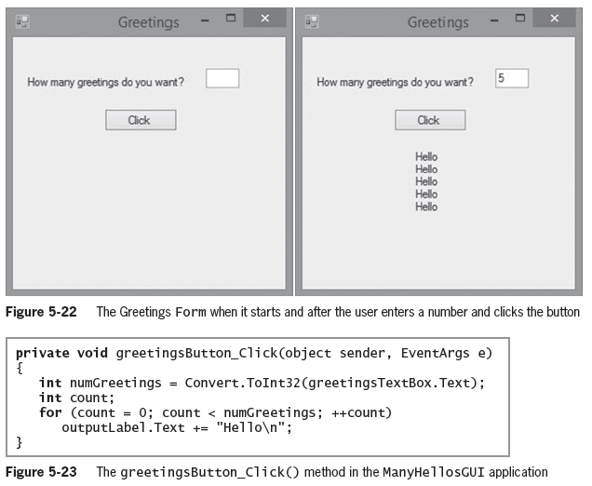
Looping Issues in GUI Programs (cont’d.)

Slide 30
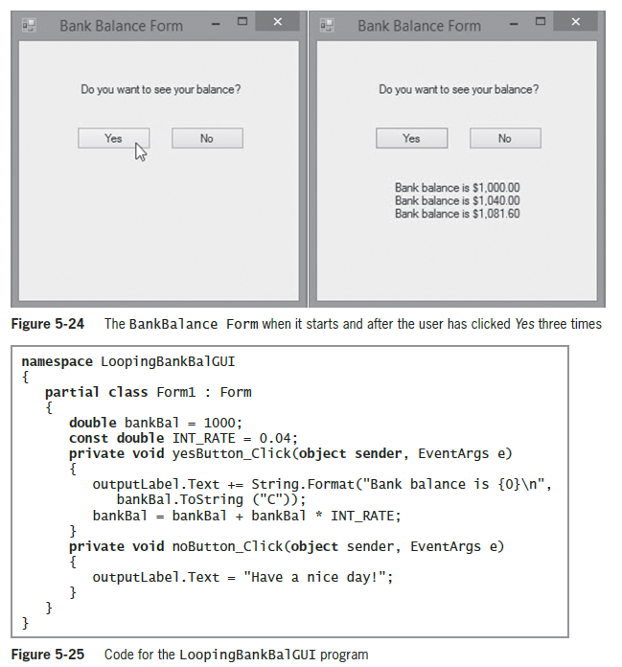
Looping Issues in GUI Programs (cont’d.)

Slide 31
Summary
Use a while loop to execute a body of statements continuously while some condition continues to be true
When using a for statement, you can indicate in one place:
  The starting value for the loop control variable
  The test condition that controls loop entry
  The expression that alters the loop control variable

Slide 32
Summary (cont’d.)
The do loop checks the “bottom” of the loop after one repetition has occurred
You can nest any combination of loops to achieve the desired results
In computer programs, totals frequently are accumulated
Improve loop performance by making sure the loop does not include unnecessary operations
You can use while, for, and do...while loops in the same ways as in console and GUI programs

