Slide 1
Chapter 6:
Using Arrays

Slide 2
Objectives
Declare an array and assign values to array elements
Access array elements
Search an array using a loop
Use the BinarySearch(), Sort(), and Reverse() methods
Use multidimensional arrays
Learn about array issues in GUI programs

Slide 3
Declaring an Array and Assigning Values to Array Elements
Array
  A list of data items that all have the same data type and the same name
  Each item is distinguished from the others by an index
Declaring and creating an array
  double[] sales;
  sales = new double[20];
new operator
  Used to create objects
You can change the size of an array

Slide 4
Declaring an Array and Assigning Values to Array Elements (cont’d.)
Array element
  Each object in an array
Subscript (or index)
  An integer contained within square brackets that indicates the position of one of an array’s elements
  An array’s elements are numbered beginning with 0
“Off by one”
  Remember to start counting at zero!
    Item 1 in an array is Element [0]
    Item 2 in an array is Element [1]

Slide 5
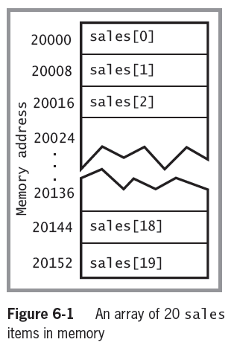
Declaring an Array and Assigning Values to Array Elements (cont’d.)
Assigning a value to an array element
sales[0] = 2100.00;
Printing an element value
WriteLine(sales[19]);

Slide 6
Initializing an Array
In C#, arrays are objects
  Arrays are instances of a class named System.Array
Initializing objects
  Numeric fields are set to 0
  Character fields are set to ‘\u0000’ or null
  bool fields are set to false
Initializer list
  A list of values provided for an array

Slide 7
Initializing an Array (cont’d.)
An Initializer list is the list of values provided for an array
  Examples (each does the same thing)
  int[] myScores = new int[5] {100, 76, 88, 100, 90};
  int[] myScores = new int[] {100, 76, 88, 100, 90};
  int[] myScores = {100, 76, 88, 100, 90};
    If you declare a size, then you must list a value for each element (example 1)
    If you initialize an array with values, you are not required to give the array a size (example 2)
    If you initialize an array, you do not need to use the keyword new (example 3)

Slide 8
Accessing Array Elements
The power of arrays becomes apparent when you use subscripts that are variables rather than constant values
  Remember that variables can change values
Using a loop to perform arithmetic on each element
int sub = 0; for(int sub = 0; sub < 5; ++sub)
while(sub < 5) myScores[sub] += 3;
{
myScores[sub] += 3;
++sub;
}
OR

Slide 9
Using the Length Property
Length property
  A member of the System.Array class
  Automatically holds an array’s length
  If the subscript, or index, is greater than the last valid index (e.g., the index value is 20 for a 20-element array), you will get a System.IndexOutOfRangeException…the highest valid index value is 19
Examples
  int[] myScores = {100, 76, 88, 100, 90};
  WriteLine("Array size is {0}",myScores.Length);
  for(int x = 0; x < myScores.Length; ++x)
  WriteLine(myScores[x]);

Slide 10
Using foreach
foreach statement
  Cycles through every array element without using a subscript
  Uses a temporary iteration variable
    Automatically holds each array value in turn
Example
double[] payRate = {6.00, 7.35, 8.12, 12.45, 22.22};
foreach(double money in payRate)
  WriteLine("{0}", money.ToString("C"));

Slide 11
Using foreach (cont’d.)
Used when you want to access every array element
Since the iteration variable is read-only, you can access it but you cannot assign a value to it

Slide 12
Searching an Array Using a Loop
Searching options
  Using a for loop
  Using a while loop

Slide 13
Using a for Loop to Search an Array
for(int x = 0; x < validValues.Length; ++x)
if(itemOrdered == validValues[x])
isValidItem = true;
Called a Sequential Search because each array element is examined in sequence
Parallel arrays (a second array to hold corresponding data) allow you to use the same subscript to access additional information

Slide 14
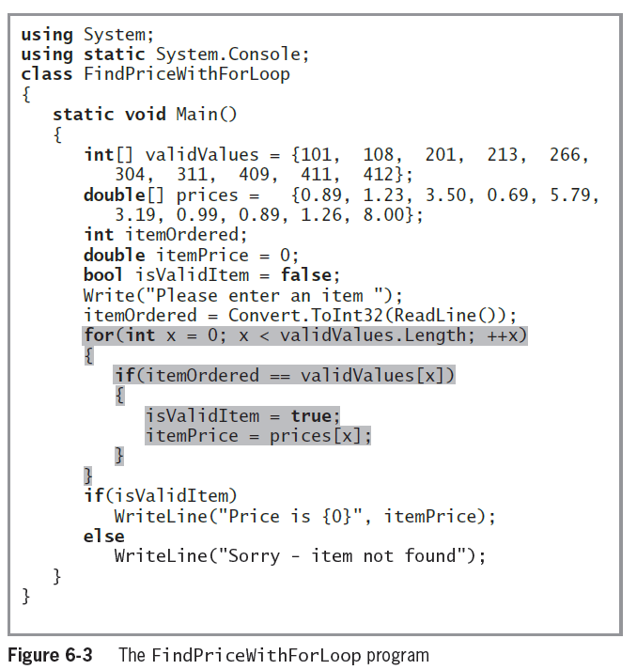
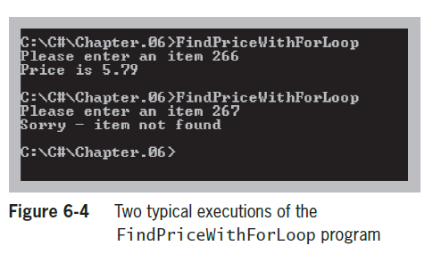
Using a for Loop to Search an Array (cont’d.)

Slide 15
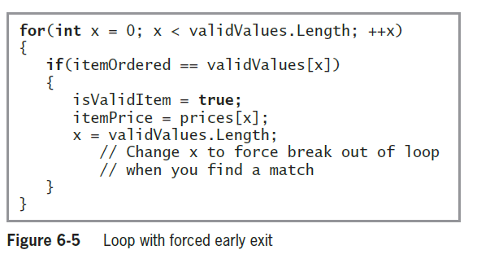
Improving a Loop’s Efficiency

Slide 16
Using a while Loop to Search an Array
Use a while loop to search for a match
  Set a subscript to 0 and, while the item being searched for is not equal to a value in the array, increase the subscript and keep looking
  You search only while the subscript remains lower than the number of elements in the array

Slide 17
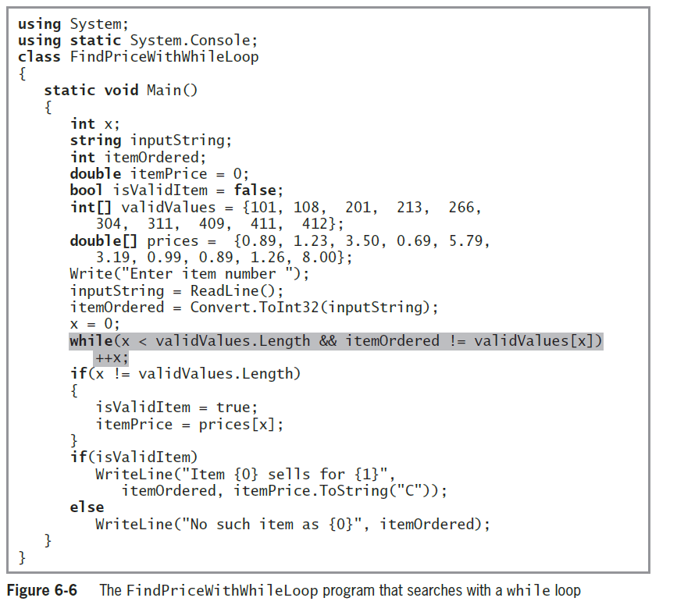
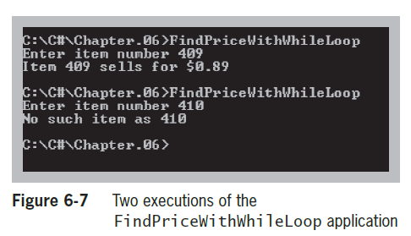

Slide 18
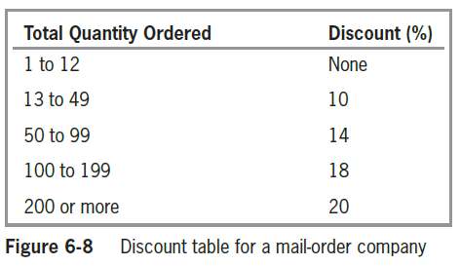
Searching an Array for a Range Match
Range match
  Determines the pair of limiting values between which a value falls

Slide 19
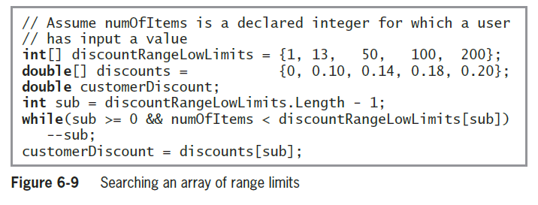
Searching an Array for a Range Match (cont’d.)

Slide 20
Using the BinarySearch(),
Sort(), and Reverse() Methods
The System.Array class contains a variety of useful, built-in methods that can search, sort, and manipulate array elements

Slide 21
Using the BinarySearch() Method
BinarySearch() method
  a sorted list of objects is split in half repeatedly as the search gets closer and closer to a match
  Similar to the “guess a Number between 1 and 100” game
    Start with Is it less than 50? Less than 25? Less than 12? Etc.
When not to use BinarySearch()
  If your array items are not arranged in ascending order
  If your array holds duplicate values and you want to find all of them
  If you want to find a range match rather than an exact match

Slide 22
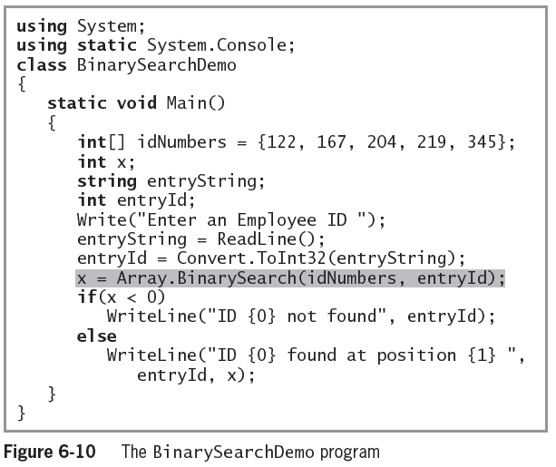
Using the BinarySearch() Method (cont’d.)

Slide 23
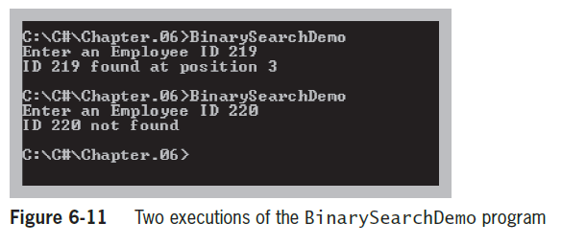
Using the BinarySearch() Method (cont’d.)

Slide 24
Using the Sort() Method
Sort() method
  Arranges array items in ascending order
  Works numerically for number types and alphabetically for characters and strings
  Use it by passing the array name to Array.Sort()
  Often used before using the BinarySearch()method which requires a sorted array

Slide 25
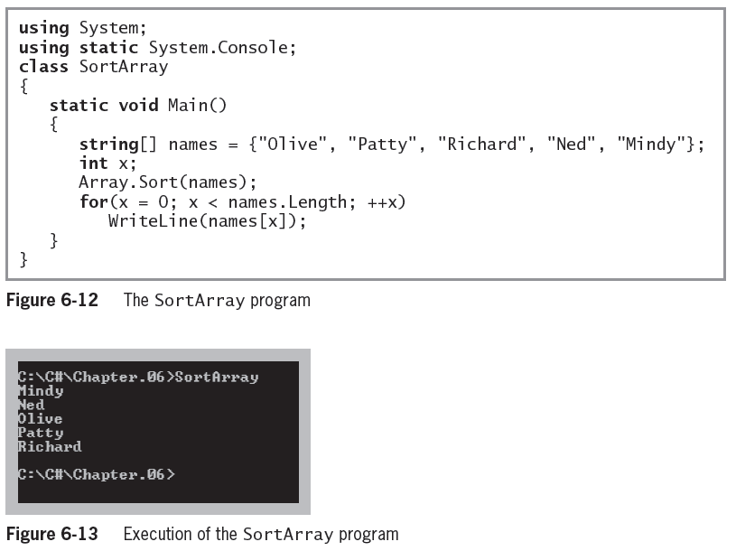
Using the Sort() Method (cont’d.)

Slide 26
Using the Reverse() Method
Reverse() method
  The Reverse() method does not sort array elements; it only rearranges their values to the opposite order
  An element that starts in position 0 is relocated to position Length – 1
  Use it by passing the array name to the method

Slide 27
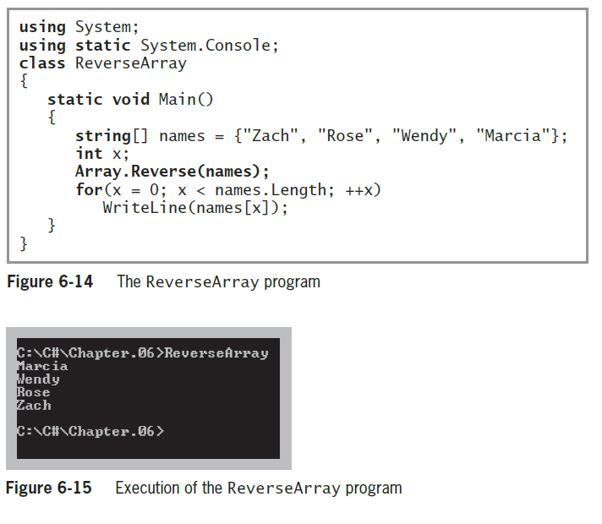
Using the Reverse() Method (cont’d.)

Slide 28
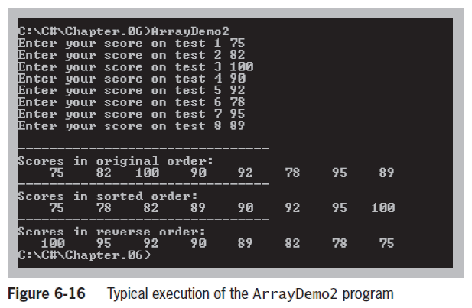
You Do It!

Slide 29
Using Multidimensional Arrays
One-dimensional or single-dimensional array
  Picture it as a column of values
  Elements can be accessed using a single subscript
Multidimensional array
  Requires multiple subscripts to access the array elements
  Two-dimensional array
    Has two or more columns of values for each row
    Rectangular array (also called a matrix, or a table
      Similar to a spreadsheet

Slide 30
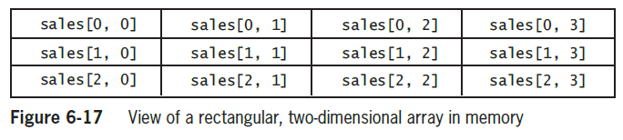
Using Multidimensional Arrays (cont’d.)
  Initializing the array
    Has two or more columns of values for each row
double[ , ] sales = {{14.00, 15.00, 16.00, 17.00},
{21.99, 34.55, 67.88, 31.99},
{12.03, 55.55, 32.89, 1.17}};

Slide 31
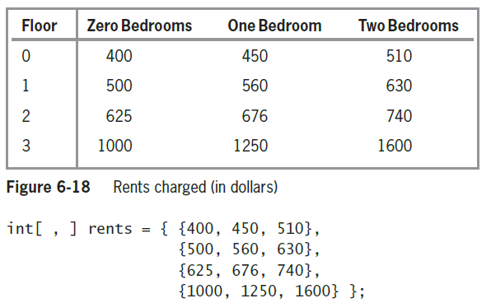
Using Multidimensional Arrays (cont’d.)

Slide 32
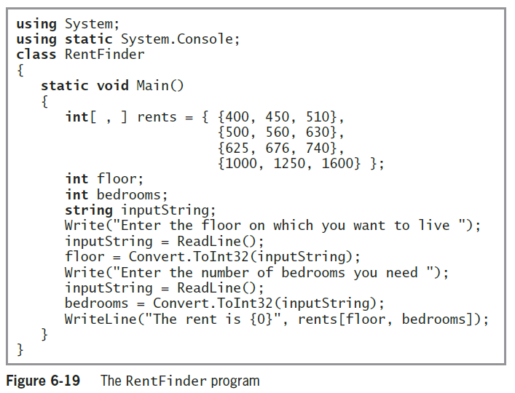
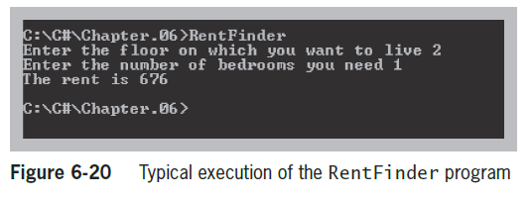
Using Multidimensional Arrays (cont’d.)

Slide 33
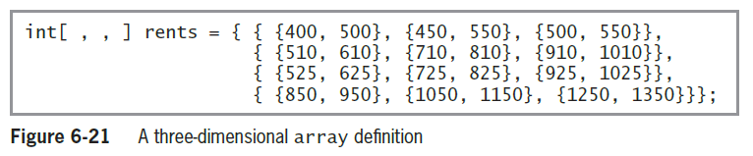
Using Multidimensional Arrays (cont’d.)
Three-dimensional array
  Examples:
    A Building. Floor, Apartment
    A Book, Page, Line
    A Month, Day, Hour
    Rent [3, 1, 0] ($1,050) refers to a refers to a studio (zero bedroom) apartment, on the first floor of building 3

Slide 34
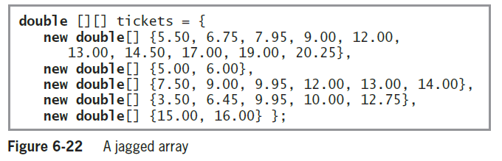
Using Jagged Arrays
Jagged array
  A one-dimensional array in which each element is another one-dimensional array
  Each row can be a different length

Slide 35
Array Issues in GUI Programs
If array values change based on user input, the array must be stored outside any method that reacts to the user’s event

Slide 36
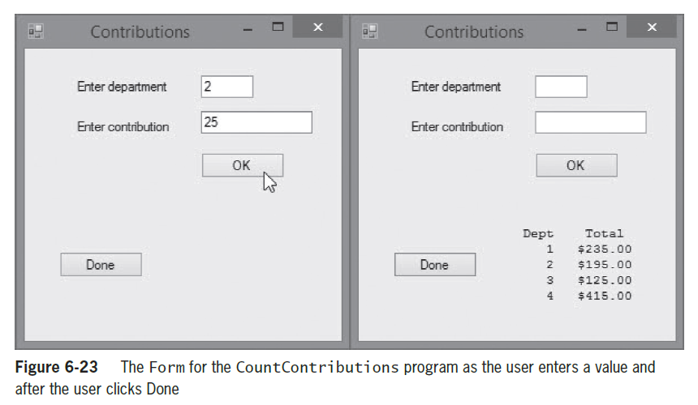
Array Issues in GUI Programs (cont’d.)

Slide 37
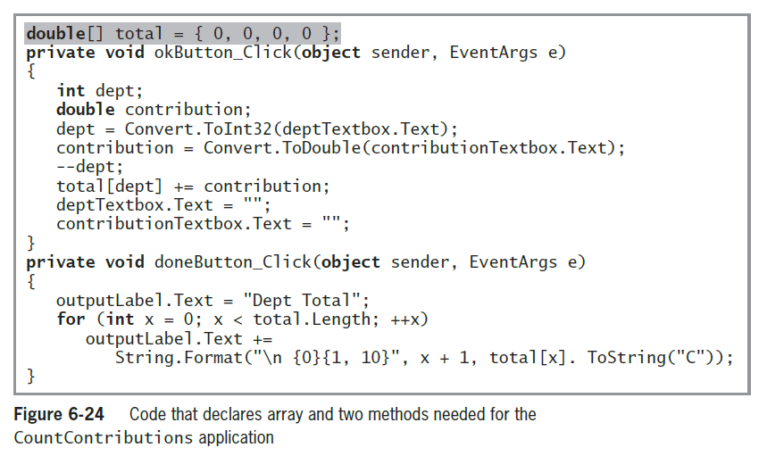
Array Issues in GUI Programs (cont’d.)

Slide 38
Summary
An array is a list of data items
  All data items have the same type and the same name
  Items are distinguished using a subscript or an index
In C#, arrays are objects of a class named System.Array
The power of arrays becomes apparent when you begin to use subscripts
The subscript you use remains in the range of 0 through Length - 1

Slide 39
Summary (cont’d.)
The foreach statement cycles through every array element without using subscripts
You can compare a variable to a list of values in an array
You can create parallel arrays to more easily perform a range match
The BinarySearch() method finds a requested value in a sorted array
The Sort() method arranges array items in ascending order

Slide 40
Summary (cont’d.)
The Reverse() method reverses the order of items in an array
Multidimensional arrays require multiple subscripts to access the array elements
Types of multidimensional arrays:
  Two-dimensional arrays (rectangular arrays)
  Three-dimensional arrays
  Jagged arrays

