Slide 1
Chapter 7:
Using Methods

Slide 2
Objectives
Learn about methods and implementation hiding
Write methods with no parameters and no return value
Write methods that require a single argument
Write methods that require multiple arguments
Write a method that returns a value
Pass array values to a method
Learn some alternate ways to write a Main() method header
Learn about issues using methods in GUI programs

Slide 3
Understanding Methods and Implementation Hiding
Method
  An encapsulated series of statements that perform a task
  Using a method is called invoking or calling the method

Slide 4
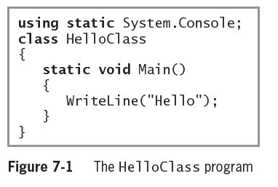
Understanding Methods and Implementation Hiding (cont’d.)
Calling Method
  Main()
Called Method
  WriteLine()

Slide 5
Understanding Implementation Hiding
Implementation hiding
  An important principle of object-oriented programming
  Keeps the details of a method’s operations hidden
The only concern is the way you interface, or interact, with the method
  The program does not need to know how the method works
  A method that uses another is a client of that method
  Methods exist in a black box – a virtual device you can use without knowing how it works internally

Slide 6
Writing Methods with No Parameters and No Return Value
Major reasons to create a method:
  The code will remain short and easy to follow
  A method is easily reusable
Code bloat
  Unnecessarily long or repetitive statements
A method must include:
  Method declaration
    Also called a method header or method definition
  Opening curly brace {
  Method body
  Closing curly brace }

Slide 7
Writing Methods with No Parameters and No Return Value (cont’d.)
Method declaration
  Defines the rules for using the method and contains:
    Optional declared accessibility
    Optional static modifier
    Return type for the method
    Method name, or identifier
    Opening parenthesis
    Optional list of method parameters
    Closing parenthesis

Slide 8
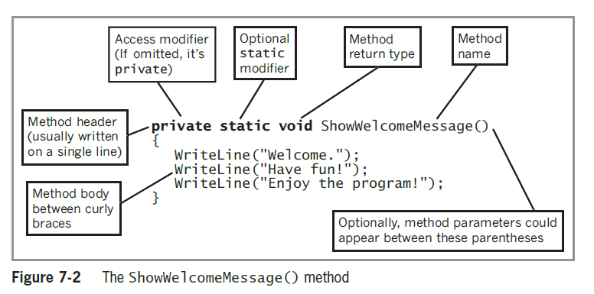
Writing Methods with No Parameters and No Return Value (cont’d.)

Slide 9
An Introduction to Accessibility
Optional declared accessibility
  Limits how other methods can use your method
  Possible access values:
    Public access – established by including a public modifier in the member declaration (allows access to the method from other classes)
    Private Access - is established by including a private modifier in the member declaration or by omitting any accessibility modifier
      This modifier limits method access to the class that contains the method
  When you use a method’s complete name, including its class, you are using its fully qualified name
    E.g. Console.WriteLine()

Slide 10
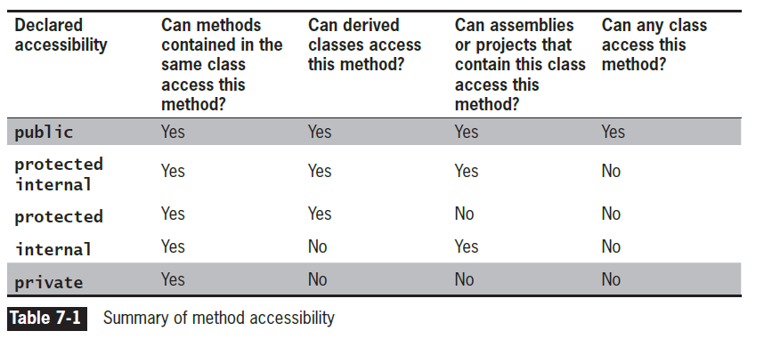
An Introduction to Accessibility (cont’d.)

Slide 11
An Introduction to the Optional static Modifier
You can declare a method to be static or nonstatic
  Methods are nonstatic by default
static method
  Can be called without referring to an object
    Instead, you refer to the class
  Cannot call nonstatic methods
nonstatic method
  The default
  Can be used only in conjunction with an object
  Nonstatic methods can call static ones

Slide 12
An Introduction to Return Types
Every method has a return type
  Indicates what kind of value the method will return to any other method that calls it
  If a method does not return a value, its return type is void
  A method’s return type is known more succinctly as a method’s type

Slide 13
Understanding the Method Identifier
The method name must be a legal C# identifier
Parameter to a method
  A variable that holds data passed to a method when it is called
  The parentheses that follow a method name in its header can hold one parameter or multiple parameters separated with commas
    The contents within the parentheses are known as the parameter list

Slide 14
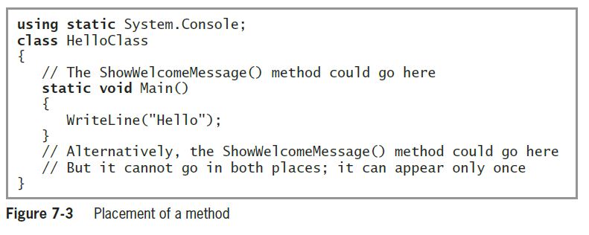
Placing a Method in a Class

Slide 15
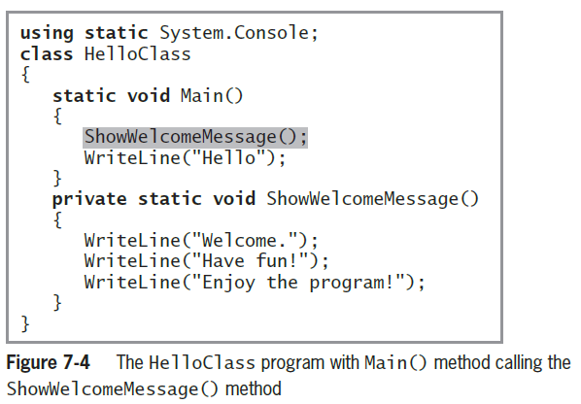
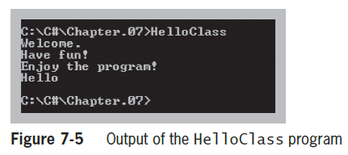
Placing a Method in a Class (cont’d.)

Slide 16
Declaring Variables and Constants in a Method
Variables and constants can be declared in a method
They are considered local to that method
  Their scope is defined by the boundaries of the method
Scope
  The area in which a variable is known
They go out of scope when the method is exited
They are not accessible outside of the method except when passed as parameters to other methods

Slide 17
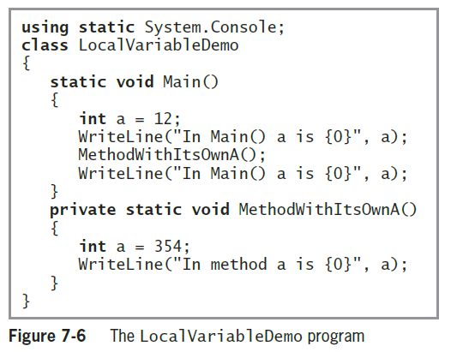
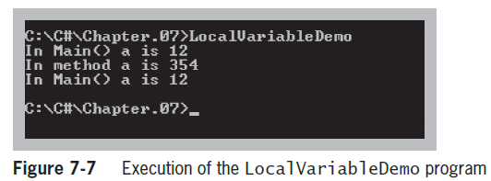
Declaring Variables and Constants in a Method (cont’d.)

Slide 18
Writing Methods That Require a Single Argument
You need:
  The type of the parameter
  A local identifier (name) for the parameter
Local variable
  Declared within a method
Formal parameter
  A parameter in a method header that accepts a value
Actual parameters
  Arguments within a method call

Slide 19
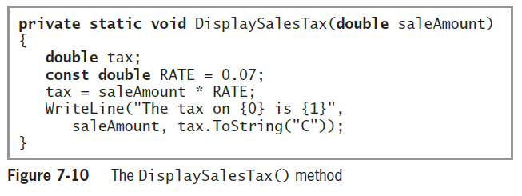
Writing Methods That Require a Single Argument (cont’d.)

Slide 20
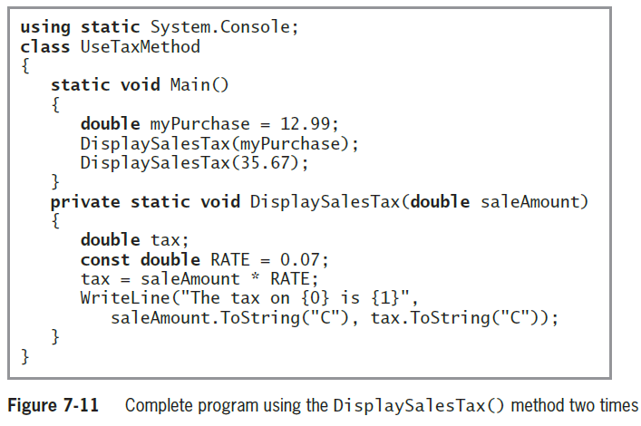
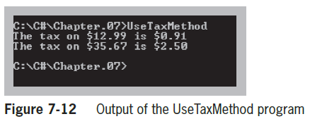
Writing Methods That Require a Single Argument (cont’d.)

Slide 21
Writing Methods That Require Multiple Arguments
Methods can take any number of parameters
When you call the method, arguments must match in number, type, and relative position
  The type qualification will be satisfied if an implicit cast (or automatic conversion) is possible
  Examples
    From int to long, float, double, or decimal
    From float to double

Slide 22
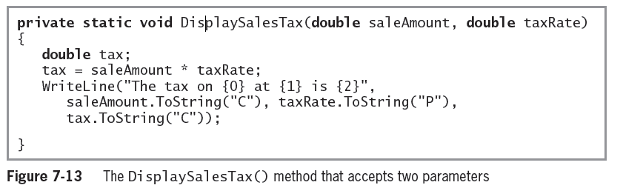
Writing Methods That Require Multiple Arguments (cont’d.)

Slide 23
Writing a Method That Returns a Value
A method can return, at most, one value to a method that calls it
Method’s type
  A method’s return type
return statement
  Causes a value to be sent back to the calling method
You are not required to use a returned value

Slide 24
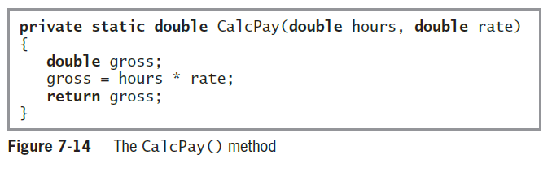
Writing a Method That Returns a Value (cont’d.)

Slide 25
Writing a Method That Returns a Value (cont’d.)
A returned value can be:
  Stored in a variable
  Used directly
Nested method calls
  Method calls placed inside other method calls
Writing a method that returns a Boolean value
  When a method returns a value that is type bool, the method call can be used anywhere you can use a Boolean expression
    Branching statements (e.g., if(…))
    Loop control variables

Slide 26
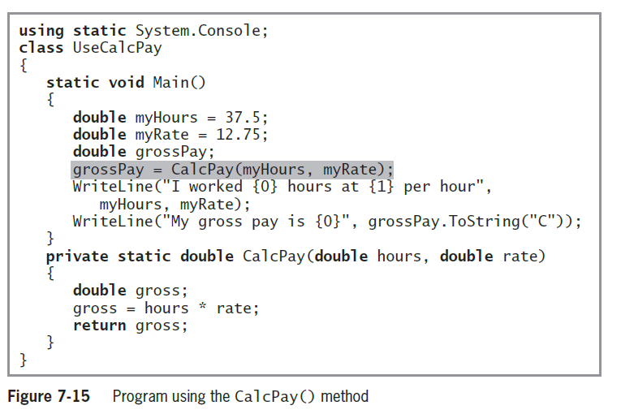
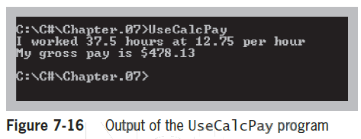
Writing a Method That Returns a Value (cont’d.)

Slide 27
Writing a Method That Returns a Boolean Value
Methods can return a value that is type bool
  Makes for more readable if statements
  E.g. A method named isPreferredCustomer() that returns a Boolean value indicating whether a customer is a
  preferred customer who qualifies for a discount\
    If statement can be written as:
      if(isPreferredCustomer())
      price = price - DISCOUNT;

Slide 28
Analyzing a Built-in Method
Prewritten Methods
  E.g. Pow()- raises a number to a power
  double result = Math.Pow(2.0, 3.0);
From this statement, you know the following about the Pow() method:
  It is in the Math class because the class name and a dot precede the method call
  It is public because you can write a program that uses it

Slide 29
Analyzing a Built-in Method
  double result = Math.Pow(2.0, 3.0);
  It is static because it is used with its class name and a dot, without any object
  It accepts two double parameters
  It returns a double or a type that can be promoted automatically to a double (such as an int) because its answer is stored in a double
  Although you know many facts about the Pow() method, you do not know how its instructions are carried out internally. In good object-oriented style, its implementation is hidden

Slide 30
Passing Array Values to a Method
Passing a Single Array Element to a Method
  You can pass a single array element to a method in the same manner as you would pass a variable
  Variables are passed by value
    Local variables store a local copy of the value

Slide 31
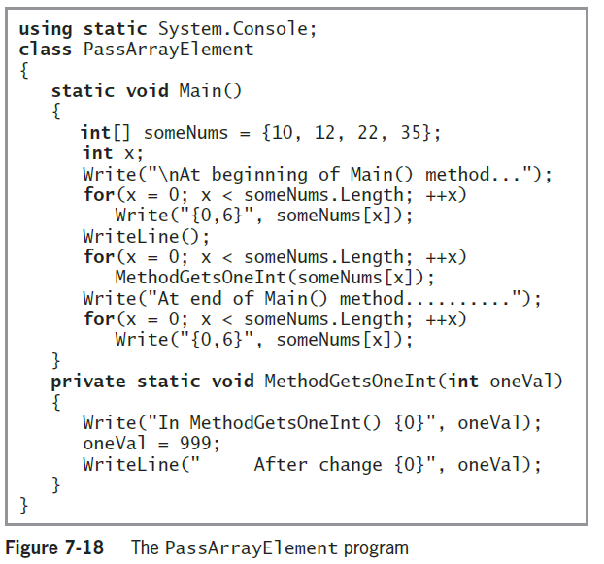
Passing Array Values to a Method (Cont’d.)

Slide 32
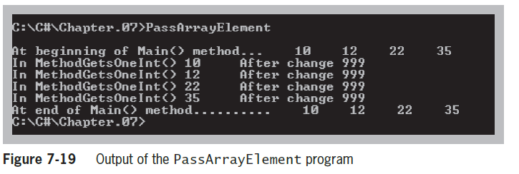
Passing a Single Array Element to a Method (cont’d.)

Slide 33
Passing an Array to a Method
You can pass an entire array as a parameter
Arrays, like all objects but unlike built-in types, are passed by reference
  The method receives the actual memory address of the array
    Has access to the actual values in the array elements

Slide 34
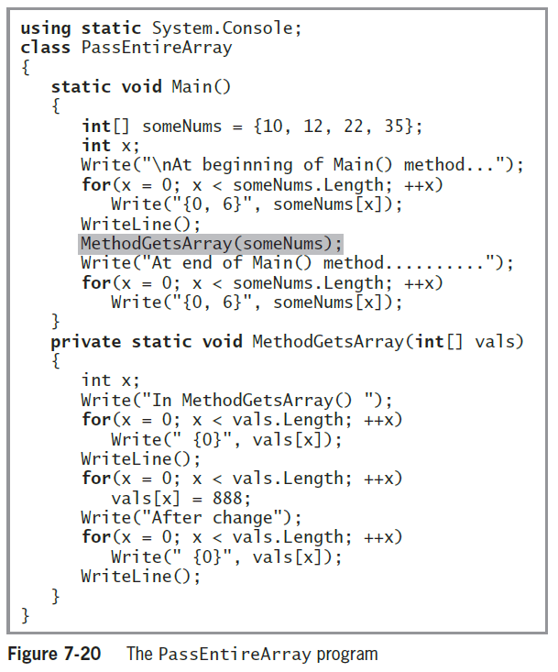

Slide 35
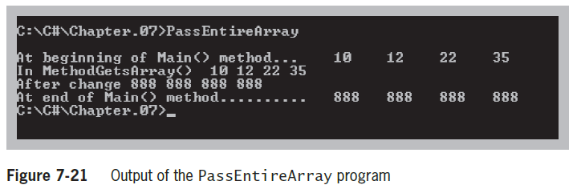
Passing an Array to a Method (cont’d.)

Slide 36
Passing an Array to a Method (cont’d.)
You can pass a multidimensional array to a method by indicating the appropriate number of dimensions after the data type in the method header
  Example
  public static void displayScores(int[,] scoresArray)
Jagged arrays insert the appropriate number of square brackets after the data type in the method header
  Example
  public static void displayIDs(int[][] idArray)

Slide 37
Alternate Ways to Write a Main() Method Header
Writing a Main() Method with a Parameter List
  Conventional way:
    public static void Main()
  Passing command-line arguments:
    static void Main(string[] args)

Slide 38
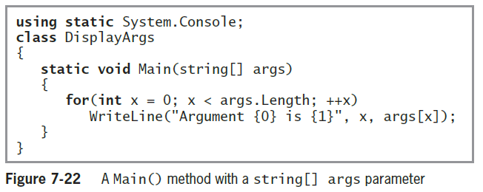
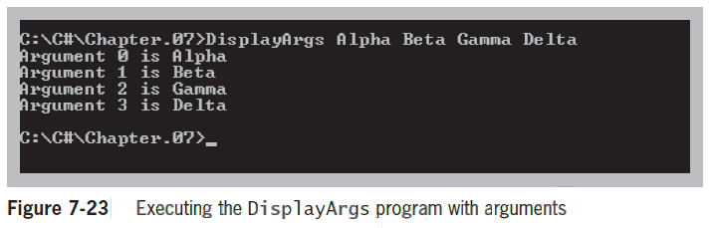
Writing a Main() Method with a Parameter List (cont’d.)

Slide 39
Writing a Main() Method with an Integer Return Type
Some programmers prefer to write Main() method headers with a return type of int instead of void
  The last statement in the Main() method must be a return statement
  A return code of 0 indicates a successful execution
  Any other value can be interpreted as an error code

Slide 40
Writing a Main() Method with public access
Some programmers prefer to write Main() method headers with public access
  The default is private access
A public Main() method can be called by another class
  The call must be made using the fully qualified name

Slide 41
Issues Using Methods in GUI Programs
Some special considerations are necessary when creating GUI applications
  Understanding methods that are automatically generated in the visual environment
  Appreciating scope in a GUI program
  Creating methods to be nonstatic when associated with a Form

Slide 42
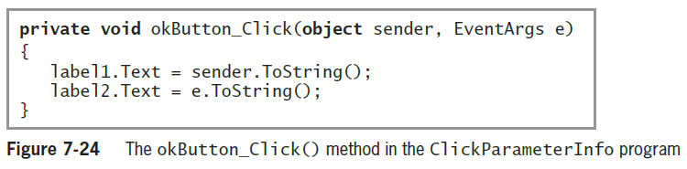
Understanding Methods That Are Automatically Generated in the Visual Environment
When you create GUI applications using the IDE, many methods are generated automatically
  To create the method, double-click on the object

Slide 43
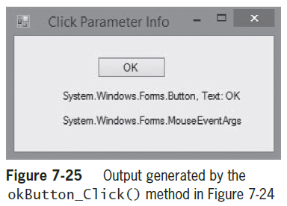
Understanding Methods That Are Automatically Generated in the Visual Environment (cont’d.)

Slide 44
Appreciating Scope in a GUI Program
When you declare a variable or constant within a method, it is local to that method
If a variable or constant is needed by multiple event-handling methods, the variables or constants in question must be defined outside the methods (but within the Form class)
Automatically generated event-handling methods have predefined sets of parameters

Slide 45
Creating Methods to Be Nonstatic When Associated with a Form
When you create a GUI application and generate a method, the keyword static does not appear in the method header
  The method is associated with an object from which the method-invoking events are sent

Slide 46
Summary
A method is a series of statements that perform a task
Some methods require passed-in information called arguments or parameters
You write methods to make programs easier to understand, and so that you can easily reuse them
Object-oriented programs hide their methods’ implementation
You can pass multiple arguments to a method

Slide 47
Summary (cont’d.)
The return type for a method can be any type used in the C# programming language
You can pass an array as a parameter to a method
You might see different Main() method headers in other books or in programs written by others
Special considerations exist for methods when you create GUI applications

