Slide 1
Chapter 8:
Advanced Method Concepts

Slide 2
Objectives
Learn about parameter types and review mandatory value parameters
Use ref parameters, out parameters, and parameter arrays
Overload methods
Learn how to avoid ambiguous methods
Use optional parameters

Slide 3
Understanding Parameter Types
Mandatory Parameter
  An argument for it is required in every method call
Types of mandatory parameters:
  Reference parameters
    Declared with the ref modifier
  Output parameters
    Declared with the out modifier
  Parameter arrays
    Declared with the params modifier

Slide 4
Using Mandatory Value Parameters
Optional Parameter
  Value parameters - declared with default values
Value Parameter
  The method receives a copy of the value passed to it
  The copy is stored at a different memory address than the actual parameter
Changes to value parameters never affect the original argument in the calling method

Slide 5
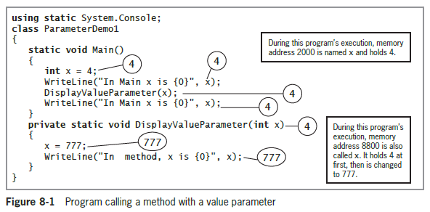
Using Mandatory Value Parameters (cont’d.)

Slide 6
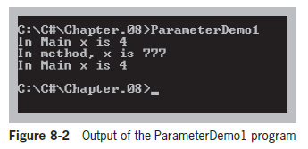
Using Mandatory Value Parameters (cont’d.)

Slide 7
Using Reference Parameters, Output Parameters, and Parameter Arrays
Each has memory addresses that are passed to a method, allowing the method to alter the original variables
Differences
  Reference parameters need to contain a value before calling the method
  Output parameters do not need to contain a value
  Parameter arrays arguments used in the call need not contain any original, assigned values, and the parameter array need not be assigned any values within the method

Slide 8
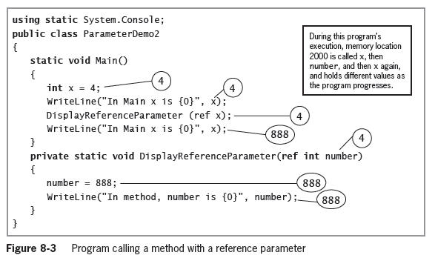
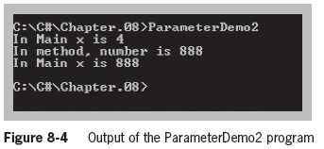
Using a ref Parameter

Slide 9
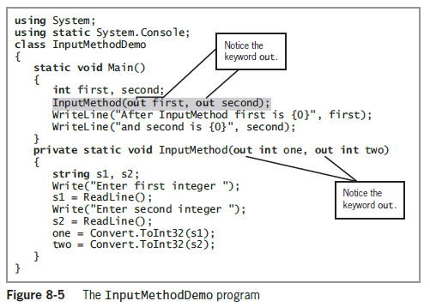
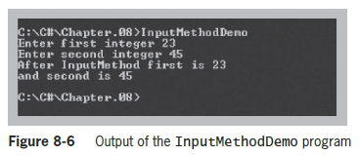
Using an out Parameter

Slide 10
Using a Built-in Method
That Has an out Parameter
The TryParse() methods are an alternative to the Convert() and Parse() methods from Chapter 2
TryParse() requires two parameters:
  The value to be converted
  An out parameter to hold the result
TryParse() returns a Boolean value

Slide 11
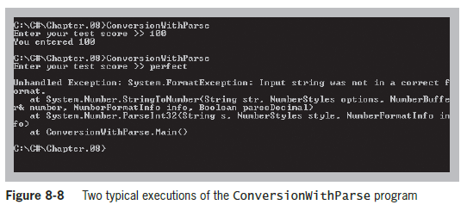
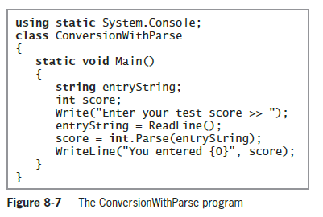
Using a Built-in Method
That Has an out Parameter (cont’d.)

Slide 12
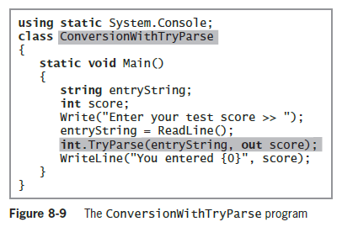
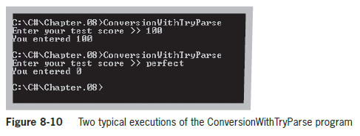
Using a Built-in Method
That Has an out Parameter (cont’d.)

Slide 13
Using Parameter Arrays
Parameter array
  A local array declared within the method header by using the keyword params
  Used when you don’t know how many arguments of the same type you might eventually send to a method
No additional parameters are permitted after the params keyword
Only one params keyword is permitted in a method declaration

Slide 14
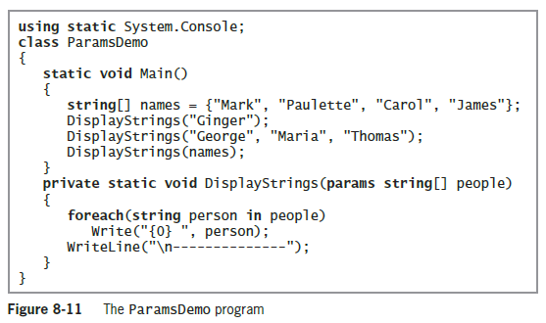
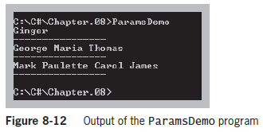
Using Parameter Arrays (cont’d.)

Slide 15
Overloading Methods
Overloading
  Involves the ability to write multiple versions of a method using the same method name
When you overload a C# method:
  You write multiple methods with the same name but different parameter lists
  The method’s name and parameter list is called the method’s signature
Methods are overloaded correctly when they have the same identifier but different parameter lists

Slide 16
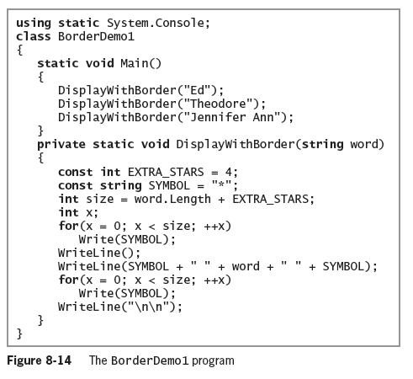
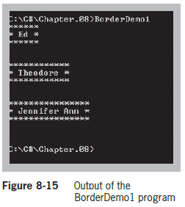
Overloading Methods (cont’d.)

Slide 17
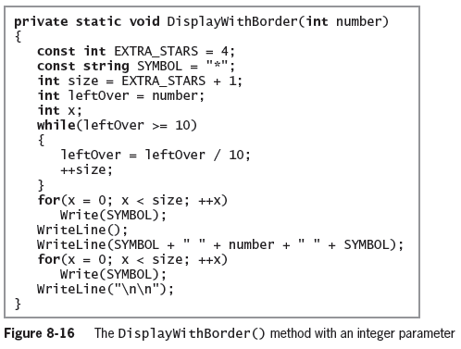
Overloading Methods (cont’d.)

Slide 18
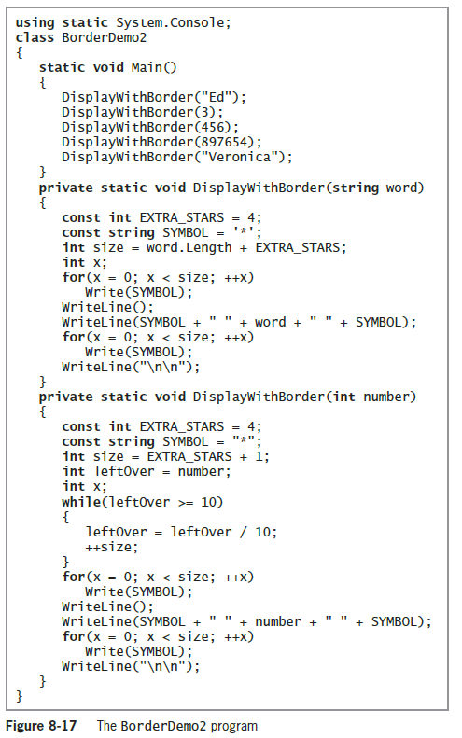
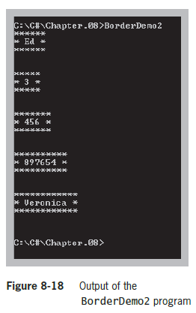

Slide 19
Understanding Overload Resolution
Overload resolution
  Used by C# to determine which method to execute when a method call could execute multiple overloaded methods
Applicable methods
  A set of methods that can accept a call with a specific list of arguments
Betterness rules
  Rules that determine which method version to call
  Similar to the implicit data type conversion rules

Slide 20
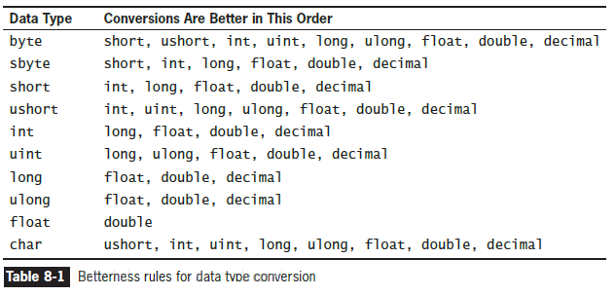
Understanding Overload Resolution (cont’d.)

Slide 21
Discovering Built-In Overloaded Methods
When you use the IDE to create programs, Visual Studio’s IntelliSense features provide information about methods you are using

Slide 22
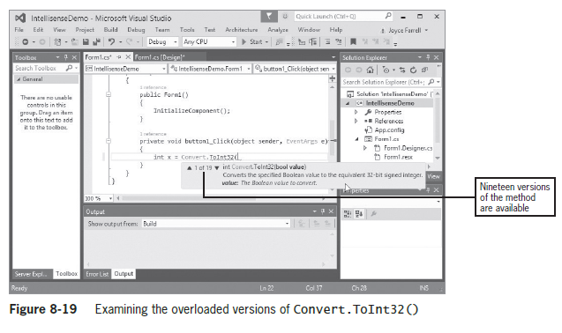
Discovering Built-In Overloaded Methods (cont’d.)

Slide 23
Avoiding Ambiguous Methods
Ambiguous method
  A situation in which the compiler cannot determine which method to use
  Occurs when you overload methods
Methods with identical names that have identical parameter lists but different return types are not overloaded

Slide 24
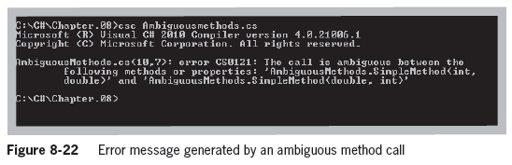
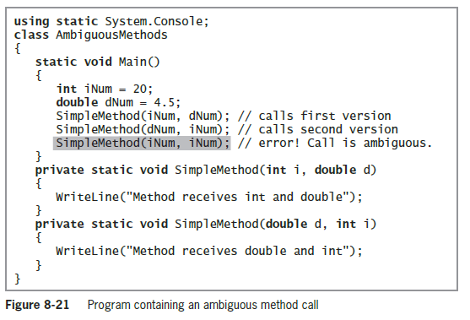
Avoiding Ambiguous Methods (cont’d.)

Slide 25
Using Optional Parameters
Optional parameter
  One for which a default value is automatically supplied
Make a parameter optional by providing a value for it in the method declaration
  Only value parameters can be given default values
Any optional parameters in a parameter list must follow all mandatory parameters

Slide 26
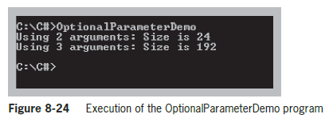
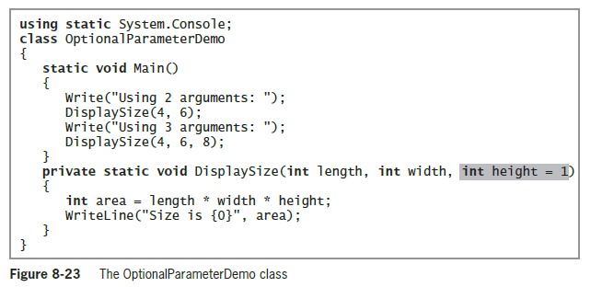
Using Optional Parameters (cont’d.)

Slide 27
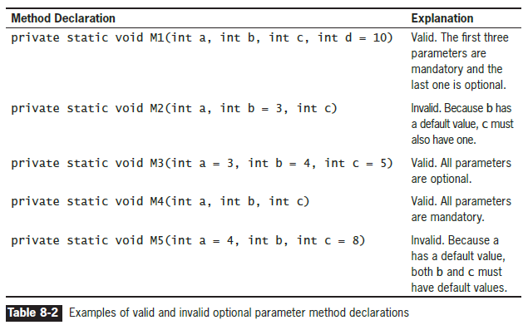
Using Optional Parameters (cont’d.)

Slide 28
Leaving Out Unnamed Arguments
When calling a method with optional parameters and you are using unnamed arguments, leave out any arguments to the right of the last one you use
Example method:

Slide 29
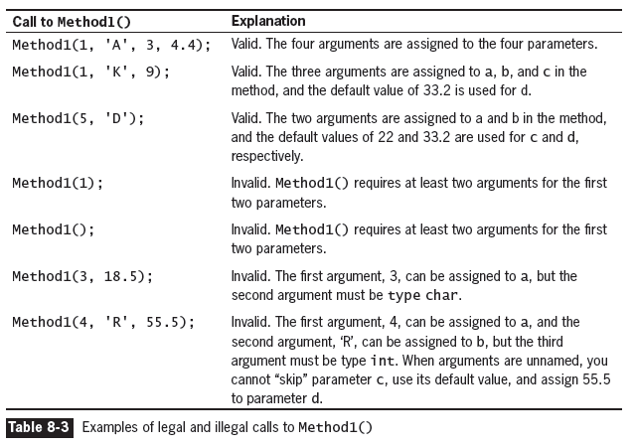
Leaving Out Unnamed Arguments (cont’d.)

Slide 30
Using Named Arguments
Named arguments are method arguments that are preceded with the name of the called method’s parameter to which it will be assigned
  Must appear after all the unnamed arguments have been listed
Each unnamed argument is also known as a positional argument
  Example method:
  private static void Method1(int a, char b,
  int c = 22, double d = 33.2)

Slide 31
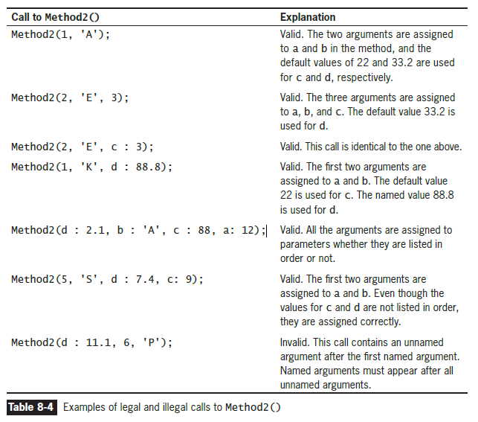
Using Named Arguments (cont’d.)

Slide 32
Advantages to Using Named Arguments
Added flexibility with method calls
  Named arguments can be coded in any order as long as they follow all the unnamed arguments
Can result in fewer overloaded methods
Self-documenting programs provide built-in explanations that make the code clearer to readers
  DisplayEmployeeData(empNumber, shouldHideSalary : true);
  -- Is better than --
  DisplayEmployeeData(empNumber, true);

Slide 33
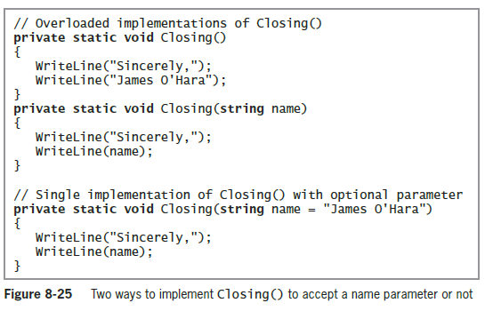
Advantages to Using Named Arguments (cont’d.)

Slide 34
Disadvantages to Using Named Arguments
Implementation hiding is compromised
Changes to the called method could cause problems and require changes to the calling method or program

Slide 35
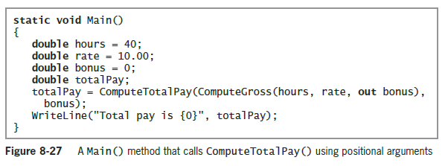
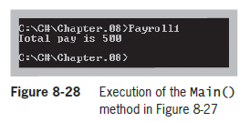
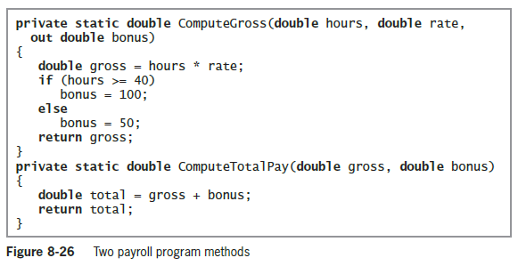
Disadvantages to Using Named Arguments (cont’d.)

Slide 36
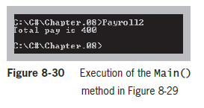
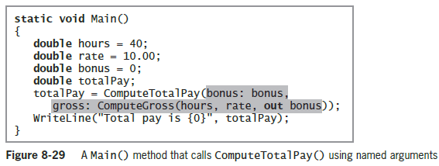
Disadvantages to Using Named Arguments (cont’d.)

Slide 37
Overload Resolution with Named and Optional Arguments
Named and optional arguments affect overload resolution
  Rules for betterness on argument conversions are applied only for arguments that are given explicitly
If two signatures are equally good, the signature that does not omit optional parameters is considered better

Slide 38
Summary
Method parameters can be mandatory or optional
Types of mandatory parameters:
  Value parameters without default values
  Reference parameters
  Output parameters
  Parameter arrays
When you overload a C# method, you write multiple methods with a shared name but different argument lists

Slide 39
Summary (cont’d.)
When you overload a method, you run the risk of creating an ambiguous situation
An optional parameter to a method is one for which a default value is automatically supplied if you do not explicitly send one as an argument

