Slide 1

Attrition Prediction: A Case Study On Why People Leave Companies
By DDSAnalytics

Slide 2

Where Do We Start?
We began by removing data that did not change between people
EmployeeCount, StandardHours, and Over18
Next we investigated the relationships between the different variables in the data

Slide 3
Top Factors Related to Attrition according to Correlation
Overtime
The most significant factor
Employees working overtime show a higher tendency towards attrition
Marital Status
The Second most influential factor
Single > Married > Divorced
Job Role
The third most significant factor
Sales Rep > HR > Lab Tech > Researcher > Sales Exec > Healthcare Rep > Manager > Manufacturing Director > Research Director

Slide 4

Top Factors Continued: The Possibilities
Over Time
An overworked and tired employee might be more willing to join a company where hours are more stable
Marital Status
Someone that does not feel obligated to others may be more likely to make riskier changes
Job Role
Some jobs may be more stressful or have high rewards for switching companies based on compensation

Slide 5
Top Factors Related to Attrition according to t-tests
Monthly Income
The most significant factor
Employees earning more are less likely to leave
Job Level
The Second most influential factor
Employees in higher job roles leave less
Total Working Years
The third most significant factor
As employee working years increase, the rate of attrition decreases

Slide 6

The Possibilities Part 2
Employees who make more, are in higher roles, and have worked for a long time likely feel stable.
Alongside stability comes a reduced volatility, meaning employees likely don’t feel the need to leave to climb a company’s ranks.

Slide 7

How Did We Come to These Conclusions?
Creating a correlation table yielded interesting results – after sorting through all of the relationships, 3 variables returned with the highest correlation
It’s important to note that correlation does not equal causation, but this led us to further explore the data
The coefficients were:
Overtime – 0.272
Marital Status – 0.197
Job Role – 0.09

Slide 8
How Did We Come to These Conclusions?
Running t-tests to determine whether the variable had an impact on attrition yielded different results from the correlation analysis.
The test works by comparing each case against the others with the influence of a given variable removed. The test then provides a p-value (or likelihood of the effect being random).
Lower p-values mean a higher likelihood that the influence is causal and not chance. (<0.05 or 5.0e-2 is typical for a conclusion)
Monthly Income 2.412e-07
Job Level 4.041e-07
Working Years 6.59e-07

Slide 9

T-test results continued
While we searched for the top 3 variables, there were many more that would fit the standard for being significant.
Years in Current Role 1.522e-06
Job Involvement 2.00e-06
Years with Current Manager 5.08e-06
Stock Option Level 3.86e-06
Age 5.04e-05
Years at Company 2.56e-04
Job Satisfaction 1.50e-02
Distance From Home 1.64e-02
Work Life Balance 1.90e-02
Environment Satisfaction 3.40e-02

Slide 10
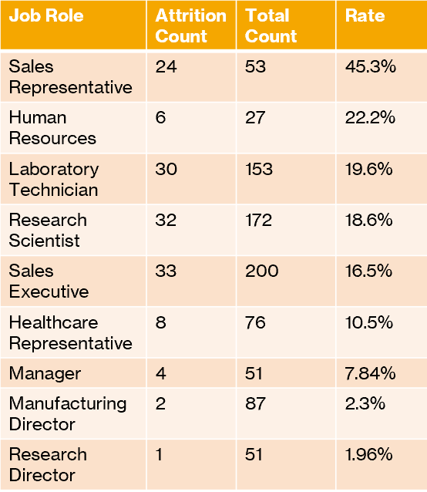
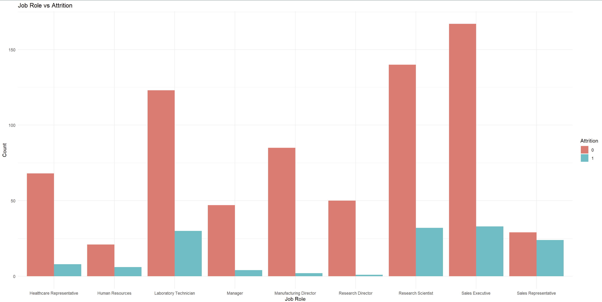
Job Role vs Attrition

Slide 11
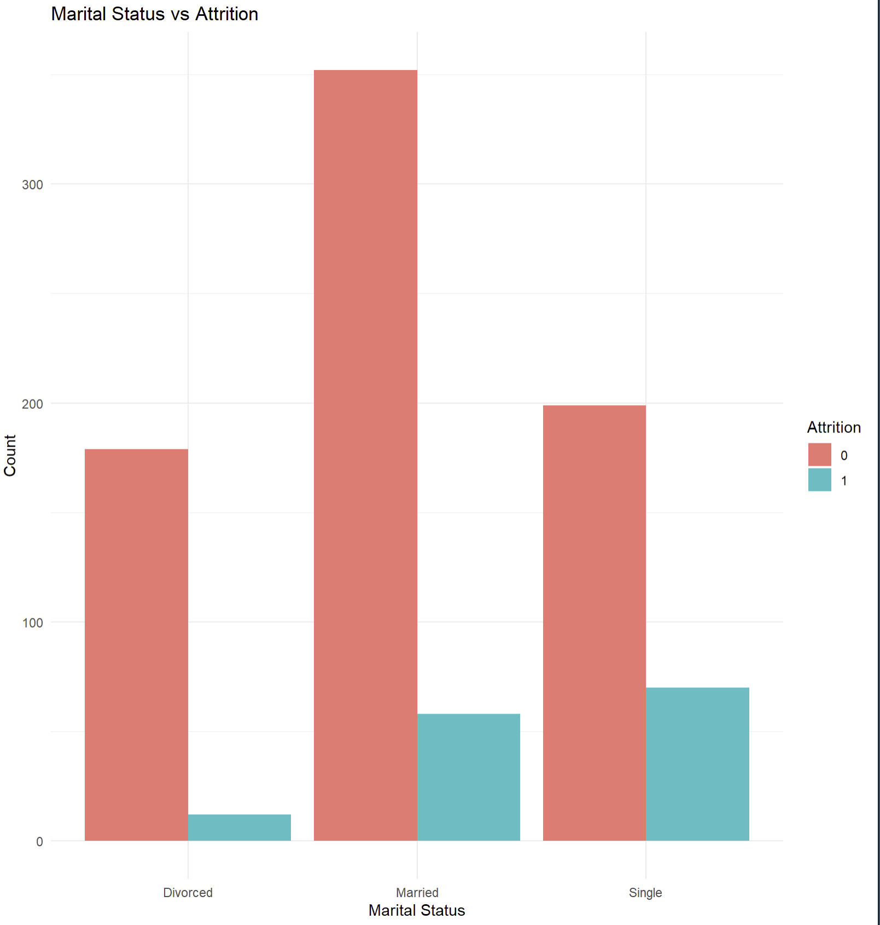
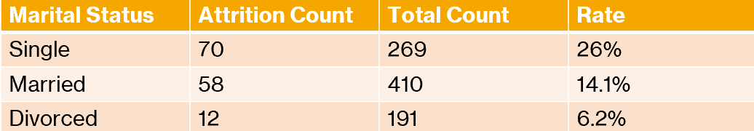
Marital Status vs Attrition

Slide 12
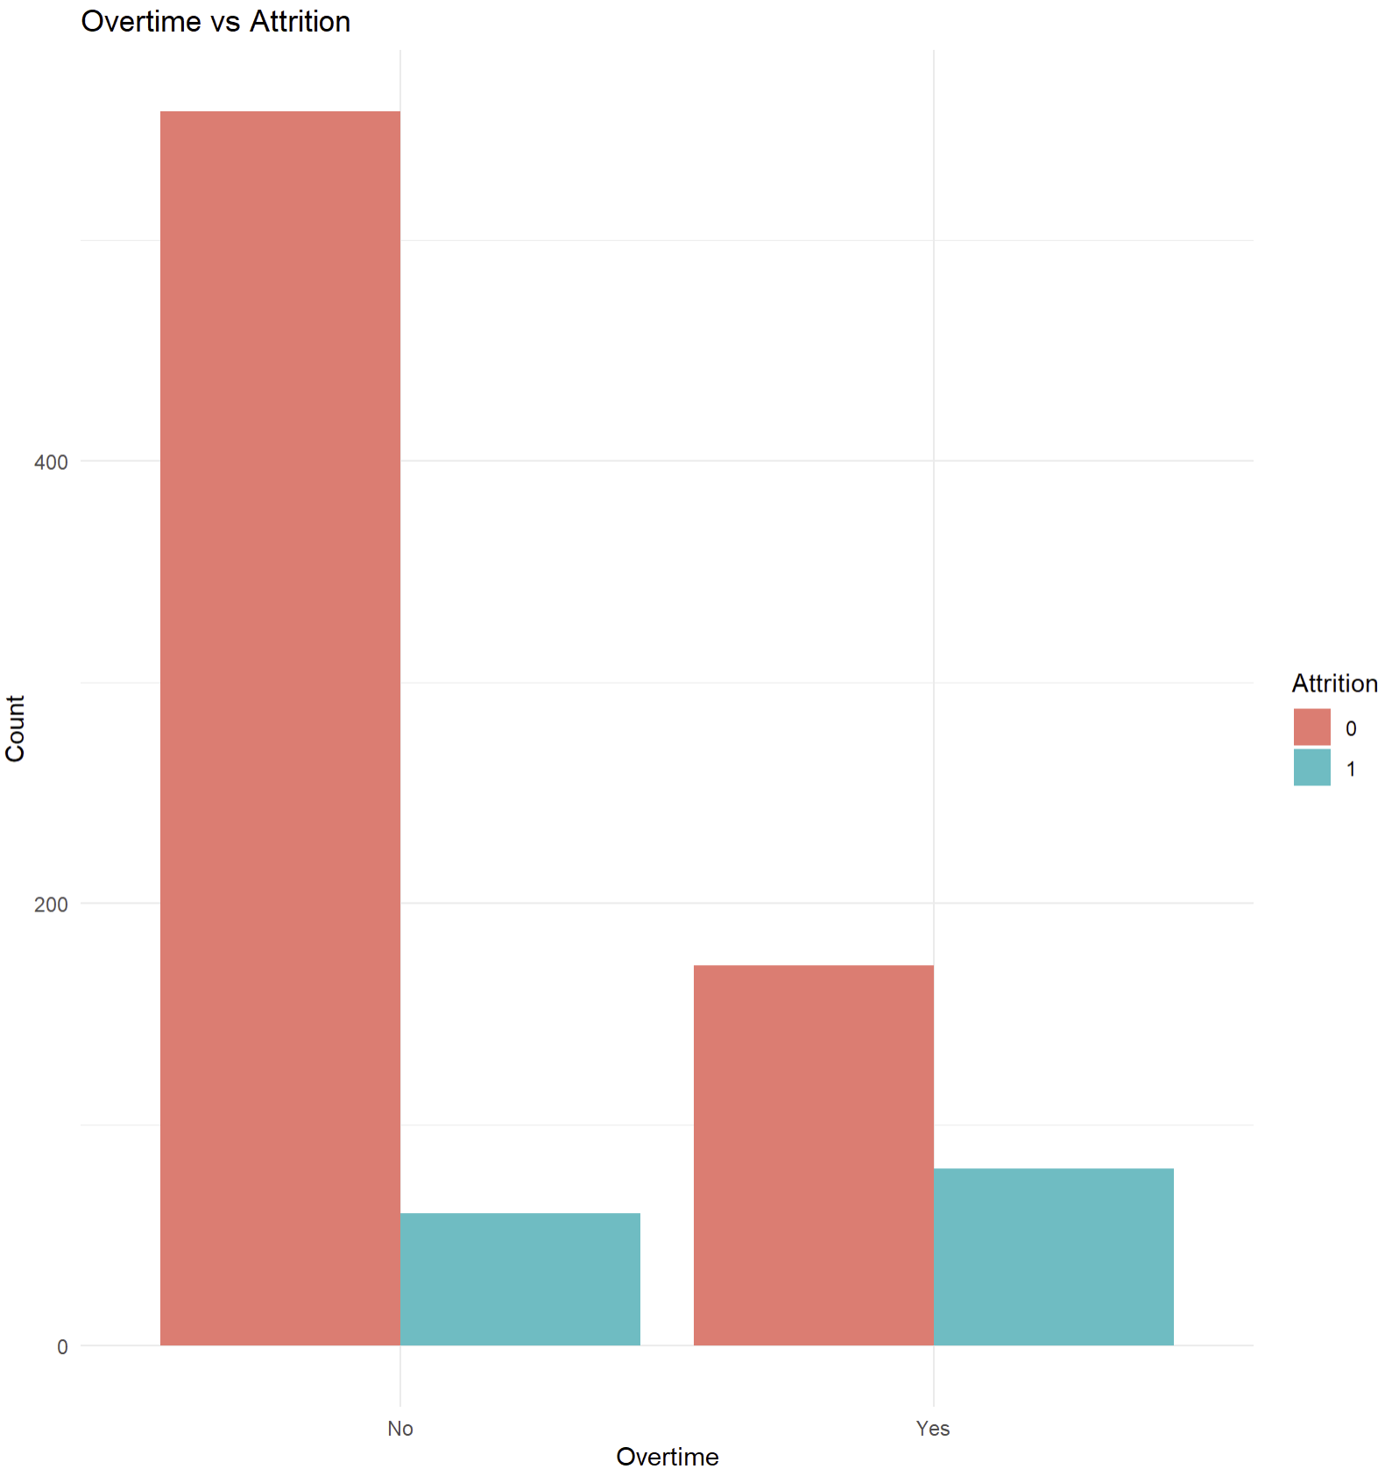
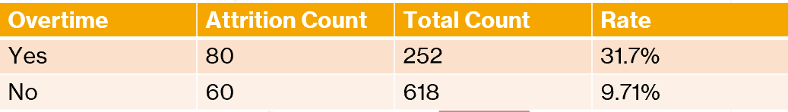
Overtime vs Attrition

Slide 13
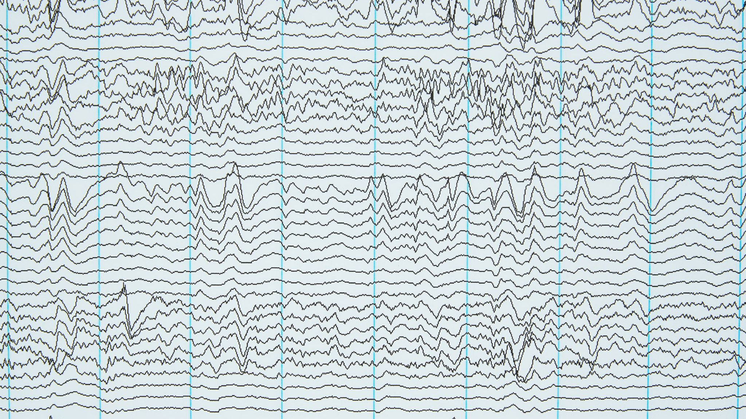
Conclusion
While we identified important variables, none of the models were able to accurately predict attrition or income.
Most of the models provided < 50% accuracy and specificity
The Naïve Bayes Model came closest at 80% accuracy, but ~30% specificity.
This is the fault of technical limitations of myself and a failure to create a model that would work.

Slide 14

thank you for your time

