Slide 1

Attrition Prediction: A Case Study On Why People Leave Companies
By DDSAnalytics

Slide 2

Where Do We Start?
We began by removing data that did not change between people
EmployeeCount, StandardHours, and Over18
Next we investigated the relationships between the different variables in the data

Slide 3
Top Factors Related to Attrition
Overtime
The most significant factor
Employees working overtime show a higher tendency towards attrition
Marital Status
The Second most influential factor
Single > Married > Divorced
Job Role
The third most significant factor
Sales Rep > HR > Lab Tech > Researcher > Sales Exec > Healthcare Rep > Manager > Manufacturing Director > Research Director

Slide 4

Top Factors Continued: The Possibilities
Over Time
An overworked and tired employee might be more willing to join a company where hours are more stable
Marital Status
Someone that does not feel obligated to others may be more likely to make riskier changes
Job Role
Some jobs may be more stressful or have high rewards for switching companies based on compensation

Slide 5

How Did We Come to These Conclusions?
Creating a correlation table yielded interesting results – after sorting through all of the relationships, 3 variables returned with the highest correlation
It’s important to note that correlation does not equal causation, but this led us to further explore the data
The coefficients were:
Overtime – 0.272
Marital Status – 0.197
Job Role – 0.09

Slide 6
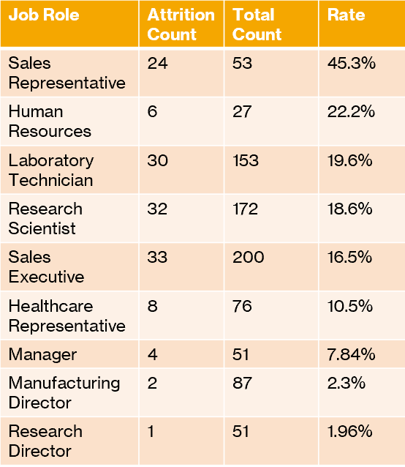
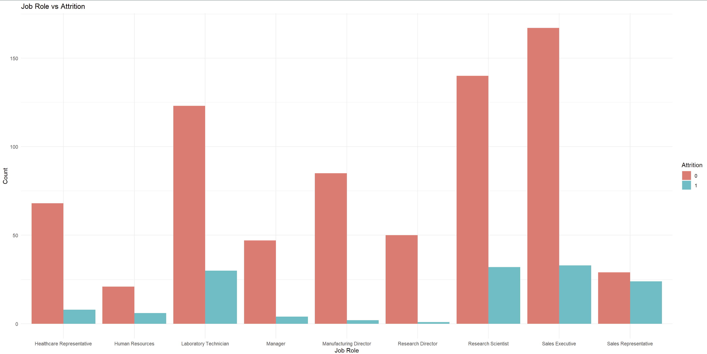
Job Role vs Attrition

Slide 7
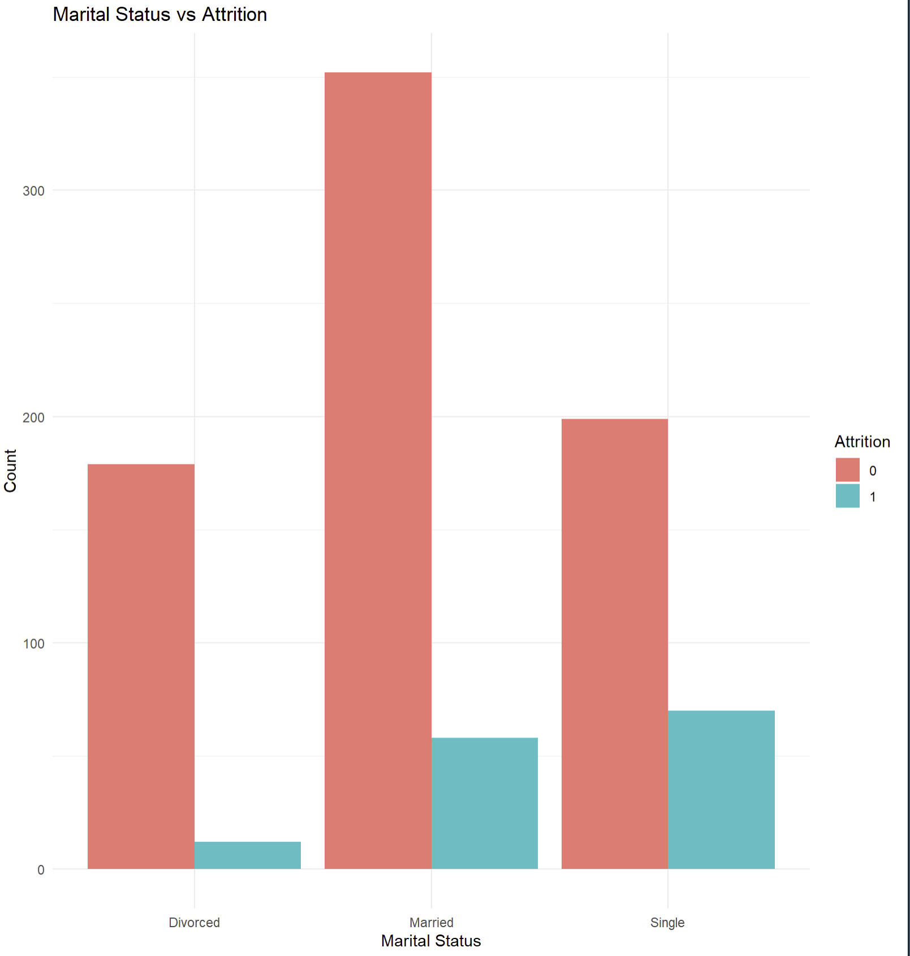
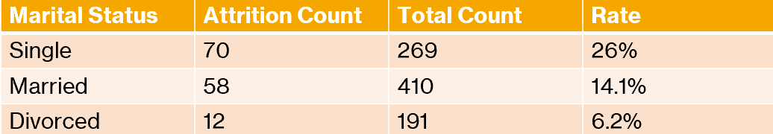
Marital Status vs Attrition

Slide 8
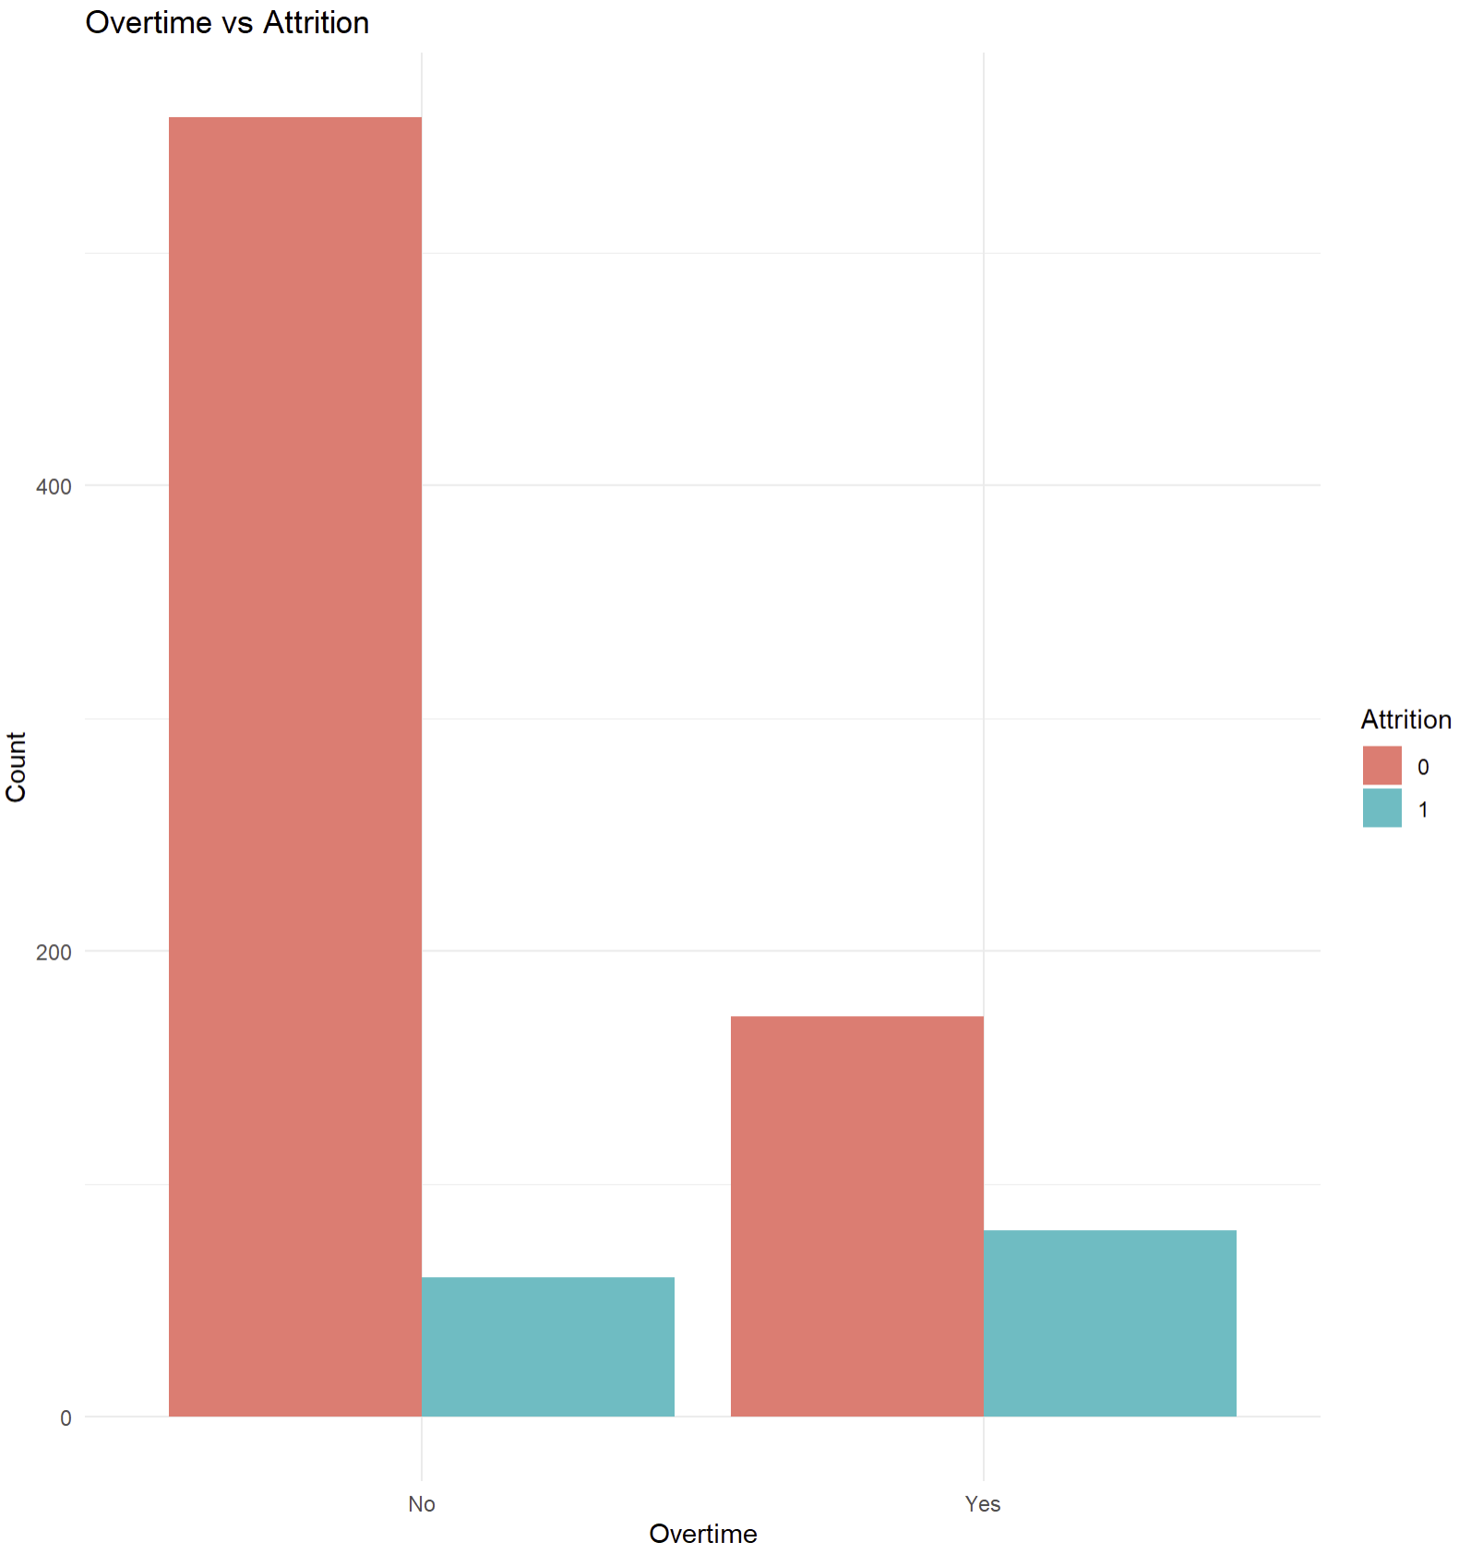
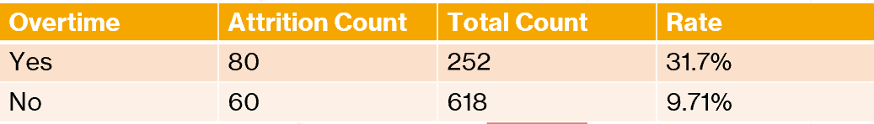
Overtime vs Attrition

Slide 9
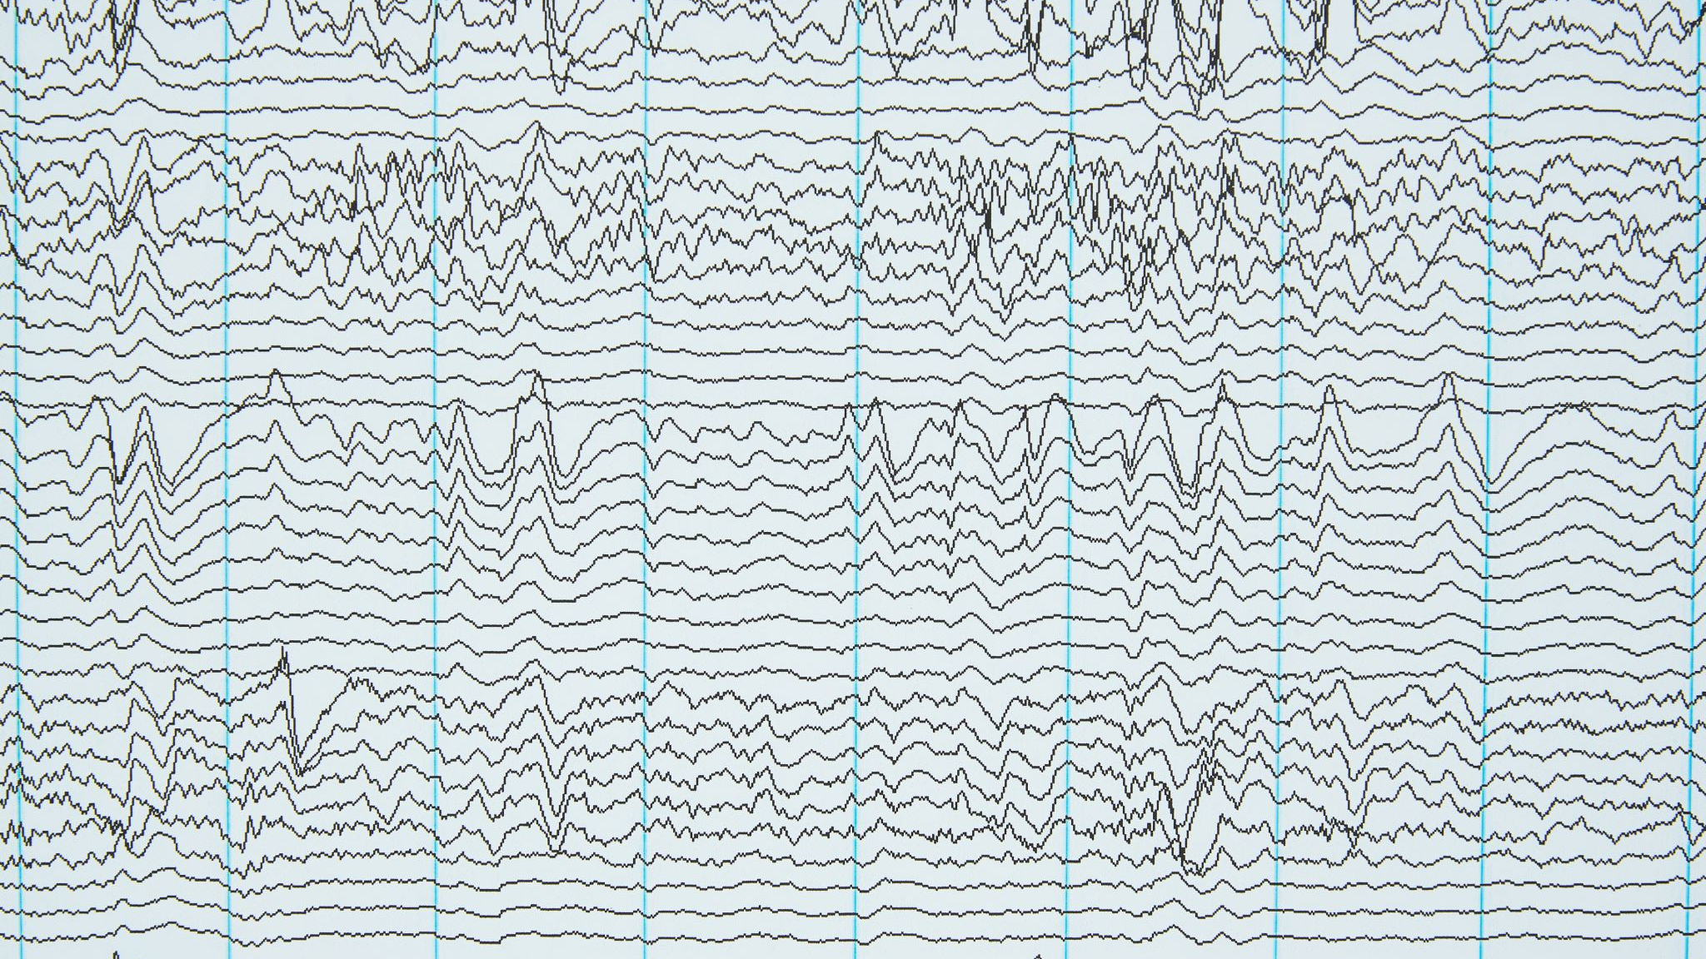
Let’s Look at Some Models
K-Nearest Neighbors
Naïve Bayes
Linear Regression

