Slide 1
Demography Spawn R Package
Ishaan Dave

Slide 2
Team at CDC
Molecular Epi and Bioinformatics Team within NCHHSTP (at CDC, of course)
Laboratory support of investigations of new/emerging retroviruses
Bioinformatics support to Public Health agencies nationwide
Eg. internal cluster to manage/store data MTNAB
Analytical support to other groups in DHAP
Suite of tools/software found here

Slide 3
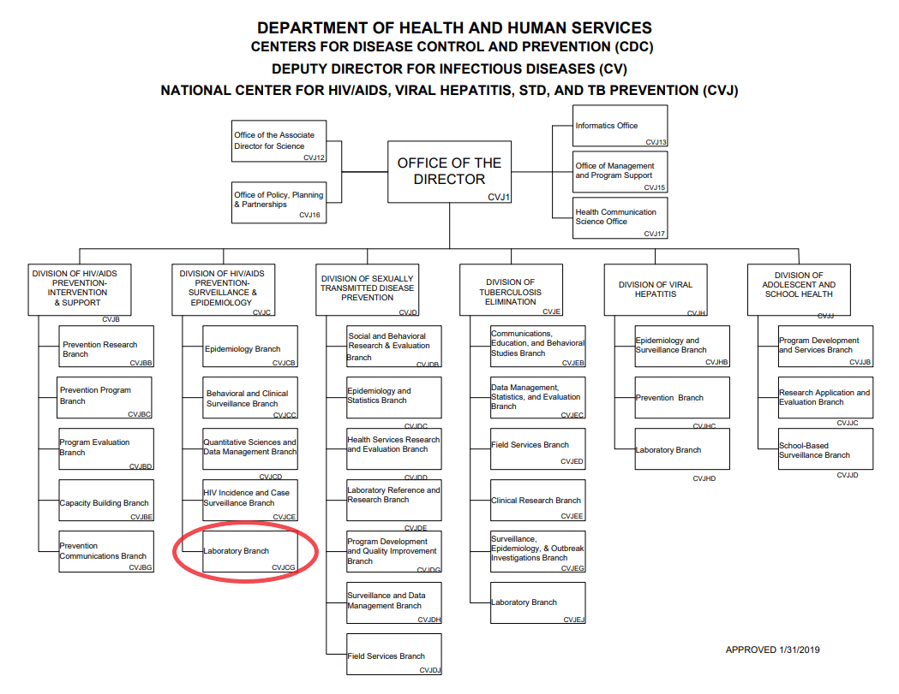
Organizational Chart
NCHHSTP Organizational Chart
Notes:
photo obtained from https://www.cdc.gov/maso/pdf/NCHHSTP.pdf

Slide 4
The Problem
Oftentimes, this group/CDC uses data with personally identifiable information (PII)
Vetting new tools, but can’t use live data
Security restrictions with use of PII
Scalable?
Not only a CDC/Public Health problem
Likely that every market Leidos works in has this issue. Plus could be used internally.

Slide 5
Potential Solution
Demography SpawnR aims to solve this – “recreates” a dataset based on distributions of variables in the original
What is a distribution?
Basically, it’s a list/function that gives all possible outcomes and likelihood they occur
Most common is the normal distribution, or the bell curve (continuous)
Can also have frequency distributions

Slide 6
Example Normal Distribution
## Warning in as.POSIXlt.POSIXct(Sys.time()): unknown timezone 'zone/tz/2019b. ## 1.0/zoneinfo/America/New_York'

Slide 7
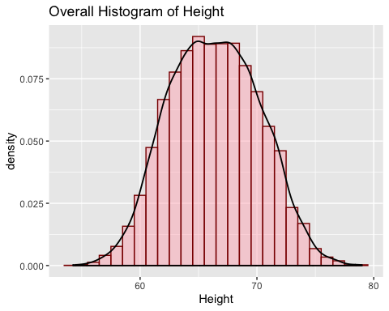

Slide 8
Example Frequency Distribution
## Warning: package 'pander' was built under R version 3.4.4

Slide 9
Color | Frequency | Percentage
Brown | 17 | 30.9%
Red | 18 | 32.7%
Blue | 7 | 12.7%
Yellow | 6 | 10.9%
Green | 4 | 7.3%
Orange | 2 | 3.6%
Colorless/White | 1 | 1.8%
The Great M&M Data

Slide 10
But…
Overall, heights ~65 inches
Sometimes, we don’t know the whole story – let’s separate by gender
There may be underlying patterns in the data we want to tease out
We just happen to know in this particular example

Slide 11
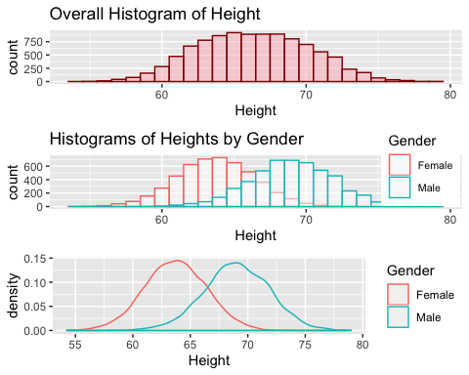
Height by Gender

Slide 12
A pattern!
Males generally taller than females
We’d like to recreate similar pattern in output dataset
(More on this later)

Slide 13
Now, what does this package do?
Goes through variables and attempts to determine each type
Continuous, categorical, string, factor, dates, etc.
A column with all different values is assumed to be sensitive information or PII
Name, address, SSN, etc.
Usually, these aren’t important in analyses, replace with missing values/NA’s.

Slide 14
How it works
Computes/determines distributions of each variable
If categorical, uses frequency/percentage of each level
For continuous variables, populates with random values that follow a normal distribution with respective means/SD
Dates
Generates kernel density estimate
Used that as “distribution” and samples – similar to an Epi curve

Slide 15
Missing Values
Categorical variables – NA / missing is included as a category
For continuous variables
percentage of missing values is calculated -> randomly inserted into each row with probability = original proportion

Slide 16
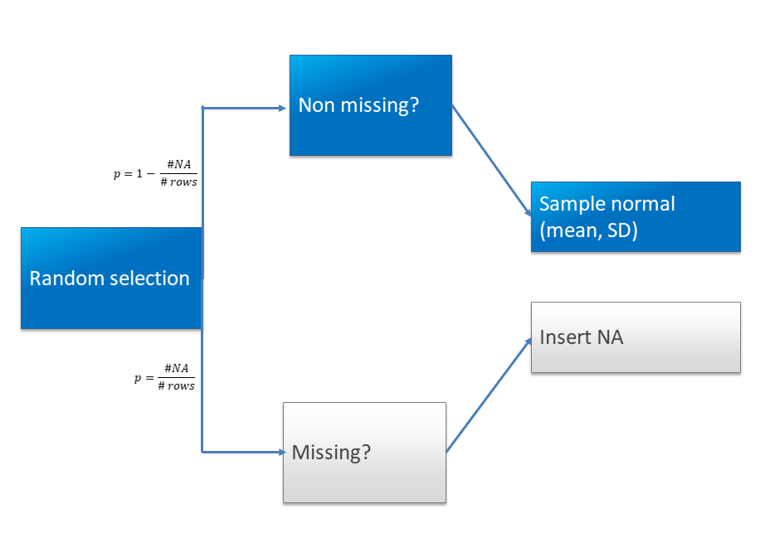
Decision Tree
Decision tree to handle missing values with continuous data

Slide 17
Example pipeline of use
Ells will likely have some fun graphics and pictures to add here
May even have slides?

Slide 18
Other functionalities
List all pairwise combinations of variables – continuous/continuous + categorical/categorical
Correlations/associations and corresponding p-value for above combinations
If user knows 2 variables to be correlated, able to input those and sample from bivariate distribution

Slide 19
Potential issues
Handling with variables that contain zeros
Categorical variables with several levels (e.g. > 10 but < # of rows)
In bivariate sampling, variables strongly associated with 2+ others
Original: Var A associated with Var B and Var C
Sampled: No guarantees Var A associated with both after sampling
Give user choice of which continuous distribution to use – lognormal, gamma, weibull, exponential, etc.
Or have package just pick best fitting distribution
If working with dates – no way to guarantee date2 comes after date1 (e.g. patient starting/stopping drug)

Slide 20
Package Website
https://cdcgov.github.io/DemographySpawnR/
Or click here

Slide 21
Acknowledgements
Tony Boyles
Ellsworth Campbell
Bill Switzer
Sherry Ketemepi
Stack Overflow

Slide 22
Comments, Questions, Concerns?
Thanks!

