Slide 1
Introduction to Quarto

Slide 2
Funding Disclosure
This work is supported by the United States Centers for Disease Control and Prevention funding under the Global Health Security Partnerships: Expanding and Improving Public Health Laboratory Strategies and Systems (Grant Number: NU2HGH000080).

Slide 3
1
Markdown Basics
Table of contents
2
Code Chunks & Automation
3
Rendering Methods
4
Example Reports
3

Slide 4




Quarto Overview
Quarto is an open-source, scientific and technical publishing system.
Create publications / reports with code!
Can be automated!
</>
Code
PDF
Word Doc
HTML

Slide 5
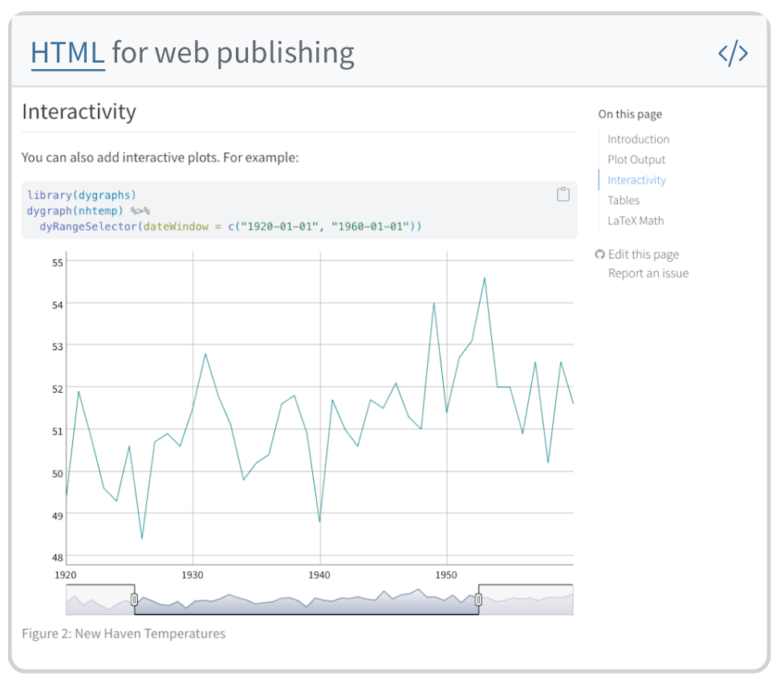

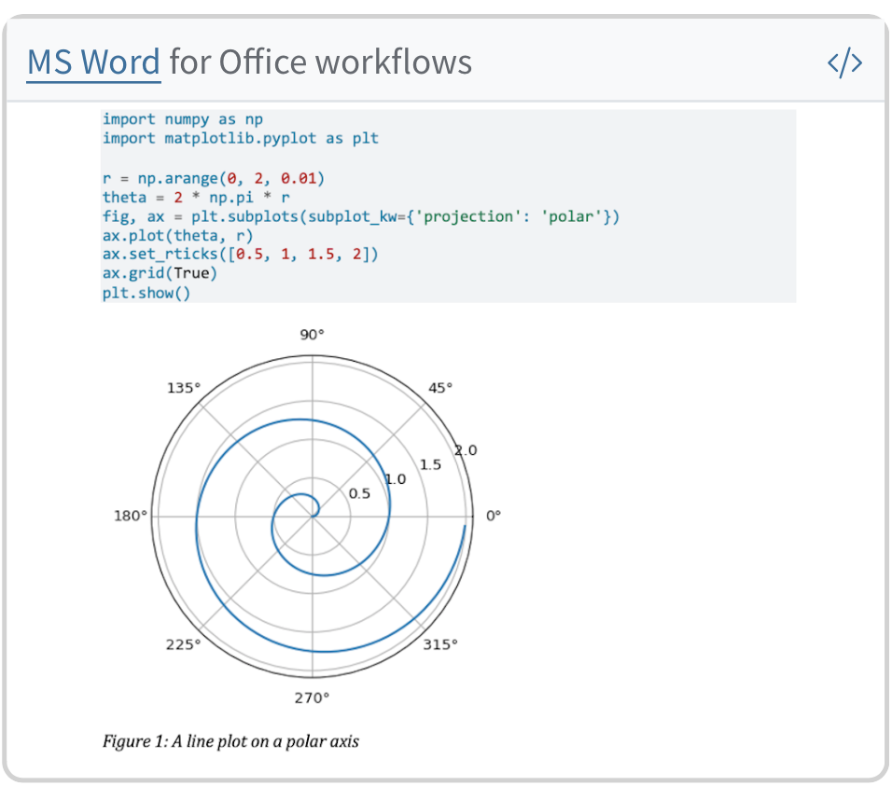
Quarto Overview
Many types of media can be produced:
Documents (articles / reports)
Presentations
Websites
https://quarto.org/docs/gallery/
Markdown and ”shortcodes” converted to HTML via Pandoc.
Markdown
Pandoc
HTML

Slide 6
Markdown Basics

Slide 7
Markdown Basics
Markdown - format media (text, images, etc.,) using plain text.
Markdown
Pandoc
HTML
Example:
Markdown
HTML
# This is a header
## This is a subheader
![This is an image](image.jpg)
<h1>This is a header<h1>
<h2>This is a subheader<h2>
<img src="image.jpg" alt=”This is an image”>

Slide 8
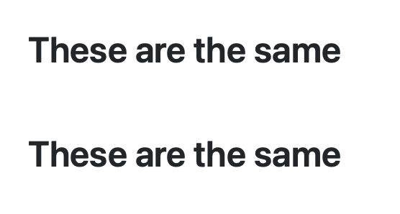
Plain HTML
Plain HTML can be used in place of markdown
Markdown & HTML
HTML (Rendered)
## These are the same
<h2>These are the same</h2>

Slide 9
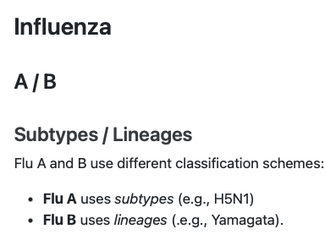
Markdown: Headers, Simple Text, & Lists
Markdown
HTML (Rendered)
# Influenza
## A / B
### Subtypes / Lineages
Flu A and B use different classification schemes:
- **Flu A** uses *subtypes* (e.g., H5N1)
- **Flu B** uses *lineages* (.e.g., Yamagata).

Slide 10
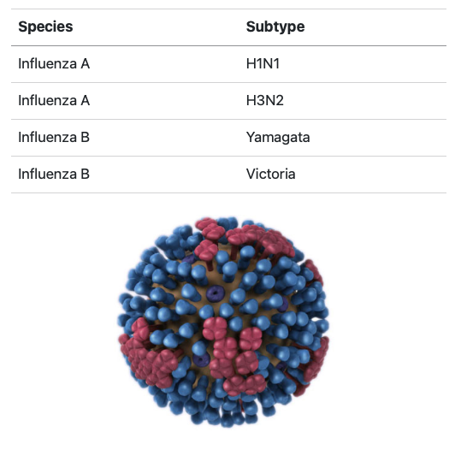
Markdown: Tables & Figures
Markdown
HTML (Rendered)
| Species | Subtype|
|-----------|--------|
|Influenza A| H1N1 |
|Influenza A| H3N2 |
|Influenza B|Yamagata|
|Influenza B|Victoria|
![](https://www.cdc.gov/bird-flu/media/images/2024/05/flu-virus.jpg)

Slide 11
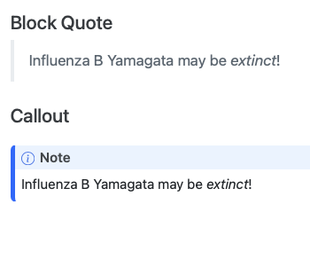
Markdown: Block quotes & Callouts
Markdown
HTML (Rendered)
#### Block Quote
> Influenza B Yamagata may be *extinct*!
#### Callout
::: {.callout-note}
Influenza B Yamagata may be *extinct*!
:::

Slide 12
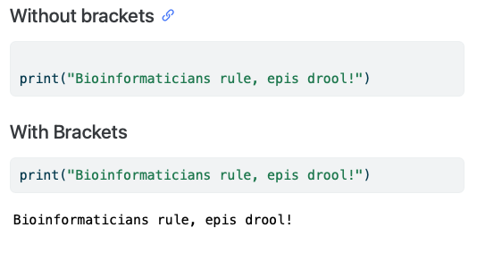
Markdown: Code Blocks
Markdown
HTML (Rendered)
#### Without brackets
```python
print("Bioinformaticians rule, epis drool!")
```
#### With Brackets
```{python}
print("Bioinformaticians rule, epis drool!")
```
Called a “chunk”
Code is executed and the result is rendered!

Slide 13
Code Chunks & Automation

Slide 14
Code “Chunk” Settings
Markdown
HTML (Rendered)
```{python}
#| echo: false
#| output: true
print("Bioinformaticians rule, epis drool!")
```
Execution settings
Only the result is returned - no code!
Option | Behavior
eval | run code
echo | show code
output | show code result
include | run code but hide all
Option | Behavior
warning | show code warnings
message | show code messages
error | show code errors
cache | cache execution result

Slide 15
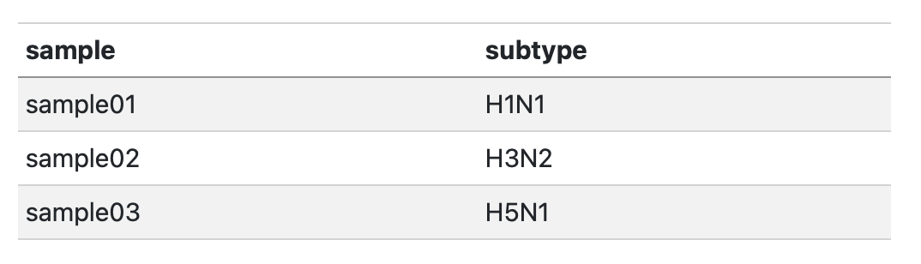
Automation with Code Chunks
Markdown
HTML (Rendered)
```{r}
#| echo: false
#| warning: false
#| message: false
#| error: false
#| output: true
df <- read.csv('results.csv')
knitr::kable(df)
```
kable renders dataframes to markdown tables!

Slide 16
Using Multiple Code Languages
Multiple coding languages can be used in a single document including Python, R, Bash, and SQL.
Python is executed via R using the reticulate package when included in the same document.
Requires configuration. Turn off with
{python, python.reticulate = FALSE}
```{r}
df <- readr::read_csv(“results.csv”)
```
```{python}
df.head()
```
Objects are shared between languages (requires reticulate)

Slide 17
Quarto Front Matter
YAML
---
title: “Influenza Report”
author:
- name: Jane Doe
date: today
format:
html:
embed-resources: true
execute:
echo: false
---
# Overview
This report includes ...
Global document configurations and metadata are defined at the start of the document in the front matter.
Metadata: title, author, date, etc.
Global Config: format, execute, etc.

Slide 18
Quarto Front Matter
YAML
---
title: “Influenza Report”
author:
- name: Jane Doe
date: today
format:
html:
embed-resources: true
execute:
echo: false
params:
species: Influenza A
subtype: H1N1
---
# Overview
This report is about {{< meta params.species >}} {{< meta params.subtype >}} ...
Global document configurations and metadata are defined at the start of the document in the front matter.
Metadata: title, author, date, etc.
Global Config: format, execute, etc.
Params: custom fields
Use short code to reference front matter metadata in the document

Slide 19
Report Development & Rendering

Slide 20
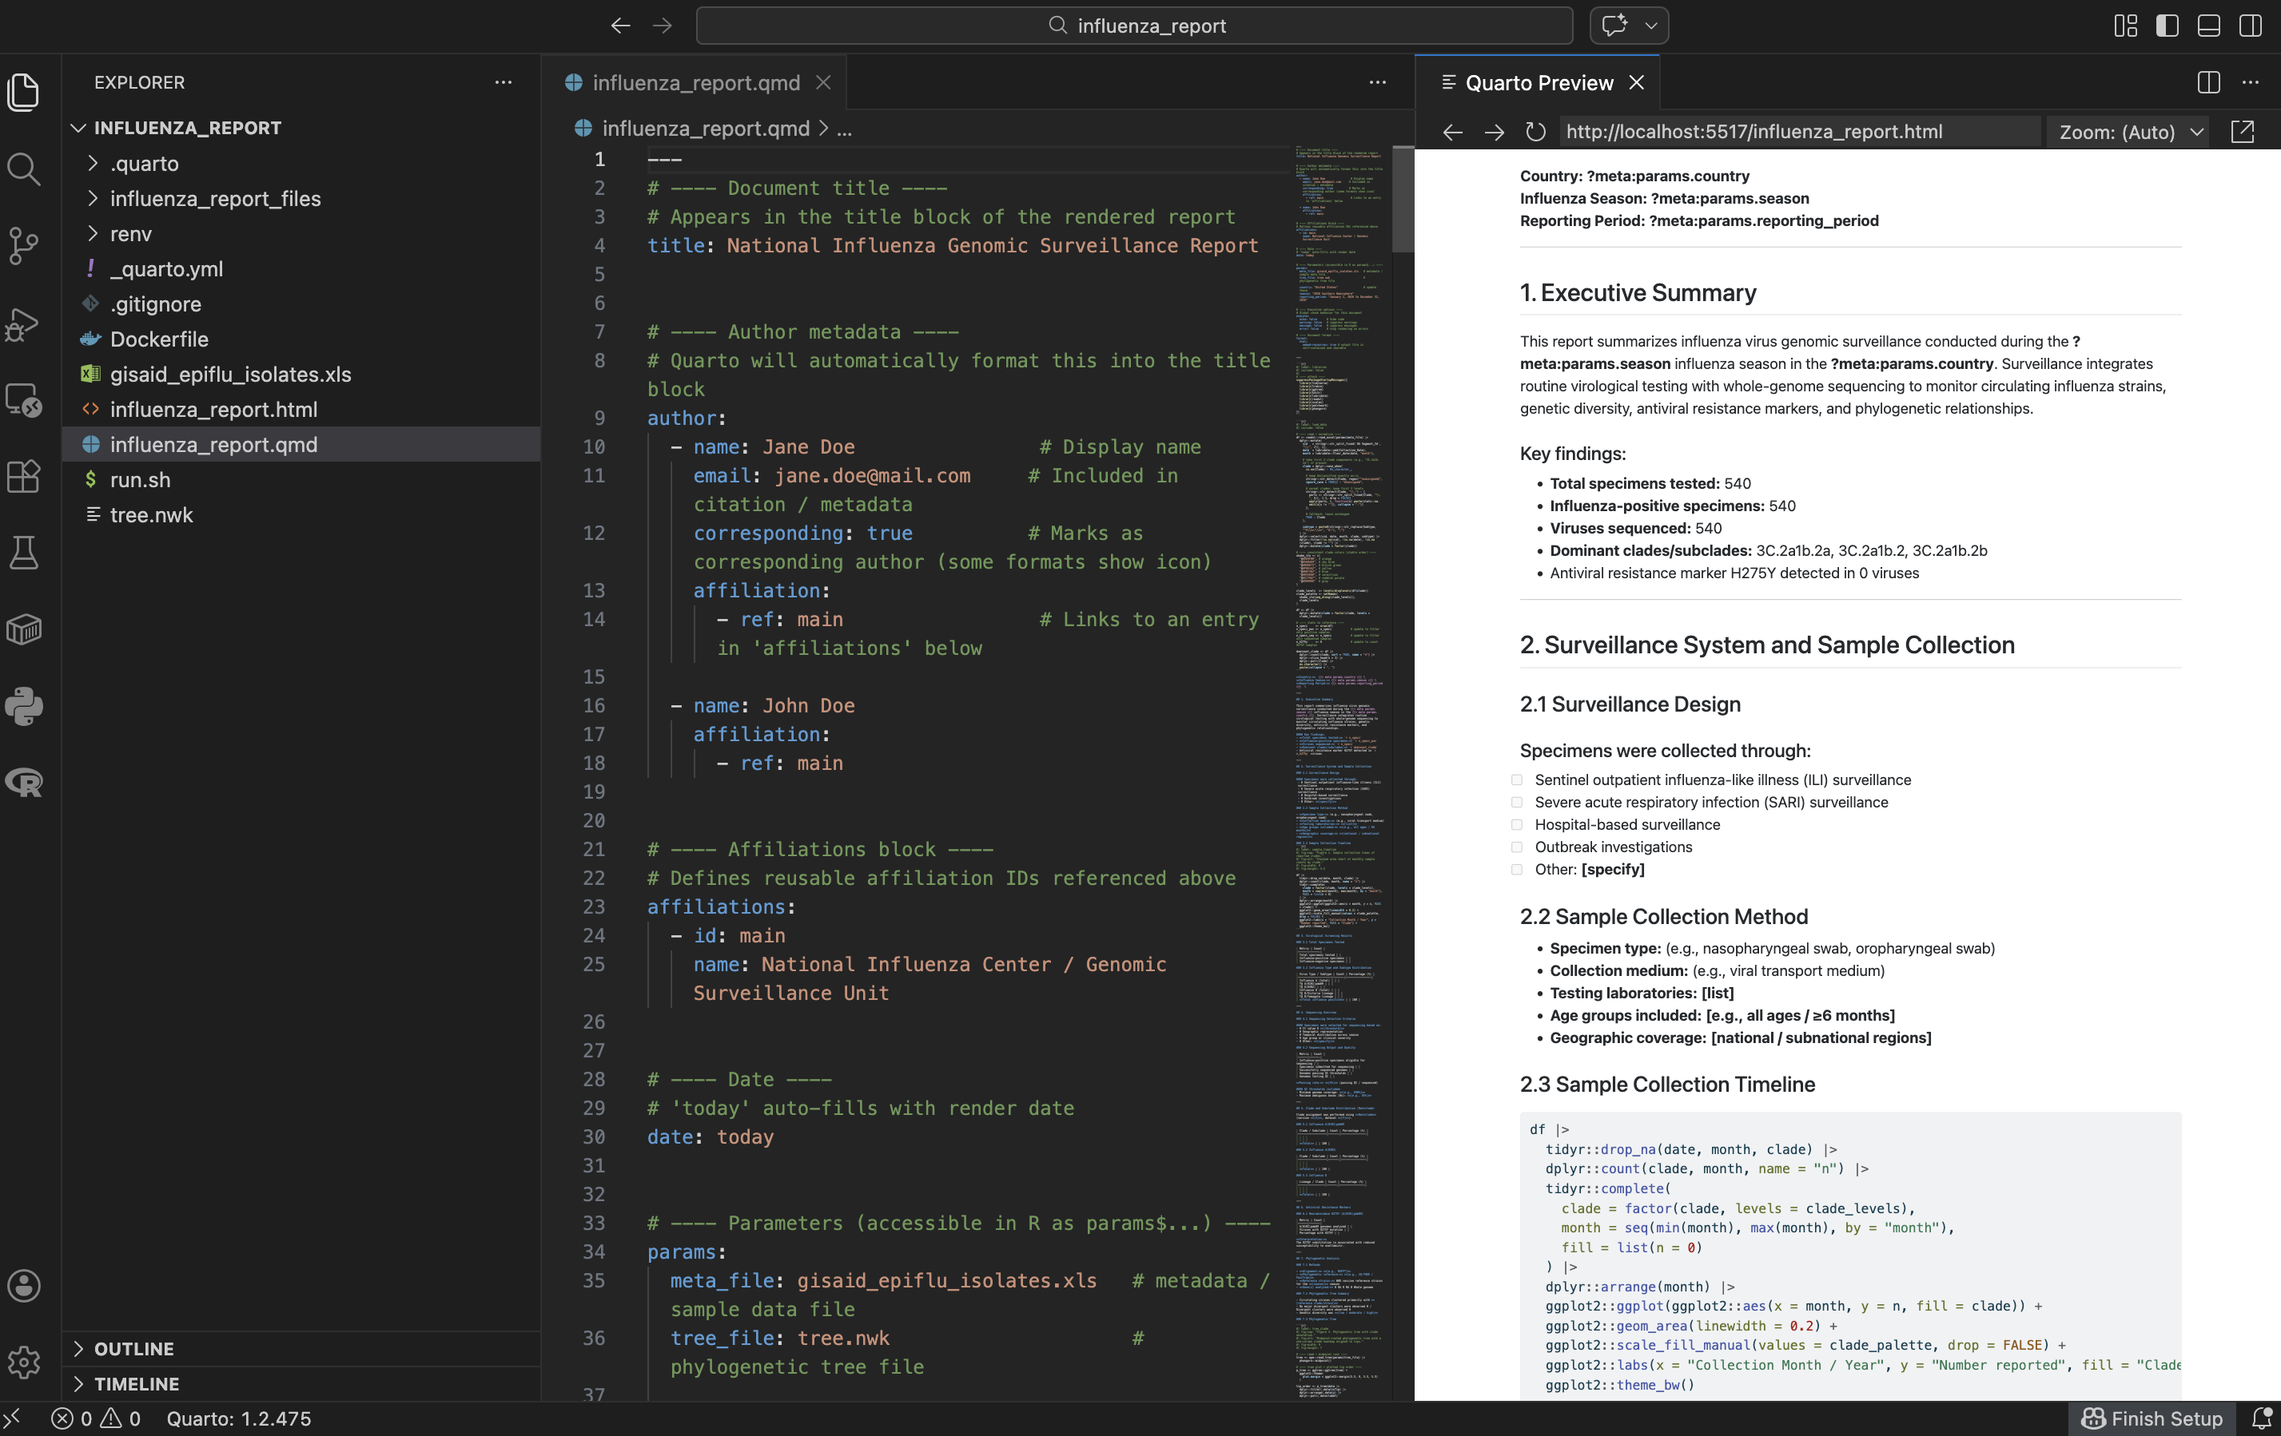
Interactive Development Environments (IDEs)
IDEs are ideal for report development or for reports that require manual edits (non-automated).
Many options:
Rstudio
Positron
Visual Studio Code
Example: Visual Studio Code

Slide 21
Basic Command-Line Use
Rendering via command-line is ideal for automation.
Shell
> quarto render \
-o $(date +"%Y-%m-%d")_report.html \
--execute-params params.yml \
report.qmd
Add timestamp to output file
Supply document parameters via a YAML file (e.g., input_file: “2026_results.csv”)
Quarto
---
params:
input_file: “results.csv”
---
```{r}
df <- read_csv(params[“input_file”])
```
Replaced by value supplied in YAML
Reference params in code!

Slide 22


Sharing Quarto reports
Embedding resources
Quarto
---
format:
html:
embed-resources: true
---
Images, themes, etc., are embedded, allowing you to share a single file
Sharing files
Share the HTML file, not the local URL
http://localhost:7779/genome_report.html
genome_report.html

Slide 23
Report Template

Slide 24

Questions?
APHL Global Health webpage
This work is supported by the United States Centers for Disease Control and Prevention funding under the Global Health Security Partnerships: Expanding and Improving Public Health Laboratory Strategies and Systems (Grant Number: NU2HGH000080).

