Slide 1

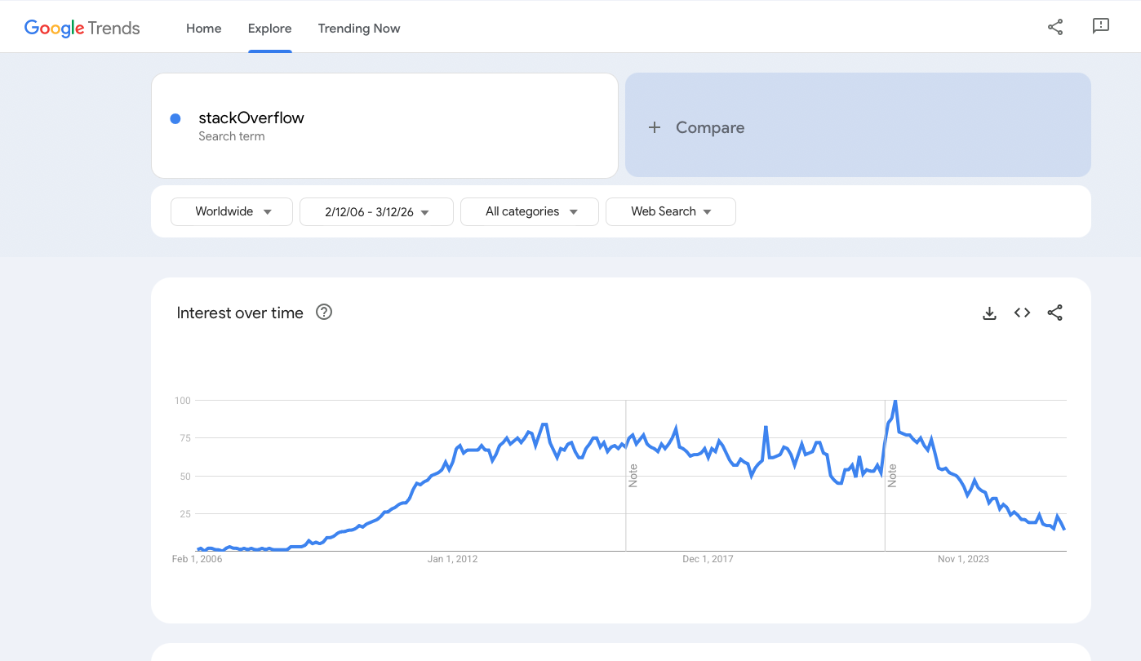
QMS and Best Practices
Leveraging QMS for Bioinformatics and programming best practices
​
Presenter Name​

Slide 2
Disclaimer

Slide 3
Module Objectives
Trainees will be able to describe a quality management system and its components
Apply quality management system (QMS) principles to pre-analytical and analytical phases of NGS workflow including quality control steps
Faculty will emphasize the importance of documentation

Slide 4
Reproducibility
Same input + same methods = same results
Core principle of computational (all) science
Record software versions
Aligners, samtools, variant callers, workflow managers
Document parameters and references
Primer schemes
Quality thresholds
Use workflow managers
Snakemake, Nextflow for structured, repeatable runs
Leverage containers
Docker or Singularity ensure consistent environments
Track changes with version control
Git for scripts and pipeline development

Slide 5
Documentation
Explains how tools and pipelines work
Inputs, outputs, parameters, and assumptions
Enables reproducibility
Others (and future you) can rerun the same analysis
Reduces errors and misuse
Clear defaults and examples prevent incorrect runs
Essential for collaboration
Shared understanding across labs, teams, and institutions

Slide 6
Documentation
Common Forms of Documentation
README files
Overview, requirements, and basic usage
Usage examples & command snippets
Copy-pasteable starting points
Parameter descriptions
What flags do, expected values, and defaults
Workflow diagrams
Visualize steps, inputs, and outputs

Slide 7
Documentation
Best Practices in writing documentation
Document data formats
FASTQ, FASTA, BAM, reference versions
Record software versions
Tools, containers, workflow managers
Include example datasets
Small test cases to validate setup

Slide 8
Documentation
Best Practices in using documentation
Start with the README
Understand the purpose, inputs, outputs, and limitations
Check versions and dates
Ensure the documentation matches the tool or pipeline version you’re using
Follow the example first
Run the provided test or example before real data
Read parameter descriptions carefully
Defaults may not match your experiment
Verify input formats
FASTQ, FASTA, BAM, sample sheets, reference builds
Look for expected outputs
Confirm files and directories match the documented results

Slide 9


Git
Git is a version control system
Tracks changes to files over time
Designed for collaboration
Multiple people can work on the same codebase
Think of it like a shared document (Microsoft office, Google docs)
Keeps a history of your work
See what changed, when, and why
Common in bioinformatics
Pipelines, scripts, documentation, and workflows
Gitlab and Github most used

Slide 10
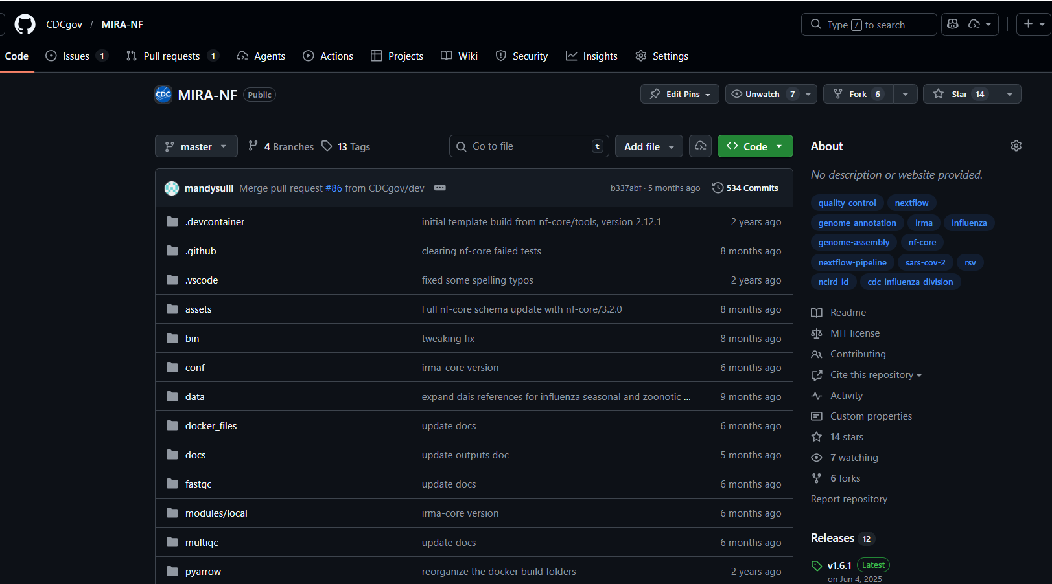
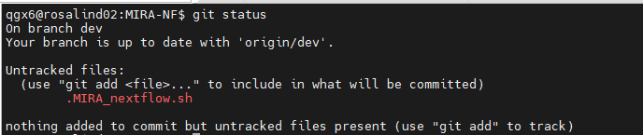
Git
Core Git Concepts
Repository (repo)
A project tracked by Git
Commit
A saved snapshot of changes with a message
Branch
A parallel version of the code for development or testing
Remote repository
Shared copy on platforms like GitHub or GitLab

Slide 11
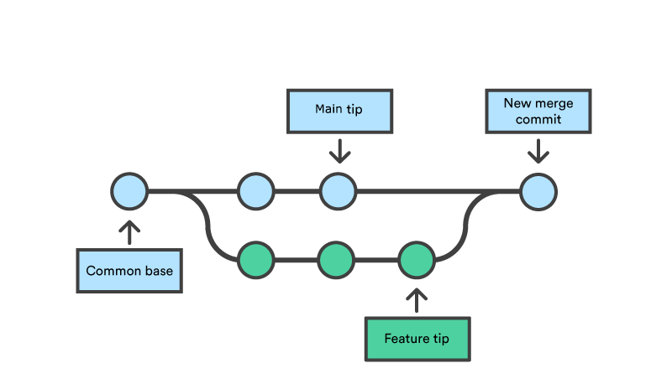
Git
Common Git Commands (User Level)
Create or get a repository
git init — start a repo
git clone <repo> — copy an existing repo
Track and save changes
git status — see changes
git add file — stage changes
git commit -m "message" — save snapshot
Sync with others
git pull — get updates
git push — share your changes
Notes:
https://www.atlassian.com/git/tutorials/using-branches/git-merge

Slide 12
Looking things up
Official documentation
Start with the tool’s official documentation or manual page (man toolname or toolname --help).
Identify the relevant section (usage, options, examples) before searching randomly online
Ctrl + F is your friend!
Look for example commands in the documentation to understand correct syntax and common workflows
Verify version-specific behavior, since options can change between tool versions
Use documentation to confirm flags, parameters, and expected inputs/outputs before running commands on real data
Notes:
https://www.atlassian.com/git/tutorials/using-branches/git-merge

Slide 13


Looking things up
Forums
StackOverflow
Biostars
LLMs
Notes:
https://www.atlassian.com/git/tutorials/using-branches/git-merge

Slide 14
Troubleshooting
End-to-end troubleshooting for NGS, Bioinformatics ​

Slide 15
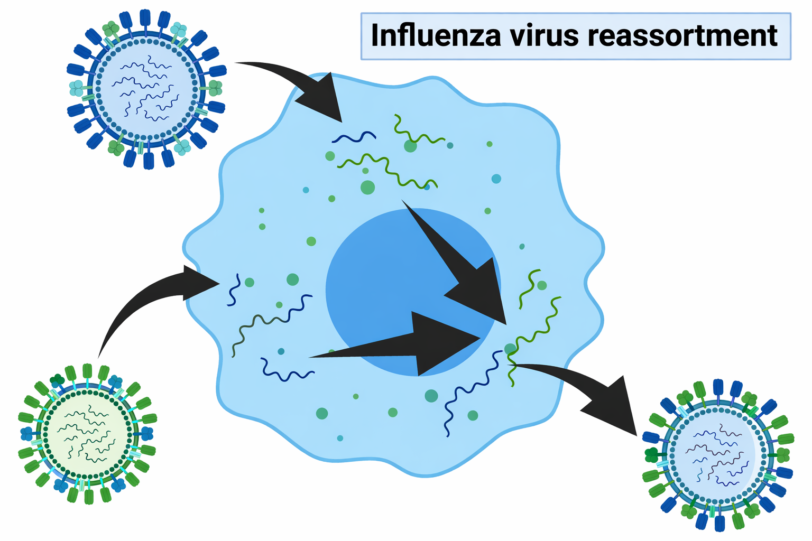
Reassortants
Reassortment occurs when two influenza viruses co-infect the same cell
Segments mix during viral replication
Produces new viral combinations
“Gene swapping” between strains
Major driver of influenza evolution
Can generate novel strains with new properties
Notes:
Adapted from https://www.biorender.com/template/influenza-virus-reassortment

Slide 16
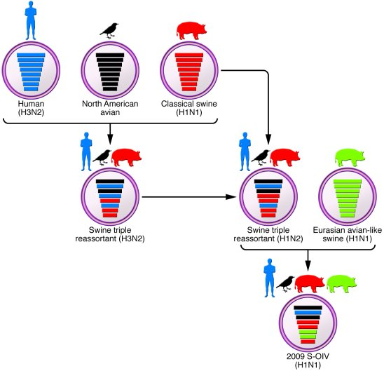
Reassortants
Major mechanism of antigenic shift
Sudden change in HA and/or NA subtype
Can create viruses with little existing population immunity
Source of pandemic emergence: 2009 H1N1 arose from reassortment among swine, avian, and human lineages
Alters viral fitness and transmissibility
Segment combinations can affect replication efficiency, host range, and virulence
Complicates surveillance and vaccine strain selection
Novel HA/NA pairings may require vaccine updates
https://www.jci.org/articles/view/44947/figure/2
Notes:
https://www.jci.org/articles/view/44947/figure/2

Slide 17
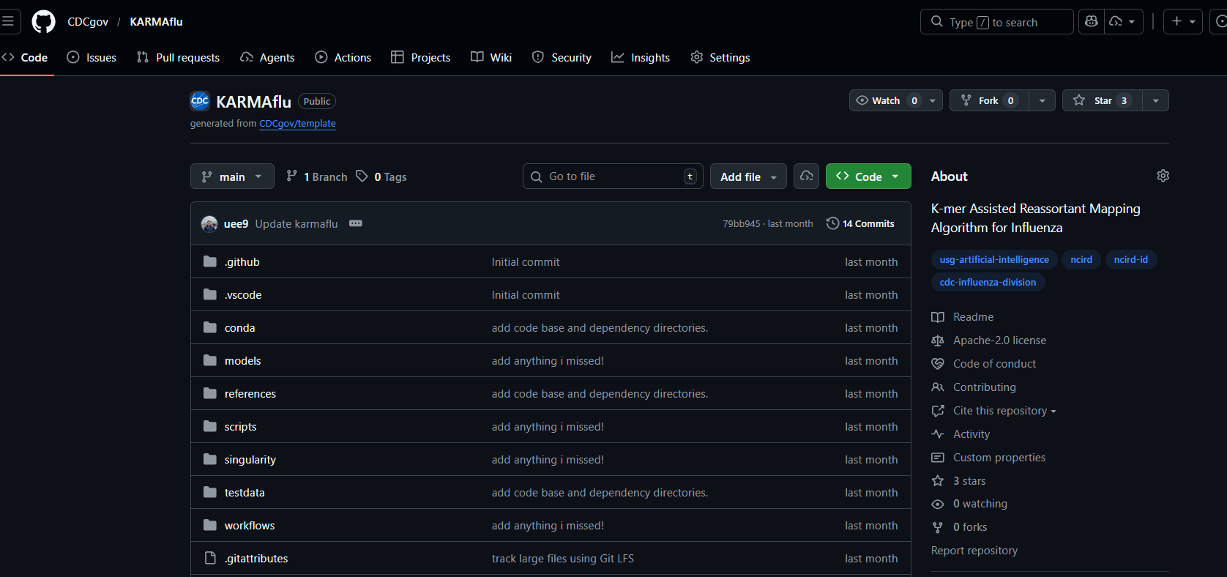
Reassortants
What happens when we detect a reassortants?
KARMAflu available (coming soon to MIRA-NF too)
Typically, it is contamination
Sometimes, it is co-infection
Rarely, it is true reassorant
How to know which?
Check SNVs
Check RT-PCR
Check .bams

Slide 18
More often: contamination
sample_id | total_reads | pass_qc | reads_mapped | reference | percent_reference_coverage | median_coverage | count_minor_snv_at_or_over_5_pct | pass_fail_reason
95f48e8a | 95828 | 95828 | 10388 | A_HA_H1 | 99.82 | 735 | 2 | Pass
95f48e8a | 95828 | 95828 | 5818 | A_MP | 100 | 686 | 148 | Count of minor variants at or over 5% > 10
95f48e8a | 95828 | 95828 | 9528 | A_NA_N1 | 99.79 | 814 | 3 | Pass
95f48e8a | 95828 | 95828 | 9146 | A_NP | 100 | 722 | 274 | Count of minor variants at or over 5% > 10
95f48e8a | 95828 | 95828 | 5704 | A_NS | 97.1 | 777 | 147 | Count of minor variants at or over 5% > 10
95f48e8a | 95828 | 95828 | 11790 | A_PA | 100 | 607 | 361 | Count of minor variants at or over 5% > 10
95f48e8a | 95828 | 95828 | 13230 | A_PB1 | 100 | 687 | 246 | Count of minor variants at or over 5% > 10
95f48e8a | 95828 | 95828 | 12175 | A_PB2 | 100 | 590 | 391 | Count of minor variants at or over 5% > 10
c282a097 | 16170 | 16170 | 1992 | A_HA_H3 | 99.82 | 158 | 35 | Count of minor variants at or over 5% > 10
c282a097 | 16170 | 16170 | 1382 | A_MP | 100 | 187 | 12 | Count of minor variants at or over 5% > 10
c282a097 | 16170 | 16170 | 1852 | A_NA_N2 | 100 | 178 | 25 | Count of minor variants at or over 5% > 10
c282a097 | 16170 | 16170 | 1720 | A_NP | 100 | 157 | 18 | Count of minor variants at or over 5% > 10
c282a097 | 16170 | 16170 | 1336 | A_NS | 97.1 | 206 | 10 | Pass
c282a097 | 16170 | 16170 | 2516 | A_PA | 100 | 148 | 22 | Count of minor variants at or over 5% > 10
c282a097 | 16170 | 16170 | 2712 | A_PB1 | 100 | 161 | 23 | Count of minor variants at or over 5% > 10
c282a097 | 16170 | 16170 | 2660 | A_PB2 | 100 | 160 | 28 | Count of minor variants at or over 5% > 10

Slide 19
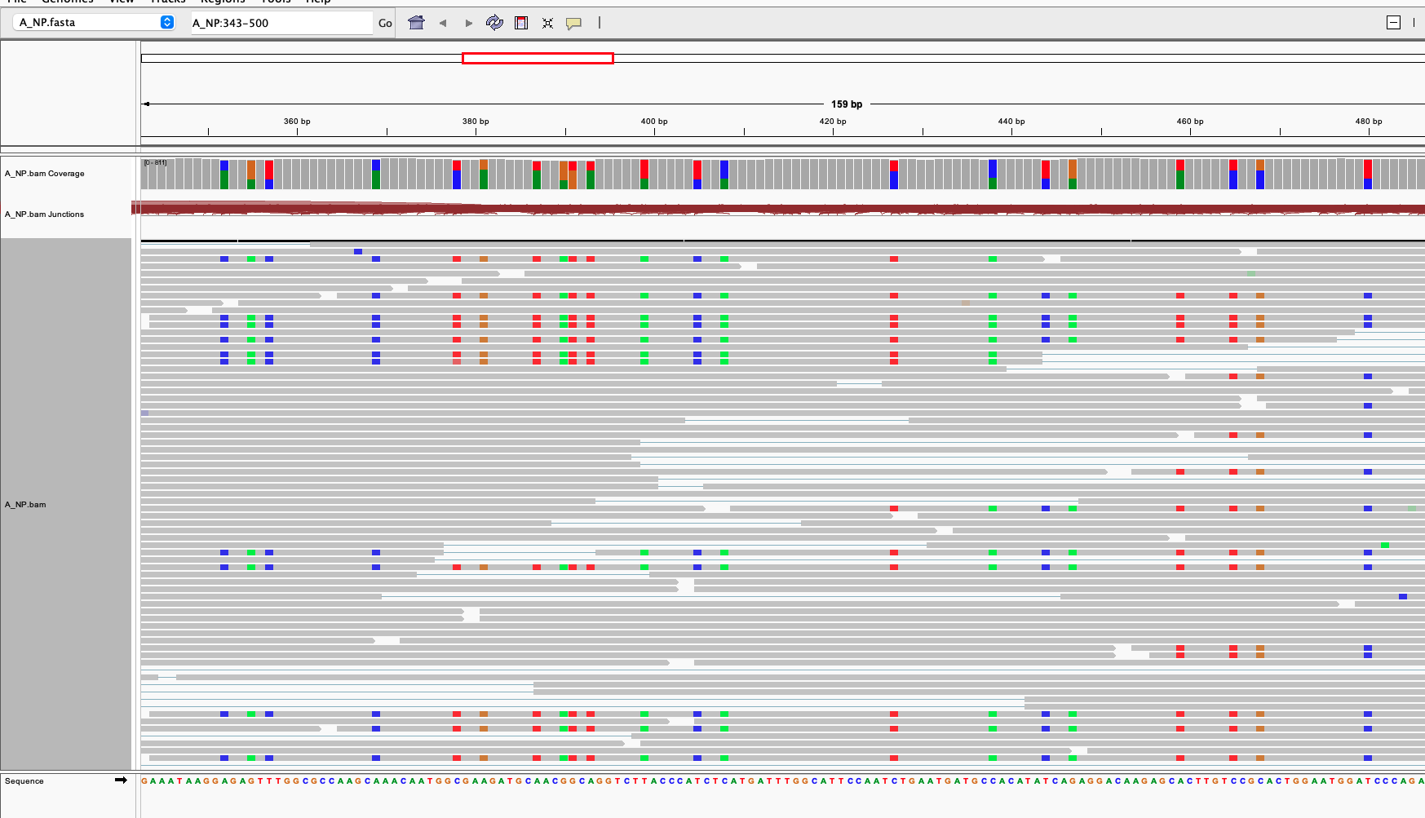
More often: contamination
Two populations are present.
One matching reference (gray) one sharing all the colored SNVs
2+ mutations on one molecule are “phased” or “linked”

Slide 20
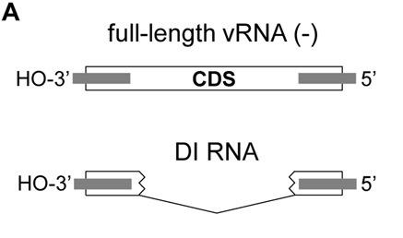
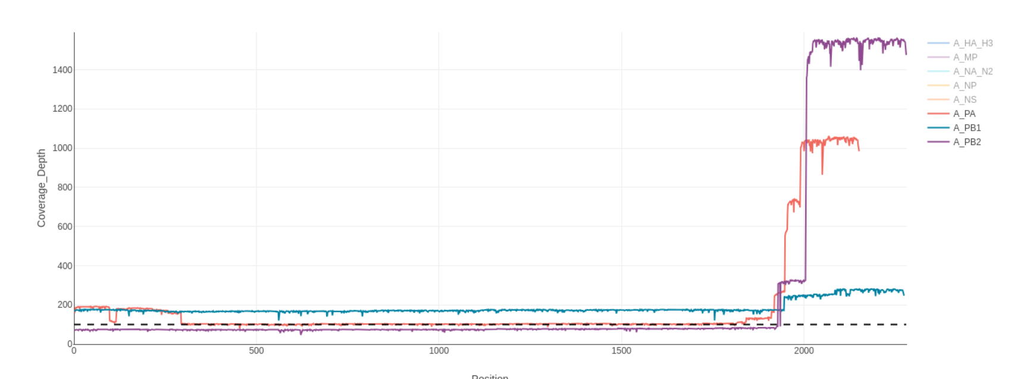
DI Particles
DI Particles can interfere with NGS
Common in polymerase segments
Coverage shape can spike at end or “bat ears”
Can create erroneous indel mutations at coverage dropoff points
https://analyticalsciencejournals.onlinelibrary.wiley.com/doi/10.1002/biot.201400429

Slide 21
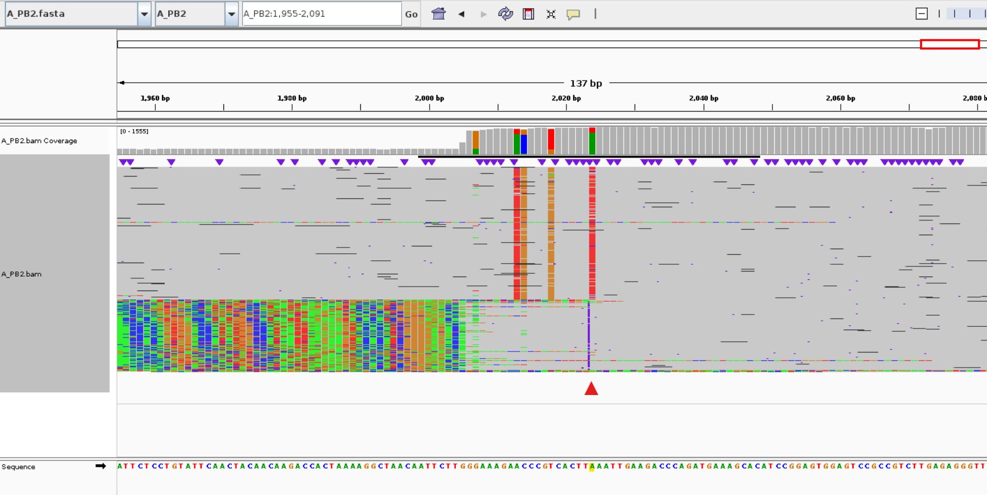
DI Particles

Slide 22
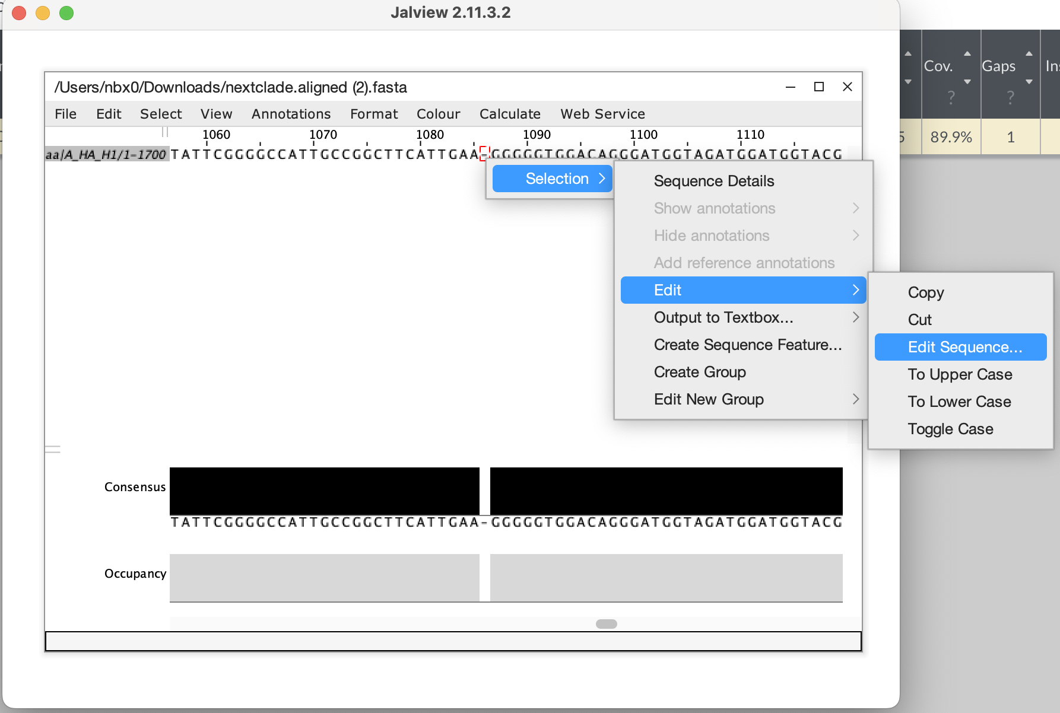
Frameshifts
Prevalent in homopolymer regions of Oxford Nanopore Sequencing
DAIS-Ribosome is frameshift-tolerant
Shows as (~) mutation
Convert back to nucleotide space and add or remove base to fix

Slide 23
Thresholds
Built-in thresholds are for standardizing QC
Statistical difference between 99x coverage and 100x coverage negligible
Consider each sample as a whole: if HA and NA pass but all other segments fail, consider why
High priority samples can be useful even when QC thresholds are not met

