Slide 1
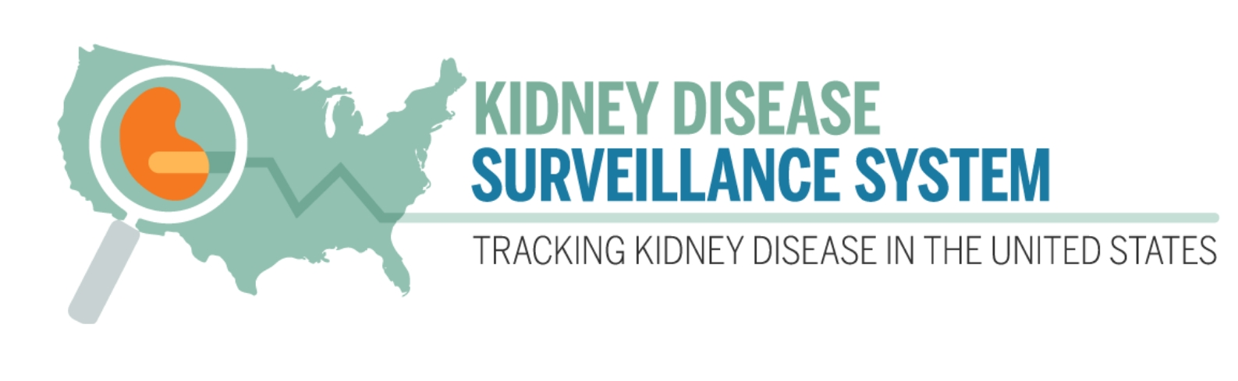
Awareness of CKD by KDIGO Risk Categories
About 1 in 7 adults have CKD; however, about 9 in 10 adults with CKD do not know they have it. Awareness of CKD was analyzed using 2017–March 2020 data from NHANES and displayed as a heatmap using KDIGO (Kidney Disease Improving Global Outcomes) guidelines. Overall, awareness of CKD was lower among adults with earlier stages, while higher awareness was seen among those with more severe or later stages of CKD. Those with moderately increased risk for CKD (yellow cells), representing 22 million U.S. adults, are often not aware of their diagnosis.
Data Source: NHANES
https://nccd.cdc.gov/CKD/detail.aspx?Qnum=Q802

Slide 2
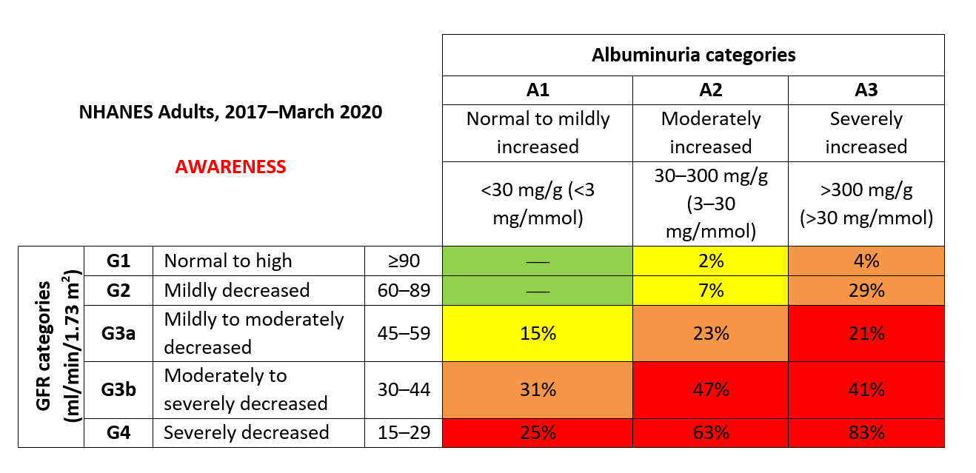
Awareness of CKD by KDIGO Risk Categories

