Slide 1

Byzantine
Generals
Problem
Anthony Soo Kaim
Ryan Chu
Stephen Wu

Slide 2
Overview
The Problem
Two Solutions
  Oral Messages
  Signed Messages
Missing Communication Paths
Reliable Systems
Conclusion

Slide 3
The Problem

Slide 4
Background
Important to have reliable computer systems
Two solutions to ensuring a reliable system
  Having components that never fail
  Ensure proper handling of cases where components fail
Byzantine Generals Problem

Slide 5
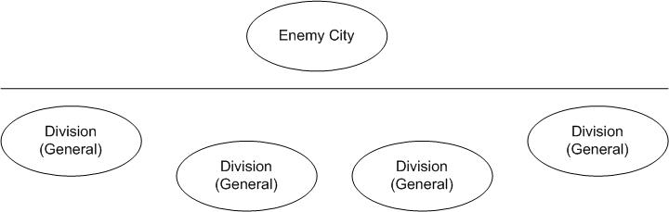
Problem
Divisions of the Byzantine army camped outside the walls of an enemy city.
Each division is led by a general.
Generals decide on a common plan of action.

Slide 6
Problem – Types of Generals
There are two types of generals
  Loyal Generals
  Traitor Generals

Slide 7
Problem – Conditions
Two conditions must be met:
  All loyal generals decide upon the same plan of action.
  A small number of traitors cannot cause the loyal generals to adopt a bad plan.

Slide 8
Problem – Not a Bad Plan
A plan that is not bad is defined in the following way:
  Each general sends his observation to all other generals.
  Let v(i) be the message communicated by the ith general.
  The combination of the v(i) for i = 1, …, n messages received determine a plan that is not bad.

Slide 9
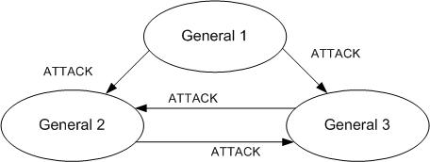
Problem – Example Not a Bad Plan
General 2 receives ATTACK, ATTACK.
General 3 receives ATTACK, ATTACK.
  So Not a Bad Plan is to ATTACK

Slide 10
Problem – Not a Bad Plan Flaw
Assumed that every general communicates the same v(i) to every other general.
A traitor general can send different v(i) messages to different generals.

Slide 11
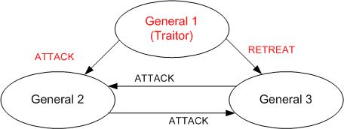
Problem – Example Flaw
General 2 receives ATTACK, ATTACK.
General 3 receives RETREAT, ATTACK.
  Is Not a Bad Plan to ATTACK or RETREAT?

Slide 12
Problem – New Conditions
The new conditions are:
  Any two loyal generals use the same value of v(i).
  If the i^{th} general is loyal, then the value that he sends must be used by every loyal general as the value of v(i).

Slide 13
Byzantine Generals Problem
A commander general giving orders to his lieutenant generals.
Byzantine Generals Problem – A commanding general must send an order to his n-1 lieutenant generals such that:
  IC1. All loyal lieutenants obey the same order.
  IC2. If the commanding general is loyal, then every loyal lieutenant obeys the order he sends.
  These are called the interactive consistency conditions.

Slide 14
Impossibility Results
When will the Byzantine Generals Problem fail?
The problem will fail if 1/3 or more of the generals are traitors.

Slide 15
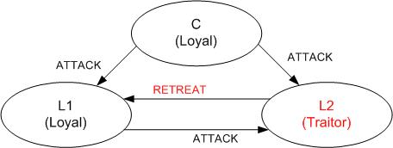
Impossibility Results – Example
L1 received the commands ATTACK, RETREAT
L1 doesn’t know which general is a traitor.

Slide 16
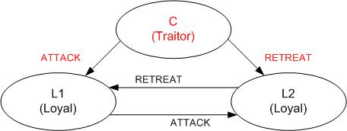
Impossibility Results – Example 2
L1 again received the commands ATTACK, RETREAT
L1 doesn’t know which general is a traitor.

Slide 17
Impossibility Results Generalization
No solution when:
  Fewer than 3m + 1 generals;
    m = number of traitor generals

Slide 18
Impossibility Results - Application
Utilized in clock synchronization as described in Dolev et al. [1986]
N > 3f
  N = number of clocks
  f = number of clocks that are faulty
Same as the Byzantine Problem!

Slide 19
A Solution with Oral Messages

Slide 20
Solution with Oral Messages
Assumptions:
  A1: Every message that is sent is delivered correctly.
  A2: The receiver of a message knows who sent it.
  A3: The absence of a message can be detected.

Slide 21
Solution with OM – Definition
majority(v₁, …, v_{n-1})
  If the majority of the values v_{i} equal v, then majority(v₁, …, v_{n-1}) is v.
  If a majority doesn’t exist, then the function evaluates to RETREAT.

Slide 22
Solution with OM – Algorithm
Case where m = 0 (No traitors)
Algorithm OM(0)
  The commander sends his value to every lieutenant.
  Each lieutenant uses the value he receives from the commander, or uses the value RETREAT if he receives no value.

Slide 23
Solution with OM – Algorithm
Algorithm OM(m), m > 0
  The commander sends his value to every lieutenant.
  For each i, let v_{i} be the value lieutenant i receives from the commander, or else be RETREAT if he receives no value. Lieutenant i acts as the commander in Algorithm OM(m-1) to send the value v_{i} to each of the n – 2 other lieutenants.
  For each i, and each j ≠ i, let v_{j} be the value lieutenant i received from lieutenant j in step 2 (using OM(m-1)), or else RETREAT if he received no value. Lieutenant i uses the value majority(v₁, …, v_{n-1}).

Slide 24
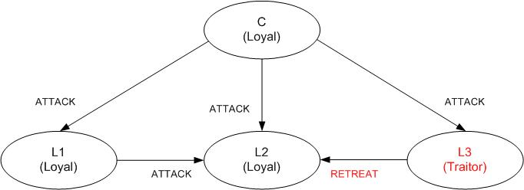
Solution with OM – Example
n=4 generals; m=1 traitors
L2 calculates majority(ATTACK, ATTACK, RETREAT) = ATTACK

Slide 25
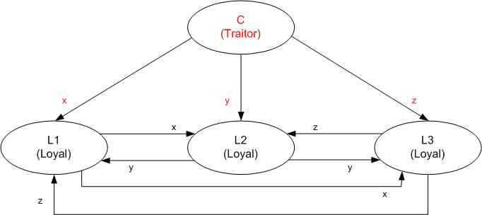
Solution with OM – Example
n=4 generals; m=1 traitors
L1, L2, L3 calculate majority(x, y, z)

Slide 26
Proof of algorithm OM(m)
Lemma 1. For any m and k, OM(m) satisfies IC2 if there are more than 2k + m generals and at most k traitors
Proof by induction on m:
  Step 1: loyal commander sends v to all n – 1 lieutenants.
  Step 2: each loyal lieutenant applies OM(m – 1) with n – 1 generals.
  By hypothesis, we have n – 1 > 2k + (m – 1) ≥ 2k.
  k traitors at most, so a majority of the n – 1 lieutenants are loyal. Each loyal lieutenant has v_{i} = v for a majority of the n – 1 values, and therefore majority(…) = v

Slide 27
Proof of algorithm OM(m)
Theorem 1. For any m, OM(m) satisfies conditions IC1 and IC2 if there are more than 3m generals and at most m traitors
Proof by induction on m:
  For no traitors, OM(0) satisfies IC1 and IC2. Assume validity for OM(m – 1) and prove OM(m) for m > 0.
  Loyal commander: k = m from Lemma 1, so OM(m) satisfies IC2.
  Traitorous commander: must also show IC1 is met:
  m – 1 lieutenants will be traitors. There are more than 3m generals and 3m – 1 lieutenants, and 3m – 1 > 3(m – 1), so OM(m – 1) satisfies IC1

Slide 28
A Solution with Signed Messages

Slide 29
Solution with Signed Messages
Simplify the problem by allowing generals to send unforgeable, signed messages
New assumption A4:
  A loyal general’s signature cannot be forged, and any alteration of the contents of his signed messages can be detected.
  Anyone can verify the authenticity of a general’s signature.

Slide 30
Solution with Signed Messages
New function: choice(V), takes in a set of orders and returns a single order. Requirements:
  If V contains a single element v, choice(V) = v
  choice(empty set) = retreat
Notation for signed messages:
  x : i denotes the value x is signed by General i
  v : j : i denotes v is signed by j, and v : j is signed by i
  Each lieutenant maintains a set V_{i}, containing the set of properly signed orders he has received so far

Slide 31
Algorithm SM(m)
Commander signs and sends v to every lieutenant.
For each i:
  If i receives a message v : 0 from the commander and he has not yet received any order, then V_{i} = {v} and he sends message v : 0 : i to every other lieutenant.
  If i receives a message v : 0 : j_{i} … j_{k} and v is not in V_{i}, then add v to V_{i.} If k < m, then send the message v : 0 : j_{i} … j_{k} : i to every lieutenant other than j_{i} … j_{k}
For each i:
  when lieutenant i will receive no more messages, he obeys order choice(V_{i}).

Slide 32
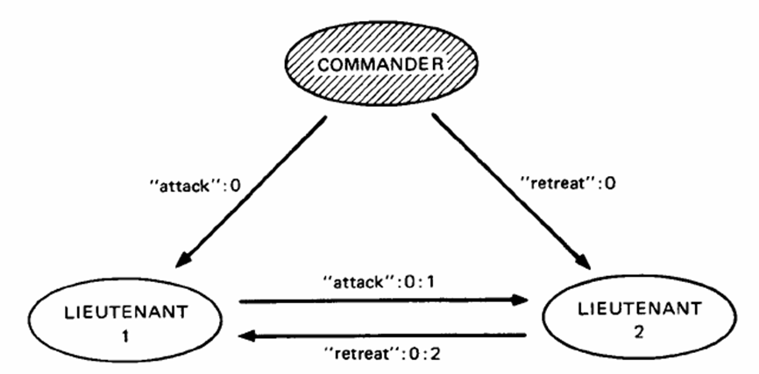
Algorithm SM(1); the commander is a traitor

Slide 33
Proof of algorithm SM(m)
Theorem 2. For any m, SM(m) solves the Byzantine Generals Problem if there are at most m traitors.
Loyal commander: sends v : 0 to all lieutenants, which cannot be forged. A loyal lt will receive only v : 0
V_{i} will contain only v, showing IC2
Traitorous commander: prove IC1 by showing if i puts order v into V_{i} in step 2, then j must also put order v into V_{j} in step 2.
i receives message v : 0 : j₁ : … : j_{k}. Is j one of the j_{i}?
If not, one of j₁ … j_{k} must be loyal, who sent j the value v

Slide 34
Missing Communication Paths

Slide 35
Missing Communication Paths
New restriction: physical barriers that may restrict sending. The generals now form the nodes of a simple, finite, undirected graph
  A set of nodes {i₁, …, i_{p}} is a regular set of neighbors of node i if: each i_{j} is a neighbor of i, and
  for any general k different from i, there exist paths p_{j,k} from i_{j} to k not passing through i such that any two different paths p_{j,k} have no node in common other than k
  G is said to be p-regular if every node has a regular set of neighbors consisting of p distinct nodes

Slide 36
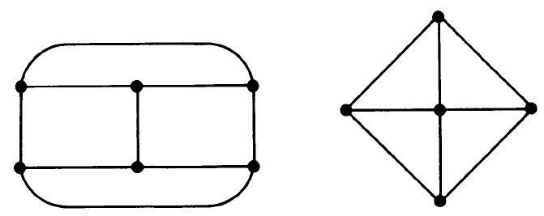
P-regular graphs

Slide 37
Algorithm OM(m, p)
Choose regular set of neighbors N of the commander consisting of p lieutenants
Commander sends his value to every lieutenant in N
For each i in N, lieutenant i receives value v_{i} from the commander, or else RETREAT if he receives no value. i sends v_{i} to every other lieutenant k as follows:
  m = 1: send the value along the path p_{i,k}
  m > 1: act as the commander in OM(m – 1, p -1), with the original commander removed from graph G
For each k and i in N with i ≠ k, let v_{i} be the value Lieutenant k received from i in step 2, or RETREAT if he received no value. Lieutenant k uses the value majority(v_{i1}, …, v_{ip}), where N = {i₁, …, i_{p}}

Slide 38
Proof of algorithm OM(m, p)
Similar to the proof for OM(m)
Lemma 2. For any m > 0 and any p ≥ 2k + m, OM(m, p) satisfies IC2 if there are at most k traitors
Theorem 3: For any m > 0 and any p ≥ 3m, OM(m, p) solves the Byzantine Generals Problem if there are at most m traitors

Slide 39
Missing paths for Signed Messages
Oral message solution is overly restrictive
We can extend signed messages more easily!
Theorem 4. For any m and d, if there are at most m traitors and the sub-graph of loyal generals has diameter d, then SM(m + d – 1) solves the Byzantine Generals Problem.
Corollary. If the graph of loyal generals is connected, then SM(n – 2) solves the Byzantine Generals Problem.

Slide 40
Reliable Systems

Slide 41
Implementation of Reliable Systems
How to implement?
  Intrinsically reliable circuit components
  Redundancy – use multiple processors
    Each processor computes same result
    Majority vote to obtain one result
    Examples
      Protect against failure of a single chip
      Missile defense system
Notes:
So far we’ve only considered the problem in terms of Byzantine Generals

Slide 42
Majority Voting
Assumption: all nonfaulty processors produce the same output
  True as long as all use same input
  Problem: processors can receive different input values.
    Any single input value comes from a single physical component
    Malfunctioning component can give different values
    Non-faulty component can give different values if read while value is changing

Slide 43
Conditions for a Reliable System
  All nonfaulty processors must use the same input value (so they produce the same output)
  If the input unit is nonfaulty, then all nonfaulty processes use the value it provides as input (so they produce the correct output)
Really just IC1 and IC2.
  Commander → Input unit
  Lieutenants → Processors
  Loyal → Nonfaulty

Slide 44
A Hardware Solution
A hardware solution for the input problem?
  Tempting, but unfeasible
  Example: make all processors read from one wire
    Faulty input unit could send marginal signal
    Different processors could interpret as a 0 or a 1
    No way to guarantee same value is used without having processors communicate among themselves

Slide 45
Faulty Input Units
What about faulty input units?
  Byzantine General’s solution can only guarantee same value is used
  If input is important, use redundant input units
  Redundant inputs cannot achieve reliability in itself

Slide 46
Nonfaulty Input Units
What if a nonfaulty input unit gives different values because it is read while the value is changing?
  Still want processors to obtain reasonable input values
  Take the choice and majority functions to be the median function
    Assume reasonable range of input values → value obtained by processors is within the range of input values provided

Slide 47
Reliable Computing Systems
How do we apply the solutions OM(m) and SM(m) to computing systems?
“Easy” to implement the algorithm in a processor
Problem is in implementing the message passing system
Need to meet assumptions A1 – A4
Notes:
So far, just stated solutions in terms of the Byzantine General’s Solution

Slide 48
Assumption A1
A1: Every message sent by a nonfaulty processor is delivered correctly.
For OM(m), communication line failure indistinguishable from processor failure
  Works with up to m failures (processor or communication line)

Slide 49
Assumption A1
SM(m) is insensitive to communication line failure
  Assumes a failed connection cannot result in the forgery of a signed message
  Communication line failure equivalent to removing the line
    Reduces connectivity of graph

Slide 50
Assumption A2
A2: A processor can determine the originator of the message received.
Means a faulty processor cannot impersonate a nonfaulty one
If we assume messages are signed, we can get rid of this assumption
Notes:
Impersonation of a another process implies forging its messages

Slide 51
Assumption A3
A3: The absence of a message can be detected.
Use timeouts
  Requires two assumptions:
    Fixed max time needed for the generation and transmission of a message
    The sender and receiver have clocks that are synchronized to within some fixed maximum error
Notes:
The absesne of a message can only be detected by its failure to arrive within a fixed length of time

Slide 52
Assumption A3 – Using Timeouts
Any message sent should be received by time: T + τ + µ
  µ: max generation and transmission delay
  τ: max difference between clocks
  T: time at which processor begins to generate message
Ex. For SM(m), a processor must wait until time T₀ + k(τ + µ)
  T₀ : Time at which commander sends message
  k: number of signatures on message
Notes:
If the receiver has not received the message by this time, we can assume the message was not sent.
If it arrives later, then the sender must be faulty
By fixing the time at which the input processor sends its value, we can calculate the time at which the message should have arrived by.
Problem of clock synchronization already covered in class and beyond the scope of the topic

Slide 53
Assumption A4
A4: Processors can sign their messages in such a way that a nonfaulty processor’s signature cannot be forged.
What is a signature?
  Redundant information S_{i}(M)
    Generated by process i from a message M
    A message signed by i is sent with the signature:
      (M, S_{i}(M))

Slide 54
Assumption A4
Vulnerable to “replay” attacks
  Use sequence numbers to guarantee uniqueness
To meet parts (a) and (b) of A4, S_{i} must have the following two properties:
  If processor i is nonfaulty, the no faulty processor can generate Si(M)
  Given M and X, any process can determine if X = S_{i}(M)

Slide 55
Assumption A4 – Function S_{i}
Property (a) is impossible to guarantee
  We can make the probability of violation as small as we want (… and as reliable as we want)
  How? Depends on types of faults we expect…
    Random Malfunction
      Make S_{i} a “randomizing” function
    Malicious Intelligence
      Ex. A hacker trying to disrupt the system
      Becomes a cryptography problem
Notes:
Signature can always be “guessed”
Signature is just a data item, and any faulty processor can generate any data item
Probability that a random malfunction in a processor generates a correct signature is equal to the probability of generating one through a random choice procedure

Slide 56
Conclusion

Slide 57
Complexity
Solutions OM and SM are expensive in both time and number of messages required
  Both require message paths of length up to m + 1
    This is optimal.
    For graphs not completely connected, require paths with length up to m + d
      d: diameter of the subgraph of loyal generals
  Both require up to (n – 1)(n – 2) … (n – m – 1) messages to be sent.
    Can be reduced by combining messages.
Notes:
Each lieutenant may have to wait for messages originating from the commander which were then relayed via m other lieutenants
Has been shown that this is true for any algorithm that can deal with up to m traitors

Slide 58
Conclusion
Achieving reliability in the face of arbitrary malfunctioning is a difficult problem
Solution inherently expensive
  Can reduce cost by making assumptions of type of failure that can occur
    Reduces reliability
Notes:
Ex, can assume a computer may fail to respond but will never respond incorrectly.
When highest reliability is required, we cannot make these assumptions.

