Slide 1
Paxos Made Simple
Gene Pang

Slide 2
Paxos
L. Lamport, The Part-Time Parliament, September 1989
Aegean island of Paxos
A part-time parliament
Goal: determine the sequence of decrees passed
Lamport related their protocol to fault-tolerant distributed systems

Slide 3
So Simple, So Obvious
“In fact, it is among the simplest and most obvious of distributed algorithms.”
- Leslie Lamport

Slide 4
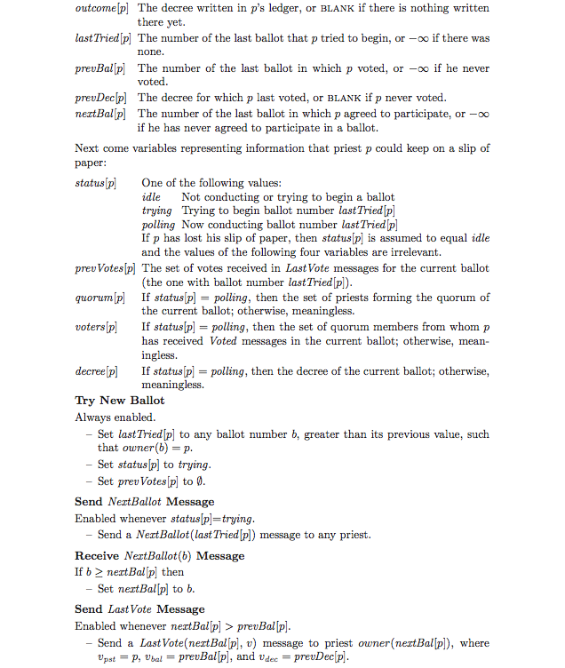
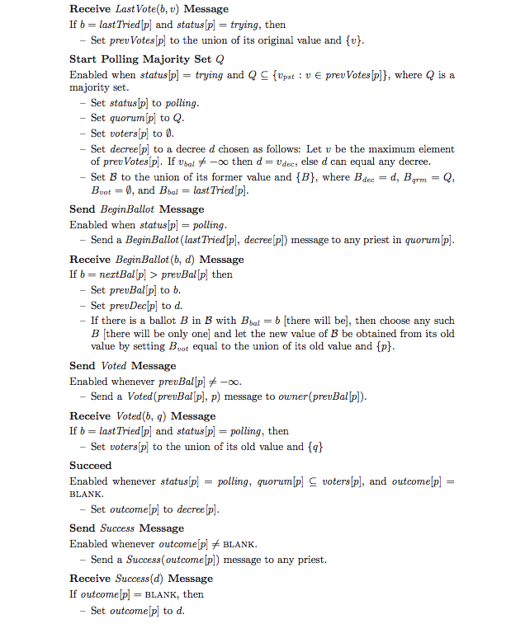
Simple Pseudocode

Slide 5
Paxos Made Simple - 2001
It actually IS simple
Lamport walks through the algorithm
Distributed consensus problem
Group of processes must agree on a single value
Value must be proposed
After value is agreed upon, it can be learned

Slide 6
Safety Requirements
Only a value which has been proposed can be chosen
Only a single value can be chosen
A process never learns a value unless it was actually chosen

Slide 7
3 Types of Agents
Proposers
Acceptors
Learners
Assumption: asynchronous, non-byzantine model

Slide 8
Choosing a Value
Proposer sends proposal to group of acceptors
Value is chosen when majority accepts
P1: an acceptor must accept first proposal it receives

Slide 9
Multiple Pending Proposals?
If there are multiple proposals, no proposal may get the majority
3 proposals may each get 1/3 of the acceptors
Solution: acceptors can accept multiple proposals, distinguished by a unique proposal number

Slide 10
Multiple Accepted Proposals
All chosen proposals must have the same value
P2: If a proposal with value v is chosen, then every higher-numbered proposal that is chosen also has value v
P2a: … accepted …
P2b: … proposed …

Slide 11
Guaranteeing P2b
For any proposal number n with value v, and a majority set S:
Acceptors in S have not accepted any proposal less than n
OR
v is the same value as the highest-numbered protocol less than n, that was accepted in S
Proposers ask acceptors to “promise”

Slide 12
2 Phase Protocol – Phase 1
(a) proposers send PREPARE(n) to acceptors
(b) acceptors response:
if n is larger than any other
send the value v of the highest-numbered accepted proposal, if it exists
this is a “promise” to not accept anything less than n
if acceptor already responded to message greater than n
Do nothing

Slide 13
2 Phase Protocol – Phase 2
(a) If the proposer gets responses from a majority, sends ACCEPT(n, v) to acceptors
v is the value of the highest-numbered accepted proposal, or a new value
(b) An acceptor accepts the ACCEPT(n, v) if it did not respond to a higher-numbered PREPARE(n’) message

Slide 14
Simple Implementation
Every process is acceptor, proposer, and learner
A leader is elected to be the distinguished proposer and learner
Distinguished proposer to guarantee progress
Avoid dueling proposers
Distinguished learner to reduce too many broadcast messages

Slide 15
Example: Prepare
PREPARE(10)
PREPARE(10)
ACCEPT(5, “A”)
Highest Accept:
(5, “A”)
Highest Prepare:
(15)
Highest Accept:
(5, “A”)
Highest Prepare:
(8)
Highest Accept:
(5, “A”)
Highest Prepare:
(10)

Slide 16
Example: Accept
ACCEPT(10, “A”)
ACCEPT(10, “A”)
YES
Highest Accept:
(5, “A”)
Highest Prepare:
(15)
Highest Accept:
(5, “A”)
Highest Prepare:
(10)
Highest Accept:
(10, “A”)
Highest Prepare:
(10)

Slide 17
Example: Livelock
ACCEPT(10, “A”)
ACCEPT(11, “A”)
PREPARE(10)
PREPARE(12)
PREPARE(11)
PREPARE(13)
ACCEPT(5, “A”)
ACCEPT(5, “A”)
Highest Accept:
(5, “A”)
Highest Prepare:
(8)
Highest Accept:
(5, “A”)
Highest Prepare:
(10)
Highest Accept:
(5, “A”)
Highest Prepare:
(11)
Highest Accept:
(5, “A”)
Highest Prepare:
(12)
Highest Accept:
(5, “A”)
Highest Prepare:
(13)

Slide 18
Future
Paxos already used for many distributed systems/storage
Paxos (and variations) will be important in the future
Achieve various points in the CAP spectrum
Newer distributed consensus algorithms may need to consider:
Wide-area networks
Varying latencies
Performance characteristics and probabilistic guarantees

