Slide 1

Final Project
11-06-23 Day FSCP
03-01-2024

Slide 2


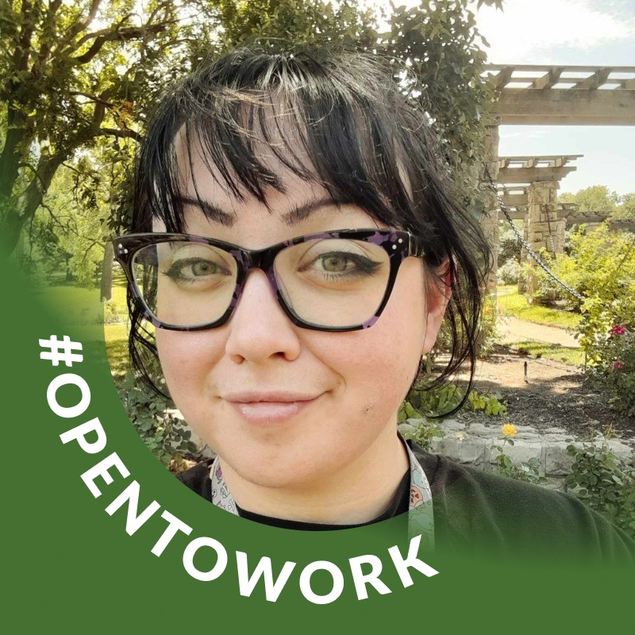
Meet The Team
Nicole Park
Sam Negus
Chanel Dubreuil

Slide 3
Project Overview
Our team developed a secure administrative intranet application for Atomic Synergistics, designed to allow access solely to authorized personnel. The website boasts a sleek, minimalistic design, emphasizing functionality over form. It provides comprehensive tools for the company to efficiently manage, access, and manipulate records within a large database. Additionally, it features role-based data access, enabling employees to interact with information according to their clearance levels.
About the technology used:
.NET 6.0
.NET Core Web Application (Model-View-Controller Architecture)
Microsoft SQL Server Relational Database

Slide 4
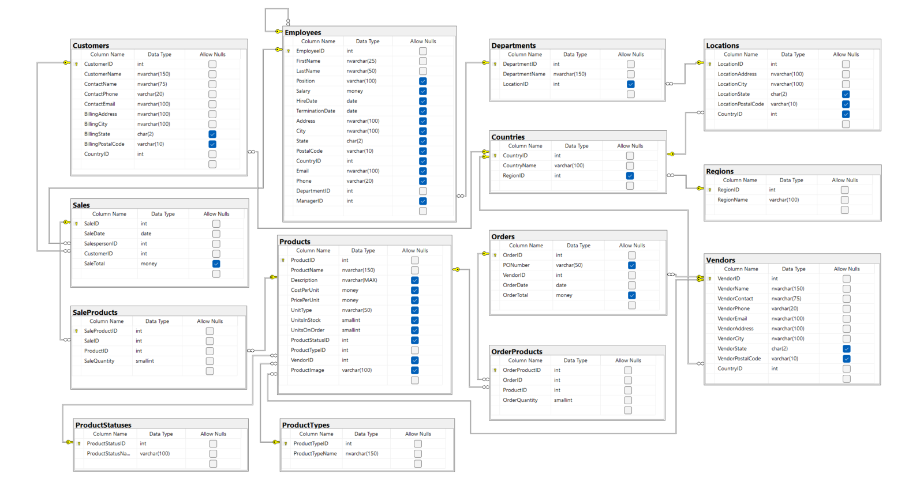
AS Database

Slide 5
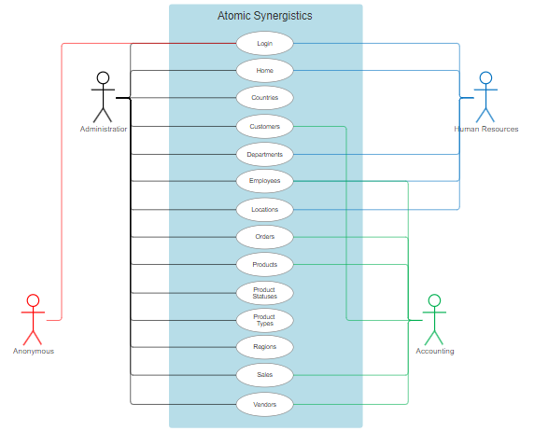
Use/Case Diagram
Only the admin is able to access all of the information. They are also the only users with access to delete functionality.
Other users who are authorized as Human Resources and Accounting have different levels of access depending on their department.
Anonymous users only have access to the login page.

Slide 6
Code Snippets
The following slides will showcase some snippets of code that we found to be particularly noteworthy or had a major impact on the functionality of the website.

Slide 7
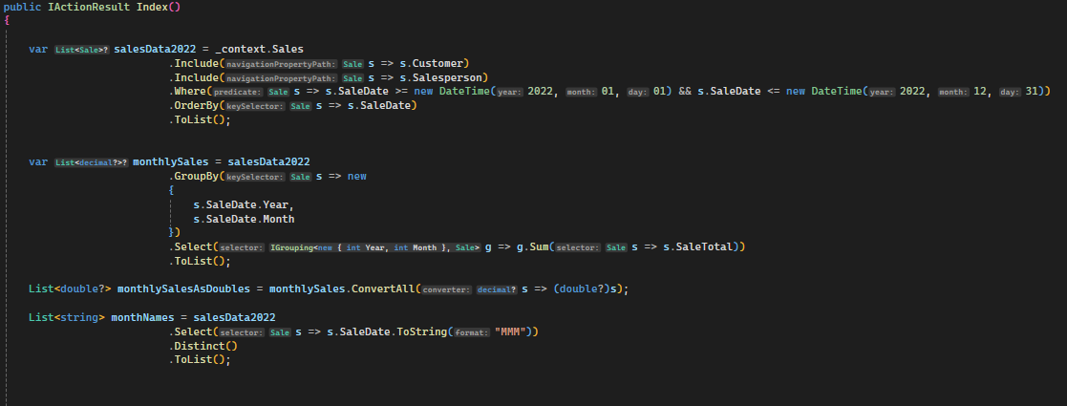
Bar Chart

Slide 8
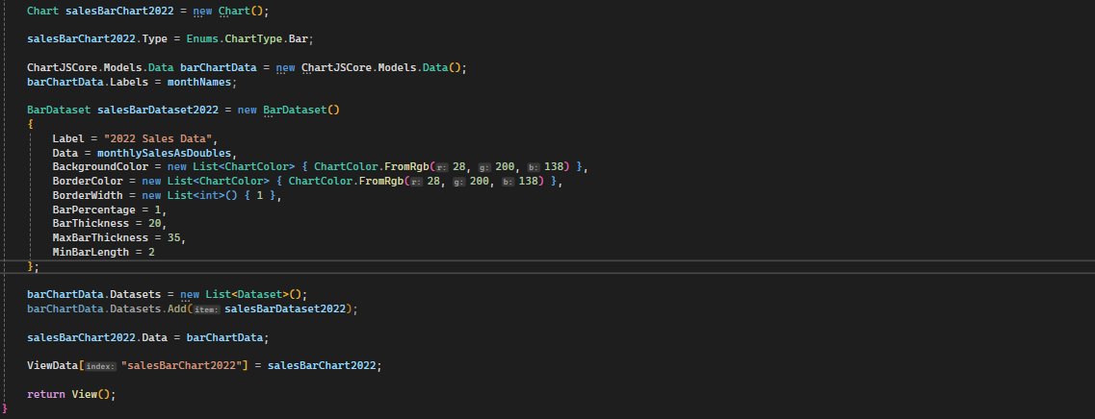
Bar Chart

Slide 9
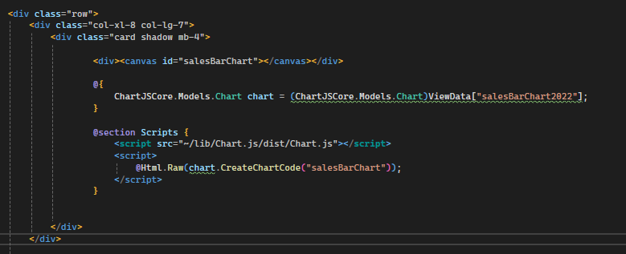
These screenshots highlight portions of the code for the bar chart. Ensuring it worked and appeared correctly was an extensive process due to the complexity.
This chart utilized ChartJS and a Nuget package to generate the chart.

Slide 10
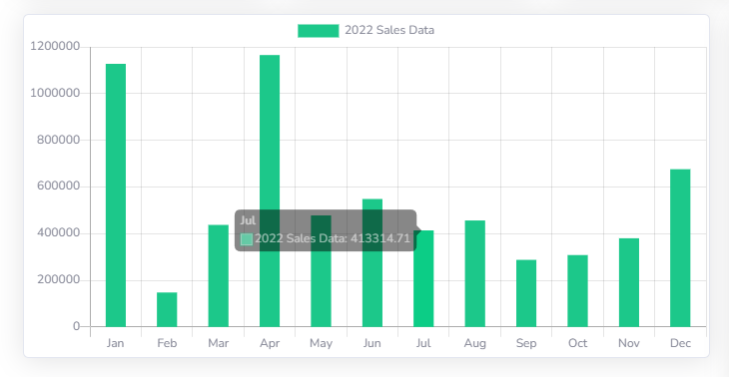
Bar Chart Graph

Slide 11
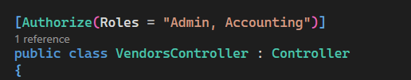

Authorization Lockdown
This portion of the code restricts user access to certain sections of the site, as well as delete functionality. This ensures that only authorized users can access and alter specific data. Authorization is based on Microsoft’s Identity platform.

Slide 12
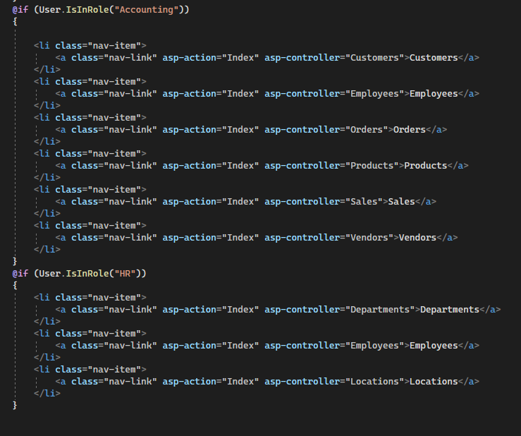
Authorization Lockdown
By specifying which user type was allowed to view certain sections of the site, we can ensure that data is only accessed by users who are authorized to view it.

Slide 13
Helping Technologies
There were several online tools we had at our disposal to help make this site in addition to Visual Studio and SSMS.
Datatables.net
ChatGPT
Trello

Slide 14
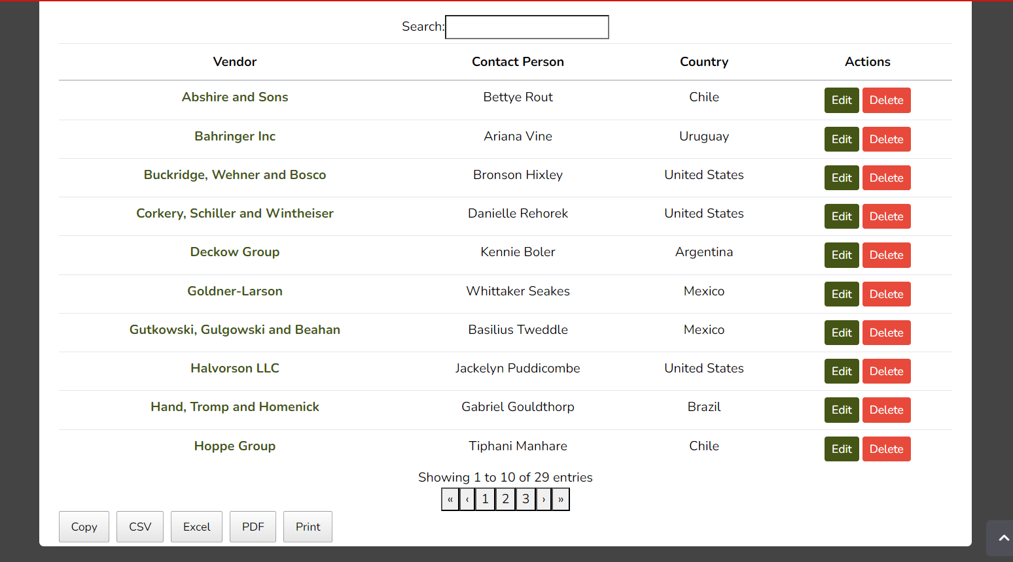
Datatables.net
Datatables.net provided some of the code that we used in our Index pages. We used their code to provide the structure for our data tables, which enabled us to create data tables with clean, organized columns and rows. It also supports pagination and search capabilities, and includes a plugin that facilitates the export of table data.

Slide 15
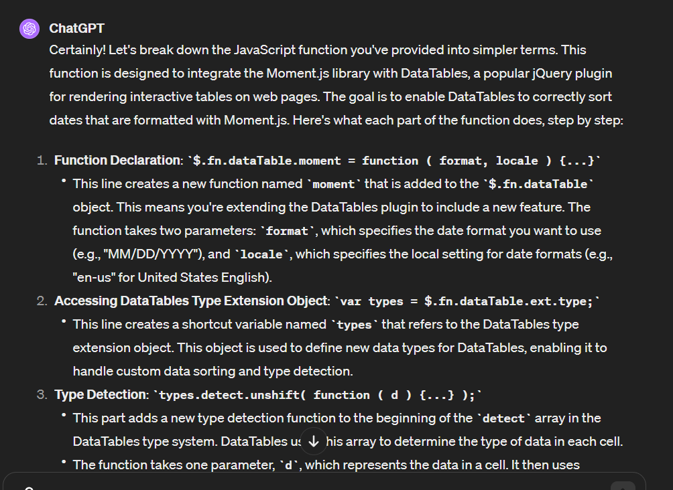
ChatGPT
Utilizing AI proved to be an invaluable asset in navigating unfamiliar code structures within our web development project. By leveraging AI-powered tools, we were able to efficiently dissect and comprehend complex code segments, thus enhancing our ability to architect functions and realize the desired aesthetic and functionality of our web application.

Slide 16
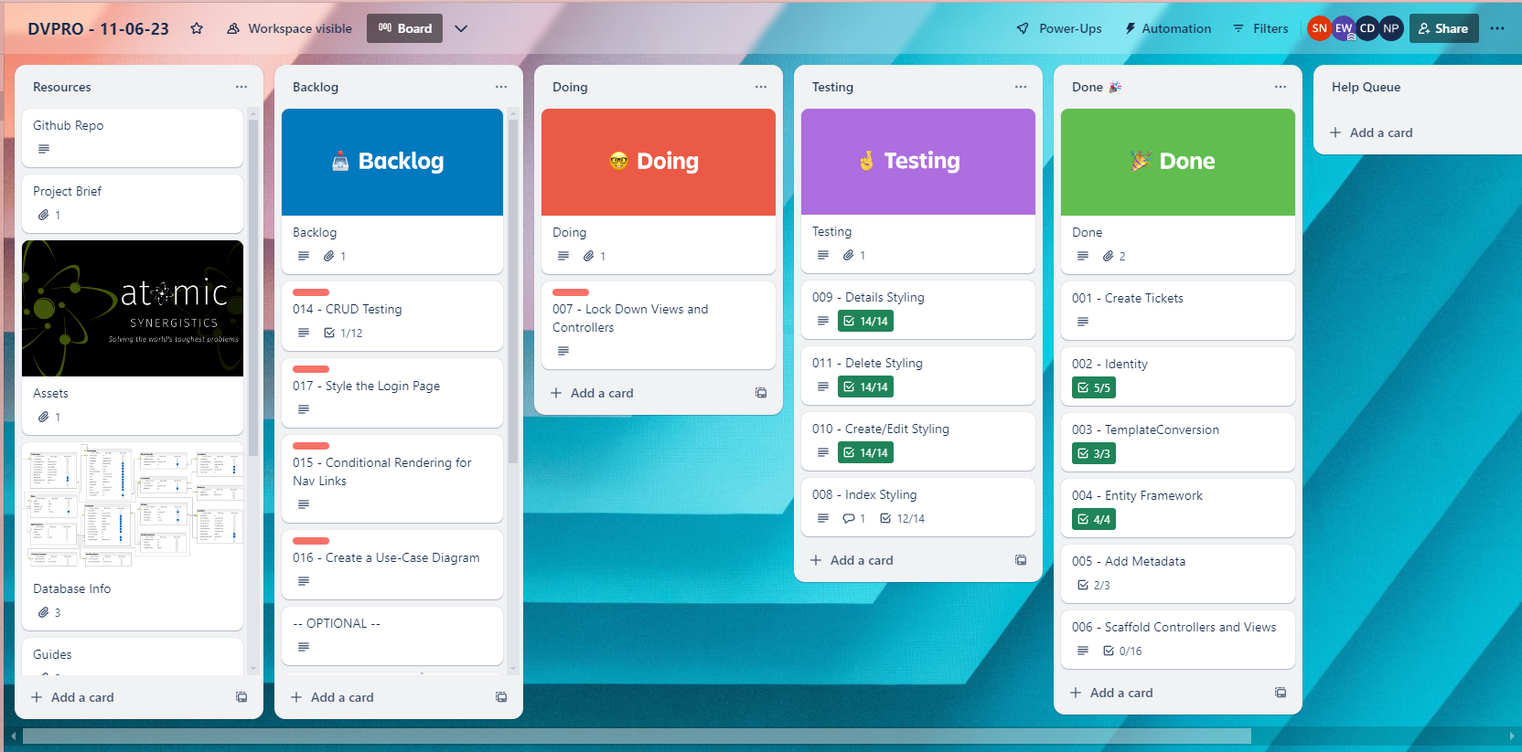
Trello
Perhaps the most useful organization tool we used was Trello. This website provided a Kanban-style collaborative workspace where we tracked of all the major milestones of our project and visualized our progress throughout the project.

Slide 17
Contact Information
Sam Negus
https://www.linkedin.com/in/samnegus/
http://www.samnegus.com/
Nicole Park
https://www.linkedin.com/in/nicoleipark/
http://www.nicolepark.net/
Chanel Dubreuil
https://www.linkedin.com/in/chanel-dubreuil/
http://www.chaneldubreuil.com/

