Slide 1
Web Service

Slide 2
Web Services
What is a web service
Basic concept behind web services
Why we use it

Slide 3
What is a Web Service?
Service available over the web
Enables communication between applications over the web
Provides a standard protocol/format for communication.

Slide 4
Why we use it?
Platform independent communication
Using web services two different applications (implementation) can talk to each other and exchange data/information

Slide 5
How Web Services Work - Overview
1. Basic concepts of working of web services
2. Client Server model
3. Types of WS - SOAP and REST (overview)

Slide 6
WEB SERVICES Services available over the web
MEDIUM –HTTP /INTERNET
FORMAT – XML/JSON
A web service provider develops/implements the application (web service) and makes it available over the internet (web)
To enable COMMUNICATION between two applications.
CLIENT ServiceConsumer
Request
SERVER ServiceProvider
Response
Notes:
Example: While speaking to your friend over telephone , Medium is the Phone and Format is the common language (e.g.English) that both of you can understand.

Slide 7
Types of Web Services
SOAP- Simple Object Access Protocol
REST - Representational State Transfer
SOAP
Medium : HTTP,SMTP,TCP,UDP,JMS
Format :XML
REST
Medium : HTTP(get,post,put,delete)
Format :XML/JSON/TEXT
Notes:
Web services are , in most cases implemented using HTTP as transport protocol but other options exists.
SOAP can operate over any protocol such as HTTP,SMTP,TCP,UDP,JMS.
SOAP - Medium : HTTP(post) Format :XML
REST - Medium : HTTP(post,get,put,delete ,…) Format :XML/JSON/TEXT… other well
REST as well doesn’t restrict communication to a particular protocol , however its rare to see REST implementation with protocol other than HTTP

Slide 8
Types of Web services
❖ Service-Oriented Web Services
▪ Based on “services”
▪ One service offers multiple functionalities
▪ “Big” Web Services
▪ JAX-WS = JAVA-API for XML-based Web Services, mainly using
WSDL/SOAP
❖ Resource-Oriented Web Services
▪ Based on “resources”
▪ Resource - any directly accessible and distinguishable distributed
component available on the network.
▪ RESTful Web Services
▪ JAX-RS = JAVA-API for RESTful Web Services, using only HTTP

Slide 9
Components of Web Services
WSDL
UDDI

Slide 10
WEB SERVICES WSDL-UDDI
A Webservice provider publishes his web service (through wsdl) on an online directory from where consumers can query and search the web services. This online registry/directory is called UDDI.
UDDI
Universal Description , Discovery and Integration
Is an XML based standard for publishing and finding web services
Service Provider publishes an interface for his web services that describes all attributes of the web services.
This is XML based interface and is called – Web Services Description Language - WSDL
UDDI
WSDL
WSDL
Consumer needs to know:
What are the services available?
What are the request and response parameters?
How to call the Webservice?
WSDL
Is an XML based interface that is used to describe the functionalities of the web services.
WSDL
WSDL
WSDL
CLIENT ServiceConsumer
Request
SERVER ServiceProvider
Response
Notes:
commencement

Slide 11
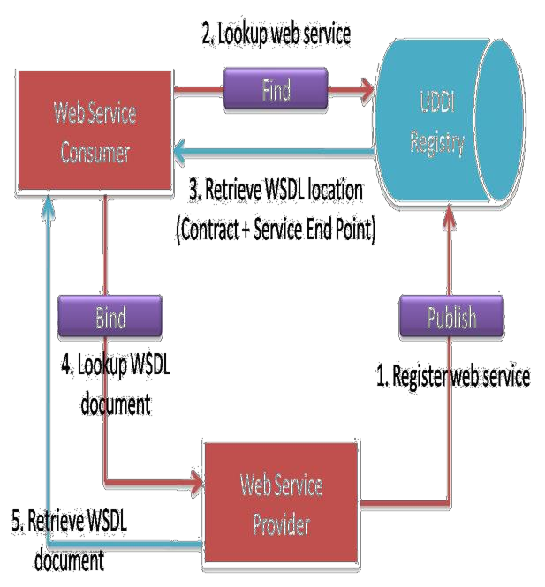
Service Oriented Web Services - Architecture
➢ SOAP (Simple Object Access Protocol)
➢ WSDL (Web Services Definition Language)
➢ UDDI (Universal Discovery, Description and Integration)

Slide 12
SOAP Web Services
What are a Soap Web Service?
Soap Web Services Specifications/Components

Slide 13
What is a Soap Web Service?
A web service that complies to the SOAP Web services specifications is a SOAP web Service.
What are these specifications/ standards?
Who defines and dictates these standards ?
W3C (World wide web consortium) An international community that develops open standards for world wide web. https://www.w3c.org
Notes:
Comply

Slide 14
What are Soap Web Service?
SOAP Web Services Specifications
BASIC
EXTENDED
SOAP
WSDL
UDDI
WS-Security
WS-Policy
……

Slide 15
What are Soap Web Service?
A web service that complies to the SOAP Web services specifications is a SOAP web Service.
SOAP Web Services Specifications
SOAP
WSDL
UDDI

Slide 16
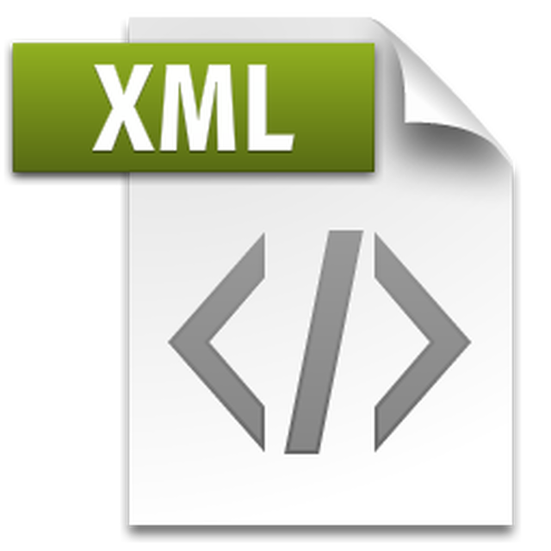
SOAP
All information/message exchange
happens over a common format : XML
Simple Object Access Protocol
(with SOAP v1.2-the expansion is discontinued)
Protocol/Rules /Definitions how 2 Applications
will talk to each other over the web
SOAP
XML messages have a defined structure :
SOAP MESSAGE
SOAP MESSAGE consists of :
Envelop
Header
Body
CLIENT ServiceConsumer
Request
SERVER ServiceProvider
Response

Slide 17
SOAP
Envelop is the root element of a soap message.
This is the basic unit of the XML document which contains other units like Header and Body
Body contains the actual data of the request meant to be sent to the server.
Skeleton SOAP Message
<?xml version="1.0"?> <soap:Envelope xmlns:soap="http://www.w3.org/2003/05/soap-envelope/" soap:encodingStyle="http://www.w3.org/2003/05/soap-encoding"> <soap:Header> ... </soap:Header> <soap:Body> ... </soap:Body> </soap:Envelope>
Header element provides information about the message itself.
Header might include authentication,complex types, routing information etc.
SOAP Message
Envelop
HEADER
BODY
CLIENT ServiceConsumer
SERVER ServiceProvider

Slide 18
What are Soap Web Service?
A web service that complies to the SOAP Web services specifications is a SOAP web Service.
Specifications are :
SOAP
WSDL
UDDI
All information/message exchange
happens over a common format : XML
XML messages have a defined structure :
SOAP MESSAGE
SOAP MESSAGE consists of :
Envelop
Header
Body

Slide 19
JAX-WS
There are two ways to develop JAX-WS example.
RPC style
Document style

Slide 20
RPC Style
1) RPC style web services use method name and parameters to generate XML structure.
2) The generated WSDL is difficult to be validated against schema.
3) In RPC style, SOAP message is sent as many elements.
4) RPC style message is tightly coupled.
5) In RPC style, SOAP message keeps the operation name.
6) In RPC style, parameters are sent as discrete values.

Slide 21
Document Style
1) Document style web services can be validated against predefined schema.
2) In document style, SOAP message is sent as a single document.
3) Document style message is loosely coupled.
4) In Document style, SOAP message uses the operation name.
5) In Document style, parameters are sent in XML format.

Slide 22
SOAP binding style
SOAP binding represents what kind of communication and data passed to request and response for the service.
JAX-RPC | Document
no XSD | XSD document as an input and output
easy to read | complex to read
no validation | validates inputs (ex : minoccurs)
Note:
Document style binding is default

Slide 23
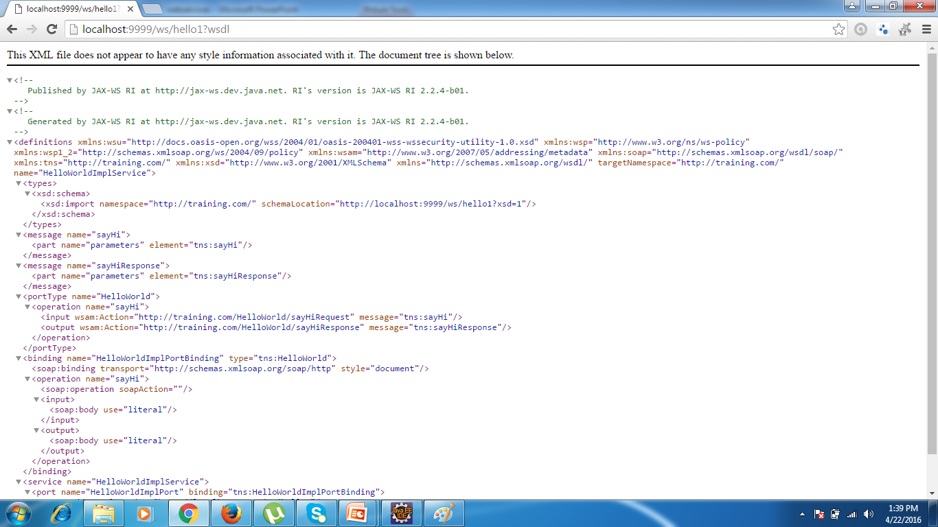
Document style binding

Slide 24
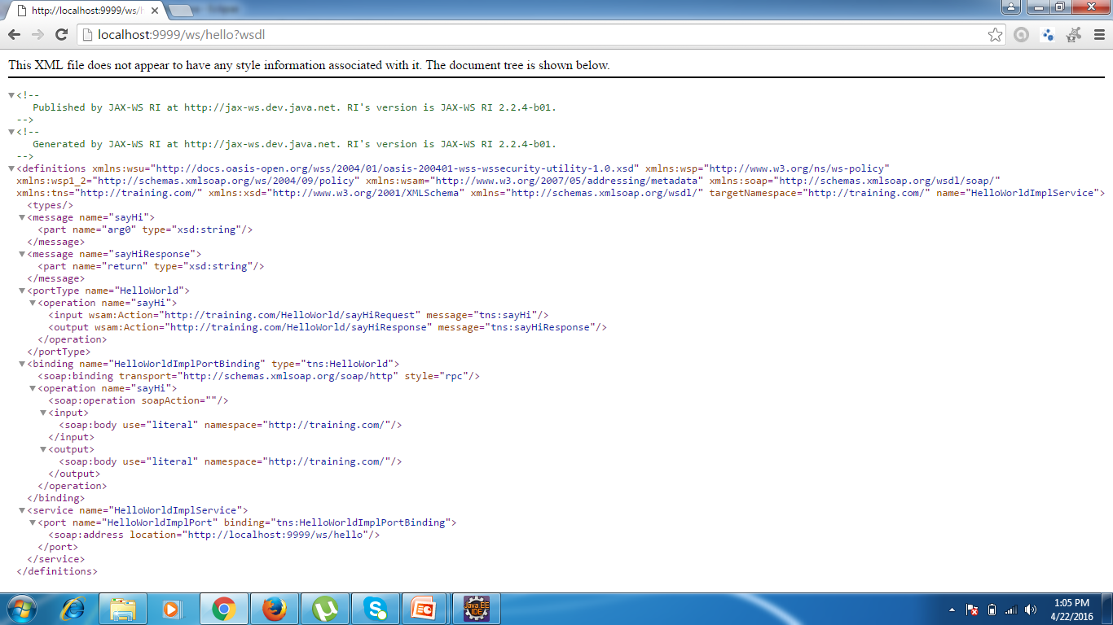
RPC binding

Slide 25
REST
What is REST
Basic architecture of REST
What are RESTful Web Service
Constraints of REST - Uniform Interface

Slide 26
What are RESTful Web Services?
A Web service that communicates / exchanges information between two applications using REST architecture / principles is called a RESTful Web Service.
What is REST?
What rules should a web service follow to become a RESTful Web Service?

Slide 27
What is REST?
REST (REpresentational State Transfer) Is an architectural style.
REST defines a set of principles to be followed while designing a service for communication/ data exchange between 2 applications.
When these principles are applied while designing web services (for client –server interactions) we get: RESTful Web Services.

Slide 28

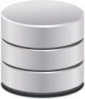

Resource Oriented Web Services - Architecture
Videos
Images
Text
❖ Resources
▪ Every distinguishable entity is a resource.
▪ A resource may be a Web site, an HTML page, an XML document, a
Web service, an image, a video etc.
❖ URIs - Every resource is uniquely identified by a
URI.
CRUD HTTP Method
Create POST
Read GET, HEAD or OPTIONS
❖ Resource lifecycle management using HTTP
methods
Update PUT
Delete DELETE

Slide 29
What are the principles/constraints of REST architecture?
1.Resource: everything is a resource
2.URI: any resource/data can been accessed by a URI
3.HTTP: make explicit use of HTTP methods
Uniform Interface
Stateless
4.Stateless: all client- server communications are stateless
Cacheable
5.Caching: happens at client side
Layered System
6.Layering: layers can exist between client and server
Code on Demand (optional)
7.Code-on-deamnd: ability to download and execute code on client side

Slide 30
What are RESTful Web Services?
How to get list of employees from a particular department?
Employee Management System
1.Resources: everything is a resources
Employees
2.URI : any resource/data can be accessed by a URI
Id
http://example.com/departments/11/employees
URI
Resources
Name
http://example.com/employees
Employees
Departments
http://example.com/employees/{id}
http://example.com/employees/10
Id
Departments
http://example.com/departments
Name
http://example.com/departments/{id}
http://example.com/departments/11
Notes:
The key abstraction of information in REST is a resource.Any information that can be named can be a resource: a document or image and so on.. -Roy Fielding

Slide 31

What are RESTful Web Services?
Using HTTP methods along with URI, we can access/modify any resource or resource information.
REQUEST RESPOSE
GET – http://example.com/employees list of employees
GET – http://example.com/employees/10 list of employee with id=10
DELETE–http://example.com/employees/10delete employee with id=10
POST – http://example.com/employees add a new employees
+
Data of new employee
PUT – http://example.com/employees/10 modify data for employee 10
+
Data to be changed
UNIFORM INTERFACE -1st principle of REST
Identification of Resource – Resources+URI+HTTP
Each resource has a URI and is accessed through a defined set of HTTP methods (GET,PUT,POST,DELETE)
Manipulation of Resources using Representations
Each resource ca have one or more representations. Such as application/xml,application/json,text/html,etc. Clients and servers negotiate to select representations.
Self descriptive message
Requests and Responses contain not only data but additional headers describing how the content should be handled. Such as if it should be cached, authentication requirements, etc.
3.HTTP: make explicit use of HTTP methods
GET – http://example.com/employees/10 details of employee with id=10
HTTP
HTTP
RESOURCE
GET
CRUD
C=CREATE =POST
R=READ =GET
U=UPDATE =PUT
D=DELETE =DELETE
GET
employees
POST
Nouns
POST
Verbs
departments
PUT
PUT
DELETE
DELETE
http://example.com/getemployees/10 X
…
http:// GET example.com/employees/10

Slide 32
What are RESTful Web Services?
4.Stateless: all client-server communications are stateless
Each request from the client to the server must contain all of the data that is necessary to handle the request. No need of storing any state on the server.
+
Improves Web Service Performance
STATELESSNESS
Server should not require to store the state of a session.
If the concept of a session is required all information should be stored at client side and sent with every subsequent request.
This makes every request (call) from client independent and a complete entity in itself. FOR EXAMPLE:
If a person is adding items to his cart on a shopping website, the state of the cart should be stored at the client side only. And this state of the cart has to be sent from the client to the server whenever required.
CLIENT ServiceConsumer
Request
SERVER ServiceProvider
Response

Slide 33
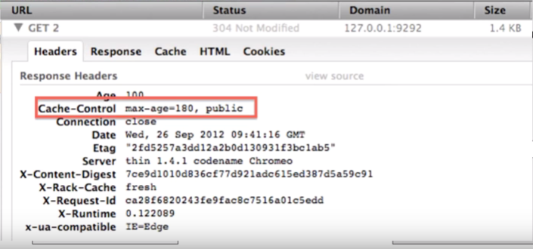
What are RESTful Web Services?
5.Caching: happens at client side
Server generates responses that indicate whether they are cacheable or not to improve the performance by reducing number of requests for duplicate resources.
Server does this by including a Cache-Control and LastModified (data value) In HTTP Response Headers.
Client uses the Cache-Control header to determine whether to cache the resource (make local copy) or not
The data within a response to a request must be implicitly or explicitly labeled as cacheable or non-cacheable
CLIENT ServiceConsumer
Request
SERVER ServiceProvider
Response

Slide 34
What are RESTful Web Services?
6.Layering: multiple layers can exist between client and server
CLIENT ServiceConsumer
SERVER ServiceProvider
There can be many layers (intermediaries) between client and server. These are HTTP Intermediaries.
Can be used for message translations / improving performance with caching etc.
Can include Proxies and Gateways.

Slide 35
What are RESTful Web Services?
6.Layering: multiple layers can exist between client and server
CLIENT ServiceConsumer
Proxies
Gateways
SERVER ServiceProvider
A client may send the request to a Proxy server (instead of main server).
Proxy server evaluates the request to simplify or control its complexity, etc.
Gateways may be used for managing traffic on the network,protocol translations etc.

Slide 36
What are RESTful Web Services?
6.Layering: multiple layers can exist between client and server
CLIENT ServiceConsumer
Caching
SERVER ServiceProvider
wevers
Example : we use a layer (intermediary) that can cache a response and store it for an hour. If a new request comes from the client within an hour, the cached response will be sent from the intermediary (without going untill the server)
Improves Performance and Scalability.

Slide 37
What are RESTful Web Services?
6.Layering: multiple layers can exist between client and server
This is to improve scalability.
The layered constraint was added to address improving internet sized scalability requirements. Each layer cannot see the beyond the immediate layer with which it is communicating with. This places boundaries on the overall complexity of the system.
Like most solutions for scalability there are usually trade-offs. Latency is increased with introduction of layers but the cache-constraint above can certainly help reduce the amount of requests over the network.

Slide 38
What are RESTful Web Services?
7.Code on Demand: ability to download and execute code at
client side
The code on demand constraint allows clients to be extendable by downloading and executing code. Similarly to java script in a web browser this allows you to add functionality without re-deploying client software.
The code-on-demand constraint is optional.
For Example:
Client requests a resource
Server returns resource with some JavaScript

Slide 39
What are RESTful Web Services?
1.Resource: everything is a resource
2.URI: any resource/data can been accessed by a URI
3.HTTP: make explicit use of HTTP methods
Uniform Interface
Stateless
4.Stateless: all client- server communications are stateless
Cacheable
5.Caching: happens at client side
Layered System
6.Layering: layers can exist between client and server
Code on Demand (optional)
7.Code-on-deamnd: ability to download and execute code on client side

Slide 40

What are RESTful Web Services?
REST
REpresentational State Transfer
REPRESENTATION =description of the current state of the resource
A Resource’s Representation is transferred between server and client
GET/images/1
Accept:JPEG
Or
GET/images/1.jpg
GET/images/1
Accept:XML
Or
GET/images/1.jpg
XML
JSON
HTML
YAML
……
<pic>
<name>mydog</name>
<size>1080p</size>
</pic>

Slide 41
SOAP
<?xml version="1.0"?> <soap:Envelope xmlns:soap="http://www.w3.org/2003/05/soap-envelope/" soap:encodingStyle="http://www.w3.org/2003/05/soap-encoding"> <soap:Header> …. </soap:Header> <soap:Body pb=“http://www.example.com/employees”>
<pb:GetEmployee><pb:Empid>11</pb:Empid>
</pb:GetEmployee></soap:Body> </soap:Envelope>
REST
http://example.com/employees/11

Slide 42
SOAP vs REST
SOAP
Client
Server
Data
+
SOAP
Standard
=
Huge Data
<=>
REST
Server
Client
Data
<=>
Sending data as its
*REST are mostly used in industry

Slide 43
Web service Flow (Actual)
Client for Web service
Client for Web App
Web/Servlet application
Web services
Web Browser
(Toolkit)
Java Web service Client
HTTP
SOAP
WSDL
HTTP
REST
Mobile
Web Server/application server
Application Server
DB
DB

Slide 44
SOAP VS REST
SOAP | REST
SOAP is a protocol. | REST is an architectural style.
SOAP stands for Simple Object Access Protocol. | REST stands for REpresentational State Transfer.
SOAP can't use REST because it is a protocol. | REST can use SOAP web services because it is a concept and can use any protocol like HTTP, SOAP.
SOAP uses services interfaces to expose the business logic. | REST uses URI to expose business logic.
JAX-WS is the java API for SOAP web services. | JAX-RS is the java API for RESTful web services.
SOAP defines standards to be strictly followed. | REST does not define too much standards like SOAP.
SOAP requires more bandwidth and resource than REST. | REST requires less bandwidth and resource than SOAP.
SOAP defines its own security. | RESTful web services inherits security measures from the underlying transport.
SOAP permits XML data format only. | REST permits different data format such as Plain text, HTML, XML, JSON etc.
SOAP is less preferred than REST. | REST more preferred than SOAP.

Slide 45
Important JAX-RS Annotations
Aspect | Annotation | Scope | Description
URI | @PATH (resource-path) | Class ,Method | It is a relative URI path indicating where the Java class/method will be hosted.
Resource Method Designators - Rules
1. Only one JAX-RS method designation annotation is allowed per method in a java class resource. 2.Only public methods may be exposed as resource methods | @GET | Method | specifies method responds to GET request.
 | @POST | Method | specifies method responds to POST request.
 | @PUT | Method | specifies method responds to PUT request.
 | @HEAD | Method | specifies method responds to HEAD request.
 | @DELETE | Method | specifies method responds to DELETE request.

Slide 46
Important JAX-RS Annotations
Aspect | Annotation | Scope | Description
ApplicationPath | @ApplicationPath | Class | The @ApplicationPath annotation is used to define the URL mapping for the application. The path specified by @ApplicationPath is the base URI for all resource URIs specified by @Path annotations in the resource class. You may only apply @ApplicationPath to a subclass of javax.ws.rs.core.Application.
Media Types
MIME Type | @Consumes | Class ,Method | a resource can consume that were sent by the client.
 | @Produces | Class ,Method | a resource can produce and send back to the client, for example, "text/plain".

Slide 47
JAX-RS Injection Annotations
Annotations | Description | DataSource
@PathParam | Extracts the value of a URI template parameter. | URI
@FormParam | Extracts information from a request representation whose content type is application/x-www-form-urlencoded. | Payload of HTTP Request
@QueryParam | Extracts the value of a URI query parameter. | URI
@HeaderParam | Extracts the value of a HTTP header. | Header of HTTP request
@CookieParam | Extracts information from cookies declared in the cookie request header. | Header of HTTP request
@MatrixParam | to extract matrix parameters from the request URL. | URI

Slide 48
Extracting Request Parameters
Annotations | Client Request
Path Param | http://localhost:8080/TestRestfulService/rs/customer/12345
Query Param | http://localhost:8080/TestRestfulService/rs/employees?id=543
Matrix Param | http://localhost:8080/TestRestfulService/rs/employees;role=ITA
Payload (Form Data) | Book: Da Vince Code Credit Card:65756 Visa Number: 123-45-6789
HTTP Header | POST / HTTP/1.1 Host: http://www.amazon.com Cookie: x=56 User-Agent: Mozilla

Slide 49
?

