Slide 1
Portfolio management system
By POD-1(CDE20IJ015)

Slide 2
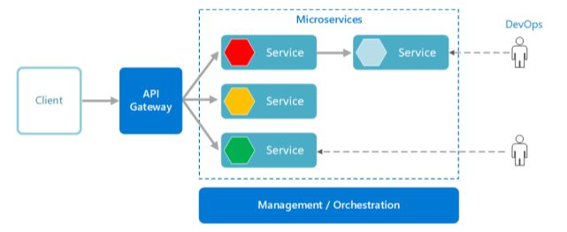
System Architecture Diagram

Slide 3
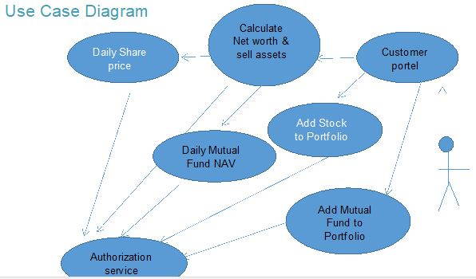

Slide 4

TYPES OF MICROSERVICES
Backend Microservice
Auth Microservice
Frontend Microservice

Slide 5
Frontend Microservices
Auth Microservices
Backend Microservices
Customer Portal
Authorization
Daily Share Price
Daily Mutual Fund NAV
Calculate Net worth

Slide 6
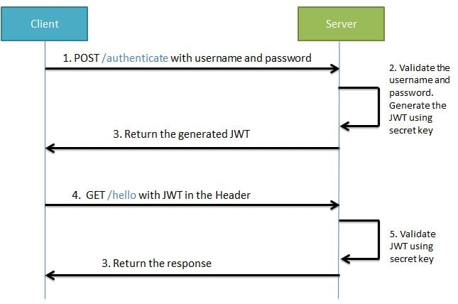
JWT ARCHITECTURE

Slide 7
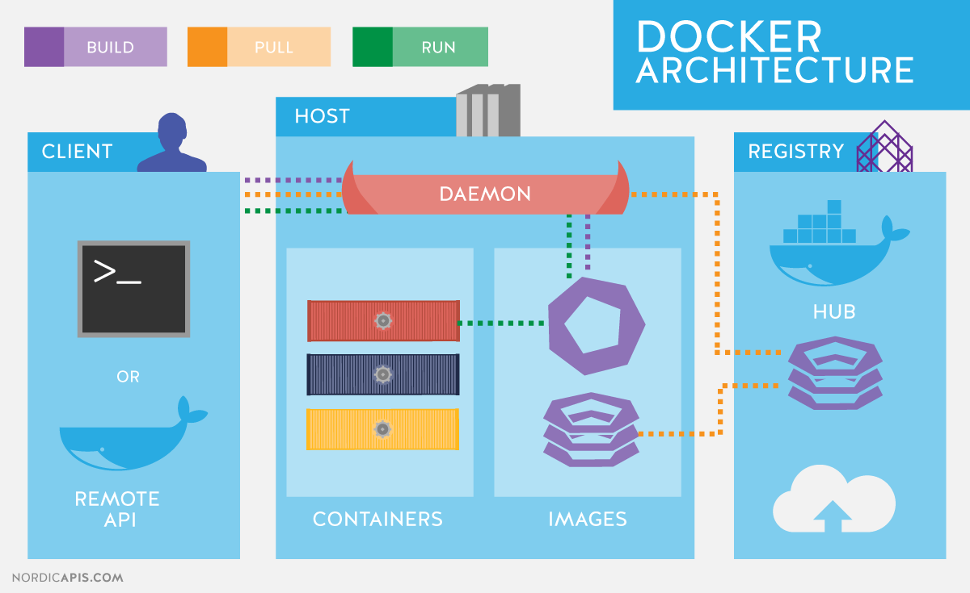
DOCKER ARCHITECTURE

Slide 8
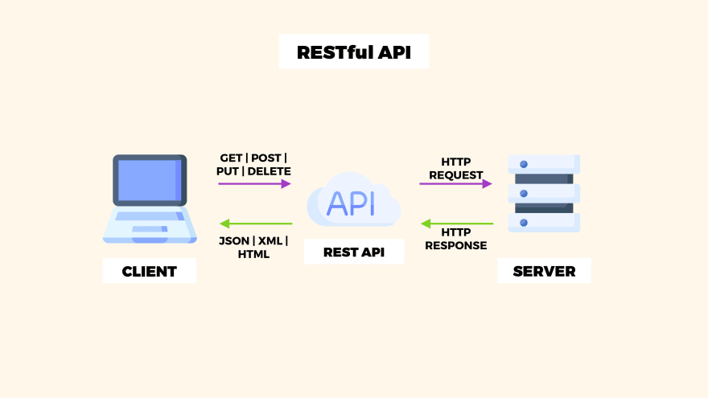
REST API

Slide 9
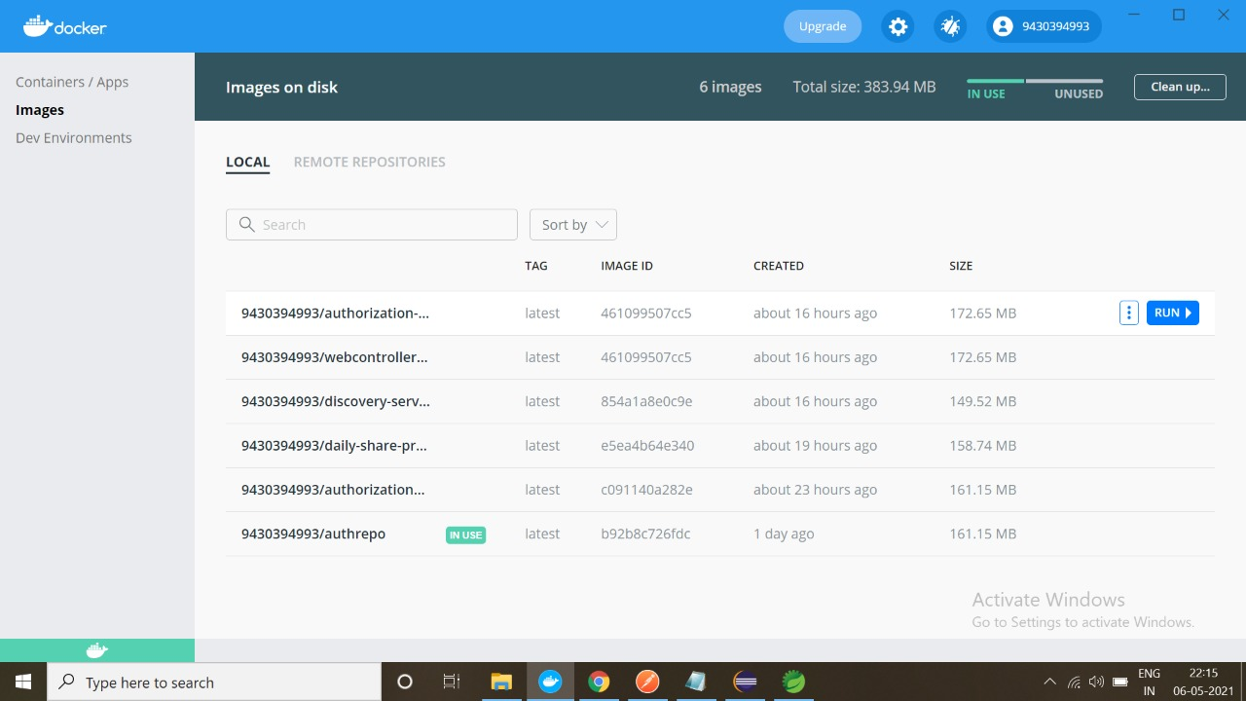
Docker Image

Slide 10
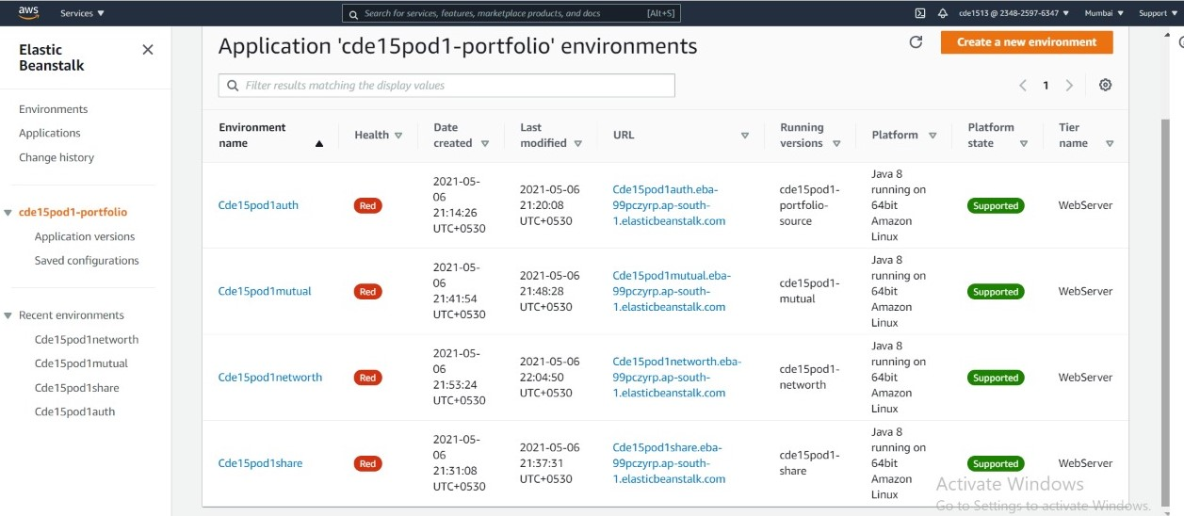
Portfolio Application Deployment

Slide 11
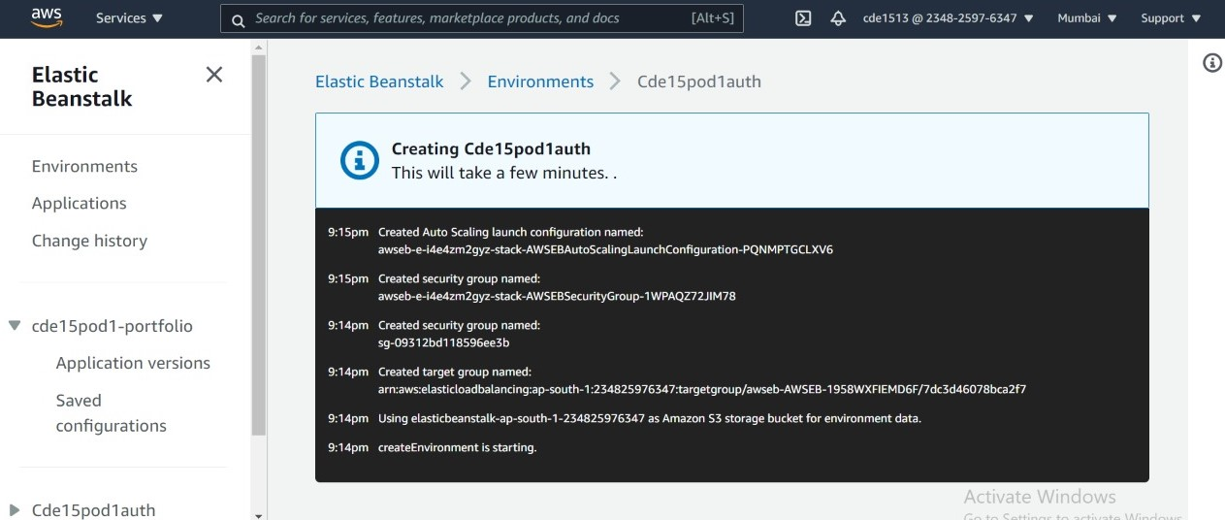
Auhtorization Service Deployment

Slide 12
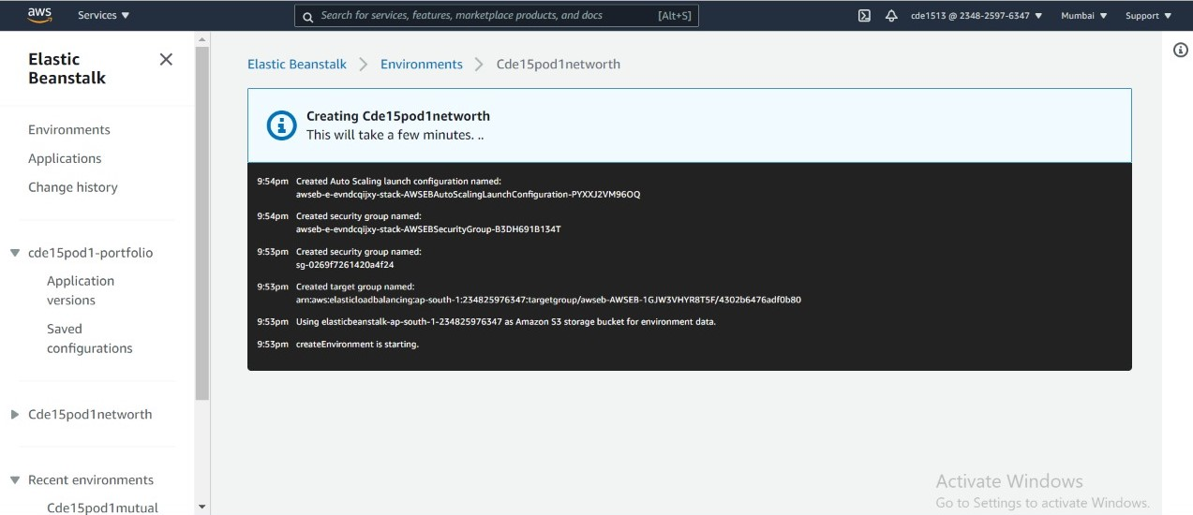
Net Worth Service Deployment

Slide 13
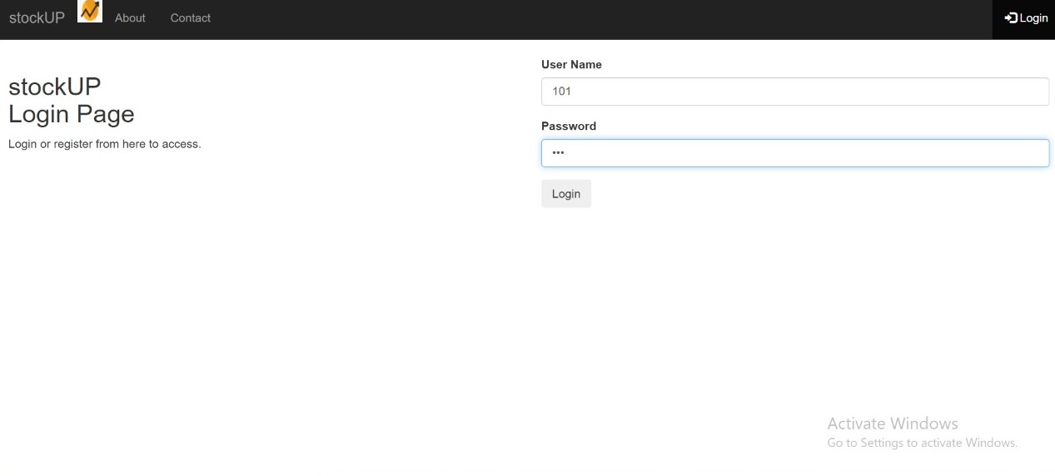
UI-login

Slide 14
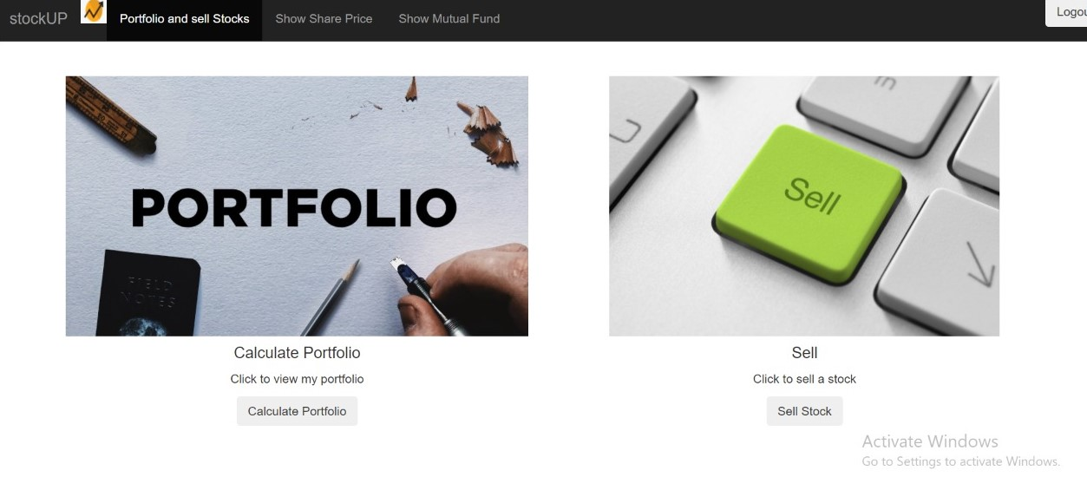
UI-Home

Slide 15
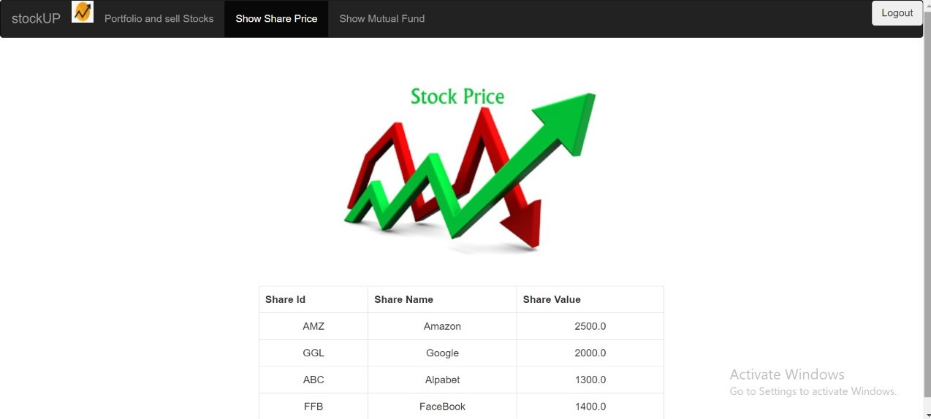
UI-Daily share price

Slide 16
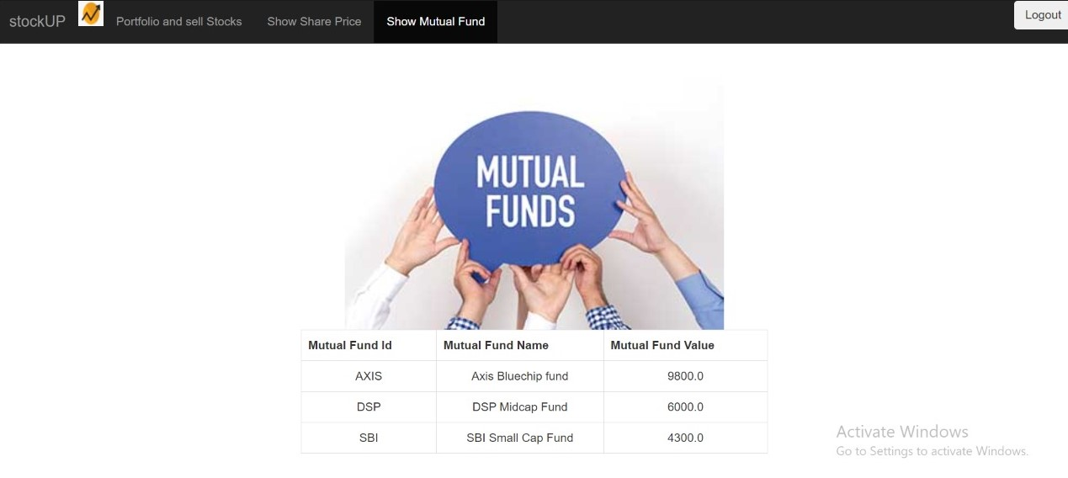
UI-Daily MF NAV

Slide 17
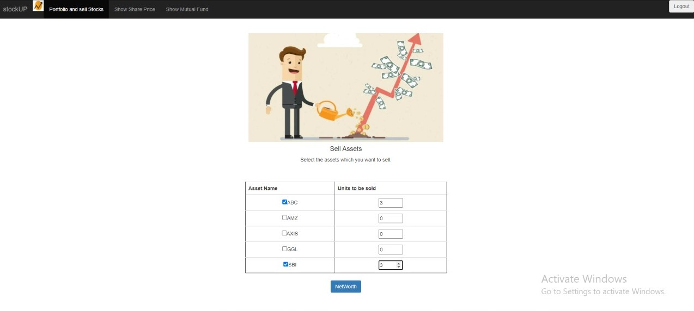
UI-Sell Asset

Slide 18
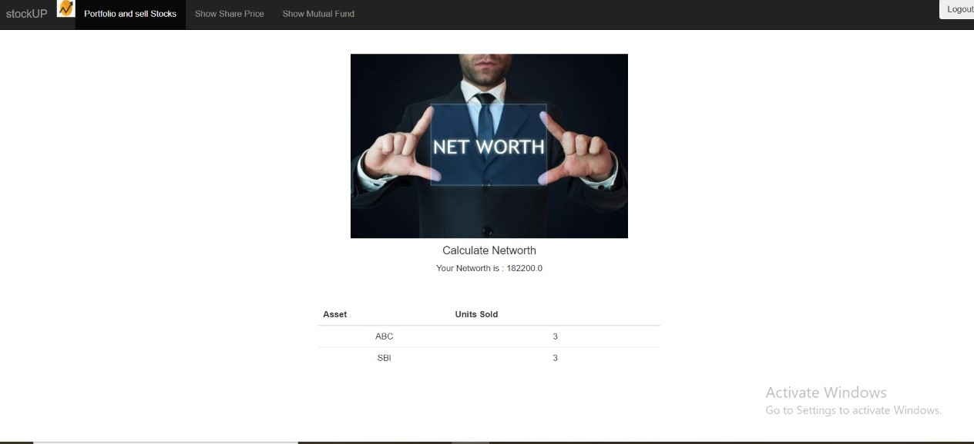
UI-Net Worth

Slide 19
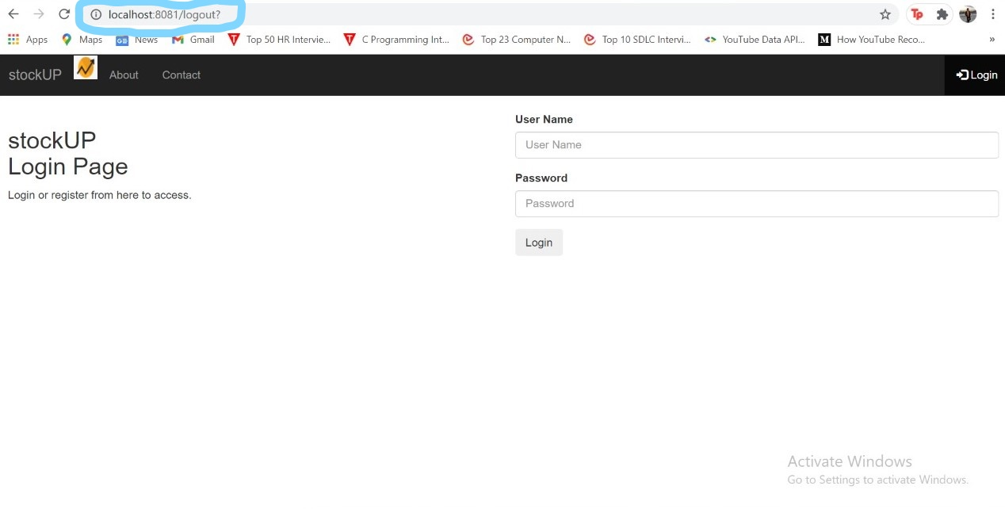
UI-logout

Slide 20
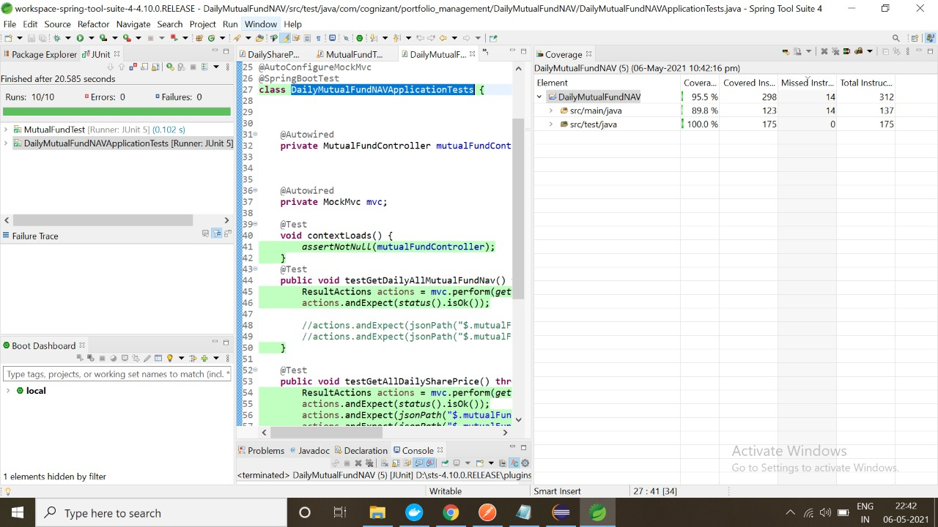
Mutual Fund Junit

Slide 21
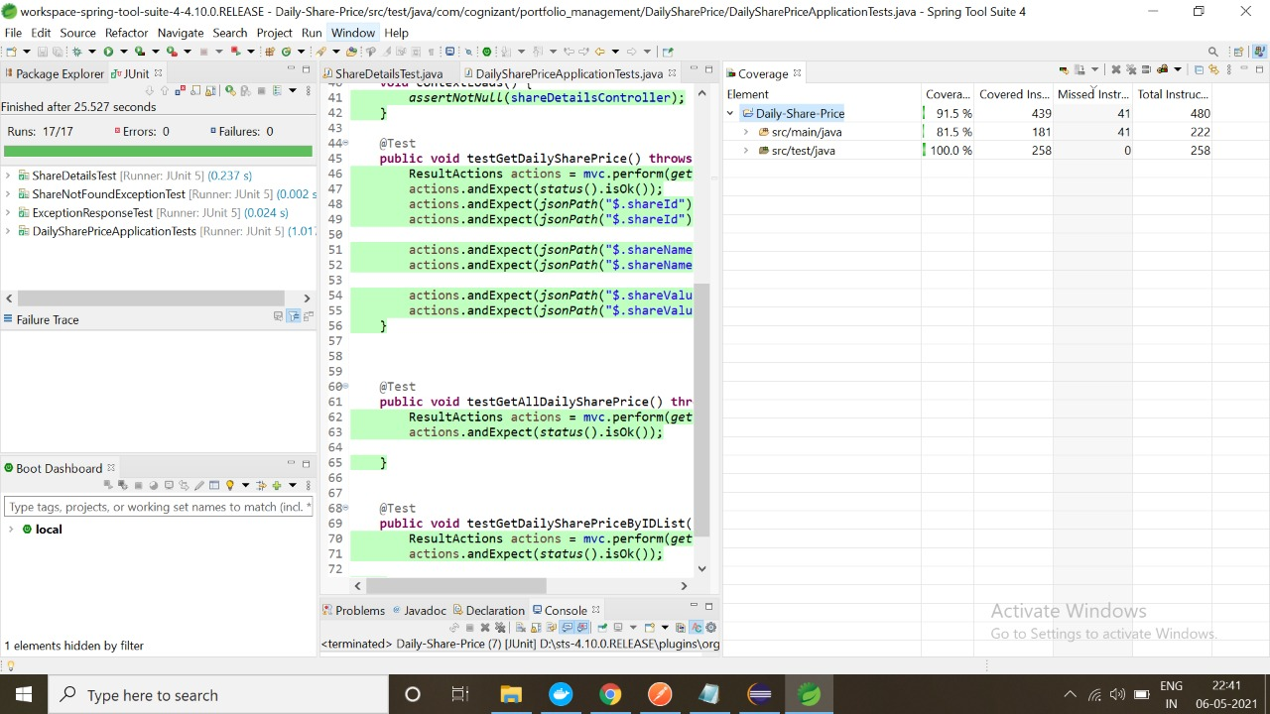
Share Price Junit

Slide 22
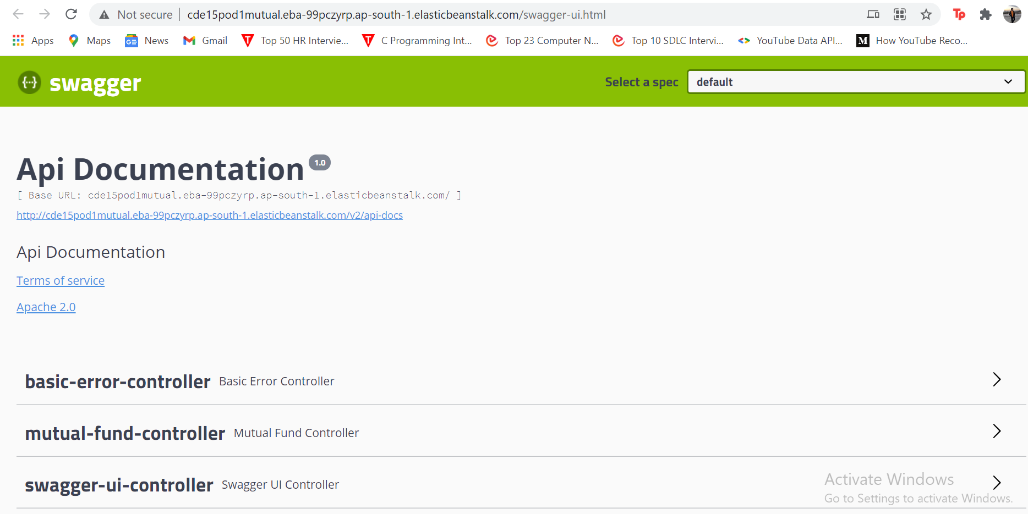
Swagger-UI

Slide 23
THANK YOU

