Slide 1
What is the first cell that this code colors?
int rows = g.getNumRows();
int cols = g.getNumCols();
for(int i=0; i<rows; i++) {
for(int j=0; j<cols; j++) {
g.setColor(i, j, Color.RED);
}
}
A
B
C
D
E: None of the above

Slide 2
What is the first cell that this code colors?
int rows = g.getNumRows();
int cols = g.getNumCols();
for(int i=0; i<rows; i++) {
for(int j=0; j<cols; j++) {
g.setColor(i, j, Color.RED);
}
}
A
B
C
D
E: None of the above

Slide 3
What is the second cell that this code colors?
int rows = g.getNumRows();
int cols = g.getNumCols();
for(int i=0; i<rows; i++) {
for(int j=0; j<cols; j++) {
g.setColor(i, j, Color.RED);
}
}
A
B
C
D
E: None of the above

Slide 4
What is the second cell that this code colors?
int rows = g.getNumRows();
int cols = g.getNumCols();
for(int i=0; i<rows; i++) {
for(int j=0; j<cols; j++) {
g.setColor(i, j, Color.RED);
}
}
A
B
C
D
E: None of the above

Slide 5

How would you draw the British flag?
https://en.wikipedia.org/wiki/Flag_of_Great_Britain#/media/File:Flag_of_Great_Britain_(1707%E2%80%931800).svg

Slide 6
One strategy: Drawing “layers”
Color entire background blue
Draw white diagonals
Draw vertical and horizontal red lines

Slide 7
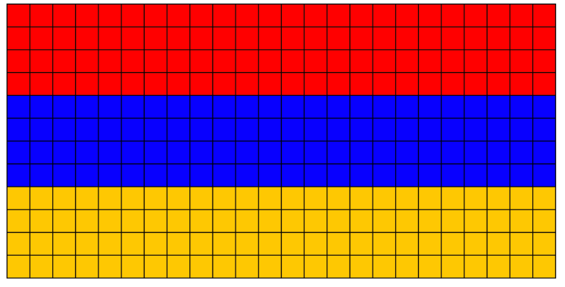
Advanced topic: Parallel computation (concept only now, do in later courses)
Modern computers are all multicore (dual-core, quad-core, …) so they can perform multiple operations at a time
Potentially speeds up some tasks, like drawing the Armenian flag
Simultaneously do these tasks:
Draw red stripe
Draw blue stripe
Draw yellow stripe

Slide 8
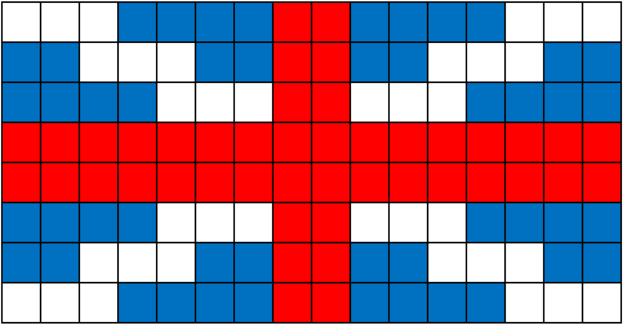
Advanced topic: Parallel computation (concept only now, do in later courses)
Modern computers are all multicore (dual-core, quad-core, …) so they can perform multiple operations at a time
Potentially speeds up some tasks, like drawing the Armenian flag
Simultaneously do these tasks:
Draw red stripe
Draw blue stripe
Draw yellow stripe
Can we do this with the British flag?

Slide 9
“Task Graph”
Diagram of dependencies (when one thing must come before another)
For flags: when operations would color a tile different colors
Draw arrows to show which must come before others
Draw white
\ stripe
Draw red vertical stripe
Draw blue stripe
Draw red stripe
Draw blue background
Draw white
/ stripe
Draw red horizontal stripe
Draw yellow stripe

Slide 10

Create a task graph to draw the flag of Jordan
https://upload.wikimedia.org/wikipedia/commons/c/c0/Flag_of_Jordan.svg

