Slide 1
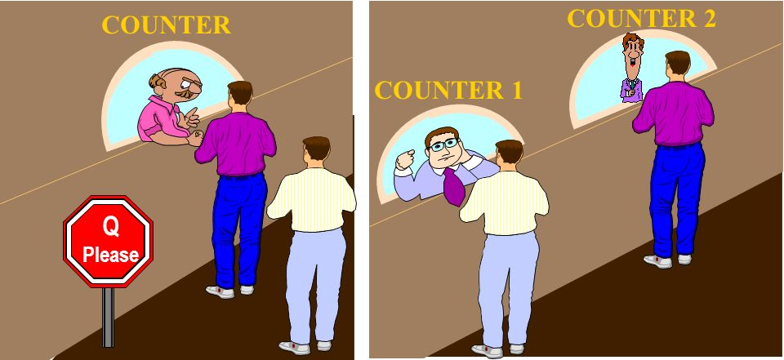
Basics of Parallel & Distributed Computing
Dr. Mary Smith
CSCI 2911/2916
Notes:
Good afternoon students. As I had mentioned in our last class, today we will work on an unplugged and plugged-in activity to learn some fundamental concepts of PDC.

Slide 2
OUTLINE
Why Parallel and Distributed Computing Curriculum?
What is Parallel Computing – videos
Unplugged activity 1: Sorting Pennies
Activity phases: sequential sorting, parallel sorting
Group/class discussion
Survey
Plugged activity: Sorting Pennies using code
Sequential sorting
Parallel sorting
Survey
Notes:
Here is the plan for the class today. [then go over the outline]

Slide 3
Why a Parallel and Distributed Computing Curriculum?
An initiative mandated by the National Science Foundation (NSF) and the ACM/IEEE Computer Society
https://grid.cs.gsu.edu/~tcpp/curriculum/?q=curr_whypdc.html
Notes:
In the last few years all laptops, desktops and servers have switched to having one or more multicore processors, with increased performance for applications running on those machines coming from application parallelization instead of increasing clock speeds. Even tablets and smartphones (both Android and iOS based devices) and music players (e.g., the Apple iPod Touch) utilize multicore processors. This shift in processor architectures has made waiting until graduate courses to learn parallelism untenable as it leaves students unprepared for the workforce and for performing graduate level work in many important areas of computer science. Therefore the IEEE TCPP along with NSF and ACM have taken an initiative to mandate the introduction of PDC at an undergrad level. This work is also a research step towards that initiative. For more info visit the link on the slide.

Slide 4
What is Parallel Computing?
Parallel Computing: What is parallel computing?
Sequential vs Parallel vs Distributed Computing Explained Simply
More videos for later:
https://www.youtube.com/watch?v=RJNx90ODawk
https://www.youtube.com/watch?v=GXrI3oJ3Eak
Description
https://www.britannica.com/science/computer-science/Parallel-and-distributed-computing
Notes:
We will look at one short video to understand the basic concept behind parallel computing. If you are interested in learning more then refer to the links on this slide.

Slide 5
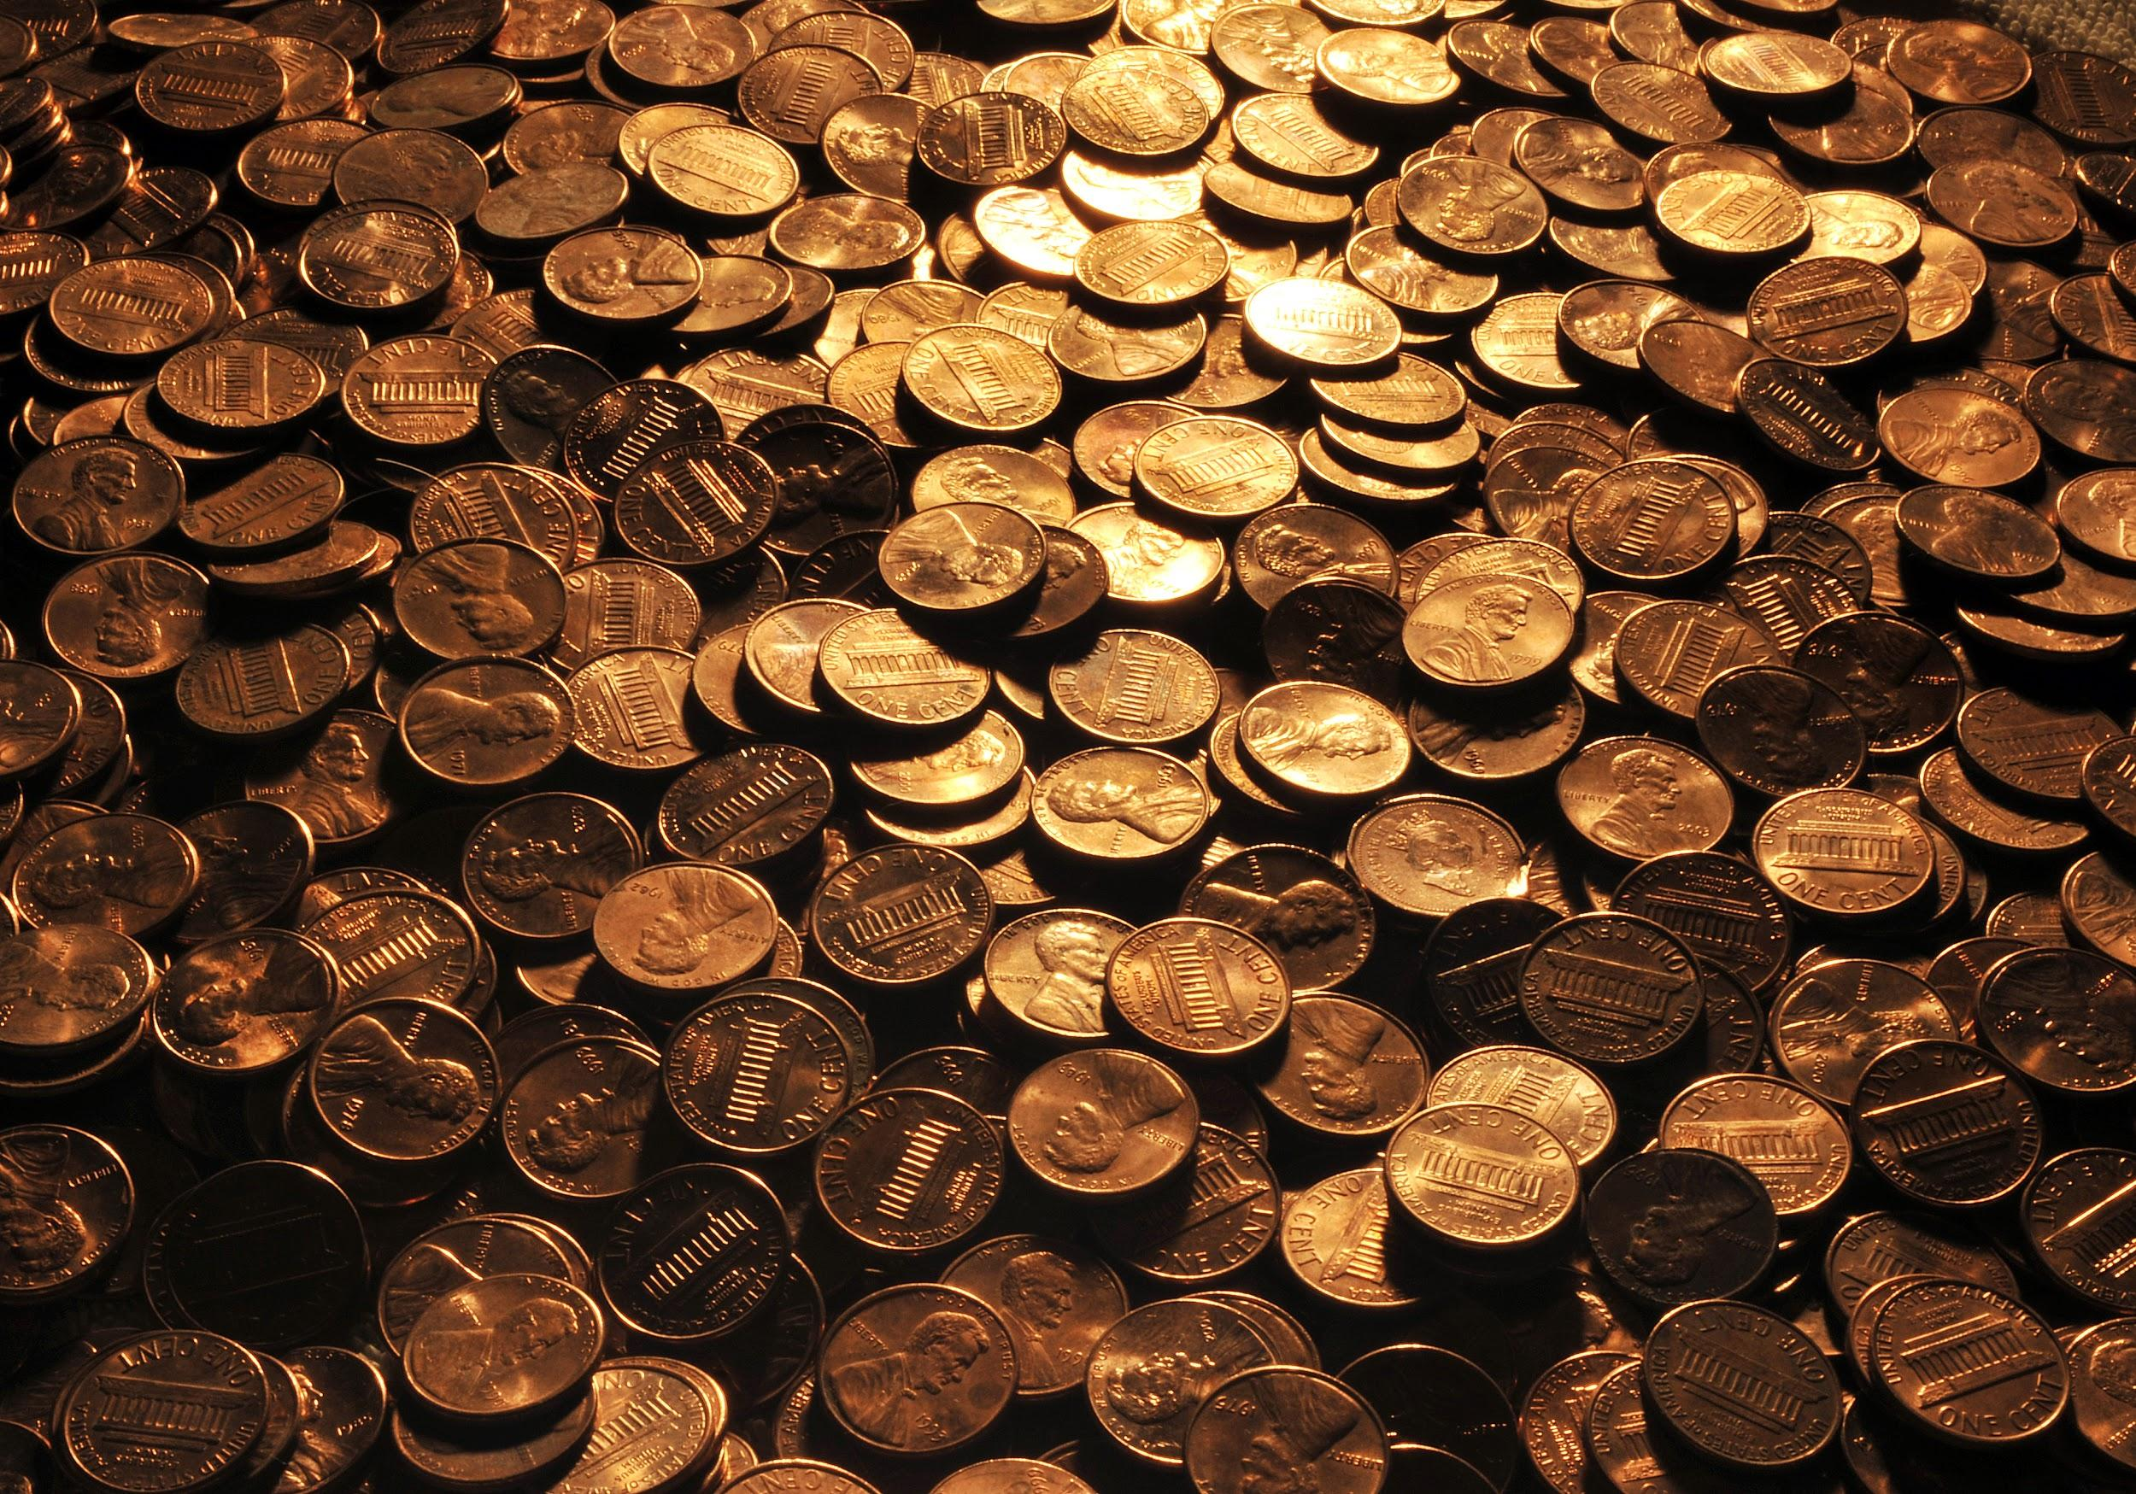
Unplugged Activity 1: A pile of Pennies
Notes:
This activity involves a concept we have learnt in class called sorting. We will also learn how we can use parallelism to improve sorting performance.

Slide 6
Unplugged Activity 2: Description
Goal: find oldest penny.
We are going to explore several solutions to achieving the goal.

Slide 7
Unplugged activity 2 description
I have 50 coins and the problem is to find the oldest one in the quickest time. So we are going to do it first in a sequential mode and then in various parallel variations.
Students break into groups of 5 or 6.
Phase 1 (sequential): each group (student 1 sorting and student 2 timing, other students observing)
Student 1 task: find the oldest penny
Student 2 task: time the activity of student 1 and writes it down. Other students’ task: observe Student 1 and 2. When they are done Shuffle coins and put back in bag

Slide 8
Unplugged activity 2 description cont’d….
Phase 2 (Parallelize it): each group (students 1 and 2 are given equal number of pennies and are asked to find the oldest penny in their pile, student 3 records the times for student 1 & 2. Parallel Time is calculated as the time of the slowest student among 1 and 2.
At a set time, sorting begins for all groups.
Student 3 records the time it takes each student to find the oldest penny in their pile. Parallel Time is calculated as the time of the slowest student among 1 and 2.
When done shuffle coins and put back in their respective bags. Please do not mix coins. Each bag should have 25 pennies.

Slide 9
Unplugged activity 2 description cont'd….
Phase 3 (Parallelize it-2):
Parallelize it (2): Teacher gives 2 pennies to students 1, 2, 3, 4 and the remaining pennies to student 5.
At a set time, sorting begins for all groups.
Student 6 records time for each of the worker students. Parallel time is calculated as the time of the slowest student.
What do we learn? This is poor load balancing! Shuffle and put coins back in the bag

Slide 10
Group Discussion: what did we learn?
Notes:
Now discuss among your group what aspects of parallel computing you learnt from the activity [allow 5 mins, then give time for questions to the teacher]

Slide 11
Plugged (code) Activity 1: sorting an array of numbers
Notes:
This activity involves a concept we have learnt in class called sorting. We will also learn how we can use parallelism to improve sorting performance.

Slide 12
Review Code
Review Code for sequential sorting – PennySortingSequential.java
Review Code for parallel sorting - PennySortingParallel.java
parallelSort()
Sorting with Stream
Fork/Join

Slide 13
Student Survey
Student Engagement Survey – link provided

Slide 14
Thank you for your participation! Hope you enjoyed the parallelism day

