Slide 1
LAB Data Parallelism CSCI 2911/2916

Slide 2
STEP 1: Pre-Activity Quiz to Assess Pre-Knowledge
Please go to the consent form and pre-lab quiz
Link provided

Slide 3

STEP TWO: Flag Maker Activity
You’ll be pretending to be the computer drawing the flag of Mauritius (on the right).
You’ll use paper and colored pencils but otherwise follow how a computer might draw it.
You must fill in the squares.
You must color one square at a time. Do not color in multiple squares at one time.
Img from: https://en.wikipedia.org/wiki/Mauritius

Slide 4

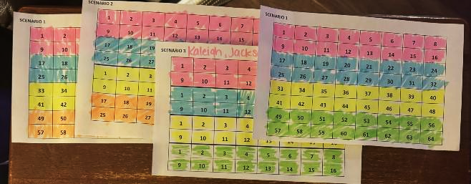

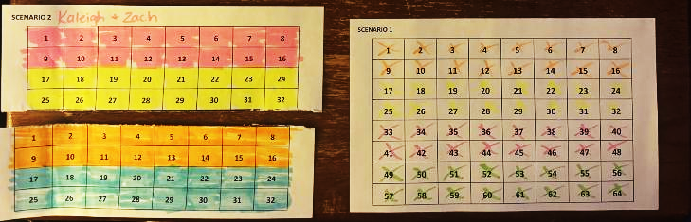
Flag Maker Activity
CORRECT!
You must color one square at a time.
Do not color in multiple squares at one time.
WRONG!
Fill in the squares
WRONG!
Don’t tear the paper!

Slide 5
Scenario 1: A Single Processor
Two people:
The Processor: colors first stripe (cell by cell), second stripe (cell by cell), third stripe (cell by cell), and then fourth stripe (cell by cell)
Timer: Times the Processor
P1 | 1 | 2 | 3 | 4 | 5 | 6 | 7 | 8
 | 9 | 10 | 11 | 12 | 13 | 14 | 15 | 16
 | 17 | 18 | 19 | 20 | 21 | 22 | 23 | 24
 | 25 | 26 | 27 | 28 | 29 | 30 | 31 | 32
 | 33 | 34 | 35 | 36 | 37 | 38 | 39 | 40
 | 41 | 42 | 43 | 44 | 45 | 46 | 47 | 48
 | 49 | 50 | 51 | 52 | 53 | 54 | 55 | 56
 | 57 | 58 | 59 | 60 | 61 | 62 | 63 | 64
Remember: squares must be mostly colored in & you can only color one square at a time!

Slide 6
Scenario 1: A Single Processor QUESTIONS
Why does this process take a long time with only one “processor”?
How could this approach cause inefficiency in more complex tasks?
Notes:
Question 1: Why does this process take a long time with only one "processor"? Answer: With only one processor, every action is sequential, meaning each cell has to be processed one at a time without any parallel work. This highlights the limitations of a single-threaded system where tasks cannot be divided to reduce time, demonstrating the concept of processing bottlenecks.
Question 2: How could this approach cause inefficiency in more complex tasks? Answer: In complex tasks requiring a lot of data handling, using a single processor would result in slow performance as it processes each item individually. This scenario illustrates that while accurate, sequential processing is not scalable for tasks requiring high efficiency and speed.

Slide 7
Scenario 2: Two Processors Collaborating
P1 | 1 | 2 | 3 | 4 | 5 | 6 | 7 | 8
 | 9 | 10 | 11 | 12 | 13 | 14 | 15 | 16
 | 17 | 18 | 19 | 20 | 21 | 22 | 23 | 24
 | 25 | 26 | 27 | 28 | 29 | 30 | 31 | 32
P2 | 1 | 2 | 3 | 4 | 5 | 6 | 7 | 8
 | 9 | 10 | 11 | 12 | 13 | 14 | 15 | 16
 | 17 | 18 | 19 | 20 | 21 | 22 | 23 | 24
 | 25 | 26 | 27 | 28 | 29 | 30 | 31 | 32
Three people:
Processor 1: Colors red and blue stripes (cell by cell)
Processor 2: Colors yellow and green stripes (cell by cell)
Timer: Times them; stop when all cells are colored.
Remember: squares must be mostly colored in & you can only color one square at a time!

Slide 8
Scenario 2: Two Processors Collaborating QUESTIONS
How does the addition of a second processor impact the overall completion time?
What potential problems could arise if both processors were given overlapping tasks such as coloring the same stripes?
Notes:
Question 1: How does the addition of a second processor impact the overall completion time? Answer: Adding a second processor allows for parallel processing, so two stripes (red and blue, yellow and green) can be worked on simultaneously, effectively cutting down the completion time. This demonstrates how distributing tasks between processors can increase efficiency.
Question 2: What potential problems could arise if both processors were given overlapping tasks? Answer: If both processors colored the same stripes, they might overwrite each other’s work, causing inconsistencies. This introduces the concept of race conditions, where two processes access and modify shared data at the same time, leading to unpredictable results.

Slide 9
Scenario 3: Four Processors Collaborating
P1 | 1 | 2 | 3 | 4 | 5 | 6 | 7 | 8
 | 9 | 10 | 11 | 12 | 13 | 14 | 15 | 16
P2 | 1 | 2 | 3 | 4 | 5 | 6 | 7 | 8
 | 9 | 10 | 11 | 12 | 13 | 14 | 15 | 16
P3 | 1 | 2 | 3 | 4 | 5 | 6 | 7 | 8
 | 9 | 10 | 11 | 12 | 13 | 14 | 15 | 16
P4 | 1 | 2 | 3 | 4 | 5 | 6 | 7 | 8
 | 9 | 10 | 11 | 12 | 13 | 14 | 15 | 16
Five people:
Processors 1-4: Each assigned to one color, which they color (cell by cell)
Timer: Times them; stop when all cells are colored.
Remember: squares must be mostly colored in & you can only color one square at a time!

Slide 10
Scenario 3: Four Processors Collaborating QUESTIONS
How does using four processors further improve efficiency, and what challenges might this bring?
What would happen if one processor finished its task significantly earlier than the others?
Notes:
Question 1: How does using four processors further improve efficiency, and what challenges might this bring? Answer: Four processors allow each to work on one color stripe independently, reducing the time needed even more than with two processors. However, with more processors, synchronization becomes crucial to ensure they don’t interfere with each other’s work, which can lead to increased coordination complexity.
Question 2: What would happen if one processor finished its task significantly earlier than the others? Answer: If one processor finishes early, it sits idle, which is an example of underutilized resources. In real systems, load balancing is essential to ensure all processors have tasks of roughly equal duration to maximize efficiency.

Slide 11
Scenario 4: Four Processors Collaborating a Different Way (Column Assignments)
P1 |  | P2 |  | P3 |  | P4
1 | 9 | 1 | 9 | 1 | 9 | 1 | 9
2 | 10 | 2 | 10 | 2 | 10 | 2 | 10
3 | 11 | 3 | 11 | 3 | 11 | 3 | 11
4 | 12 | 4 | 12 | 4 | 12 | 4 | 12
5 | 13 | 5 | 13 | 5 | 13 | 5 | 13
6 | 14 | 6 | 14 | 6 | 14 | 6 | 14
7 | 15 | 7 | 15 | 7 | 15 | 7 | 15
8 | 16 | 8 | 16 | 8 | 16 | 8 | 16
Five people:
Processors 1-4: Each assigned a strip of two columns (first takes left 2 columns, second takes next two columns, etc.) Processors colors these the correct color cell by cell.
Timer: Times them; stop when all cells are colored.
Remember: squares must be mostly colored in & you can only color one square at a time!

Slide 12
Scenario 4: Four Processors Collaborating a Different Way (Column Assignments) QUESTIONS
How does assigning processors by columns rather than stripes impact performance and potential errors?
How does this scenario reflect real-world issues in distributed systems?
Notes:
Question 1: How does assigning processors by columns rather than stripes impact performance and potential errors? Answer: This column-based approach lets each processor work on sections across all colors, which might improve efficiency if coloring large sections by color becomes too complex. However, with this setup, processors might again risk stepping into each other’s workspaces at the boundaries, which can lead to race conditions unless clearly separated.
Question 2: How does this scenario reflect real-world issues in distributed systems? Answer: Distributed systems often allocate resources by dividing tasks spatially, just as columns are divided here. However, managing boundaries is crucial to prevent overlaps and race conditions, which require robust coordination protocols in real-world systems to ensure data integrity.

Slide 13
STEP 3: Post-Activity Quiz & Survey
Please take this post-lab quiz & Survey:
Post lab link provided
Survey link provided

