Slide 1
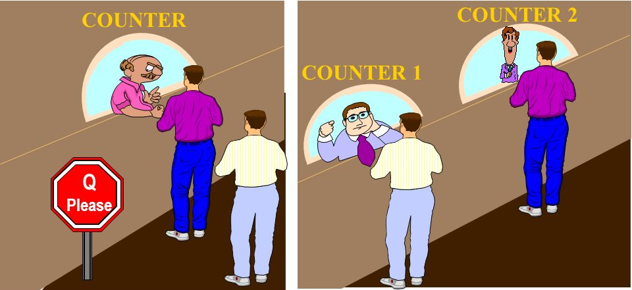
Basics of Parallel & Distributed Computing
Dr. Mary Smith
CSCI 2911/2916
Notes:
Good afternoon students. As I had mentioned in our last class, today we will work on some unplugged activities to learn some fundamental concepts of PDC.

Slide 2
OUTLINE
Why Parallel and Distributed Computing Curriculum?
What is Parallel Computing – videos
Unplugged activity 1: More Processors are Not Always the Best
Activity phases: sequential and parallel
Group/class discussion
Survey
Unplugged activity 2: Sorting Pennies
Activity phases: sequential sorting, parallel sorting
Group/class discussion
Survey
Notes:
Here is the plan for the class today. [then go over the outline]

Slide 3
Why a Parallel and Distributed Computing Curriculum?
An initiative mandated by the National Science Foundation (NSF) and the ACM/IEEE Computer Society
https://grid.cs.gsu.edu/~tcpp/curriculum/?q=curr_whypdc.html
Notes:
In the last few years all laptops, desktops and servers have switched to having one or more multicore processors, with increased performance for applications running on those machines coming from application parallelization instead of increasing clock speeds. Even tablets and smartphones (both Android and iOS based devices) and music players (e.g., the Apple iPod Touch) utilize multicore processors. This shift in processor architectures has made waiting until graduate courses to learn parallelism untenable as it leaves students unprepared for the workforce and for performing graduate level work in many important areas of computer science. Therefore the IEEE TCPP along with NSF and ACM have taken an initiative to mandate the introduction of PDC at an undergrad level. This work is also a research step towards that initiative. For more info visit the link on the slide.

Slide 4
What is Parallel Computing?
Brief Overview of Parallel & Distributed Computing:
https://www.youtube.com/watch?v=RJNx90ODawk
Longer video for later:
https://www.youtube.com/watch?v=GXrI3oJ3Eak
Description
https://www.britannica.com/science/computer-science/Parallel-and-distributed-computing
Notes:
We will look at a short video to understand the basic concept behind parallel & distributed computing. If you are interested in learning more then refer to the links on this slide.

Slide 5

Unplugged activity 1
More processors are not always the best
Notes:
Now lets create groups according to the group list posted on blackboard. Each group will have 5 -6 members. Please take turns in working as a processor for the activities we will do today.

Slide 6
Unplugged activity 1 description
The activity involves participation of two or more students for the following phases:
Uniprocessor Sequential phase
Participant 1 - acts as a processor to perform
Task 1: writing a sentence (more processors are not always the best), followed by
Task 2: assigning a numeric value as an index (0,1,...32) to each character in the written sentence.
Participant 2 - times the tasks performed by participant 1.

Slide 7
Unplugged activity 1 description cont’d...
An example of the two writing tasks:
M | o | r | e | P | r | o | c | e | s | s | o | r | s | A | r | e | N | o | t | A | l | w | a | y | s | T | h | e | B | e | s | t
0 | 1 | 2 | 3 | 4 | 5 | 6 | 7 | 8 | 9 | 10 | 11 | 12 | 13 | 14 | 15 | 16 | 17 | 18 | 19 | 20 | 21 | 22 | 23 | 24 | 25 | 26 | 27 | 28 | 29 | 30 | 31 | 32
The above two tasks can be timed either in serial or in parallel in one of the activity phases.
NOTE: all processors (participants) are provided their own local buffer to work on. Thus, all processors (participants will work on their own sheets of paper).

Slide 8
Unplugged activity 1 description cont’d...
Uniprocessor Multi Tasking Phase
Participant 1 - acts as a processor to perform
Task 1: writing a sentence (more processors are not always the best), interleaved character by character with
Task 2: assigning a numeric value as an index (0,1,...32) to each character in the written sentence, interleaved with Task 1, number by number
Participant 2 - times the tasks performed by participant 1.
Compares performance with Sequential Phase

Slide 9
Unplugged activity 1 description cont’d...
Two Processor Parallel Phase
Participant 1 - acts as a parallel processor to perform
Task 1: writing a sentence (more processors are not always the best)
Participant 2 - acts as a parallel processor to perform
Task 2: assigning a numeric value as an index (0,1,...32) to each character in the written sentence. Starting and ending index values are given. Starts at the same time as Participant 1.
Participant 3 - times the tasks performed by parallel participants 1 and 2. Overall time is calculated as the time of the slower processor.
Compares performance with Sequential Phase and multi-tasking phase

Slide 10
Unplugged activity 1 description cont’d...
Multi Processor Parallel Phase
Participant 1 -
|(Task 1)/2|: writing a partial sentence (more processors are)
Participant 2 -
|(Task 1)/2|: writing a partial sentence (not always the best), starts at the same time as participant 1.
Participant 3 -
|(Task 2)/2|: assigning a numeric value as an index (starting at 0) to each character in the partial sentence written by participant 1. Starts with participant 1. Once done sends last index + 1 value to participant 4.
Participant 4 -
|(Task 2)/2|: assigning a numeric value as an index (continues from participant 3) to each character in the partial sentence written by participant 2. Gets starting index from participant 3. Overhead: may have to wait on participant 3 to continue proper indexing.
Participant 5 - times the tasks performed by parallel participants. Overall time is calculated as the time of the slowest processor
Compares performance with Sequential Phase and multi-tasking phase and previous parallel scenario.

Slide 11
Amdahl’s Law limitations: Scenario on Previous slide
A suggested Improvement - Increase # of TASKS
Participant 1 -
|(Task 1)/2|: writing a partial sentence (more processors are not always the best)
Participant 2 -
|(Task 1)/2|: writing a partial sentence (more processors are not always the best), starts at the same time as participant 1.
Participant 3 -
Task 2: assigning a numeric value as an index to each character in the sentence written by participants 1 and 2. Starting and ending index are provided.
Participant 4 -
Task 3: calculating the total number of characters for each word in the sentence
Participant 5 - times the tasks performed by parallel participants. Overall time is calculated as the time of the slowest processor
Compares performance with Sequential Phase and multi-tasking phase and previous parallel scenario

Slide 12
Group Discussion: what did we learn?
Notes:
Now discuss among your group what aspects of parallel computing you learnt from the activity [allow 5 mins, then give time for questions to the teacher]

Slide 13
Thank you for your participation! Hope you enjoyed the parallelism day

