Slide 1
CSIT 111: Fundamentals of Programming I
Lecturer: Jiayin Wang
Class 16: Data Parallelism Activity

Slide 2
STEP 1:Pre-activity Quiz
Please take the pre-activity quiz to assess the pre-knowledge of the lab:

Slide 3

STEP TWO: FlagMaker Activity
You’ll be pretending to be the computer drawing the flag of Mauritius (on the right).
You’ll use paper and crayons, but otherwise follow how a computer might draw it.
You must fill in the squares.
You must color one square at a time. Do not color in multiple squares at one time.
Img from: https://en.wikipedia.org/wiki/Mauritius

Slide 4

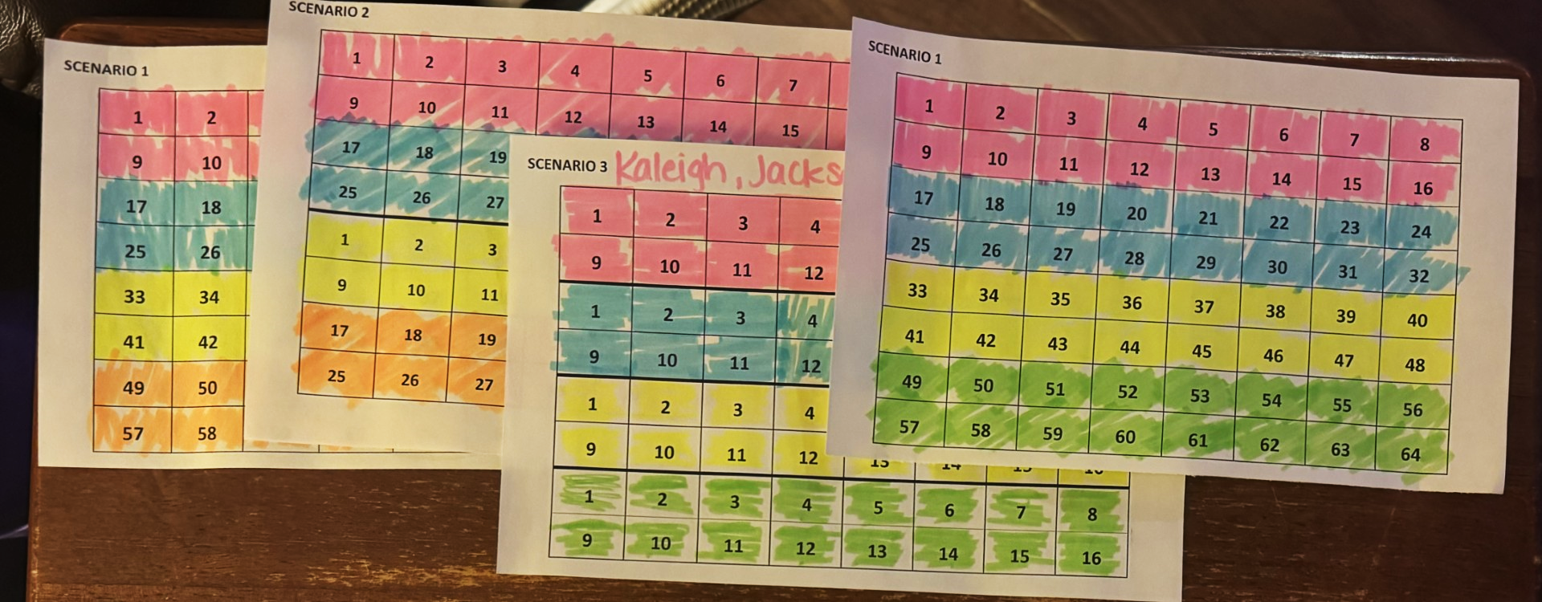

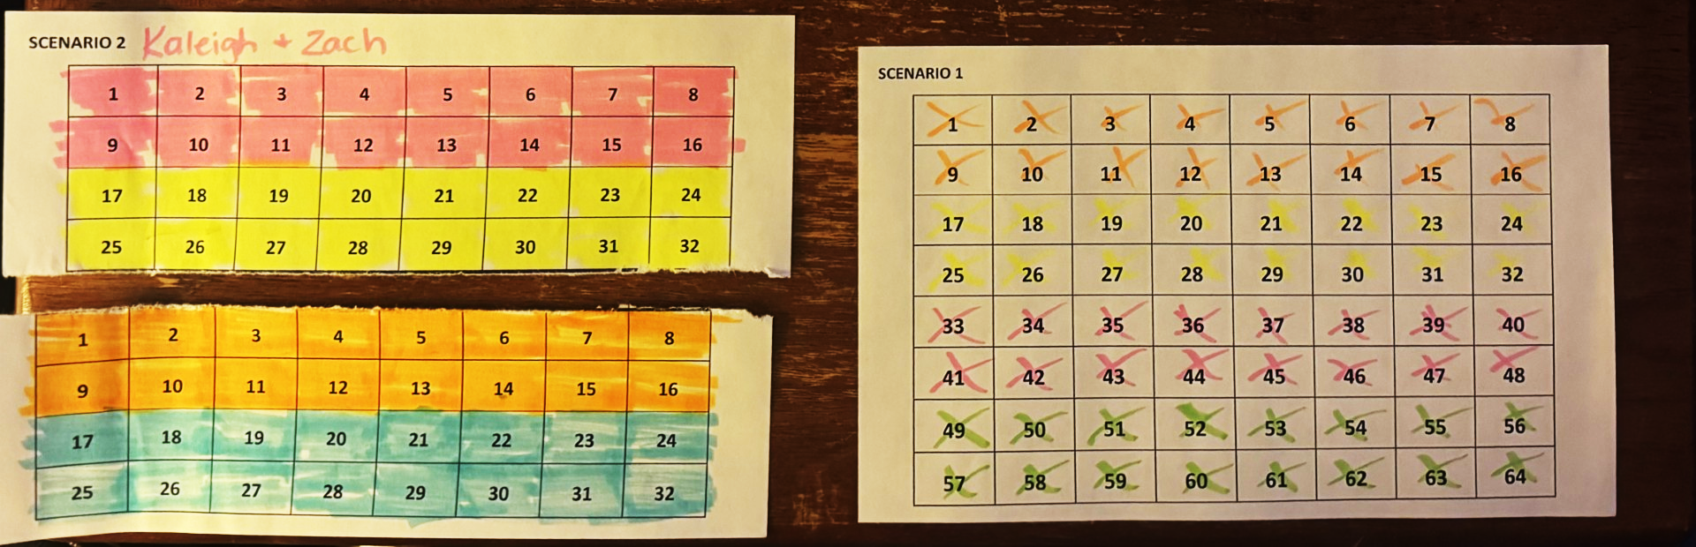
FlagMaker Activity
CORRECT!
You must color one square at a time.
Do not color in multiple squares at one time.
WRONG!
Fill in the squares
WRONG!
Don’t tear the paper!

Slide 5
Scenario 1: A Single Processor
Two people:
The Processor: colors first stripe (cell by cell), second stripe (cell by cell), third stripe (cell by cell), and then fourth stripe (cell by cell)
Timer: Times the Processor
P1 | 1 | 2 | 3 | 4 | 5 | 6 | 7 | 8
 | 9 | 10 | 11 | 12 | 13 | 14 | 15 | 16
 | 17 | 18 | 19 | 20 | 21 | 22 | 23 | 24
 | 25 | 26 | 27 | 28 | 29 | 30 | 31 | 32
 | 33 | 34 | 35 | 36 | 37 | 38 | 39 | 40
 | 41 | 42 | 43 | 44 | 45 | 46 | 47 | 48
 | 49 | 50 | 51 | 52 | 53 | 54 | 55 | 56
 | 57 | 58 | 59 | 60 | 61 | 62 | 63 | 64
Remember: squares must be mostly colored in & you can only color one square at a time!
Notes:
28 students / 2 = 14 scenario 1 pages per lab * 10 labs = 140 (2 per page so 70 copies)

Slide 6
Scenario 1: A Single Processor QUESTIONS
Why does this process take a long time with only one “processor”?
How could this approach cause inefficiency in more complex tasks?
Notes:
Question 1: Why does this process take a long time with only one "processor"? Answer: With only one processor, every action is sequential, meaning each cell has to be processed one at a time without any parallel work. This highlights the limitations of a single-threaded system where tasks cannot be divided to reduce time, demonstrating the concept of processing bottlenecks.
Question 2: How could this approach cause inefficiency in more complex tasks? Answer: In complex tasks requiring a lot of data handling, using a single processor would result in slow performance as it processes each item individually. This scenario illustrates that while accurate, sequential processing is not scalable for tasks requiring high efficiency and speed.

Slide 7
Why does this process take a long time with only one “processor”?
Sequential Processing: Each action is executed one at a time, meaning every cell is processed sequentially.
Single-Threaded Limitation: Tasks cannot be divided or handled in parallel, leading to longer completion times.
Processing Bottlenecks: This highlights how a single-threaded system becomes a bottleneck when handling multiple or repetitive tasks.

Slide 8
How Could This Approach Cause Inefficiency in More Complex Tasks?
Slow Performance for Complex Tasks:
A single processor processes each item individually, making it inefficient for data-heavy tasks.
Scalability Issues:
In general, a problem is scalable if it can handle ever increasing problem sizes.
While sequential processing ensures accuracy, it’s not scalable for tasks requiring high efficiency or speed.
Inefficient Resource Utilization:
Single-threaded systems often cannot handle modern workloads effectively.

Slide 9
Scenario 2: Two Processors Collaborating
Three people:
Processor 1: Colors red and blue stripes (cell by cell)
Processor 2: Colors yellow and green stripes (cell by cell)
Timer: Times them; stop when all cells are colored.
P1 | 1 | 2 | 3 | 4 | 5 | 6 | 7 | 8
 | 9 | 10 | 11 | 12 | 13 | 14 | 15 | 16
 | 17 | 18 | 19 | 20 | 21 | 22 | 23 | 24
 | 25 | 26 | 27 | 28 | 29 | 30 | 31 | 32
P2 | 1 | 2 | 3 | 4 | 5 | 6 | 7 | 8
 | 9 | 10 | 11 | 12 | 13 | 14 | 15 | 16
 | 17 | 18 | 19 | 20 | 21 | 22 | 23 | 24
 | 25 | 26 | 27 | 28 | 29 | 30 | 31 | 32
Remember: squares must be mostly colored in & you can only color one square at a time!
Notes:
28 students / 3 = ~10 scenario 2 pages per lab * 10 labs = 100 (2 per page so 50 copies)

Slide 10
Scenario 2: Two Processors Collaborating QUESTIONS
How does the addition of a second processor impact the overall completion time?
What potential problems could arise if both processors were given overlapping tasks such as coloring the same stripes?
Notes:
Question 1: How does the addition of a second processor impact the overall completion time? Answer: Adding a second processor allows for parallel processing, so two stripes (red and blue, yellow and green) can be worked on simultaneously, effectively cutting down the completion time. This demonstrates how distributing tasks between processors can increase efficiency.
Question 2: What potential problems could arise if both processors were given overlapping tasks? Answer: If both processors colored the same stripes, they might overwrite each other’s work, causing inconsistencies. This introduces the concept of race conditions, where two processes access and modify shared data at the same time, leading to unpredictable results.

Slide 11
How Does the Addition of a Second Processor Impact Completion Time?
Parallel Processing Advantage: With two processors, tasks can be split and executed simultaneously, e.g., one processor handles red/blue stripes, and another handles yellow/green.
Increased Efficiency: The total completion time is effectively halved, as the workload is distributed across two processors.
Demonstration of Scalability: Adding processors improves performance for divisible tasks, showing how multi-threading can optimize workflow.

Slide 12
What Potential Problems Could Arise if Tasks Overlap?
Race Conditions: If both processors attempt to work on the same stripes, they may overwrite each other’s results, causing inconsistencies.
Need for Coordination: Proper task assignment or locking mechanisms are required to prevent overlapping and ensure accurate results.

Slide 13
Scenario 3: Four Processors Collaborating
Five people:
Processors 1-4: Each assigned to one color, which they color (cell by cell)
Timer: Times them; stop when all cells are colored.
P1 | 1 | 2 | 3 | 4 | 5 | 6 | 7 | 8
 | 9 | 10 | 11 | 12 | 13 | 14 | 15 | 16
P2 | 1 | 2 | 3 | 4 | 5 | 6 | 7 | 8
 | 9 | 10 | 11 | 12 | 13 | 14 | 15 | 16
P3 | 1 | 2 | 3 | 4 | 5 | 6 | 7 | 8
 | 9 | 10 | 11 | 12 | 13 | 14 | 15 | 16
P4 | 1 | 2 | 3 | 4 | 5 | 6 | 7 | 8
 | 9 | 10 | 11 | 12 | 13 | 14 | 15 | 16
Remember: squares must be mostly colored in & you can only color one square at a time!
Notes:
28 students / 4 = 7 scenario 3 pages per lab * 10 labs = 70 (2 per page so 35 copies)

Slide 14
Scenario 3: Four Processors Collaborating QUESTIONS
How does using four processors further improve efficiency, and what challenges might this bring?
What would happen if one processor finished its task significantly earlier than the others?
Notes:
Question 1: How does using four processors further improve efficiency, and what challenges might this bring? Answer: Four processors allow each to work on one color stripe independently, reducing the time needed even more than with two processors. However, with more processors, synchronization becomes crucial to ensure they don’t interfere with each other’s work, which can lead to increased coordination complexity.
Question 2: What would happen if one processor finished its task significantly earlier than the others? Answer: If one processor finishes early, it sits idle, which is an example of underutilized resources. In real systems, load balancing is essential to ensure all processors have tasks of roughly equal duration to maximize efficiency.

Slide 15
How Does Using Four Processors Improve Efficiency?
Parallel Processing at Scale:
Each processor works on a single color stripe independently, drastically reducing the total completion time.
More processors mean the task is divided into smaller portions, making processing faster and more efficient.
Speedup
Number of processors: p
Serial run-time = T_{serial}
Parallel run-time = T_{parallel}
T_{parallel} = T_{serial} / p
Speedup = T_{serial} / T_{parallel}

Slide 16
How Does Using Four Processors Improve Efficiency?
Parallel Processing at Scale:
Each processor works on a single color stripe independently, drastically reducing the total completion time.
Scalability:
More processors mean the task is divided into smaller portions, making processing faster and more efficient.
Challenges of Synchronization:
Synchronization imposes order constraints and is used to protect access to shared data.
As the number of processors increases, synchronization becomes crucial to ensure they don’t interfere with each other’s work, which can lead to increased coordination complexity.

Slide 17
What Happens if One Processor Finishes Early?
Underutilization: A processor completing its task early remains idle while others finish their tasks, wasting resources.
Importance of Load Balancing: Distributing tasks of equal duration among processors ensures all are fully utilized and efficient.
Real-World Insight: Load balancing techniques are critical in multi-processor systems to prevent idle time and maximize throughput.

Slide 18
Scenario 4: Four Processors Collaborating a Different Way (Column Assignments)
Five people:
Processors 1-4: Each assigned a strip of two columns (first takes left 2 columns, second takes next two columns, etc.) Processors colors these the correct color cell by cell.
Timer: Times them; stop when all cells are colored.
P1 |  | P2 |  | P3 |  | P4
1 | 9 | 1 | 9 | 1 | 9 | 1 | 9
2 | 10 | 2 | 10 | 2 | 10 | 2 | 10
3 | 11 | 3 | 11 | 3 | 11 | 3 | 11
4 | 12 | 4 | 12 | 4 | 12 | 4 | 12
5 | 13 | 5 | 13 | 5 | 13 | 5 | 13
6 | 14 | 6 | 14 | 6 | 14 | 6 | 14
7 | 15 | 7 | 15 | 7 | 15 | 7 | 15
8 | 16 | 8 | 16 | 8 | 16 | 8 | 16
Remember: squares must be mostly colored in & you can only color one square at a time!
Notes:
28 students / 4 = 7 scenario 3 pages per lab * 10 labs = 70 (2 per page so 35 copies)

Slide 19
Scenario 4: Four Processors Collaborating a Different Way (Column Assignments) QUESTIONS
How does assigning processors by columns rather than stripes impact performance and potential errors?
How does this scenario reflect real-world issues in distributed systems?
Notes:
Question 1: How does assigning processors by columns rather than stripes impact performance and potential errors? Answer: This column-based approach lets each processor work on sections across all colors, which might improve efficiency if coloring large sections by color becomes too complex. However, with this setup, processors might again risk stepping into each other’s workspaces at the boundaries, which can lead to race conditions unless clearly separated.
Question 2: How does this scenario reflect real-world issues in distributed systems? Answer: Distributed systems often allocate resources by dividing tasks spatially, just as columns are divided here. However, managing boundaries is crucial to prevent overlaps and race conditions, which require robust coordination protocols in real-world systems to ensure data integrity.

Slide 20
How Does Assigning Processors by Columns Impact Performance?
Efficiency in Task Distribution: Assigning processors by columns allows each to handle portions across all colors, potentially speeding up tasks when coloring large sections by stripe is inefficient.
Challenges at Boundaries: Processors risk overlapping at the edges of their assigned columns, leading to potential errors or race conditions.
Error Mitigation: Clear separation of workspaces or boundary management is essential to avoid stepping into other processors’ tasks.

Slide 21
Real-World Reflection: Distributed Systems
Pipelining
Pipelining is a technique used in computer systems to improve efficiency by organizing tasks into sequential stages. Stages in Scenario 4: coloring Red->Blue->Yellow->Green
Processors pass work between stages, maintain steady progress (e.g. marker sharing). Pipelining benefits systems by keeping all components active once initiated.
Contention and Dependencies
Contention occurs when processors compete for shared resources (e.g., markers in this activity)
Dependencies: Certain tasks require others to finish before proceeding (e.g., coloring red before blue)
Adding resources (e.g. more markers) can reduce contention but not eliminate dependencies.

Slide 22
Real-World Reflection: Distributed Systems
Spatial Task Allocation: Distributed systems often divide tasks spatially, similar to assigning processors to columns.
Boundary Management: Overlaps or conflicts at task boundaries mimic real-world issues like race conditions in distributed systems.
Coordination Protocols: Robust systems implement protocols to synchronize operations and ensure data integrity, just as processors need coordination here.

Slide 23
Animation
https://raw.githack.com/xiaoyuansuo51-webster/Flag_Coloring_Activity/refs/heads/main/flags.html
https://raw.githack.com/xiaoyuansuo51-webster/Flag_Coloring_Activity/refs/heads/main/parallel_linked_list.html

Slide 24
STEP 3: Post-Activity Quiz
Please take the post-activity quiz to assess the knowledge of the lab.
Notes:
Answer: AABAB

Slide 25
STEP 4: Post-Activity Survey

