Slide 1
Fork-join parallelism
??/??/??
(drawing on materials by Dan Grossman)

Slide 2
Using multiple cores
Essentially all computers now are multi-core (dual-core means 2 cores, quad-core means 4 cores, etc)
Each core can run all the operations needed to run a program
Up to this point, our programs have always done a single thing at once so one can run on each core
What if we wanted multiple cores to run a single program faster?
Need to split program into parts that can run on different cores
Notes:
Motivating the idea of using parallelism– we already have the hardware for it so how do we use that? We want to create programs where appropriate parts of them can run in parallel (at the same time on different cores) so that the program can finish faster.

Slide 3
Sample problem: Summing an array
int simpleSum(int[] array, int low, int hi) {
int sum = 0;
for(int i=low; i < hi; i++)
sum = sum + array[i];
return sum;
}
Notes:
We’re going to start by looking at a very simple problem, summing the values in an array. It’s not clear that we would actually want to do this in parallel since it has so little computation, but we’re going to use it as our example since it’s a simple problem or the right type.
Talk through the code, which sums the values in indices >=low and < hi
Transition: This is an example of a problem that we should be able to parallelize. In particular, summing different parts of the array are completely independent operations and thus could be done simultaneously on different cores. We can’t do this in the for loop, however. Instead, we need to split the task into different parts.

Slide 4
Splitting the sum into two parts
int sum(int[] array, int low, int hi) {
int left = simpleSum(array, low, (hi+low)/2);
int right = simpleSum(array, (hi+low)/2, hi);
return left + right;
}
Notes:
Here is the summing problem split into two different parts. Talk through the code, pointing out that the left and right halves are separate problems.
Transition: So how do we run the calls to simpleSum in parallel?

Slide 5
New conceptual keywords (not real Java)
Allows child call (rest of line) to run in parallel with its parent
int sum(int[] array, int low, int hi) {
int left = fork simpleSum(array, low, (hi+low)/2);
int right = simpleSum(array, (hi+low)/2, hi);
join;
return left + right;
}
Wait for all children to complete
Notes:
For now, we’re going to express parallel computing with two new keywords, fork and join. These are NOT actual keywords in Java. Later in the lecture, I’ll show you the way to write this in actual Java and it will be clear why we’re using this notation instead. The idea is to talk about what we want to do first and then we’ll figure out how to do it in the actual programming language.
The first keywork, fork, is used to mark some code as being able to be run in parallel. When you add fork to the beginning of a line, the rest of that line is marked as a separate strand of code that can be run at the same time as the next part of the method. In this example, the first call to simpleSum can run in parallel with the second call.
(next slide)

Slide 6
New conceptual keywords (not real Java)
Allows child call (rest of line) to run in parallel with its parent
int sum(int[] array, int low, int hi) {
int left = fork simpleSum(array, low, (hi+low)/2);
int right = simpleSum(array, (hi+low)/2, hi);
join;
return left + right;
}
Wait for all children to complete
Hopefully, this
becomes these
time
Notes:
This shows how we’d like the schedule to change. The boxes represent the work being done, laid out over time. Before the addition of fork, a single core had to run the entire method. With fork, the method is split into two parts. Hopefully, two different cores will run the two different parts and they’ll both finish earlier.
Whether the code actually runs in parallel or not is determined by the system scheduler; fork just marks the code as something that can run in parallel. By putting fork in our code, we are giving the scheduler that option.
The other keyword, join, causes the program to wait until all the strands started above it have finished. This is needed because both left and right have to be computed before we run the method’s last line.

Slide 7
fork and join in pictures
A();
B();
C();
D();
A
Boxes are strands (chunk of code we want to run without a fork or join)
Arrows show precedence constraints, relationship where one strand must run before another
B
C
D
Each line must run in the given order
Notes:
Now for a graphical way to look at fork and join. We start with a serial program that runs A, then B, then C, and then D. This can be depicted as 4 boxes with arrows from one to another. Each box represents a piece of code (in this case a function) that doesn’t use fork or join. We call these strands. The arrows represent precedence constraints on when the different functions have to run. The arrow from A to B means that we have to finish A before we start B. The figure shows how the code runs; each method finishes before the next one starts.

Slide 8
fork and join in pictures
A();
B();
C();
D();
A
A
A();
fork B();
C();
join;
D();
B
B
C
C
D
D
Each line must run in the given order
Both B and C must run after A and before D, but their relationship is undefined
Notes:
This is the same four methods, but now we’ve added a fork and join, which changes the precedence diagram. B still has to run after A because the call that creates the strand for B is after A finishes. C also has to wait for A to finish because we call C after the call to A. Note that C doesn’t have to wait for B, however. The call “fork B” sets up the strand, but doesn’t necessarily run B immediately. Thus, C could run before, after, or at the same time as B. Both B and C must run before D, though. C must run before D because the call to D is after the call to C. B must run before D because D doesn’t run until after the join command, which waits for B to finish.
Make sure questions are answered before proceeding.

Slide 9
Which of the following could be printed by the code below?
fork System.out.print(1);
System.out.print(2);
fork System.out.print(3);
join;
System.out.print(4);
3124
2134
1243
Only I.
Only II.
Only I. and II.
Only II. and III.
None of the above
Notes:
First clicker question. Here is a different collection of fork and join calls and the methods now print things. Which of the sequences of numbers could this code print?
Give time for them to answer individually. Then, unless either everyone gets it right or everyone gets it wrong, have them explain their answers to their neighbors and vote again.

Slide 10
Which of the following could be printed by the code below?
fork System.out.print(1);
System.out.print(2);
fork System.out.print(3);
join;
System.out.print(4);
3124
2134
1243
Only I.
Only II.
Only I. and II.
Only II. and III.
None of the above
Notes:
Ask someone to explain the correct answer. Then elaborate on it and ask questions.
Precedence diagram for this code:
1 -> 4
^
|
2 -> 3
I is not allowed because 3 can’t come before 2
II can happen with appropriate switching between strands without predecessors
III is not allowed because 4 can’t come before 3

Slide 11
Which of the following could be printed by the code below?
System.out.print(1);
fork System.out.print(2);
System.out.print(3);
System.out.print(4);
join;
1234
2134
1324
Only I.
Only II.
Only I. and II.
Only II. and III.
None of the above
Notes:
Another of the same type of problem. Could be skipped if the class did well on the first one. (My class still needed the practice…)

Slide 12
Which of the following could be printed by the code below?
System.out.print(1);
fork System.out.print(2);
System.out.print(3);
System.out.print(4);
join;
1234
2134
1324
Only I.
Only II.
Only I. and II.
Only II. and III.
None of the above (I. and III.)
Notes:
Get one of them to explain the answer and then talk through all the possibilities.
I is possible if 2 prints immediately
II is not possible because 1 has to print before 2
III is possible if 2 waits until after 3 (it can run immediately, but doesn’t have to)

Slide 13
Running a precedence graph
Have a pool of cores/processors/threads (“processors”) that are available to run strands
Each time unit, strands w/o unfinished predecessors are assigned to available processors and completed
Typically assume strands represent equal amounts of work
Processors are never voluntarily idle
Notes:
We’ve looked at going from code to a precedence graph. Now, what does it look like when such a program is run. Basically, the strands need to be scheduled to the available cores. Here is how that works. (Go through the slide.)

Slide 14
Running a precedence graph
Have a pool of cores/processors/threads (“processors”) that are available to run strands
Each time unit, strands w/o unfinished predecessors are assigned to available processors and completed
Typically assume strands represent equal amounts of work
Processors are never voluntarily idle
A
Processor 1:
Processor 2:
A
B
D
B
C
C
D
time →
Notes:
Now, let’s look at an example, this graph on the bottom left.
If we have 2 processors, one of them will run A in the first time unit. (Note how the schedule works; each row represents the strands run on a single processor and each column corresponds to a single time unit.) Nothing else can run because of the precedence constraints so the other processor will be idle.
For the second time unit, both B and C are available to run so they both will.
Then D becomes available and runs in the third time unit.
Make sure questions are answered.

Slide 15
How long will this graph run on 2 processors?
Exactly 3 time units
Exactly 4 time units
Either 3 or 4 time units
Either 4 or 5 time units
None of the above
a
b
c
d
e
f
Notes:
Now, it’s time for you to do it yourself. Here is a graph. How long can a legal schedule for this graph take on 2 processors? There may be more than one, which is why more than one running time might be possible.

Slide 16
How long will this graph run on 2 processors?
Exactly 3 time units
Exactly 4 time units
Either 3 or 4 time units
Either 4 or 5 time units
None of the above
a
b
c
d
e
f
Notes:
Try to have students give you these schedules.
4 unit schedule:
A B E F
C D
Nothing can be faster than this because only one of the leftmost strands (A, B, E, F) can run at a time
5 unit schedule:
A C B E F
D
Nothing can be slower than this because both C and D can run in the second time unit (and thus will) and there can’t be any idle time.
When I did this in class, this was the last slide I covered in the first (70-minute) period. (I did cover a few minutes worth of other stuff before the first slide of this deck, but it a 50-minute class probably needs to end before this slide…)

Slide 17
How long will this graph run on 2 processors?
Exactly 4 time units
Exactly 5 time units
Either 4 or 5 time units
Either 5 or 6 time units
None of the above
a
b
c
d
e
f
g
h
i
Notes:
What about this one?
Can potentially skip this one. The point of both of these questions to see that the length of the longest chain (i.e. the span) is a limiting factor in the time.

Slide 18
How long will this graph run on 2 processors?
Exactly 4 time units
Exactly 5 time units
Either 4 or 5 time units
Either 5 or 6 time units
None of the above
(between 5 and 7)
a
b
c
d
e
f
g
h
i
Notes:
Ideally have them construct the schedules
5 unit schedule
A B E H I
C D F G
Can’t be better than this because of long chain along the left edge
6 unit schedule
A C B E H I
D F G
7 unit schedule
A C F B E H I
D G
Can’t be longer than this because definitely finish everything except long chain in 3 units of both processors working on them

Slide 19
How long will this graph run on 2 processors?
Exactly 4 time units
Exactly 5 time units
Either 4 or 5 time units
Either 5 or 6 time units
None of the above
a
b
c
d
e
f
g
h
i
Notes:
This one has short span, but still takes a long time. It’s running time is more based on the total work.
Could potentially skip it as long as you make this point.

Slide 20
How long will this graph run on 2 processors?
Exactly 4 time units
Exactly 5 time units
Either 4 or 5 time units
Either 5 or 6 time units
None of the above
a
b
c
d
e
f
g
h
i
Notes:
5 unit schedule:
A B D G H
C F E I
Can’t be less than this because 9 tasks take >= 5 time units on 2 processors (only 8 can finish in 4 time units)
6 unit schedule:
A D G B C F
E H I
Can’t be longer than this because times 2-4 consume all but 2 strands (always have enough options to keep both processors busy; seem to need to look at cases for this argument)

Slide 21
Now we’re trying to optimize 2 things
Work = number of strands (denoted T₁)
Span = length of longest path (denoted T∞)
Notes:
Bringing our observations together. The time can depend on the number of strands (work) so we want to minimize that. The time can also depend on the length of the longest path (span) so we want to minimize that.
notation comes from T_p being the time on p processors.
T_1 runs one strand per time unit on a single processor. It isn’t idle until all strands are run so the time is exactly the number of strands.
T_infinity considers having an infinite number of processors. In this case, every available strand is completed in each time unit. Doing this once shortens the length of every path of precedence constraints. Thus, the time is the length of the longest such path.
Note that work and span are both properties of the precedence graph, not a schedule. (Though the length of the schedule depends on them.)

Slide 22
Now we’re trying to optimize 2 things
Work = number of strands (denoted T₁)
Span = length of longest path (denoted T∞)
a
What are the work and span of this graph?
3 and 4
4 and 4
6 and 3
7 and 3
None of the above
b
c
d
e
f
Notes:
Let’s apply these concepts to a graph.

Slide 23
Now we’re trying to optimize 2 things
Work = number of strands (denoted T₁)
Span = length of longest path (denoted T∞)
a
What are the work and span of this graph?
3 and 4
4 and 4
6 and 3
7 and 3
None of the above (6 and 4)
b
c
d
e
f
Notes:
Work is just the number of boxes, i.e. 6.
Span is length of longest path (a,b,e,f) so 4

Slide 24
Combining subcomputations
A
A
B
B
Notes:
Now let’s look at how we can analyze programs based on these metrics.
It relies on two kinds of operations in the program.
The first is a sequence, do A and then do B.
The other is a fork-join so that A and B are done in parallel and then the program proceeds after both are completed.
The idea is that the precedence graph for the program can be represented as the composition of these two operations.
How does each of them affect the work and span?
Let’s start with work; what is the work of each of these combinations in terms of the work of A and the work of B?

Slide 25
Combining subcomputations
A
A
B
B
Work: T₁(A) + T₁(B)
Work: T₁(A) + T₁(B)
Notes:
Work is just additive. It doesn’t matter how the parts of the program are arranged since all work cares about is the number of strands. Thus, the work for either combination is just the sum of the work for each part.
What about span? How does the span of each combination depend on the span of A and the span of B?

Slide 26
Combining subcomputations
A
A
B
B
Work: T₁(A) + T₁(B)
Span: T∞(A) + T ∞(B)
Work: T₁(A) + T₁(B)
Span: max{ T∞(A), T ∞(B) }
Notes:
Here we see a difference.
For the sequence, the span is the sum of the spans of A and B. That’s because every path in B isn’t begun until after the longest path in A. The longest path in the combination is the longest path in A followed by the longest path in B.
For the fork-join, the longest path in the combination is the maximum of the spans. That’s because the longest path now is either the longest path in A or the longest path in B.

Slide 27
Using different (fixed) numbers of cores
int sum(int[] arr, int low, int hi) {
int p1 = (hi+2*low)/3;
int p2 = (2*hi+low)/3;
int s1 = fork simpleSum(array, low, p1);
int s2 = fork simpleSum(array, p1, p2);
int s3 = simpleSum(array, p2, hi);
join;
return s1 + s2 + s3;
}
int sum(int[] arr, int low, int hi) {
int p1 = (hi+3*low)/4;
int p2 = (2*hi+2*low)/4;
int p3 = (3*hi+low)/4;
int s1 = fork simpleSum(array, low, p1);
int s2 = fork simpleSum(array, p1, p2);
int s3 = fork simpleSum(array, p2, p3);
int s4 = simpleSum(array, p3, hi);
join;
return s1 + s2 + s3 + s4;
}
Notes:
The code before only allows 2 strands to run in parallel. What if we have more cores than that? Here are versions of the code for 3 and 4 cores. Talk through each of them.
What is the problem with this approach? (hard coding the number of strands; need to edit program for each new size of computer)

Slide 28
Generalizing to any number of cores
int sum(int[] arr, int low, int hi) {
int c = getNumCores();
int[] sums = new int[c];
for(int i=0; i < c; i++) {
int s = (i*hi + (c-i)*low) / c;
int e = ((i+1)*hi + (c-i-1)*low) / c;
sums[i] = fork simpleSum(array, s, e);
}
join;
return simpleSum(sums, 0, c);
}
Notes:
Here is a more general solution. We get the number of cores from a system call (or set it elsewhere in the program) and then use a loop to create that number of strands.
Talk through the method. Particularly observe that the value of e in one iteration is the same as the value of s in the next iteration. Also s and e are low and hi respectively on the 0th and (c-1)st iterations
What could go wrong with this?

Slide 29
Generalizing to any number of cores
int sum(int[] arr, int low, int hi) {
int c = getNumCores();
int[] sums = new int[c];
for(int i=0; i < c; i++) {
int s = (i*hi + (c-i)*low) / c;
int e = ((i+1)*hi + (c-i-1)*low) / c;
sums[i] = fork simpleSum(array, s, e);
}
join;
return simpleSum(sums, 0, c);
}
What if
… c is wrong? (the OS takes a core back)
Notes:
Just because the system has c cores doesn’t mean the operating system will give them all to you. (The user is watching Netflix while running your program and that uses a core.) The OS can also change its mind (it decides to take a backup or do some other task during the run so the number of available cores changes). In this case, one or more of the cores will end up doing an extra strand (figure shows 3 strands running on 2 cores).

Slide 30
Generalizing to any number of cores
int sum(int[] arr, int low, int hi) {
int c = getNumCores();
int[] sums = new int[c];
for(int i=0; i < c; i++) {
int s = (i*hi + (c-i)*low) / c;
int e = ((i+1)*hi + (c-i-1)*low) / c;
sums[i] = fork simpleSum(array, s, e);
}
join;
return simpleSum(sums, 0, c);
}
What if
… c is wrong? (the OS takes a core back)
… strands need different amounts of work?
Notes:
The strands might require different amounts of work. (Not so much for this example, but consider splitting a more complicated task into parts.) if one of the strands takes longer than the other than putting one on each core will still give an uneven work distribution.
Transition: What can we do?

Slide 31
Recursion to the rescue!
int sum(int[] array, int low, int hi) {
//base case
int left = fork sum(array, low, (hi+low)/2);
int right = sum(array, (hi+low)/2, hi);
join;
return left + right;
}
Notes:
It turns out that a recursive solution can help here. Talk through this code: base case is a small number of elements, which we sum with a loop. Otherwise, the array is split into two parts, each in a separate strand.

Slide 32
Recursion to the rescue!
int sum(int[] array, int low, int hi) {
//base case
int left = fork sum(array, low, (hi+low)/2);
int right = sum(array, (hi+low)/2, hi);
join;
return left + right;
}
Creates many more strands than cores
As each core finishes a strand, it gets another
Strands may have initial assignment, but any core can potentially take them (work stealing)
Notes:
Why does this work?
Creates a bunch of extra strands (actually too many; we’ll come back to this later)
By having more strands than cores, we’ll automatically load balance; whenever a core finishes one strand, it will just start another until they are all done. Draw some pictures showing how this gives good balance: 2 cores with 7 stands of the same size (and observe that it gets more balanced as the number of strands increases), 2 cores with strands of different sizes (“arbitrarily” picking them so that the larger strands are run fairly early in the process)

Slide 33
Precedence graph for this code
int sum(int[] array, int low, int hi) {
//base case
int left = fork sum(array, low, (hi+low)/2);
int right = sum(array, (hi+low)/2, hi);
join;
return left + right;
}
left half
Base case, making calls
adding
right half
Notes:
Let’s look at work and span in the context of a program. Here is the recursive program to compute the sum of an array. A high-level precedence graph for it is shown to the right. This is a sequence of three parts:
The base case and making the recursive calls.
The recursive calls. This part is an instance of the fork-join pattern. The recursive calls in each will also split the graph into more parts (left half is itself this entire graph, with a base case, each of its halves, and then adding the subresults).
Adding the result from each recursive call

Slide 34
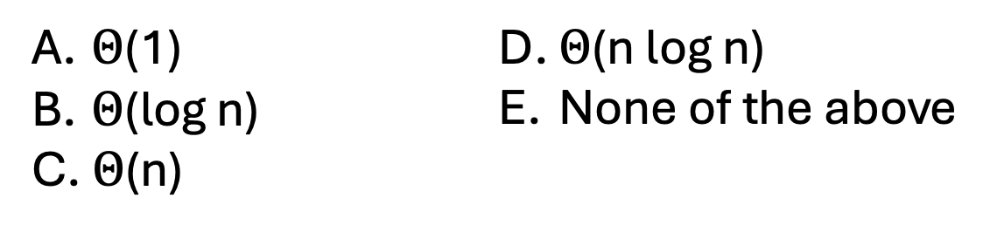
Precedence graph for this code
int sum(int[] array, int low, int hi) {
//base case
int left = fork sum(array, low, (hi+low)/2);
int right = sum(array, (hi+low)/2, hi);
join;
return left + right;
}
left half
Base case, making calls
adding
right half
What is the span of this code? (n=hi-low)
$Θ$(1)
$Θ$(log n)
$Θ$(n)
$Θ$(n log n)
None of the above
Notes:
Now looking at the span

Slide 35
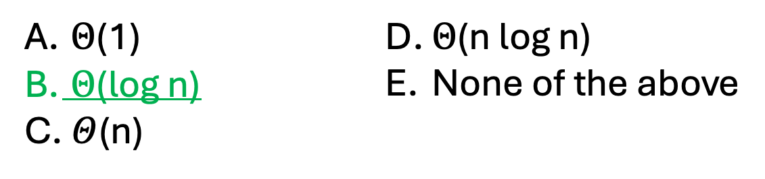
Precedence graph for this code
int sum(int[] array, int low, int hi) {
//base case
int left = fork sum(array, low, (hi+low)/2);
int right = sum(array, (hi+low)/2, hi);
join;
return left + right;
}
left half
Base case, making calls
adding
right half
What is the span of this code? (n=hi-low)
$Θ$(1)
$Θ$(log n)
$Θ$(n)
$Θ$(n log n)
None of the above
Notes:
For the recurrence, the middle part is just the max of the two halves. Since they are each half the array, they will have the same span. Thus, the recurrence is T_inf(n) = T_inf(n/2) + c. This is same as binary search or you can unroll it to verify that it’s O(log n).
Asking this on a slide where they’re looking at the full tree (as suggested on the answer slide for the question about work) should make this more clear.
Summary: this version gives O(n) work and O(log n) span.

Slide 36
Precedence graph for this code
int sum(int[] array, int low, int hi) {
//base case
int left = fork sum(array, low, (hi+low)/2);
int right = sum(array, (hi+low)/2, hi);
join;
return left + right;
}
left half
Base case, making calls
adding
right half
What is the work of this code? (n=hi-low)
$Θ$(1)
$Θ$(log n)
$Θ$(n)
$Θ$(n log n)
None of the above

Slide 37
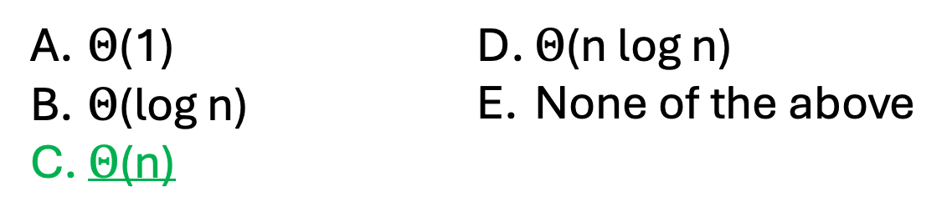
Applying this to a program
int sum(int[] array, int low, int hi) {
//base case
int left = fork sum(array, low, (hi+low)/2);
int right = sum(array, (hi+low)/2, hi);
join;
return left + right;
}
left half
Base case, making calls
adding
right half
What is the work of this code? (n=hi-low)
$Θ$(1)
$Θ$(log n)
$Θ$(n)
$Θ$(n log n)
None of the above
Notes:
For the work, we get the sum of the two parts. This is going to be n. As a recurrence, it would be T_1(n)=2T_1(n/2)+1. If you expand the fanning out part as a tree, there is 1 work on the first level, 2 on the second, 4 on the third, etc down to n/2 parts. The total work from all of that is a decreasing geometric series, giving O(n).

Slide 38
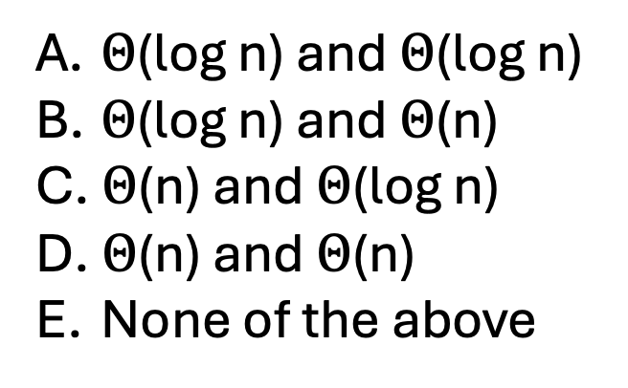
What is the work and span of this code? (n is hi-low)
int sum(int[] array, int low, int hi) {
int total = 0;
for(int i=low; i < hi; i++)
total += array[i];
return total;
}
$Θ$(log n) and $Θ$(log n)
$Θ$(log n) and $Θ$(n)
$Θ$(n) and $Θ$(log n)
$Θ$(n) and $Θ$(n)
None of the above
Notes:
How do the work and span of the serial version compare to the parallel version?

Slide 39
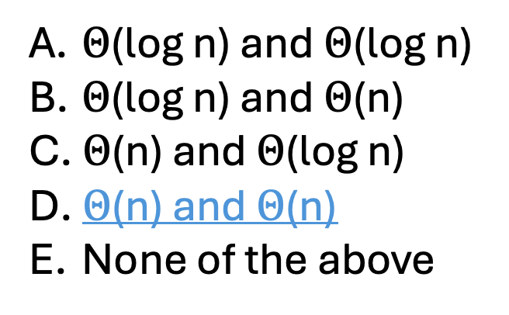
What is the work and span of this code? (n is hi-low)
int sum(int[] array, int low, int hi) {
int total = 0;
for(int i=low; i < hi; i++)
total += array[i];
return total;
}
$Θ$(log n) and $Θ$(log n)
$Θ$(log n) and $Θ$(n)
$Θ$(n) and $Θ$(log n)
$Θ$(n) and $Θ$(n)
None of the above
Notes:
Without fork and join, everything is in sequence so work and span are the same. They must both be O(n) since that’s how long the loop runs for.
Thus, our parallel version has (asymptotically) the same work as the serial version, but reduces the span from O(n) to O(log n). This is largely what we’ll be going for with parallelism: same amount of work, but logarithmic (or poly-log) span. Remember that log is much less than linear (doubling problem size only increases the span by 1) so this means we get fast programs as the number of nodes increases.

Slide 40
Putting this into actual Java
class Sum extends RecursiveTask<Integer> {
protected Integer compute() {
…
}
}
int sum(int[] array, int low, int hi) {
…
}
Use a class to represent a call to sum
Parameterized by the return type (must be a reference type)
Notes:
Everything so far has been using the imaginary fork and join notation. What does the actual Java for this look like?
To represent a strand, we need to create a class that extends RecursiveTask. An object of this type will represent one call to the sum method. RecursiveTask has a compute method, which does the actual computation. Since RecursiveTask must represent any recursive method on which we want to call fork/join, the return type is a generic type. In our case, we’ll be using an Integer. (Recall that we can’t use int because Java generic types must always be a reference/object type. Don’t worry, autoboxing and unboxing let us pretend that compute returns an int.)
Other problem: Because RecursiveTask must work for any computation like this, it’s compute method doesn’t take the arguments that I need to pass sum. How can I fix/get around this?

Slide 41
Putting this into actual Java
class Sum extends RecursiveTask<Integer> {
int[] array; int low; int high;
public Sum(int[] array, int low, int hi) {
this.array = array; this.low = low; this.hi = hi;
}
protected Integer compute() {
…
}
}
int sum(int[] array, int low, int hi) {
…
}
Can’t pass arguments into compute
Use constructor to get the information
Notes:
The arguments will be passed to the constructor and stored in attributes. Here are attribute declarations and a constructor suitable for the sum code.

Slide 42
Putting this into actual Java
int sum(int[] array, int low, int hi) {
//base case
int left = fork sum(array, low, (hi+low)/2);
int right = sum(array, (hi+low)/2, hi);
join;
return left + right;
}
…
protected Integer compute() {
if(hi – low < THRESHOLD)
return array[low];
Sum left = new Sum(array, low, (hi+low)/2);
Sum right = new Sum(array, (hi+low)/2, hi);
left.fork();
return right.compute() + left.join();
}
Only recurse to create enough strands
fork for only one half
run right half recursively, but before waiting for left half
Notes:
The compute method pretty much follows sum except that recursive calls are replaced by creating objects.
left.fork() creates the new strand that will compute the left side.
Two optimizations are added:
Instead of recursing all the way to a single value, we recurse until the array size is at most the value of some threshold. This reduces overhead since a for loop is more efficient than recursion for small problem sizes.
compute is a recursive call that doesn’t create a new RecursiveTask. Instead, it just runs the right half using the same object.

Slide 43
Putting this into actual Java: Starting off
sum = ForkJoinPool.commonPool().invoke(new Sum(array, 0, array.length));
Notes:
One more thing: the first call (from main or whatever) needs to take this form. Yuck! A ForkJoinPool Is a collection of workers than can run our strands. When compute creates new RecursiveTask objects for the recursive calls, these are automatically associated with the same ForkJoinPool. commonPool is a static attribute, a pool that it automatically created so we don’t have to create and populate one. invoke puts a RecursiveTask object into the pool for scheduling.
It’s fine to treat this as “magic”, but you need to use it.

Slide 44
Putting it all together
class Sum extends RecursiveTask<Integer> {
//attributes and constructor
protected Integer compute(){
if(hi – low < THRESHOLD) return simpleSum(array, low, hi);
Sum left = new Sum(array, low, (hi+low)/2);
Sum right = new Sum(array, (hi+low)/2, hi);
left.fork();
return right.compute() + left.join();
}
}
sum = ForkJoinPool.commonPool().invoke(new Sum(array, 0, array.length));
Notes:
Summary of what we’ve done so far, with all the code on a single slide.

Slide 45
Putting it all together
class Sum extends RecursiveTask<Integer> {
//attributes and constructor
protected Integer compute(){
if(hi – low < THRESHOLD) return simpleSum(array, low, hi);
Sum left = new Sum(array, low, (hi+low)/2);
Sum right = new Sum(array, (hi+low)/2, hi);
left.fork();
return right.compute() + left.join();
}
}
sum = ForkJoinPool.commonPool().invoke(new Sum(array, 0, array.length));
What if I wanted the minimum instead of the sum?
Notes:
This begins a separate topic. This was (part of) a separate lecture from the code above, one that introduces the idea of a reduction and shows some other examples.
What has to change if I wanted to compute the minimum of the array instead of its sum?
Only the base case (keep track of the minimum value so far and then return this value at the end of the loop) and the last line (return the min of right.compute() and left.join() instead of their sum).

Slide 46
Putting it all together
class Sum extends RecursiveTask<Integer> {
//attributes and constructor
protected Integer compute(){
if(hi – low < THRESHOLD) return simpleSum(array, low, hi);
Sum left = new Sum(array, low, (hi+low)/2);
Sum right = new Sum(array, (hi+low)/2, hi);
left.fork();
return right.compute() + left.join();
}
}
sum = ForkJoinPool.commonPool().invoke(new Sum(array, 0, array.length));
What if I wanted the minimum and its index?
Notes:
What about finding the index where this minimum value occurs?
Need to modify the return value from Integer to another class, a pair that stores the minimum value and the index where it appears.
Then modify the base case to keep track of the index as it looks for the minimum and the last line to decide which object to return based on the values, but the return the pair with the smaller value.
Pretty much the same idea; the only changes are in some of the implementation details.

Slide 47
Reductions
A reduction takes a collection of values (e.g. an array) and combined them into one value
Many useful reductions can be efficiently implemented using this framework
Sum, product, or combination using a boolean operator (and, or, xor)
Minimum or maximum (or minIndex/maxIndex)
Building a histogram (record of how many times each value occurs)
Counting number of values meeting a condition
IndexOf or lastIndexOf
Finding the longest sequence of matching values
Notes:
It turns out that these operations (sum, min, minIndex) are examples of a general phenomenon called a reduction. Go through this list of reductions and the changes that would be needed for each. (What is the return type, what should be base case do, and how are right.compute() and left.join() combined?)

Slide 48
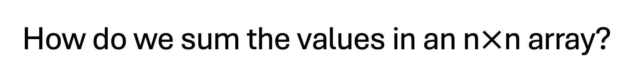
How do we sum the values in an n$×$n array?
Notes:
Could be a bonus slide as well.
Idea is to break out of 1D nature of the examples so far. If you want to parallelize a doubly-nested loop, can parallelize one loop (splitting one dimension), one and then the other (splitting on i and then starting to split on j in the base case), or split on both (have 4 recursive calls, one for each quadrant). Probably makes sense to split only one dimension (putting the width of the other into the base case) unless both dimensions are really large.

Slide 49
Bonus slides
These are slides that I used after Lab 9, which asks the students to implement reductions including to find the kth smallest. Many in the class implemented the method using library sorting routines so I used these slides to show them what I intended.
I plan to adjust the Lab 9 handout so these hopefully won’t be necessary, but they’re included in case they’re useful. (Perhaps if you want to talk about this reduction without doing the lab.)

Slide 50
Finding minimum
int min = nums[0];
for(int i=1; i < nums.length; i++)
if(nums[i] < min)
min = nums[i];

Slide 51
Finding second smallest
int first = nums[0]; //smallest so far
int second = nums[1]; //second smallest so far
if(first > second)
swap first and second;
for(int i=2; i < nums.length; i++) {
if(nums[i] < second) {
second = nums[i];
if(second < first)
swap first and second;
}
}

Slide 52
Finding k^{th} smallest
int[] smallest = new int[k]; //k smallest values so far
…
for(int i=k; i < nums.length; i++) {
if(nums[i] < smallest[k-1]) {
int j = k-1;
while((j > 0) && (nums[i] < smallest[j-1])) {
smallest[j] = smallest[j-1];
j--;
}
smallest[j] = nums[i];
}
}

Slide 53
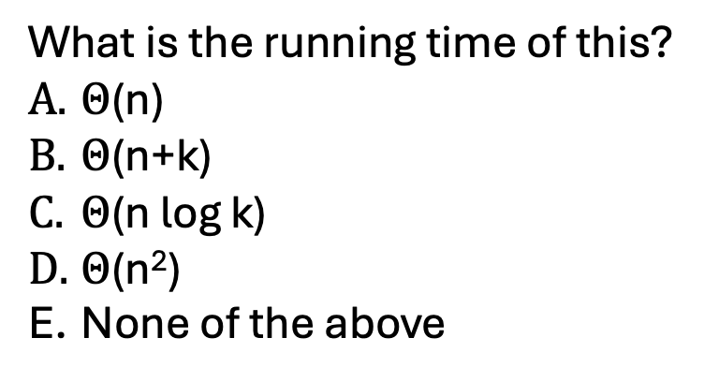
Finding k^{th} smallest
int[] smallest = new int[k]; //k smallest values so far
…
for(int i=k; i < nums.length; i++) {
if(nums[i] < smallest[k-1]) {
int j = k-1;
while((j > 0) && (nums[i] < smallest[j-1])) {
smallest[j] = smallest[j-1];
j--;
}
smallest[j] = nums[i];
}
}
What is the running time of this?
$Θ$(n)
$Θ$(n+k)
$Θ$(n log k)
$Θ$(n²)
None of the above

Slide 54
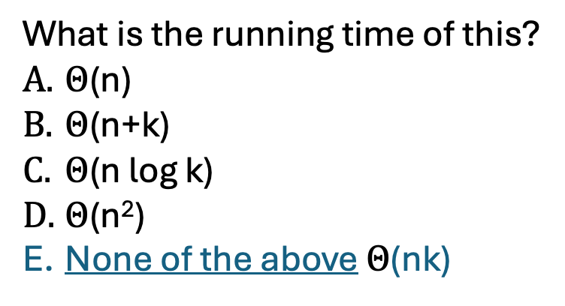
Finding k^{th} smallest
int[] smallest = new int[k]; //k smallest values so far
…
for(int i=k; i < nums.length; i++) {
if(nums[i] < smallest[k-1]) {
int j = k-1;
while((j > 0) && (nums[i] < smallest[j-1])) {
smallest[j] = smallest[j-1];
j--;
}
smallest[j] = nums[i];
}
}
What is the running time of this?
$Θ$(n)
$Θ$(n+k)
$Θ$(n log k)
$Θ$(n²)
None of the above $Θ$(nk)
Notes:
Note they can actually do O(n log k); keep the k smallest in a maxheap (to update, add the new value and then remove the max)

