Slide 1
Heat diffusion simulation

Slide 2
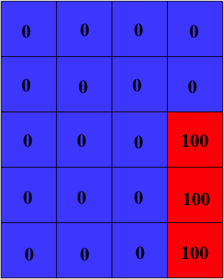
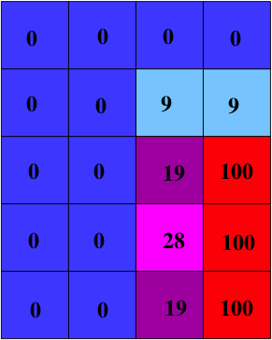
Heat diffusion
2D array of cells, each with temperature
Updates in time steps
T_{new} = weighted ave. of T_{old} and neighboring temps

Slide 3
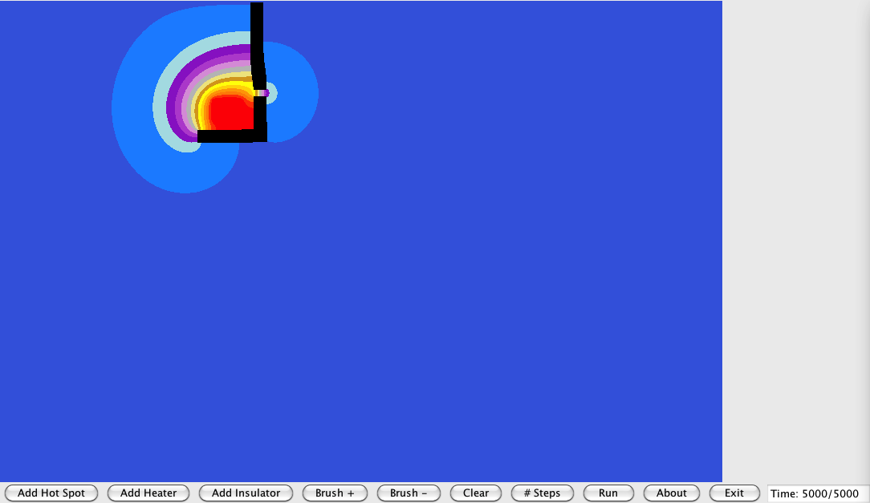
Screenshot

Slide 4
Project overview
Start with working serial application
Parallelize the main loop that makes updates:
for (int y=0; y<Y; y++)
for (int x=0; x<X; x++)
...
Just split the iterations of the y loop
Animation will be faster and it will report a faster time

