Slide 1
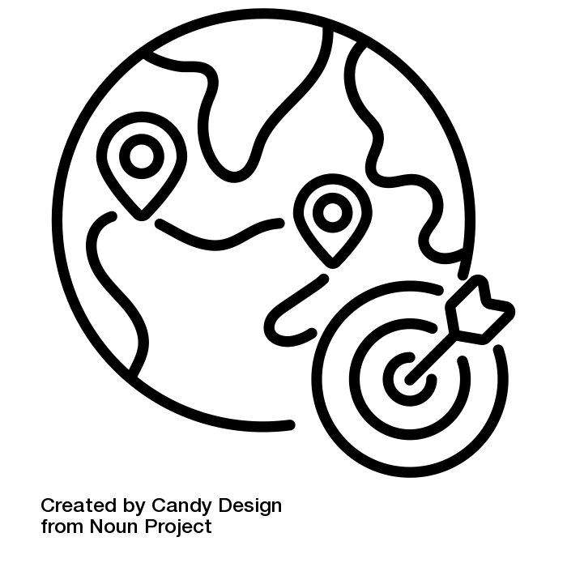
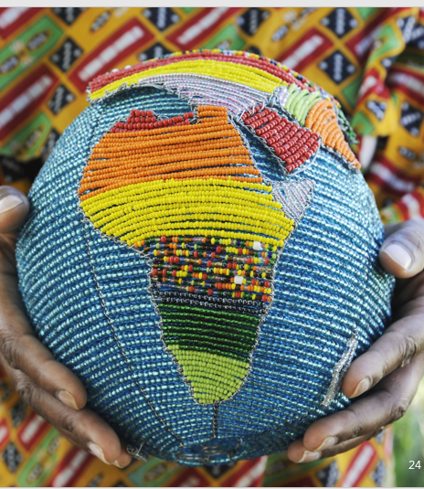
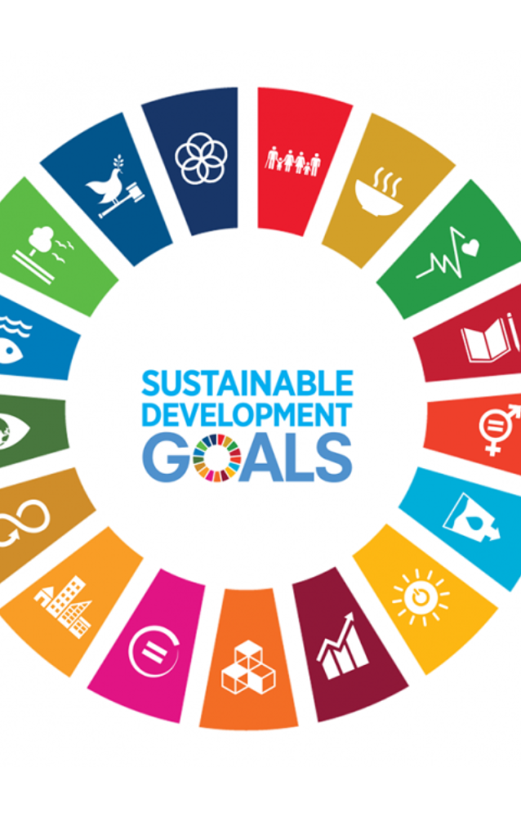

Integrating Sustainability into Higher Education: Theories, Concepts, and Practical Strategies
Version 2025

Slide 2
Session 1: Introduction to Sustainable Development x
Notes:
ID=d924773e-9a16-4d6d-9803-8cb819e99682 Recipe=text_billboard Type=TextOnly Variant=0 FamilyID=AccentBoxWalbaum_Zero

Slide 3
Outline
1 – Introduction
2 – Defining Sustainable Development
3 – Sustainability Challenges
4 – Sustainability Theories and UN Conferences
5 – Key Messages and Q&A
6 – Reflection
7 – Introduction to Overall Course Project
This icon indicates slides which can be adjusted to your own context (if necessary).

Slide 4
Learning Outcomes
By the end of this session, participants will be able to:
define sustainable development and its core principles,
identify key challenges that sustainability aims to address,
discuss the relevance of sustainable development in their own national context.

Slide 5
Introduction
1

Slide 6
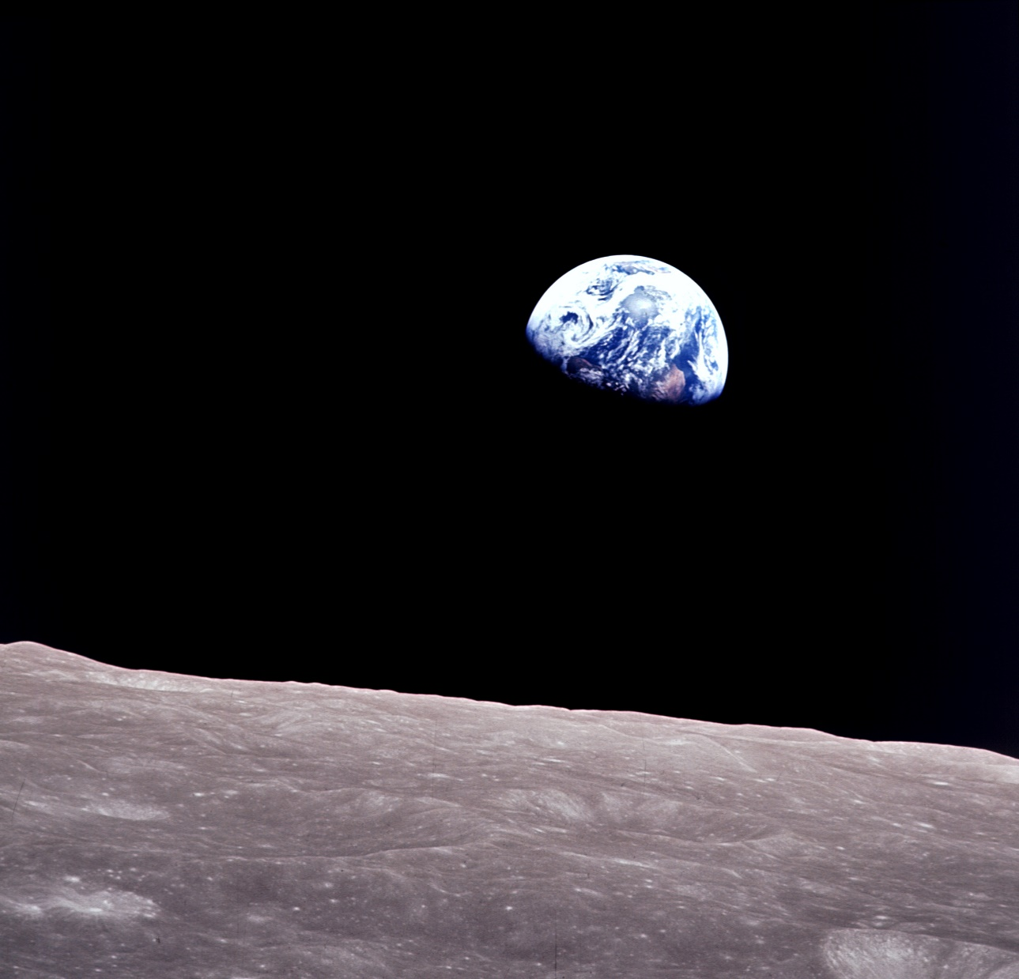
Imagine that you see the Earth from outer space for the very first time…what comes to mind?
Credit: NASA; Author of the image: Bill Anders/ NASA Taken from the Apollo 8 mission, 1968; Image known as earth rise, https://www.nasa.gov/sites/default/files/thumbnails/image/apollo08_earthrise.jpg
Notes:
https://www.nationalgeographic.com/science/article/earthrise-apollo-8-photo-at-50-how-it-changed-the-world, min 14:08 -16:45
This is not the first image, there are a number of images, it’s just world famous, next to the blue marble image from the apollo 17 mission in 1972 (Dempesy: 2019)
The beauty of the earth, A sense of how the earth was special, delicate, vulnerable, worthy of care.

Slide 7
Only One Earth – Let's Protect It
Notes:
The beauty of the earth, A sense of how the earth was special, delicate, vulnerable, worthy of care.

Slide 8
Defining Sustainable Development
2
Notes:
20 mins: Reminder of the definition and core principles of sustainable development (using visuals and examples to illustrate the concepts).

Slide 9
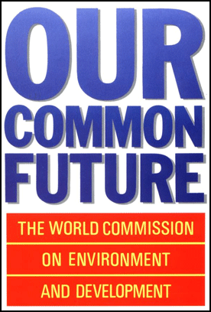
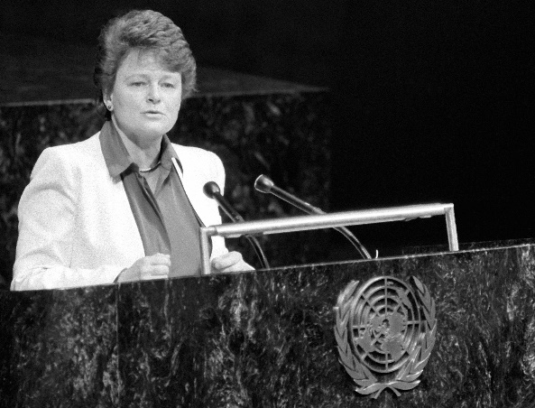
Sustainable Development is “development that meets the needs of the present without compromising the ability of future generations to meet their own needs.”
Definition of the World Commission on Environment and Development (WCED) 1987
Gro Harlem Brundtland, Norwegian Prime Minister who led the World Commission on Environment and Development
Report Our Common Future («Brundtland Report»)
9
Notes:
Since publication of the Brundtland Report in 1987, the term “Sustainable Development” (SD) has been used as a general guide for global social development. The report, Our Common Future, defines SD as “development that meets the needs of the present without compromising the ability of future generations to meet their own needs.” This understanding of SD was adopted in 1992 by the United Nations Conference on Environment and Development (UNCED – also known as Rio Conference or Earth Summit), and later by numerous organizations and governments – and has since become the most widely used global reference. In addition to the environmental, sociocultural, and economic aspects of SD, the UN understanding also includes a spatial and a temporal sustainability dimension.

Slide 10
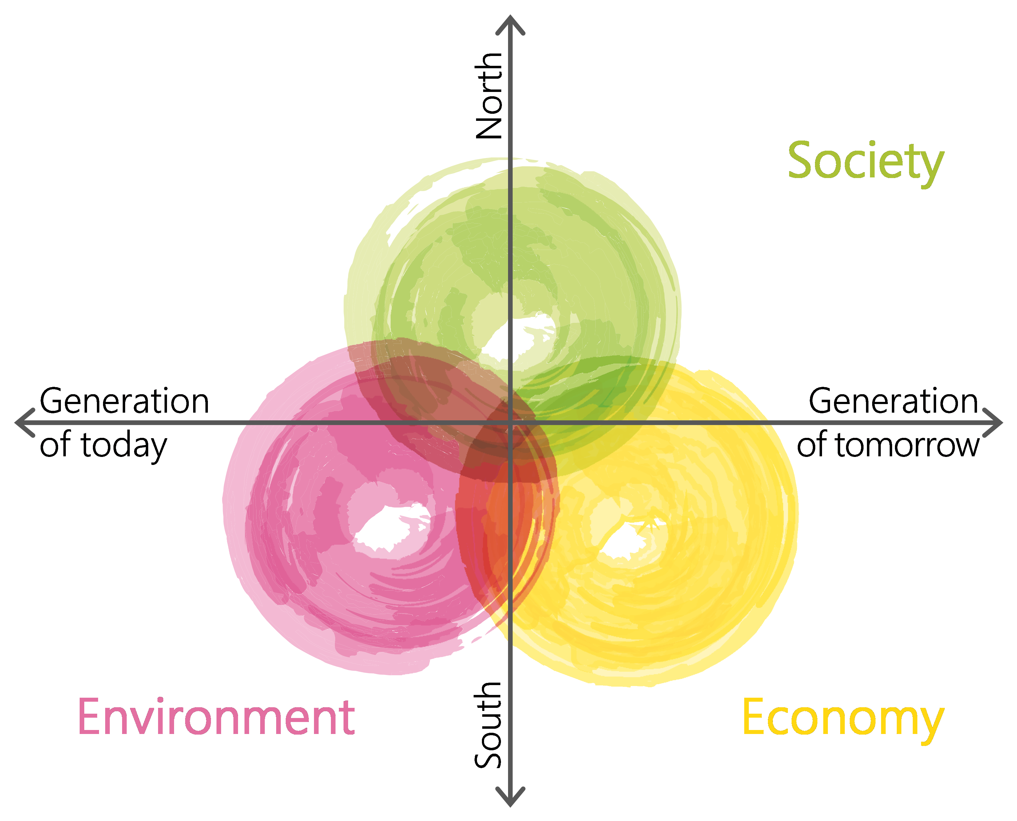
Sustainable Development
Environment: Resource management, environmental protection, land degradation, water quality, clean air, waste governance, etc.
Society: Quality of life, education, community development, equal opportunity, laws and ethics, standard of living, health, etc.
Economy: employment, R&D spending, cost of living, cost saving, finances, productivity, etc.
Hermes 2023 based on ARE 2001
Notes:
Three dimensions of Sustainable Development (SD): the UN understanding, as it is used in Switzerland for the «Monitoring of Sustainable Development (MONET)» (left), . Efforts towards a transparent negotiation of trade-offs means that the sustainability dimensions are not always given equal weighting. SD models with three dimensions are easy to understand and therefore widespread. In a university environment, however, they could give the impression of having neglected aspects such as culture, technology, health, etc. It is therefore important that these not-mentioned but implicit components be made explicit in further work with the models.
Sustainability (admin.ch)

Slide 11
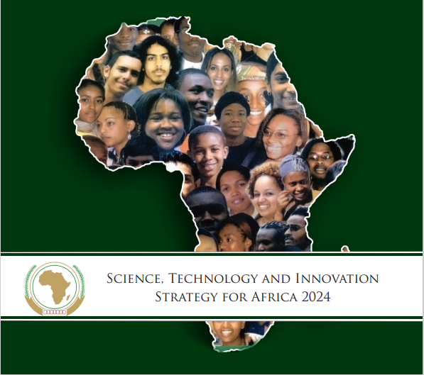
Agenda 2063: The Africa we Want
Aspirations:
A prosperous Africa, based on inclusive growth and sustainable development.
An integrated continent, politically united and based on the ideals of Pan-Africanism and the vision of African Renaissance.
An Africa for good governance, democracy, respect for human rights, justice and the rule of law.
A peaceful and secure Africa.
Africa with a strong cultural identity, common heritage, values and ethics.
An Africa whose development is people driven, relying on the potential offered by African people, especially its women and youth, and caring for children.
An Africa as a strong, united, resilient, and influential global player and partner.
Agenda 2063: The Africa We Want. | African Union (au.int)
Notes:
Agenda 2063: The Africa We Want. | African Union (au.int)
Agenda 2063 encapsulates not only Africa’s Aspirations for the Future but also identifies key Flagship Programmes which can boost Africa’s economic growth and development and lead to the rapid transformation of the continent.
Agenda 2063 also identifies key activities to be undertaken in its 10 year Implementation Plans which will ensure that Agenda 2063 delivers both quantitative and qualitative Transformational Outcomes for Africa’s people
Agenda 2063: The Africa We Want | Knowledge for policy (europa.eu)
Further reading:
Ndizera, V and H Muzee. 2018. A critical review of Agenda 2063: Business as usual. African Journal of Political Science and International Relations 12(8): 142-154. https://doi.org/10.5897/AJPSIR2018.1114
Addaney, M. 2017. The African Union's Agenda 2063: Education and Its Realization. In: Onuora-Oguno, A., Egbewole, W., Kleven, T. (eds) Eduation Law, Strategic Policy and Sustainable Development in Africa. Palgrave Macmillan, Cham. https://doi.org/10.1007/978-3-319-53703-0_8

Slide 12
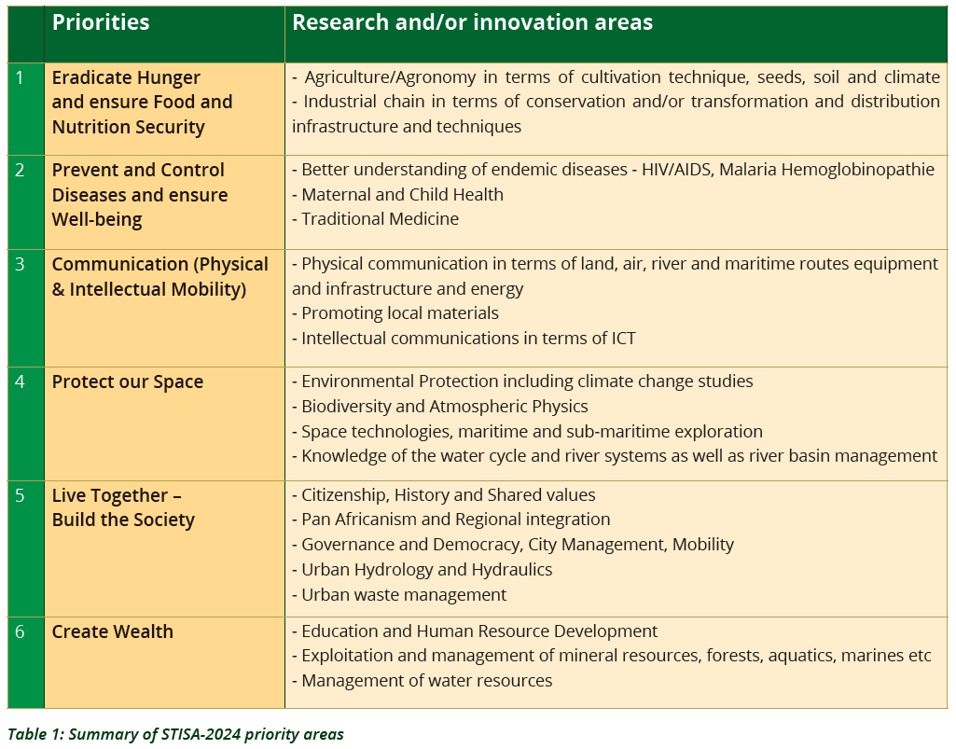
African Union
STI Strategy for Africa 2024

Slide 13
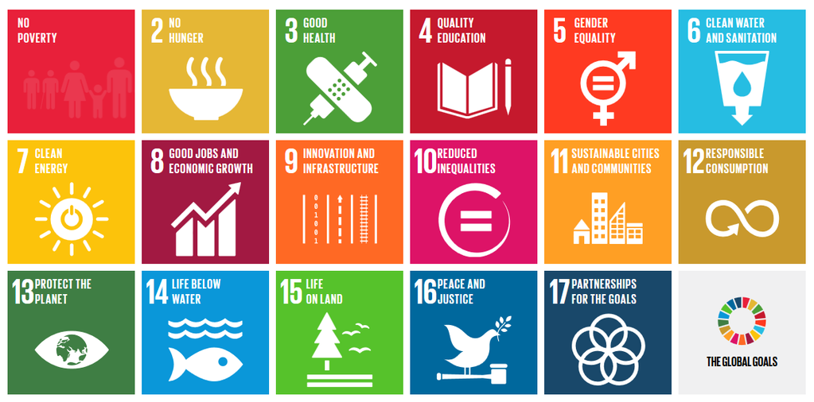
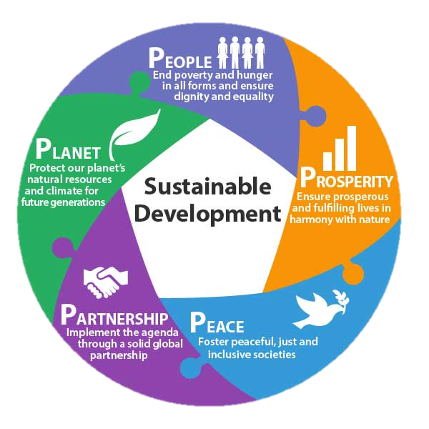
The UN Sustainable Development Goals
Approved on 25 September 2015 as the "2030 Agenda for Sustainable Development" by the 193 member states of the UN. They thus have broad global support and form the political basis for efforts towards SD in the coming years.
Notes:
The UN Sustainable Development Goals
In 2000, the UN, World Bank, International Monetary Fund (IMF), and Organization for Economic Cooperation and Development (OECD) formulated eight Millennium Development Goals (MDGs). Both the goals and the way they were set were controversial. The selection was criticized as being incomplete, defined by industrialized countries, lacking binding commitments and coordination of the individual targets, and characterized by unrealistic indicators and target sizes.
Based on this criticism as well as on the intention to unite global environmental policy and poverty reduction in a single initiative, the UN Sustainable Development Goals (SDGs) were formulated – and approved on 25 September 2015 as the «2030 Agenda for Sustainable Development», by the 193 member states of the UN. The SDGs are broad-based and form the global political basis for SD efforts in the coming years.

Slide 14
The UN Sustainable Development Goals 17 goals and 169 concrete targets
No Poverty - End poverty in all its forms everywhere
Zero Hunger - End hunger, achieve food security and improved nutrition and promote sustainable agriculture
Good Health and Well-being - Ensure healthy lives and promote well-being for all at all ages
Quality Education - Ensure inclusive and equitable quality education and promote lifelong learning opportunities for all
Gender Equality - Achieve gender equality and empower all women and girls
Clean Water and Sanitation - Ensure availability and sustainable management of water and sanitation for all
Affordable and Clean Energy - Ensure access to affordable, reliable, sustainable and modern energy for all
Decent Work and Economic Growth - Promote sustained, inclusive and sustainable economic growth, full and productive employment and decent work for all
Industry, Innovation and Infrastructure - Build resilient infrastructure, promote inclusive and sustainable industrialization and foster innovation
Reduced Inequalities - Reduce income inequality within and among countries
Sustainable Cities and Communities - Make cities and human settlements inclusive, safe, resilient and sustainable
Responsible Consumption and Production - Ensure sustainable consumption and production patterns
Climate Action - Take urgent action to combat climate change and its impacts by regulating emissions and promoting developments in renewable energy
Life Below Water - Conserve and sustainably use the oceans, seas and marine resources for sustainable development
Life on Land - Protect, restore and promote sustainable use of terrestrial ecosystems, sustainably manage forests, combat desertification, and halt and reverse land degradation and halt biodiversity loss
Peace, Justice and Strong Institutions - Promote peaceful and inclusive societies for sustainable development, provide access to justice for all and build effective, accountable and inclusive institutions at all levels
Partnerships for the Goals - Strengthen the means of implementation and revitalize the global partnership for sustainable development
http://www.un.org/sustainabledevelopment/sustainable-development-goals/

Slide 15
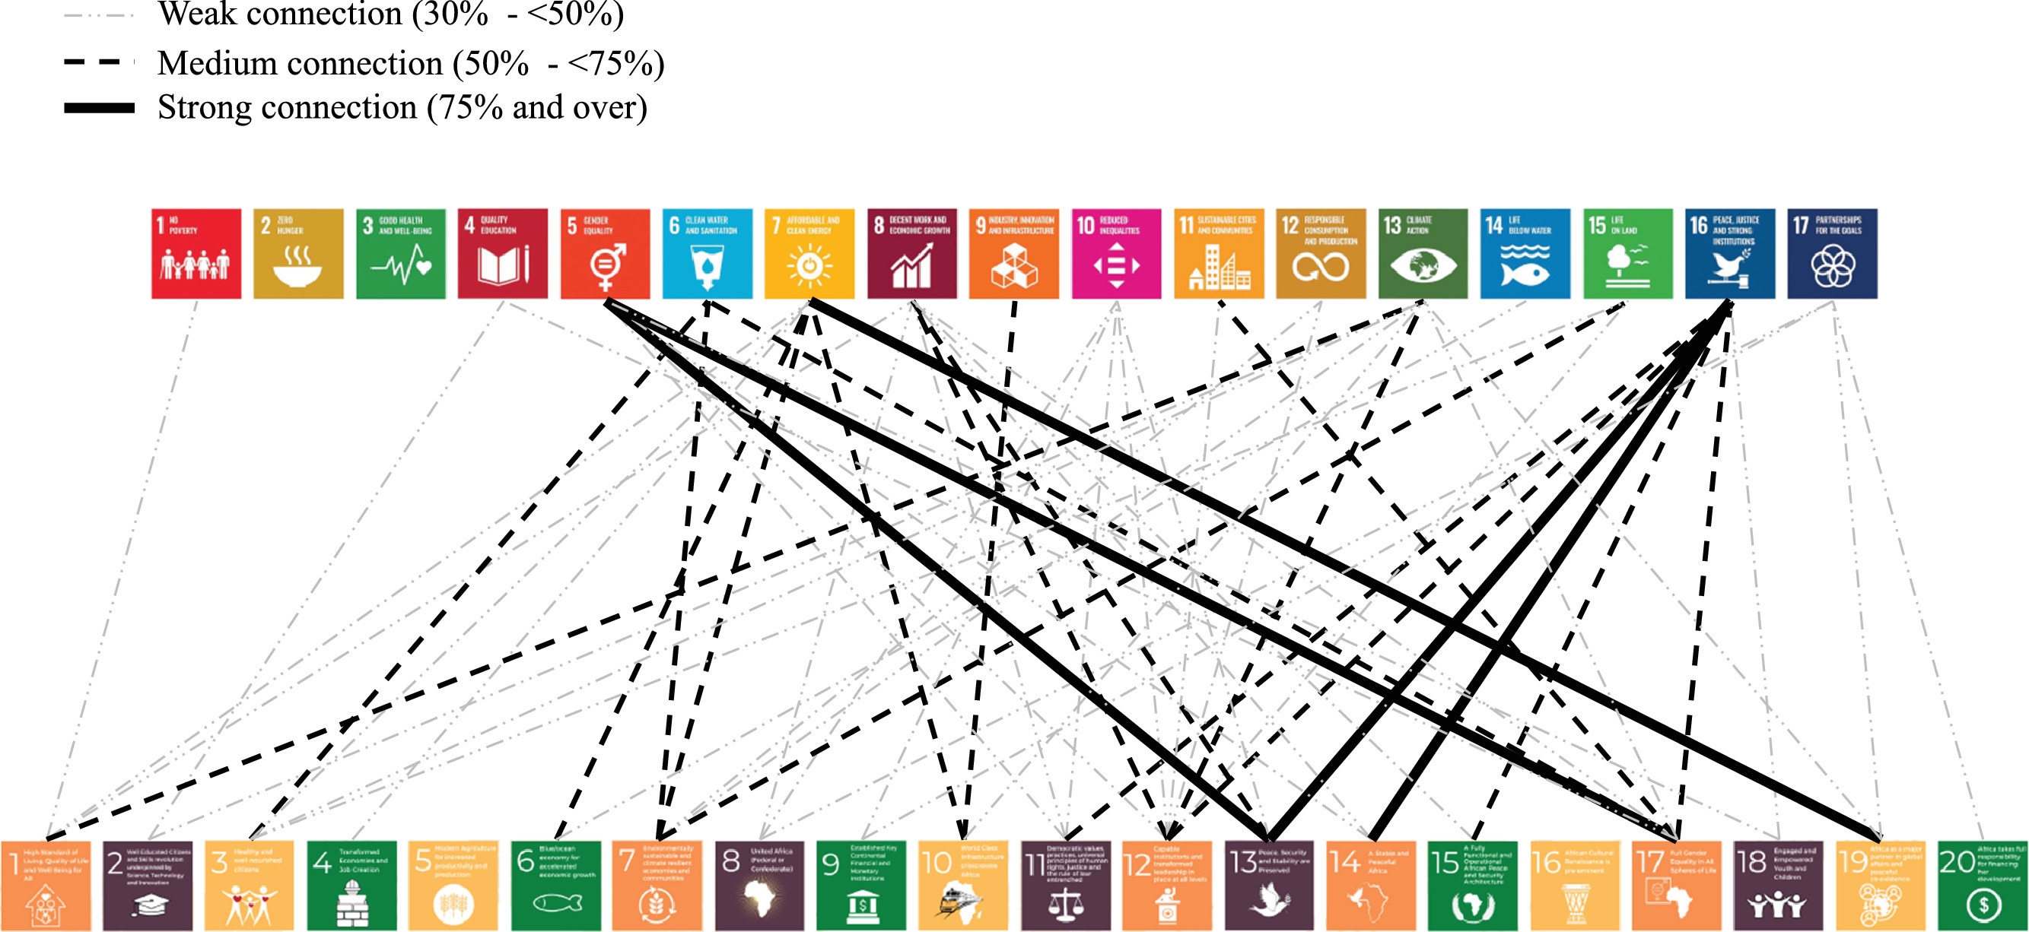
Linking Agenda 2063 and the SDGs
Royo et al., 2022
Notes:
https://doi.org/10.1016/j.wds.2022.100010

Slide 16
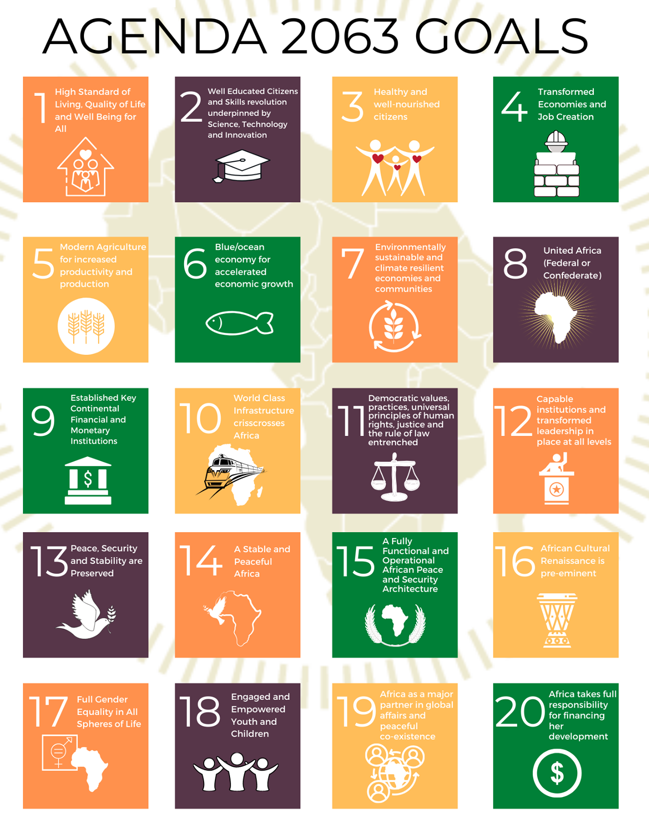
AU Agenda 2063 and UN Agenda 2030

Slide 17
Exercise Have a look at the SDGs and / or the Agenda 2063 Goals: Which ones relate most to your work? Why?

Slide 18
Sustainability Challenges
3
Notes:
30 mins: Collecting and sharing of experiences of key global sustainability challenges (e.g., climate change, poverty, biodiversity loss) with focus on relatability to own personal life/national and local sustainability challenges. Dividing participants into small groups, assigning each group a challenge to discuss its implications and possible solutions.

Slide 19
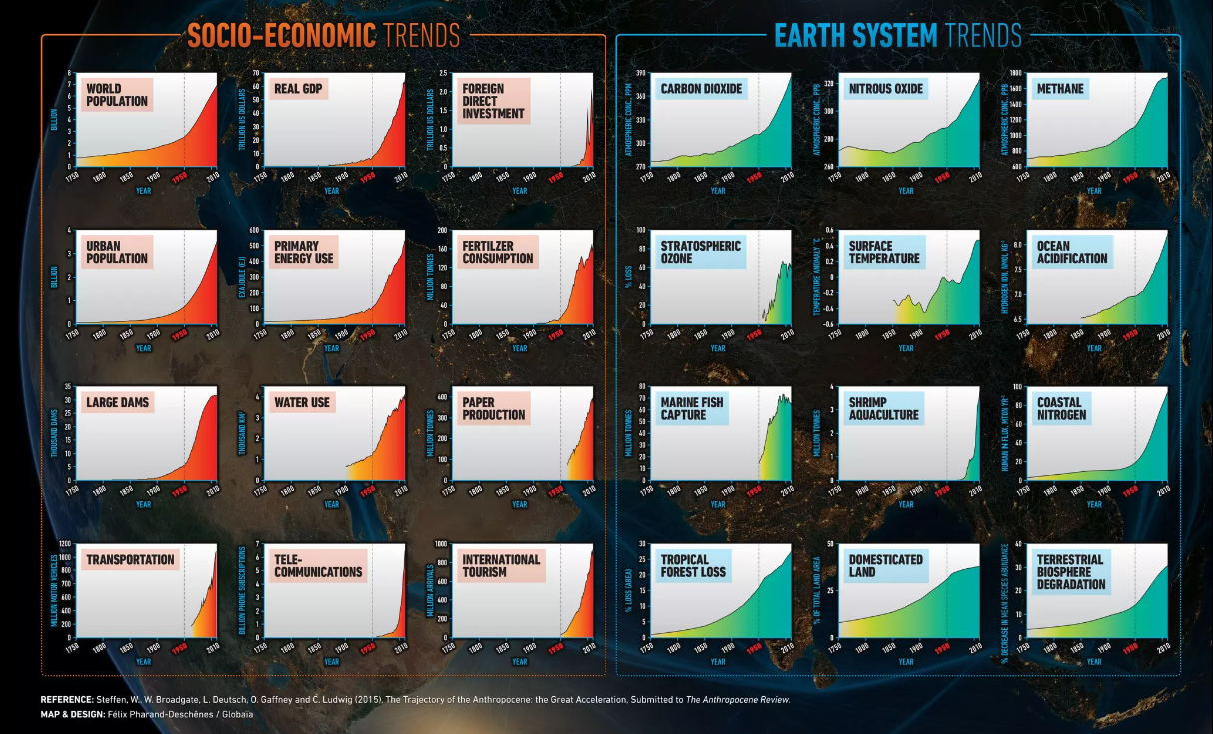
Where are we going? The Great Acceleration since 1950
Steffen et al., 2015

Slide 20
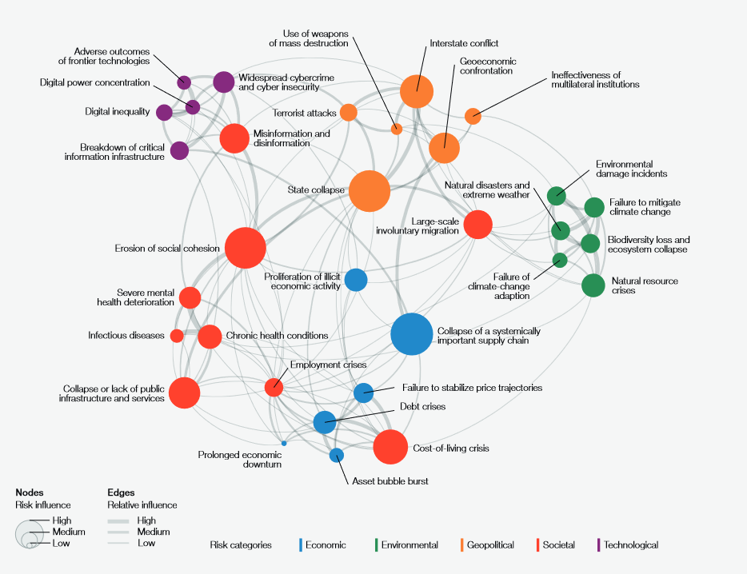
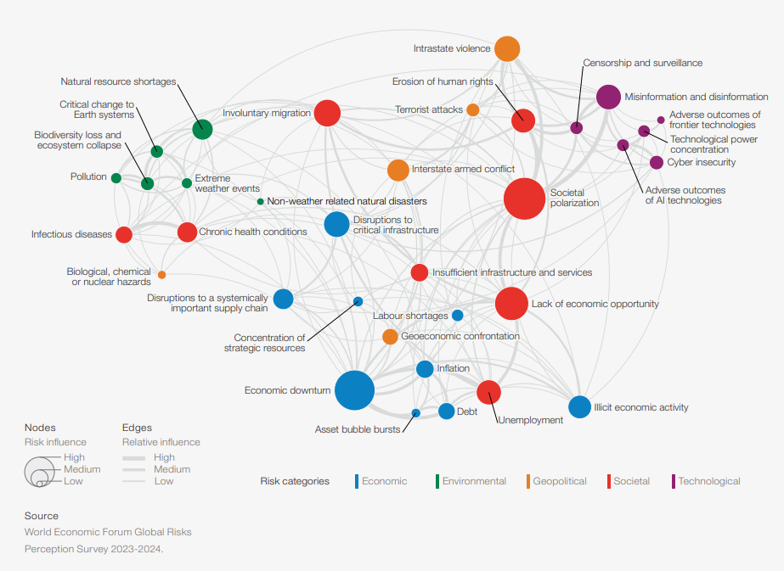
Global risk landscape: perception survey
Global Risks Perception Survey – 2023
Global Risks Perception Survey – 2024
Notes:
Global Risks Perception Survey (GRPS), which captures insights from nearly 1,500 global experts. The report analyses global risks through three-time frames to support decision-makers in balancing current crises and longer-term priorities.
As we enter 2024, 2023-2024 GRPS results highlight a predominantly negative outlook for the world over the next two years (84% respondents are concerned) that is expected to worsen over the next decade (92% are pessimistic).

Slide 21
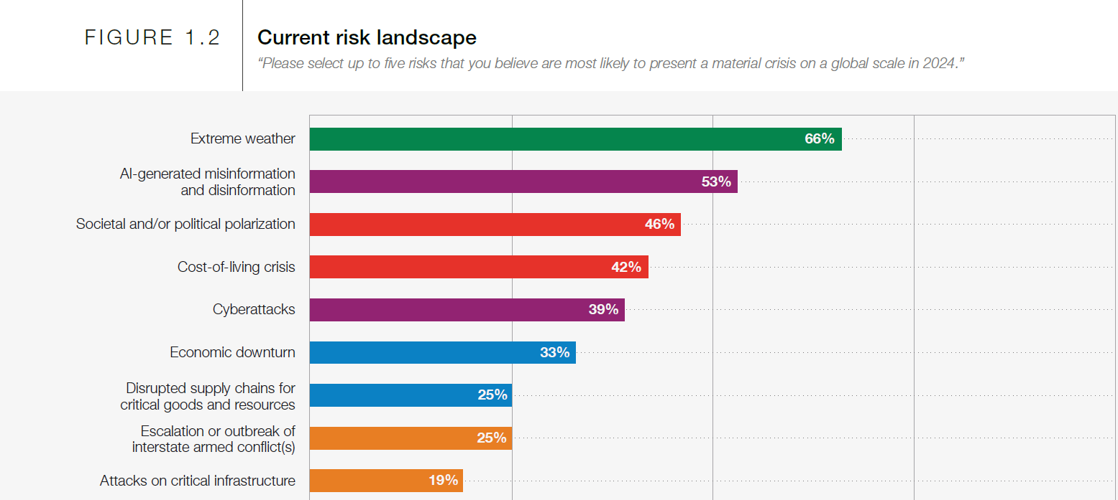
Current risk landscape
World Economic Forum Global Risks Perception Survey 2023-2024

Slide 22
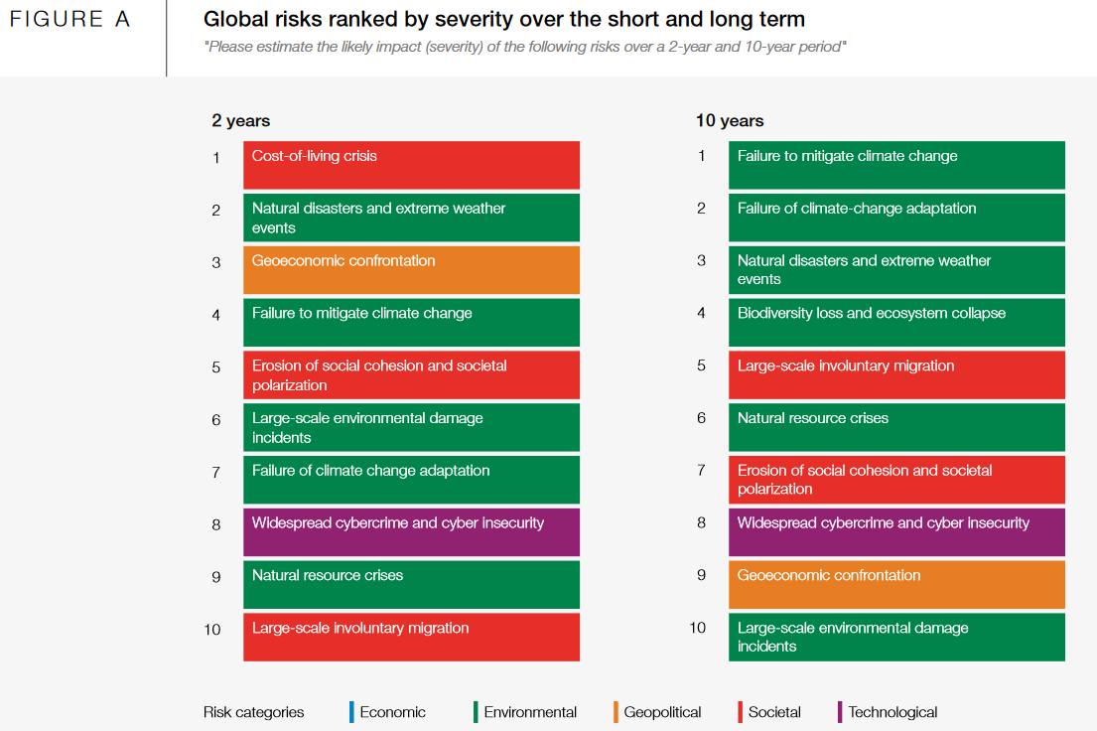
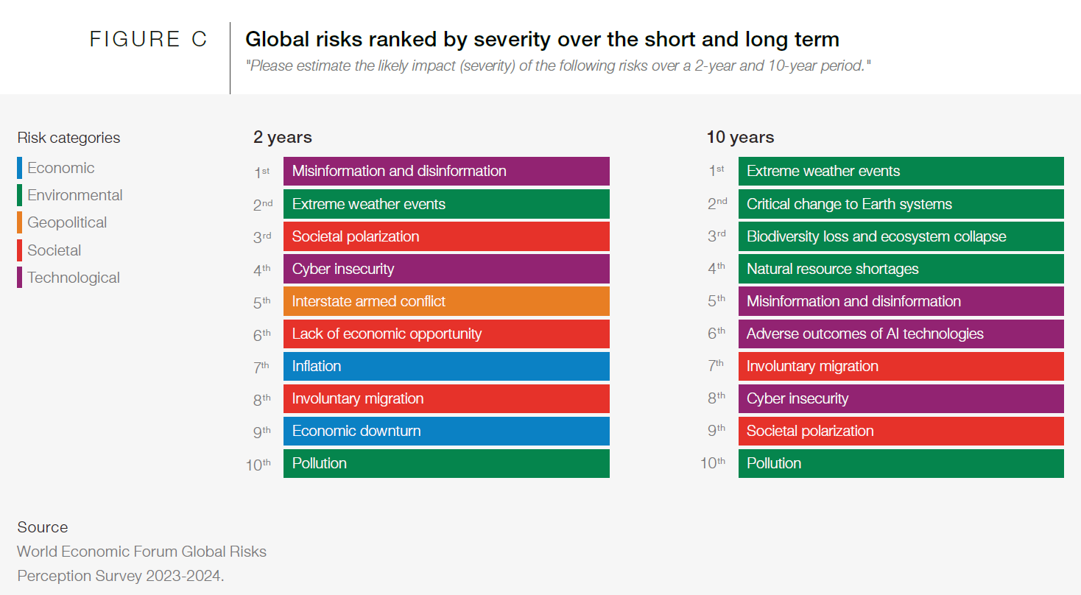
Global risks ranked: short-term
World Economic Forum Global Risks Perception Survey, 2023-2024
World Economic Forum Global Risks Perception Survey, 2022-2023
Notes:
The Global Risks Perception Survey (GRPS) has underpinned the Global Risks Report for nearly two decades and is the World Economic Forum’s premier source of original global risks data. This year’s GRPS has brought together leading insights on the evolving global risks landscape from over 1,200 experts across academia, business, government, the international community and civil society. Responses for the GRPS 2022-2023 were collected from 7 September to 5 October 2022.
WEF_Global_Risks_Report_2023.pdf (weforum.org)
Severity assessed the perceived likely impact of global risks over a one-, two- and 10-year horizon, to illustrate the potential development of individual global risks over time

Slide 23
Global risks ranked: long-term
World Economic Forum Global Risks Perception Survey, 2023-2024
World Economic Forum Global Risks Perception Survey, 2022-2023
Notes:
The Global Risks Perception Survey (GRPS) has underpinned the Global Risks Report for nearly two decades and is the World Economic Forum’s premier source of original global risks data. This year’s GRPS has brought together leading insights on the evolving global risks landscape from over 1,200 experts across academia, business, government, the international community and civil society. Responses for the GRPS 2022-2023 were collected from 7 September to 5 October 2022.
WEF_Global_Risks_Report_2023.pdf (weforum.org)
Severity assessed the perceived likely impact of global risks over a one-, two- and 10-year horizon, to illustrate the potential development of individual global risks over time

Slide 24
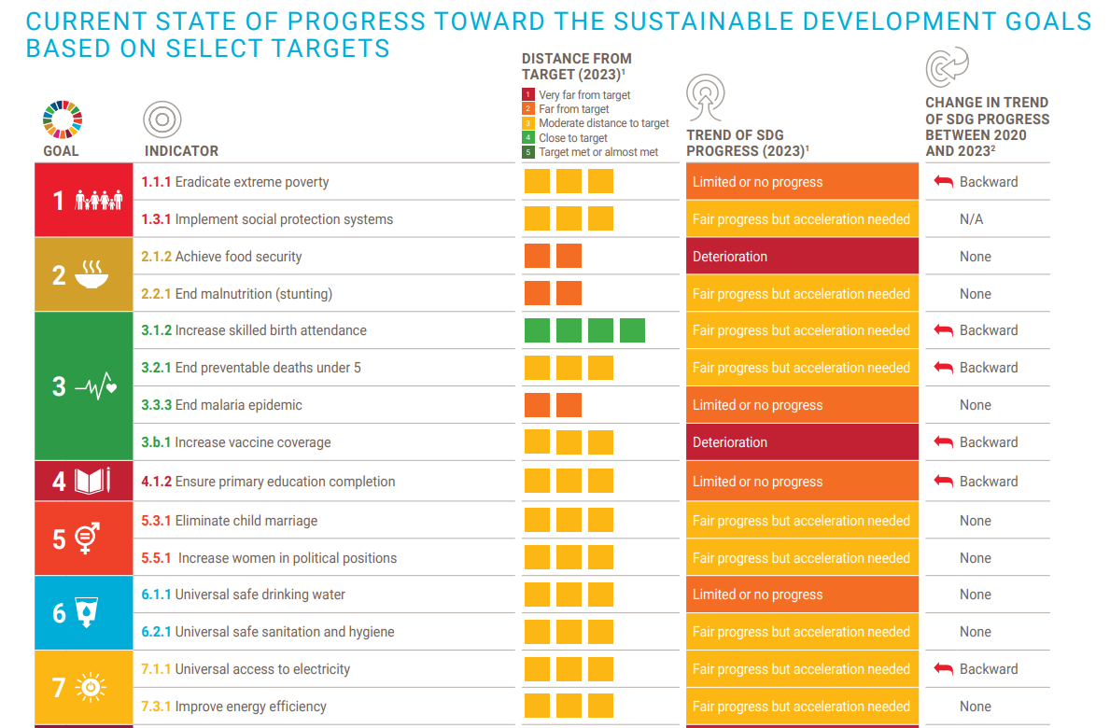
Global Sustainable Development Report (GSDR), 2023

Slide 25
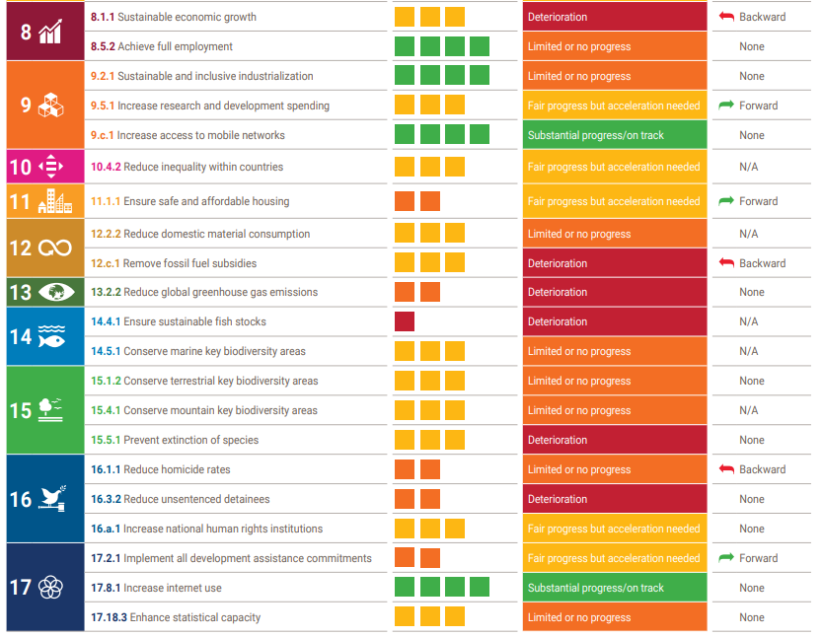
Global Sustainable Development Report (GSDR), 2023

Slide 26
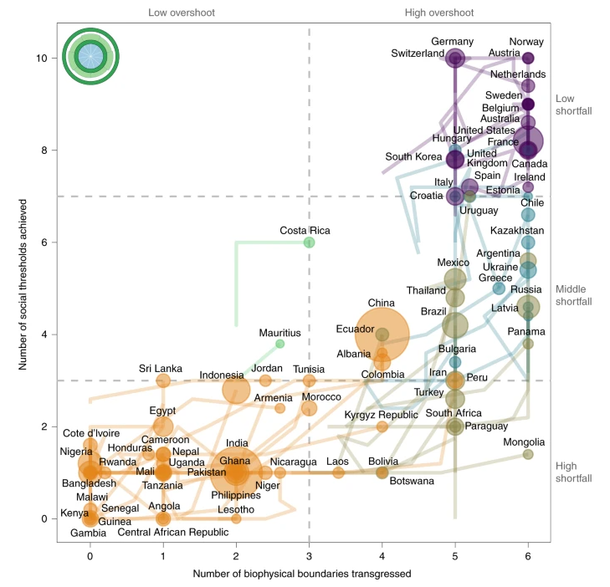
Context matters
Where we need to be
Fanning et al., 2022
Notes:
2030 Agenda. Bringing together a social and environmental agenda and gives responsibility to global North and South.
Graphic shows which physical boundaries (ecological overshoot) are already transgressed respectively how many of the 11 minimal social thresholds (social shortfalls) have been achieved.
Breaking the path dependence of development. Double challenge for developing countries needs transformation
Given that the Agenda 2030 depends on national progress and since development challenges are context-specific and must be negotiated, knowledge capacities are a prerequisite in all countries.
Number of biophysical boundaries transgressed versus social thresholds achieved. Countries are colour-coded according to the section they were in at the start of the analysis period, and are sized according to population. Ideally, they would be in the Doughnut located in the top-left corner. Instead they tend to move from left to right along the bottom, and then up to the top.

Slide 27
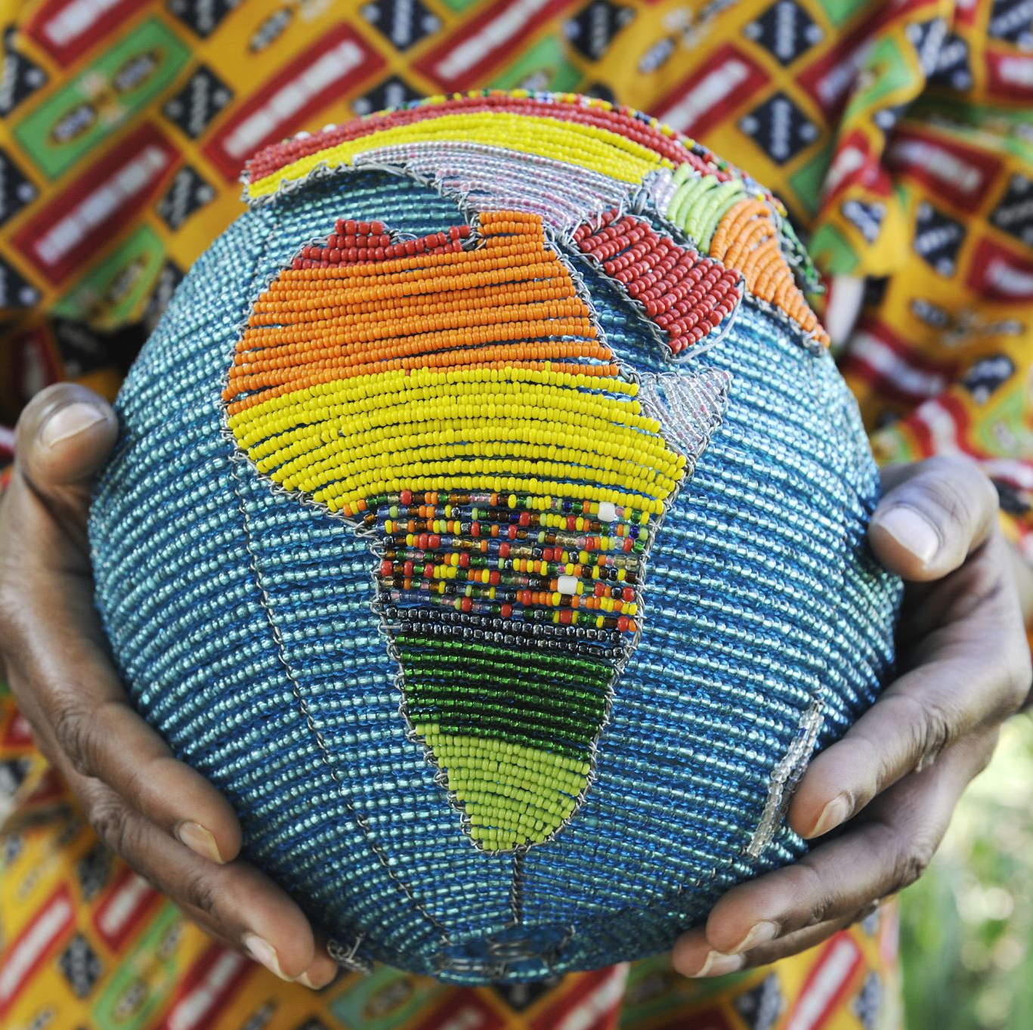
Sustainability challenges and risks in your national and local context
Individual reflection on the most pressing sustainability challenges and risks you / your country is facing. What does it mean in the local context? (5 minutes)
Group discussion on solutions to the most pressing sustainability challenges and risks identified in our specific contexts. Do you know local sustainability initiatives (challenges and solutions)? (5 minutes).
Groups share in the plenary local sustainability initiatives (challenges and solutions) (10 minutes)
Notes:
Discussion on the relevance of sustainable development in the specific contexts of Kenya and Ethiopia. Participants share local sustainability initiatives and challenges.
What kind of education and research is happening, try to get some initiatives there – make link

Slide 28
Sustainability Theories and UN Conferences
4
Notes:
20 mins Presentation of a variety of sustainability theories and concepts. Discussion of the origins, key principles, and implications of each theory.

Slide 29
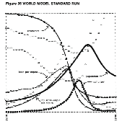
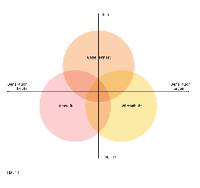
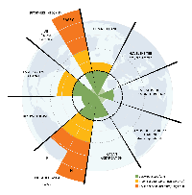
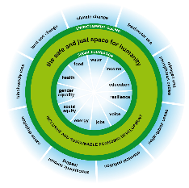
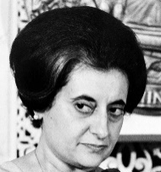
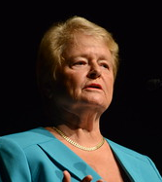

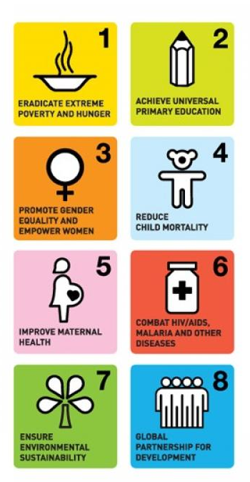



Selected Sustainability Theories and International Milestones: A Timeline from 1970 Onwards
Theory
Year
International Milestones
Limits to Growth | Emergence of 3 Circles Model |  |  |  |  |  |  |  | Planetary Boundaries | Doughnut Model
1972 |  |  | 1987 |  | 1992 |  | 2000 |  | 2009 | 2012 | 2013 | 2015 |  |  | 2030 |  |  |  | 2063
UN Conference Stockholm |  |  | Brundtland Report |  | Earth Summit Rio de Janeiro |  | Millennium Development Goals |  |  | Rio +20 | Agenda 2063 | Agenda 2030
Notes:
More detailed Sustainable Development timeline: https://www.iisd.org/system/files/publications/sd_timeline_2012.pdf

Slide 30
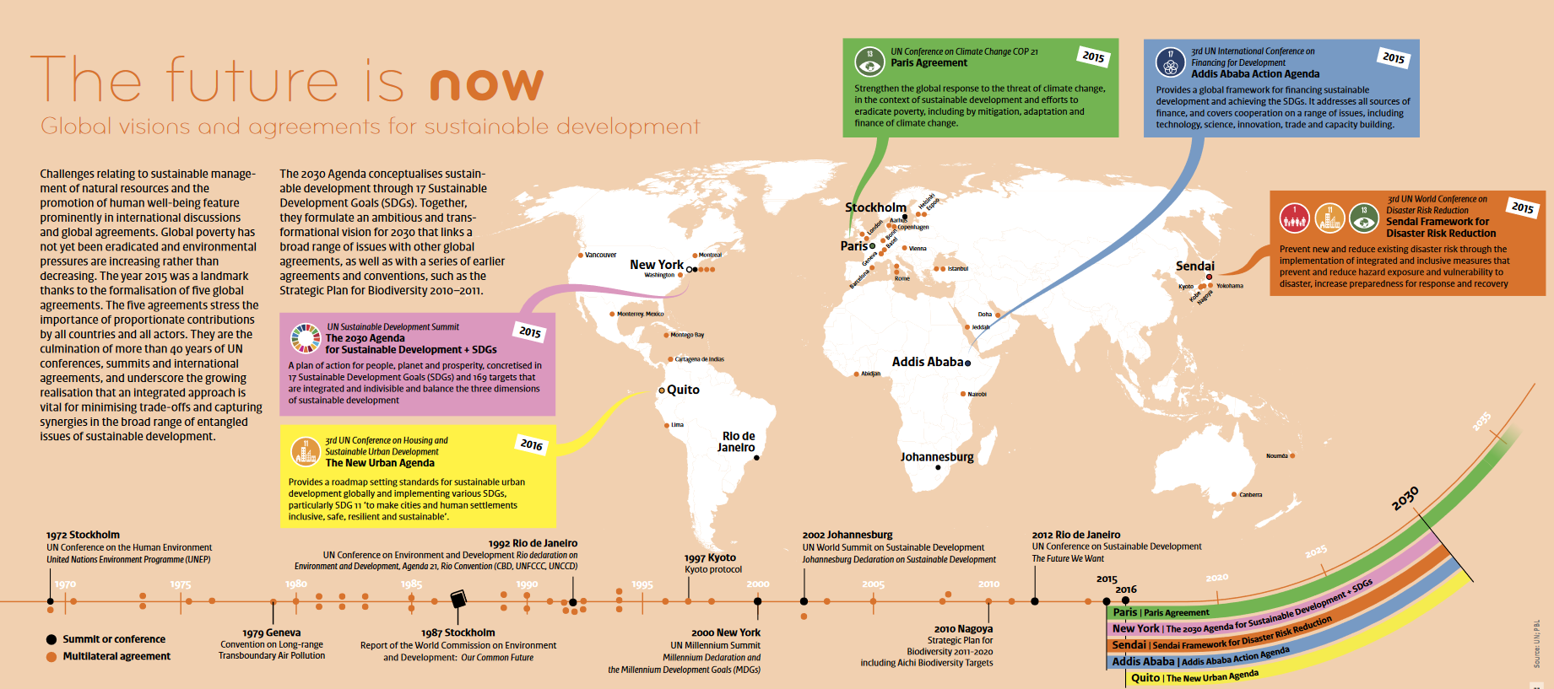
PBL 2017

Slide 31
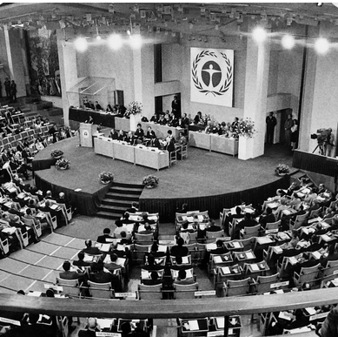
United Nations Conference on the Environment, 1972 Stockholm
Motto: only one Earth
The relationship between ecology and development are intensively discussed, which was relatively new in the international arena.
Beginning of environmental education.

Slide 32

1972 - The limits to growth
The Club of Rome = group of scientists, partly based at the MIT
Computer models
Showing potential scenarios for the world considering limited resources and different policy scenarios
Meadows et al. 1972:124
Meadows et al. 1972, Caradonna 2014
Notes:
Image shows the scenario if nothing is changed,
population, food production, industrialization, pollution, and consumption of nonrenewable natural resources
_____________________________________
Limited resources -> industrial slow down -> less food after a while so less population…
Supposedly the first time the word «sustainable» shows up in the book
First kind of co,puter model, taking into account things like
«The "standard" world model run assumes no major change in the physical, economic, or social relationships that have historically governed the development of the world system. All variables plotted here follow historical values from 1900 to 1970. Food, industrial output, and population grow exponentially until the rapidly diminishing resource base forces a slowdown in industrial growth. Because of natural delays in the system, both population and pollution continue to increase for some time after the peak of industrialization. Population growth is finally halted by a rise in the death rate due to decreased food and medical services.» (Meadows et al. 1972:124)
The earth is limited, probably un^limited growth is not possible…
Book is very much in its time, but also was a very important influencer…
Comparatively critical discourse
Criticism: Does not account for technological change, for the change in the notion of resources and the use of those

Slide 33
Emerging understanding of Sustainable Development in the 1970s
Hermes 2023 based on ARE 2001

Slide 34

Criticism on the concept of Sustainable Development
Conceptually fuzzy
No priorities – all is important, economy, environment, society
Mix between methods and goals
A concept everyone can agree to but that lacks specificity
Hermes 2023 based on ARE 2001

Slide 35
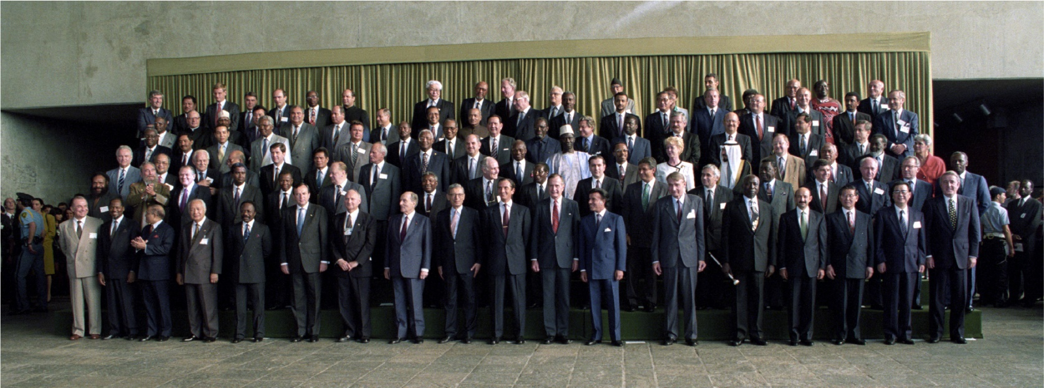
1992 “Earth Summit“ - The United Nations Conference on Environment and Development (UNCED)
20 years after Stockholm
179 countries represented
A North-South divide
Group photo of world leaders meeting at the 'Earth Summit' in Rio de Janeiro, Brazil, 13 June 1992. UN Photo/Michos Tzovaras, https://www.un.org/en/conferences/environment/rio1992

Slide 36
Five important documents, opened for signature or adopted in Rio 1992
United Nations Framework Convention on Climate Change - UNFCCC
Convention on Biological Diversity
Rio Declaration on the Environment and Development
Agenda 21
Statement of Principles on Forests
+ the Preparation on the United Nation Convention to Combat Desertification (UNCCD)

Slide 37
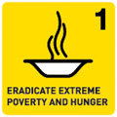
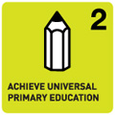

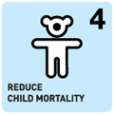



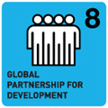
2000 Millennium Development Goals
The 55th session of the General Assembly of the UN adopted the Millennium Declaration including for the year 2015, the 8 Millennium Development Goals:
Eradicate extreme poverty and hunger
Achieve universal primary education
Promote gender equality and empower women
Reduce child mortality
Improve maternal health
Combat HIV/AIDS, malaria, and other diseases
Ensure environmental sustainability
Develop a global partnership for development
(United Nations General Assembly 2000)
Notes:
The Millennium Development Goals (MDGs) were eight international development goals for the year 2015 that had been established following the Millennium Summit of the United Nations in 2000, following the adoption of the United Nations Millennium Declaration. These were based on the OECD DAC International Development Goals agreed by Development Ministers in the "Shaping the 21st Century Strategy". The Sustainable Development Goals (SDGs) succeeded the MDGs in 2016.
All 191 United Nations member states, and at least 22 international organizations, committed to help achieve the following Millennium Development Goals by 2015:
To eradicate extreme poverty and hunger
To achieve universal primary education
To promote gender equality and empower women
To reduce child mortality
To improve maternal health
To combat HIV/AIDS, malaria, and other diseases
To ensure environmental sustainability[1]
To develop a global partnership for development[2]
Each goal had specific targets, and dates for achieving those targets. The eight goals were measured by 21 targets. To accelerate progress, the G8 finance ministers agreed in June 2005 to provide enough funds to the World Bank, the International Monetary Fund (IMF) and the African Development Bank (AfDB) to cancel $40 to $55 billion in debt owed by members of the heavily indebted poor countries (HIPC) to allow them to redirect resources to programs for improving health and education and for alleviating poverty.
Interventions evaluated include (1) improvements required to meet the millennium development goals (MDG) for water supply (by halving by 2015 the proportion of those without access to safe drinking water), (2) meet the water MDG plus halving by 2015 the proportion of those without access to adequate sanitation, (3) increasing access to improved water and sanitation for everyone, (4) providing disinfection at point-of-use over and above increasing access to improved water supply and sanitation (5) providing regulated piped water supply in house and sewage connection with partial sewerage for everyone (Hutton, G. Evaluation of the Cost and Benefits of Water and Sanitation Improvements at the Global Level, 2004 WHO-Geneva)
Critics of the MDGs complained of a lack of analysis and justification behind the chosen objectives, and the difficulty or lack of measurements for some goals and uneven progress, among others. Although developed countries' aid for achieving the MDGs rose during the challenge period, more than half went for debt relief and much of the remainder going towards natural disaster relief and military aid, rather than further development.[citation needed]
As of 2013, progress towards the goals was uneven. Some countries achieved many goals, while others were not on track to realize any. A UN conference in September 2010 reviewed progress to date and adopted a global plan to achieve the eight goals by their target date. New commitments targeted women's and children's health, and new initiatives in the worldwide battle against poverty, hunger and disease.

Slide 38
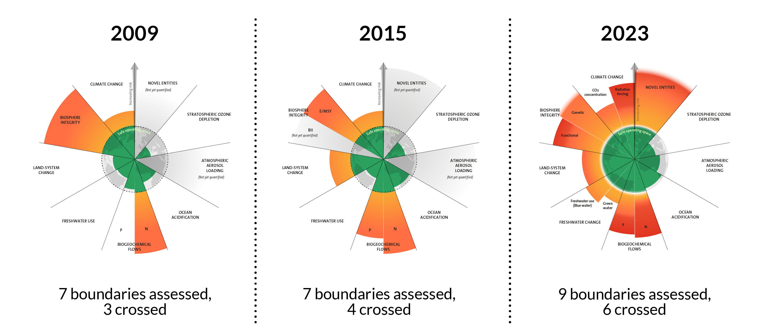
2009 Planetary Boundaries
Developed in 2009, the planetary boundaries concept presents a set of nine planetary boundaries within which humanity can continue to develop and thrive for generations to come.
Azote for Stockholm Resilience Centre, based on analysis in Richardson et al 2023
Notes:
These nine planetary boundaries were first proposed by former centre director Johan Rockström and a group of 28 internationally renowned scientists in 2009.
Since then, their framework has been revised several times. Now the latest update not only quantified all boundaries, it also concludes that six of the nine boundaries have been transgressed.
Crossing boundaries increases the risk of generating large-scale abrupt or irreversible environmental changes. Drastic changes will not necessarily happen overnight, but together the boundaries mark a critical threshold for increasing risks to people and the ecosystems we are part of.
Boundaries are interrelated processes within the complex biophysical Earth system. This means that a global focus on climate change alone is not sufficient for increased sustainability. Instead, understanding the interplay of boundaries, especially climate, and loss of biodiversity, is key in science and practice.
Since its first conceptualization, the planetary boundaries framework has generated enormous interest within science, policy, and practice.
https://www.stockholmresilience.org/research/planetary-boundaries.html

Slide 39
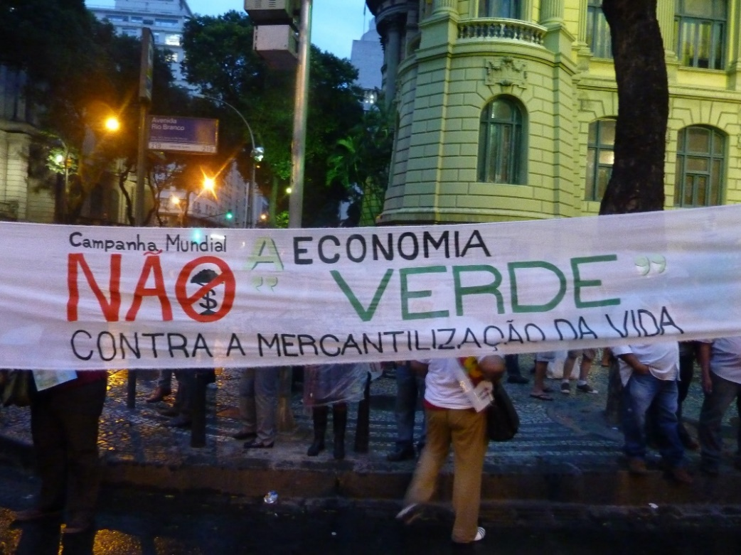
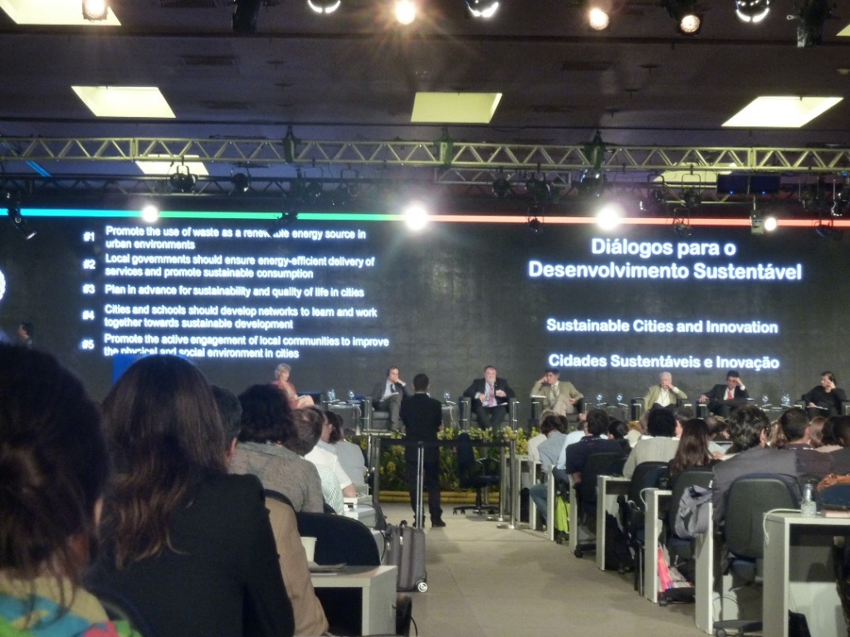
2012 Rio+20 UN Conference on Sustainable Development
Political outcome document: The Future We Want
Guidelines of green economy policies
Starting a process to develop a set of SDGs
...
Photo by Daniel Leite, Rio de Janeiro 2012
Notes:
The United Nations Conference on Sustainable Development - or Rio+20 - took place in Rio de Janeiro, Brazil on 20-22 June 2012. It resulted in a focused political outcome document which contains clear and practical measures for implementing sustainable development.
"Beyond the Resolution document, and beyond the conference halls, civil society took things a step further, exploring the legal dimensions of the problems, engaging in meaningful discourse, building partnerships and communities for transnational governance." Power 2023 (see pictures by Daniel Leite
In Rio, Member States decided to launch a process to develop a set of Sustainable Development Goals (SDGs), which will build upon the Millennium Development Goals and converge with the post 2015 development agenda.
The Conference also adopted ground-breaking guidelines on green economy policies. Governments also decided to establish an intergovernmental process under the General Assembly to prepare options on a strategy for sustainable development financing. Governments also agreed to strengthen the United Nations Environment Programme (UNEP) on several fronts with action to be taken during the 67th session of the General Assembly.
The Future We Want: 733FutureWeWant.pdf (un.org)
See Powers 2012 for a commentary on Rio+20 and the increasingly important role of civil society action, commitments and partnerships, and of transnational governance. "In the final analysis, the official Rio+20 UN Conference on Sustainable Development was anything but a runaway success. Still, it may have succeeded in providing a document that will reinforce and undergird subsequent efforts to achieve a sustainable future. While unexciting, it provides a baseline and a floor, establishing or reinforcing international norms on a host of issues. Beyond the Resolution document, and beyond the conference halls, civil society took things a step further, exploring the legal dimensions of the problems, engaging in meaningful discourse, building partnerships and communities for transnational governance. That, rather than the document itself, may outline the future we want." Powers, Ann. 2012. The Rio+20 Process: Forward Movement for the Environment? Transnational Environmental Las 1(2): 403-412. https://doi.org/10.1017/S2047102512000179

Slide 40
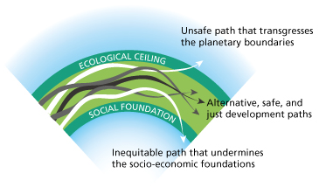
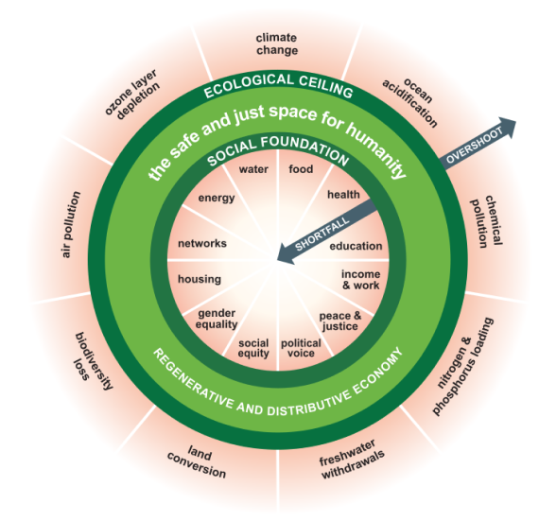
2012 The Doughnut Model
Different paths of Sustainable Development are possible, as long as they are confined between planetary boundaries and social foundations as "guard rails". These guard rails must be negotiated.
Raworth 2012; 2017
Notes:
The Doughnut combines the concept of planetary boundaries with the complementary concept of social boundaries. It consists of two concentric rings: a social foundation, to ensure that no one is left falling short on life’s essentials, and an ecological ceiling, to ensure that humanity does not collectively overshoot the planetary boundaries that protect Earth's life-supporting systems. Between these two sets of boundaries lies a doughnut-shaped space that is both ecologically safe and socially just: a space in which humanity can thrive.
The Doughnut Model (originally Raworth/Oxfam 2012, updated in Raworth 2017) is an attempt to concretize the general dimensions of Sustainability and thus to operationalize SD. To this end, Raworth first links the concept of SD to the international scientific and political debate on planetary limits on the use and degradation of natural resources (Rockström et al. 2009). In her model, Raworth expands the debate to include minimum thresholds of social and economic foundations that must not be exceeded, to allow all people on the Eartch to live a worthwhile life.
The area of Sustainable Development that is environmentally safe, socially just, and economically viable for humanity is symbolized by the light green area. There is no precise “prescription” as to how SD should look. The model is based on an understanding of SD as a search, learning, and shaping process involving all of society and thus requiring the participation of every individual. The model does not pre-empt this negotiation process, but indicates possible paths towards SD within the light green corridor. This area is enclosed by two “guard rails”, which depict threats to SD. The outer rail shows the “planetary boundaries”, whose natural resources (water, air, land, biodiversity etc.) are being massively degraded by human use. The inside rail comprises the “social foundation”, i.e. the minimum requirements without which human well-being is not possible.
The limits of environmental degradation and the minimum socio-economic requirements are not universally defined and the indicators for measuring current values and trends are the topic of ongoing research and negotiations between various actors with different interests and levels of influence. The political decisions on steering future developments are based on information including prominent scientific contributions to the collection of environmental, sociocultural, and economic systems and their dynamics.
About Doughnut Economics | DEAL

Slide 41
AU Agenda 2063 and UN Agenda 2030

Slide 42
Selected Sustainability Theories and International Milestones: A Timeline from 1970 Onwards
Theory
Year
International Milestones
Limits to Growth | Emergence of 3 Circles Model |  |  |  |  |  |  |  | Planetary Boundaries | Doughnut Model
1972 |  |  | 1987 |  | 1992 |  | 2000 |  | 2009 | 2012 | 2013 | 2015 |  |  | 2030 |  |  |  | 2063
UN Conference Stockholm |  |  | Brundtland Report |  | Earth Summit Rio de Janeiro |  | Millennium Development Goals |  |  | Rio +20 | Agenda 2063 | Agenda 2030
Notes:
More detailed Sustainable Development timeline: https://www.iisd.org/system/files/publications/sd_timeline_2012.pdf

Slide 43
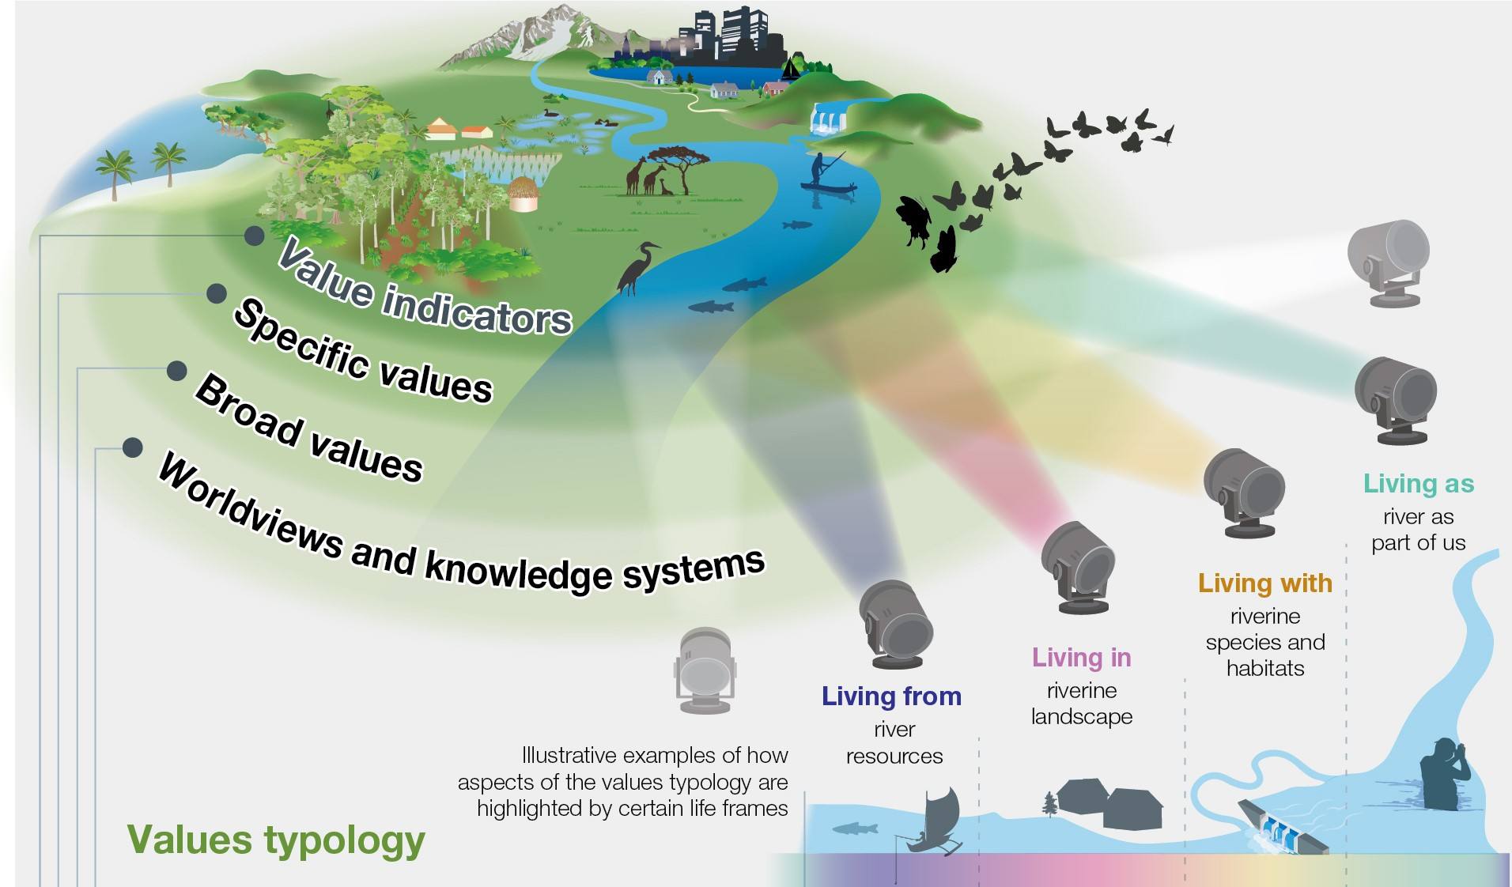
Different Worldviews and the Many Values of Nature
Living from and living in: Anthropocentric (prioritising human interests)
Living with: Bio / ecocentric (emphasising living beings or nature's processes as a whole)
Living as: Pluralistic (focusing on several intertwined relationships among humans, other-than-human beings, nature components and systemic processes)
Pascual et al., 2023
Notes:
The IPBES ‘values typology’ explicitly recognizes that different worldviews and knowledge systems impact the way people interact with and value nature.
To clarify and identify different values and their interrelationships, the typology distinguishes four flexible and interconnected layers of what value means: worldviews and knowledge systems, broad values, specific values and value indicators. Life frames (metaphorically shown as light beams) illustrate how some sets of values might be given prominence in the different ways people relate to nature (here a watershed feeding into an estuarine wetland)
In the literature, worldviews are frequently classified as anthropocentric (prioritizing human interests) or biocentric and ecocentric (emphasizing living beings or nature’s processes as a whole). Pluricentric is also used in the typology to encompass those worldviews with no single ‘centre’ (focusing on several intertwined relationships among humans, other-than-human beings, nature’s components and systemic processes)

Slide 44
Key Messages and Q&A
5
Notes:
10 mins: Open space for questions and clarifications.; Summary of the main points covered in the session and outlook on the next session.

Slide 45
Key messages
The three dimensions of Sustainable Development are interlinked at different levels.
Sustainable Development is complex and recognized at international level.
Challenges are accelerating and action is urgently needed.
Context matters to achieve Sustainable Development. Activities need to be tailored accordingly and must take into account different worldviews and values.

Slide 46
Reflection
Participants individually note their key takeaways from the session.
Invitation to share their reflections with the group.

Slide 47
Introduction to Overall Course Project
7
Notes:
10 mins: Reflective activity: Participants individually note their key takeaways from the session.
Invitation to share their reflections with the group.

Slide 48
Overall Course Project
Creating an Action Plan to Integrate Sustainable Development into Your Teaching
Notes:
10 mins: Open space for questions and clarifications.; Summary of the main points covered in the session and outlook on the next session.

Slide 49

Develop an ESD Action Plan
Task after Session 1- Review of course content Reflect on how Sustainable Development (SD) concepts and topics are currently integrated into your teaching practices. Evaluate your existing course content and syllabi. Identify areas for strengthening the integration of SD into your teaching practices.
Task after Session 2 – Identify opportunities to incorporate SD into your course Identify opportunities to incorporate Sustainable Development concepts and topics. These could include the Sustainable Development Goals (+other frameworks relevant to your context), global sustainability challenges, or different sustainability perspectives. What links does your discipline have with SD?
Task after Session 3 – Session development Find a topic related to SD in your discipline. Develop a lesson/session based on constructive alignment: Formulate at least three learning outcomes, think of suitable learning strategies (that actively engage students in understanding and applying SD and ESD principles) and design an assessment format.
In Session 4 – Present your ESD Action Plan and identify collaboration opportunities Explore opportunities for collaboration with other lecturers, departments, or external organizations working on sustainability initiatives.

Slide 50
Task after Session 1 – Review of course content
Reflect on how Sustainable Development (SD) concepts and topics are currently integrated into your teaching practices. Evaluate your existing course content and syllabi. Identify areas for strengthening the integration of SD into your teaching practices.
Be prepared to present and discuss your review of content in Session 2.

Slide 51
References
African Union Commission (2013). Agenda 2063. The Africa We Want. https://au.int/en/agenda2063/overview [Last accessed 27/12/2023]
African Union Commission (2014). Science, Technology and Innovation Strategy for Africa 2024 (STISA-2024). https://au.int/sites/default/files/newsevents/workingdocuments/33178-wd-stisa-english_-_final.pdf [Last accessed 27/12/2023]
Caradonna, K.L. (2014). Sustainability. A History. Oxford University Press. ISBN 978-0-19-937240-9.
Fanning, A. L., O’Neill, D. W., Hickel, J., & Roux, N. (2022). The social shortfall and ecological overshoot of nations. Nature Sustainability, 5(1), 26-36. https://doi.org/10.1038/s41893-021-00799-z
Independent Group of Scientists appointed by the Secretary-General, Global Sustainable Development Report 2023: Times of crisis, times of change: Science for accelerating transformations to sustainable development, (United Nations, New York, 2023) https://sdgs.un.org/sites/default/files/2023-09/FINAL%20GSDR%202023-Digital%20-110923_1.pdf. [Last accessed 27/12/2023]
Meadows, D. H., Meadows, D. L., Randers, J., & Behrens III, W. W. (1972). The Limits to Growth; a Report for the Club of Rome's Project on the Predicament of Mankind. Universe Books. ISBN 0876631650.
Pascual, U., Balvanera, P., Anderson, C. B., Chaplin-Kramer, R., Christie, M., González-Jiménez, D., ... & Zent, E. (2023). Diverse values of nature for sustainability. Nature, 620(7975), 813-823. https://doi.org/10.1038/s41586-023-06406-9
PBL. 2017. People and the Earth. International cooperation for the Sustainable Development Goals in 23 infographics. PBL, Netherlands Environmental Assessment Agency, The Hague. https://www.pbl.nl/sites/default/files/downloads/People_and_the_Earth_WEB.pdf [Last accessed 27/12/2023]
Raworth, K. (2012). A safe and just space for humanity: can we live within the doughnut?. Oxfam.
Raworth, K. (2017). Doughnut economics: seven ways to think like a 21st-century economist. Chelsea Green Publishing.
Royo, M. G., Diep, L., Mulligan, J., Mukanga, P., & Parikh, P. (2022). Linking the UN Sustainable Development Goals and African Agenda 2063: Understanding overlaps and gaps between the global goals and continental priorities for Africa. World Development Sustainability, 1, 100010. https://doi.org/10.1016/j.wds.2022.100010
Steffen, W., Broadgate, W., Deutsch, L., Gaffney, O., & Ludwig, C. (2015). The trajectory of the Anthropocene: the great acceleration. The Anthropocene Review, 2(1), 81-98. https://doi.org/10.1177/2053019614564785
World Commission on Environment and Development. (1987). Our Common Future. https://sustainabledevelopment.un.org/content/documents/5987our-common-future.pdf [Last accessed 27/12/2023]
World Economic Forum. (2023). The Global Risks Report 2023. 18th Edition. I N S I G H T R E P O R T. Geneva: Switzerland. https://www3.weforum.org/docs/WEF_Global_Risks_Report_2023.pdf [Last accessed 27/12/2023]

