Slide 1
Session 3 Education for Sustainable Development (ESD) & Constructive Alignment
Notes:
ID=d924773e-9a16-4d6d-9803-8cb819e99682 Recipe=text_billboard Type=TextOnly Variant=0 FamilyID=AccentBoxWalbaum_Zero

Slide 2

Outline
1 – Introduction to ESD
2 – Introduction to Constructive Alignment
3 – Examples of Constructive Alignment
4 – Reflection
This icon indicates slides which can be adjusted to your own context (if necessary).

Slide 3
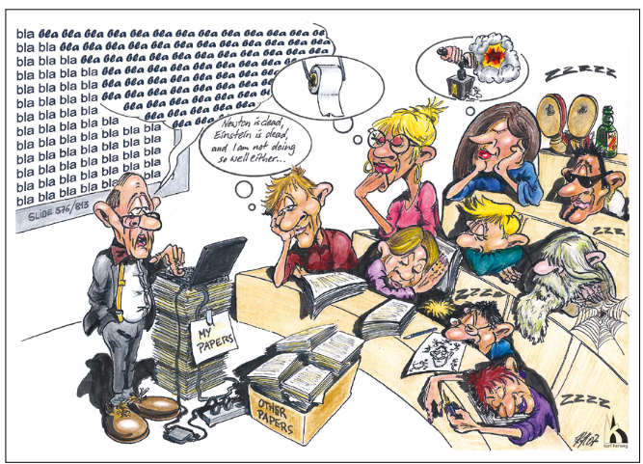
Learning Outcomes
In this session, participants will:
gain an understanding of the principles and importance of Education for Sustainable Development (ESD)
gain an understanding of the concept of constructive alignment in designing effective courses
Spray & Pray: the assumption that students, spurred on by hearing floods of scientific facts and words, will change the world professionally after they leave the classroom.
Illustration: Karl Herweg

Slide 4
Plenary discussion
Present the opportunities you have identified to incorporate Sustainable Development concepts and topics into your course(s) – task 2.
These could include the Sustainable Development Goals (+other frameworks relevant to your context), global sustainability challenges, or different sustainability perspectives.
What links does your discipline have with SD?

Slide 5
Introduction to ESD
1

Slide 6
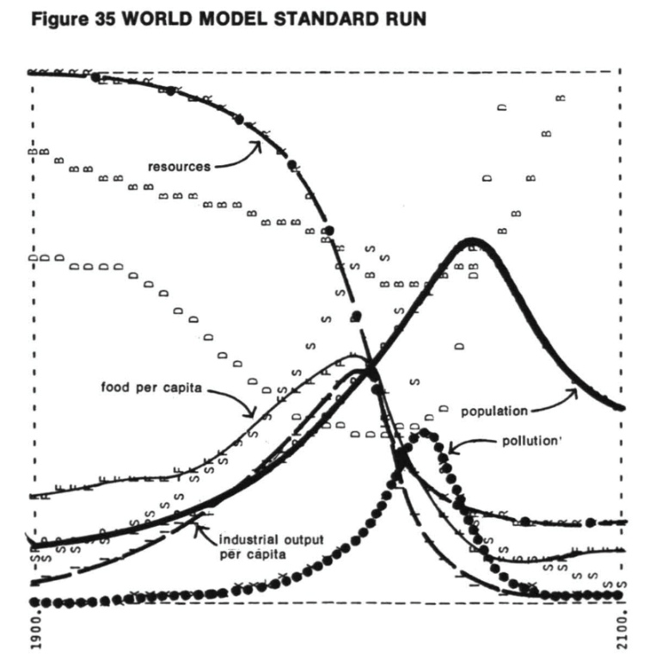
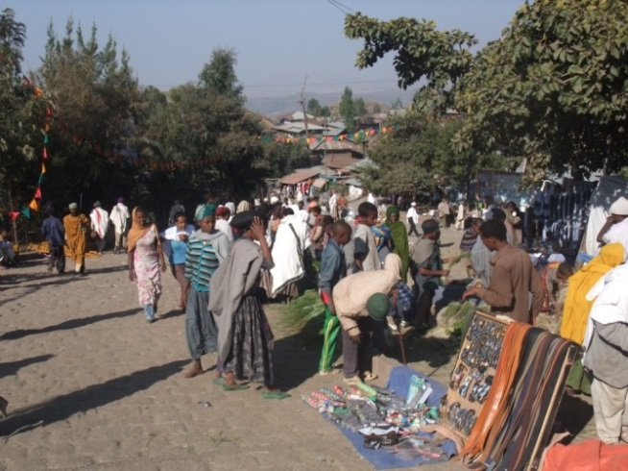
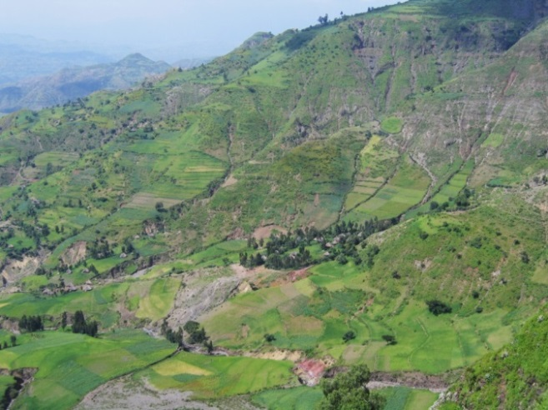
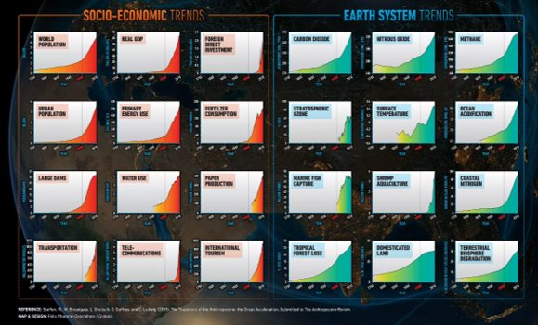
Complex sustainability challenges

Slide 7

New form of science and education
Link to Session 2: Role of Higher Education and Universities
UN 2030 Agenda for Sustainable Development calls for a new form of science, actively contributing to sustainability transformation.
Business as usual is no longer an option.
What kind of research is required for sustainability and transformative science?
What kind of education is required?
Illustrations: K Herweg

Slide 8
What is ESD? (UNESCO)
“ESD gives learners of all ages the knowledge, skills, values and agency to address interconnected global challenges including climate change, loss of biodiversity, unsustainable use of resources, and inequality. It empowers learners of all ages to make informed decisions and take individual and collective action to change society and care for the planet.”
UNESCO: https://www.unesco.org/en/education-sustainable-development/need-know
The founding value of ESD is respect
Respect for others
Respect for the present and future generations
Respect for the planet and what it provides to us (resources, fauna, and flora)

Slide 9
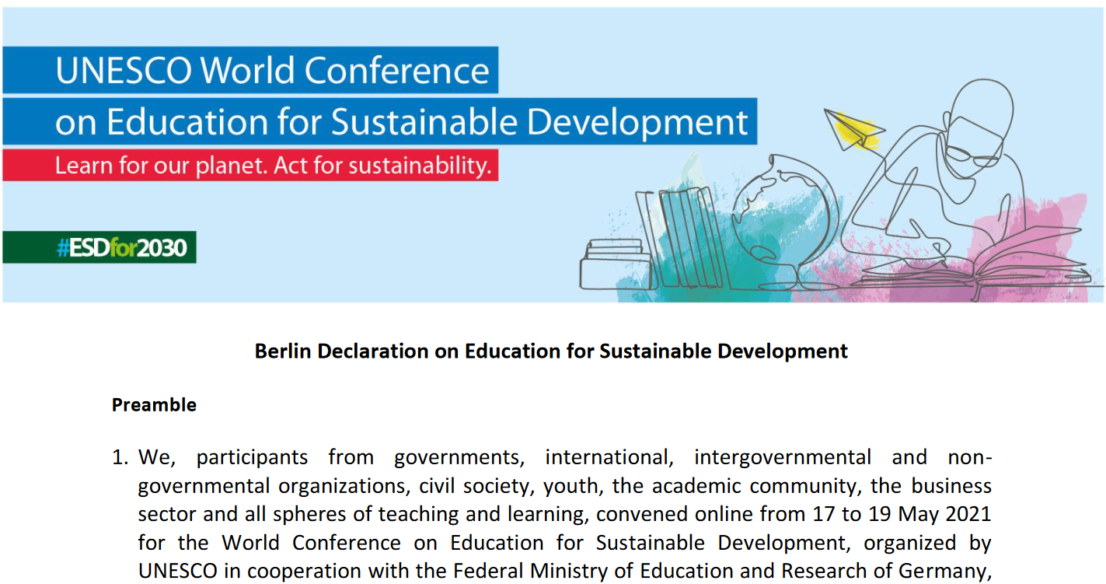
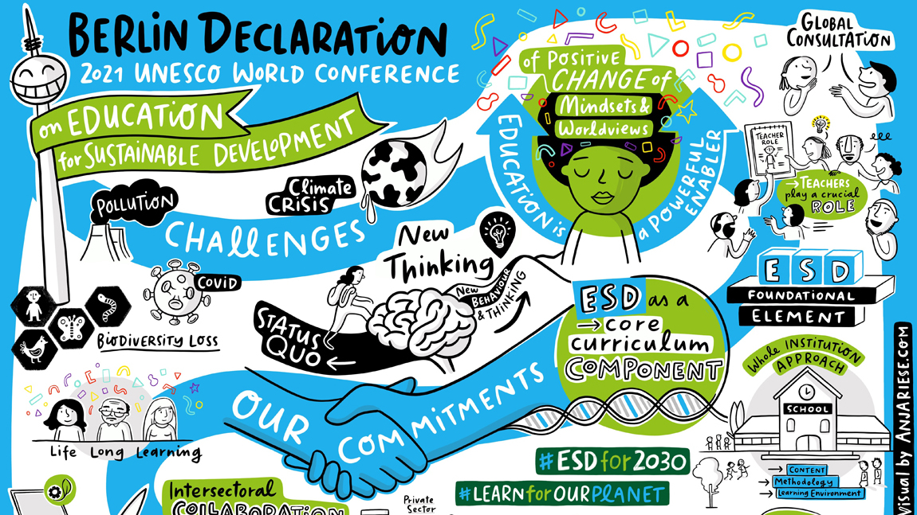
What is ESD? (UNESCO’s Berlin Declaration)
ESD is the “foundation for the required transformation, providing everyone with the knowledge, skills, values and attitudes to become change agents for sustainable development”
UNESCO’s Berlin Declaration of May 2021:
https://en.unesco.org/sites/default/files/esdfor2030-berlin-declaration-en.pdf
Notes:
UNESCO’s Roadmap report can be downloaded here: https://unesdoc.unesco.org/ark:/48223/pf0000374802.locale=en

Slide 10

Definitions
Education about sustainable development is an awareness lesson or theoretical discussion.
Education for sustainable development (ESD) is the use of education as a tool to achieve sustainability: Giving people knowledge and skills for lifelong learning to help them find new solutions to their environmental, economic and social issues.

Slide 11

The UN Sustainable Development Goal 4
Education is at the heart of the UN 2030 Agenda
Education as a stand-alone goal (SDG 4)
Ensures inclusive and quality education for all
Promotes lifelong learning
Targets on education are under several other SDGs (e.g. SDG 3 "Good Health and well-being, SDG 8 "Decent growth and economic growth", SDG 12 "Responsible consumption and production" and SDG 13 "Climate change")
Education can accelerate progress towards the achievement of all SDGs
United Nations: https://sdgs.un.org/goals/goal4#targets_and_indicators

Slide 12
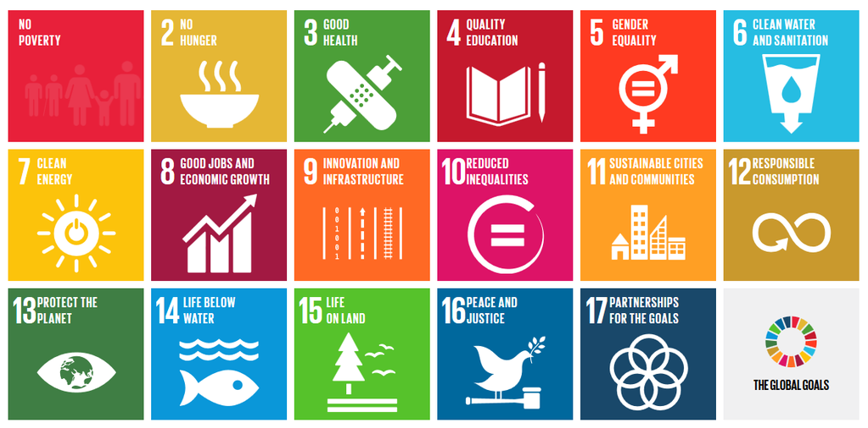
ESD is anchored in SDG 4.7
SDG Goal 4, Target 7 states: “By 2030, ensure that all learners acquire the knowledge and skills needed to promote sustainable development, including, among others, through education for sustainable development and sustainable lifestyles, human rights, gender equality, promotion of a culture of peace and non-violence, global citizenship and appreciation of cultural diversity and of culture’s contribution to sustainable development.”
United Nations: https://sdgs.un.org/goals/goal4#targets_and_indicators

Slide 13
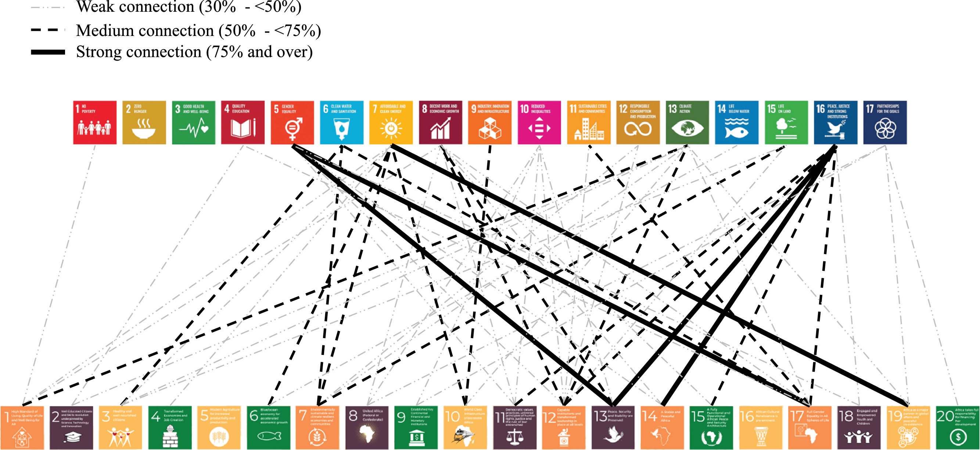
Education in the African Union Agenda 2063
Goal 2: Well Educated Citizens and Skills revolution underpinned by Science, Technology and Innovation (https://au.int/en/agenda2063/goals)
Royo et al., 2022

Slide 14
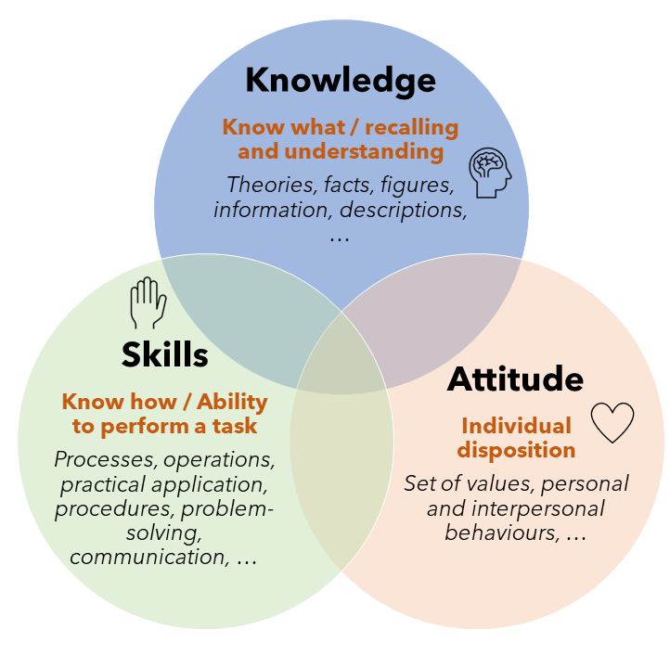
Competences
Education for Sustainable Development should lead to the development of competences for action.
Education and training should be based on the concept of competences.

Slide 15

Competences
Competence = Umbrella term for a person's knowledge, skills, abilities (and experience) (Abelha et al., 2020):
refers to people who have a previous background (knowledge, skills, abilities, past experiences, beliefs, values, etc.) that might be called resources
implies the mobilization of those resources in a specific context (e.g., solve a problem)
is visible inside of a particular context, in which it is possible to identify which competences people need to develop
requires more than the acquisition of knowledge; it is also more than a skill (something that a person is able to do)

Slide 16

Example from Kenya
Shift from the 8-4-4 system (Objective – driven curriculum)→ content-based (but performance based-pedagogic practice) to the competence-based 2-6-3-3-3 system.
The competency-based curriculum emphasises student-centered teaching and practical experiences that better equip learners with 21st-century skills like critical thinking and problem-solving.
The core competencies expected to be developed by all learners at all levels include:
creativity, innovation, critical thinking and problem solving, inclusivity and sustainable development.

Slide 17
Pedagogical strategies that foster SD competences
Mounting global challenges call for suitable strategies and prompt action.
Change agents need to be capable of addressing wicked problems.
We need to create learning environments that foster sustainability competences.

Slide 18
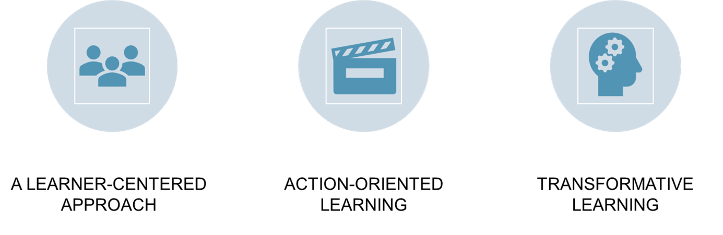
Key pedagogical approaches in ESD
Active development of knowledge rather than transfer/passive learning
Educator: facilitator of learning processes
Learner engage in action and reflect on their experiences
Educator: create learning environment that prompts reflexive thought processes
Empowers learners to question and change their ways of seeing and thinking about the world
Educator: facilitator who challenges learners
Rieckmann, 2018

Slide 19
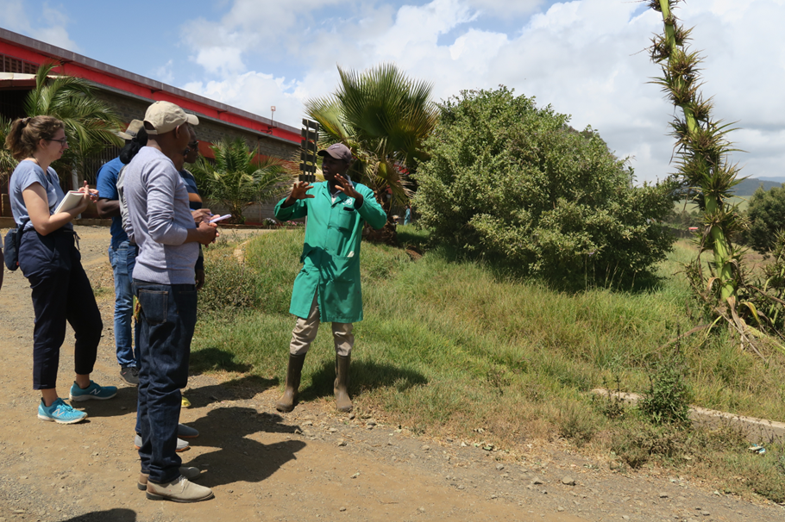
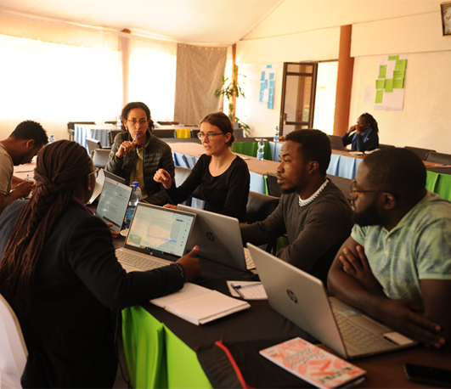
Suggestions for teaching principles
Work on a real-world context with complex problem settings; be solution-oriented
Bring together students from various disciplines: interdisciplinary and holistic learning rather than subject-based learning
Build on participation and cooperation
Meet practitioners
Values-based learning
Critical thinking rather than memorizing
Locally relevant information, rather than national

Slide 20
Discussion/Reflection
What teaching principles do you apply in your courses?

Slide 21
Introduction to Constructive Alignment
2

Slide 22
Constructive Alignment
In the mid-1990s, John Biggs presented constructive alignment as a guiding idea for the design of study programmes.
Three core elements must be aligned:
Learning outcomes (specifying the competences to be built)
Learning activities (teaching-learning arrangements)
Assessment (of competences)
The term "constructive" means that learners themselves make content meaningful through relevant learning activities.
Herweg et al. (2021)

Slide 23
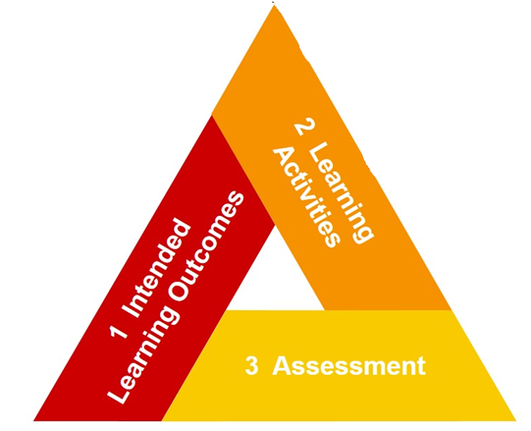
Aligning three elements
2 What learning activities
will help students to achieve
these learning outcomes?
1 What do students know?
What can they do at the end of the curriculum / course?
3 How do we know
if students have achieved
these learning outcomes?
Herweg et al. (2021)

Slide 24

Learning Outcomes
Specify competences to be built:
Define what learners are expected to know (knowledge) and be able to do (skills).
Ensure that learners understand the importance of critical awareness and can self-assess their attitude and values at the end of the course.
Clear learning outcomes are formulated in an action-oriented way.
Herweg et al. (2021)

Slide 25
Learning Outcomes
Useful active verbs for the definition of learning outcomes:
Required performance per level |  | Typical activities
Remembering recognizing and recalling information | recall information from memory (terms, facts, conventions, classifications, principles, methods, theories, concepts, models, etc. ) | reproduce, name, enumerate, designate, list, cite, indicate, draw, etc.
Understanding making connections, interpreting | link information transform information (text to graph; graph to text, etc.) capture interrelations draw conclusions | explain, describe, depict, translate, put into your own words, summarize, identify, compare, distinguish, interpret, conclude, etc.
Problem-solving evaluating and solving problems | transfer acquired knowledge to new situations (abstraction, generalization) apply acquired knowledge in problem-solving assess, evaluate, and weigh up complex information estimate consequences | execute, analyse, determine, propose, design, develop, justify, judge, generate, construct, criticize, verify, test, plan, produce, create, shape, elaborate, form, etc.
Herweg et al. (2021)

Slide 26

Example
Lecture: "Migration and research on migration" (Social Anthropology)
At the end of the lecture students are able to:
list important major migration movements of the past two centuries
explain central concepts of migration and migration research
describe selected relevant models, theories and methods of migration research
name milestones in the history of migration research
summarize the main findings of European and North American migration research
Herweg et al. (2021)

Slide 27

Learning activities
What learning activities will help students to achieve these learning outcomes?
Which learning environments and what teaching-learning-arrangements create spaces for action-oriented learning?
Herweg et al. (2021)

Slide 28
Learning activities that foster SD competences
Dialogic strategies (discussion, debate, and dialogue)
Critical reflection on locally and globally relevant issues
Hypothetical and real cases (role-play and case studies, simulation).
Collaboration on projects and tasks (group activities).
Experiential learning activities such as community action and problem-solving
Interdisciplinary exploration and joint problem-framing
Project-based learning / Problem-based learning
Action–research (a cyclical process of planning, action, observation, and reflection based on research to innovate and improve practice).
Tejedor et al. (2019)

Slide 29

Assessment
What type of assessment will tell if students have achieved the learning outcomes?
The exam must be appropriate to test what was intended (validity).
Learning outcomes, learning activities and assessment must form a unit.
Herweg et al. (2021)

Slide 30
Assessment formats
Solve tasks: Students are given a task and are expected to complete it using the correct method
Explain / define terms: Terminology must be paraphrased in students’ own words.
Working on cases and problems: present real or constructed cases in order to outline the problem-solving process and find a professionally adequate solution. Case studies are used to integrate partly authentic situations into everyday teaching, so that students without professional experience can acquire and apply knowledge to practical cases.
Write essays, papers, technical texts: Work on a research question according to scientific criteria and document it in a written paper.
Write comments, summaries, reviews, statements (on books, articles, websites, programmes, etc.)
….
Herweg et al. (2021)

Slide 31
Assessment functions
Formative Function – during the course / module
To determine the learner’s current position
Learners get feedback on their current level based on the results of the learning assessment.
The results help to draw conclusions for the next learning steps.
Summative Function – at the end of the course / module / …
Concludes a course, a unit, a module or an entire degree programme.
The result "counts". Based on their results learners are graded or receive a certificate for the successful achievement.
Herweg et al. (2021)

Slide 32
Examples of Constructive Alignment
3

Slide 33
Examples of Constructive Alignment
Land degradation
Urban migration

Slide 34
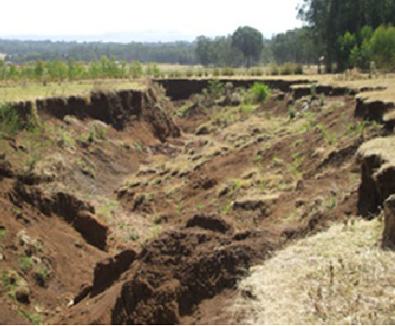
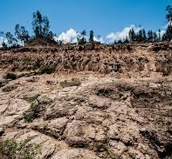
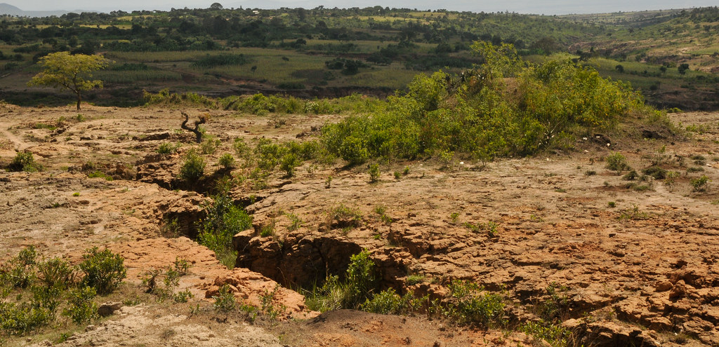
Example 1: Land degradation

Slide 35
Example 1: Land degradation
 | Environment | Society | Economy
 | Natural resources (as the basis of livelihoods), climate change, energy consumption, waste production and recycling, … | Independence / dependencies of individuals, societal structures, inclusive development, migration, knowledge, education, health, well-being, … | Livelihoods, poverty, future of labour, inequalities, migration, economic & political power relations, globalization, …
Topics | Depletion of natural resources (soil fertility, water quality, biodiversity), loss of ecosystem services, soil erosion, increased temperatures, …. | Influence on land tenure systems, migration patterns, and access to resources, leading to potential conflicts within communities, … | Contributes to poverty by reducing agricultural productivity and income, driving migration, shift in power dynamics (particularly in the context of trade and resource extraction), …

Slide 36


Example 1: Land degradation
 | Knowledge | Skills | Attitude
Learning outcomes At the end of the session, students will be able… | ...to understand the causes and consequences of land degradation, considering its environmental, societal, and economic dimensions. | ...to apply field observation and analysis skills during a guided visit to an area affected by land degradation. | ...to demonstrate an appreciation for the perspectives and experiences of stakeholders affected by land degradation through exchanges and interviews
Measurable indicator | Successful completion of a written examination or quiz assessing knowledge of key concepts related to land degradation | Submission of a field report that includes accurate observations, analysis of the identified problem, and proposed solutions, showcasing acquired skills in fieldwork | Participation in reflective discussions or submission of a written reflection highlighting insights gained from interacting with affected stakeholders, demonstrating an empathetic and open-minded attitude

Slide 37
Example 1: Land degradation
Learning activities
Teacher presentation on causes and consequences of land degradation
(Guided) field visit to an area with the identified problem
Exchange/interviews with affected stakeholders
Assessment
Write a report on the impact of land degradation, considering environmental, societal and economical aspects.

Slide 38
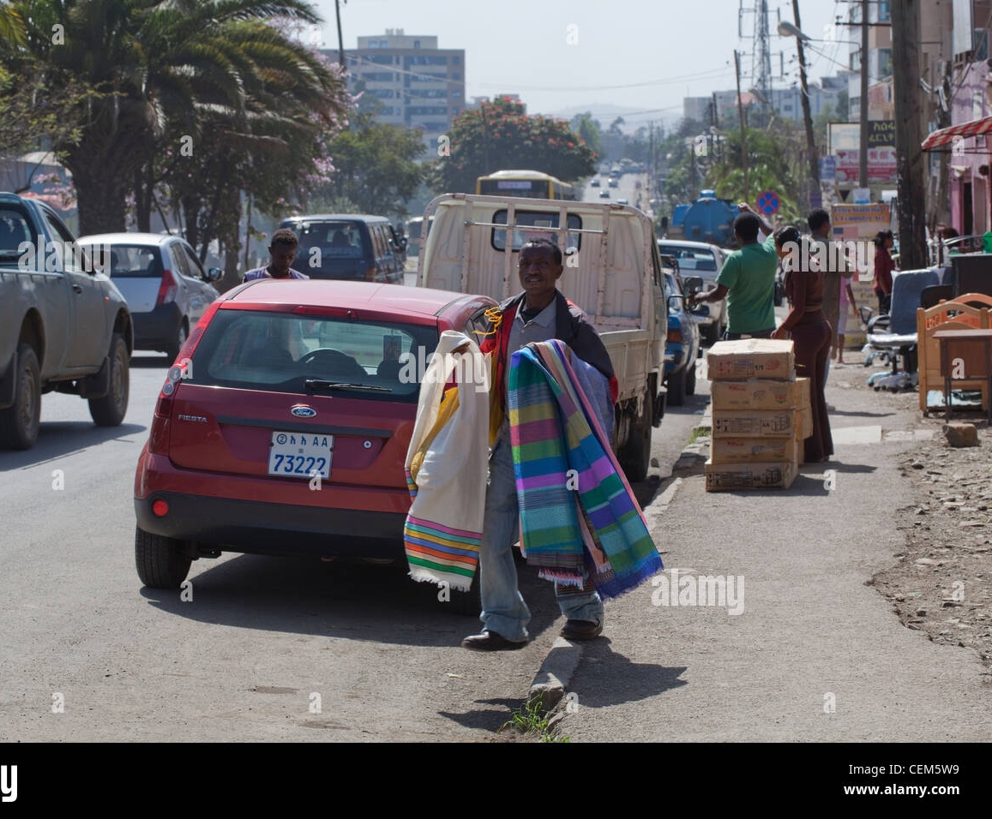
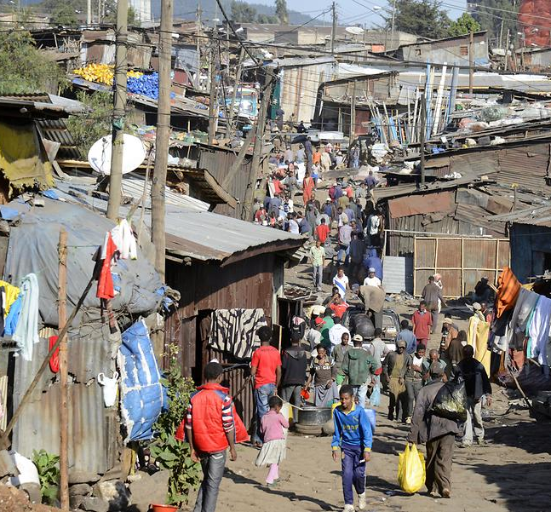
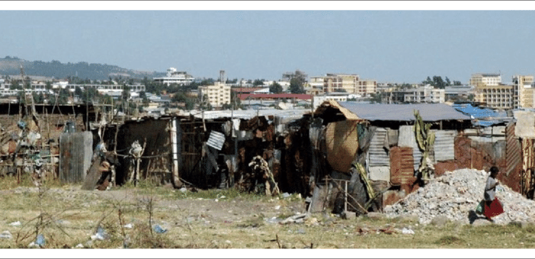
Example 2: Urban migration

Slide 39
Example 2: Urban migration
 | Environment | Society | Economy
 | Natural resources (as the basis of livelihoods), climate change, energy consumption, waste production and recycling, … | Independence / dependencies of individuals, societal structures, inclusive development, migration, knowledge, education, health, well-being, … | Livelihoods, poverty, future of labour, inequalities, migration, economic & political power relations, globalization, …
Topics | Expansion of urban areas, habitat loss, deforestation, changes in land cover (impacting ecosystems and biodversity), higher resource consumption (water, energy), waste | Dependencies on urban services and systems, strain existing urban infrastructure, delinquency, increased inequalities, … | Globalization of labor market, unequal distribution of resources, job opportunities, social services, …

Slide 40
Example 1: Urban migration
 | Knowledge | Skills | Attitude
Learning outcomes At the end of the session, students will be able... | to understand of the factors contributing to urban migration, considering social, economic, and environmental aspects. | to collect information effectively through various media, including video and photography, to analyze and present data on urban migration. | to engage in constructive debates within groups to discuss challenges related to urban migration and propose potential solutions.
Measurable indicator | Successful completion of a knowledge assessment, such as a quiz, reflecting understanding of key concepts related to urban migration | Submission of a multimedia presentation or report showcasing collected information, demonstrating proficiency in information gathering skills. | Participation in group debates and the submission of a group solution proposal, reflecting an open-minded and collaborative attitude toward problem-solving

Slide 41
Example 2: Urban migration
Learning activities
Brainstorming on urban migration (individual activity)
Collection of information: video, photo, etc.
Debating on how to overcome the challenge (in groups)
Assessment
Written reflection on how to overcome the challenge: Propose a solution and develop a strategy
Write a report about migration, asking your elders

Slide 42
Reflection
4

Slide 43

Reflection task: Muddiest point
Take a few minutes to write down the most difficult or confusing part of today’s session.
We will address your “muddiest points” in the next session.
Notes:
Link from Kenya training:
https://padlet.com/SLBScMScNE/take-a-few-minutes-to-write-down-the-most-difficult-or-confu-4qbgbhljl3akhm0x

Slide 44
Task after Session 3 – Session development
Find a topic related to SD in your discipline. Develop a lesson/session based on constructive alignment: Formulate at least three learning outcomes, corresponding learning activities (that actively engage students in understanding and applying SD and ESD principles) and design an assessment format.
Be prepared to present and discuss your developed action plan in session 4.

Slide 45

Overall Course Project
Creating an Action Plan to Integrate Sustainable Development into Your Teaching
Session | Addressed topics | Tasks
1 | Defining Sustainable Development Sustainability Challenges Further Sustainability Perspectives | Reflect on how Sustainable Development (SD) concepts and topics are currently integrated into your teaching practices. Evaluate your existing course content and syllabi. Identify areas for strengthening the integration of SD into your teaching practices
2 | Interlinkages of Sustainability Dimensions Role of Science and Higher Education Disciplinary Contributions; links between disciplines and SD | Identify opportunities to incorporate Sustainable Development concepts and topics. These could include the Sustainable Development Goals (+other frameworks relevant to your context), global sustainability challenges, or different sustainability perspectives. What is the link between your discipline and SD?
3 | Education for Sustainable Development Constructive Alignment | Find a topic related to SD in your discipline. Develop a lesson/session based on constructive alignment: Formulate at least three learning outcomes, think of suitable learning activities (that actively engage students in understanding and applying SD and ESD principles) and design an assessment format.
4 | Present your Action Plan and identify collaboration opportunities | Explore opportunities for collaboration with other lecturers, departments, or external organizations working on sustainability initiatives.

Slide 46
Outlook on next session: Presentations of action plans
Each participant has 6 minutes to present their action plan.
Focus on key points:
Current state (task after session 1),
Areas for improvement, opportunities identified (task after session 2),
Developed lesson/session (constructive alignment – task after session 3): three learning outcomes, corresponding learning activities, and assessment format.
Listeners in each session take notes and provide constructive feedback for the presenter.

Slide 47

Wrap-up and Q&A

Slide 48
References
Abelha, M., Fernandes, S., Mesquita, D., Seabra, F., & Ferreira-Oliveira, A. T. (2020). Graduate employability and competence development in higher education—A systematic literature review using PRISMA. Sustainability, 12(15), 5900.
Herweg, K., Tribelhorn, T., Lewis A.L., Providoli, I., Trechsel, L.J., Steinböck, C. (2021). Transdisciplinary Learning for Sustainable Development – Sharing Experience in Course and Curriculum Design. Bern, Switzerland: Centre for Development and Environment (CDE), University of Bern, with Bern Open Publishing (BOP).
Ministry of Education (2020). General Education Curriculum Framework. The Federal Democratic Republic of Ethiopia: Addis Ababa.
Rieckmann, M. (2018). Learning to transform the world: Key competencies in Education for Sustainable Development. Issues and trends in education for sustainable development, 39, 39-59.
Royo, M. G., Diep, L., Mulligan, J., Mukanga, P., & Parikh, P. (2022). Linking the UN Sustainable Development Goals and African Agenda 2063: Understanding overlaps and gaps between the global goals and continental priorities for Africa. World Development Sustainability, 1, 100010. https://doi.org/10.1016/j.wds.2022.100010
Tejedor, G., Segalàs, J., Barrón, Á., Fernández-Morilla, M., Fuertes, M. T., Ruiz-Morales, J., ... & Hernández, À. (2019). Didactic strategies to promote competencies in sustainability. Sustainability, 11(7), 2086. https://doi.org/10.3390/su11072086
UNESCO (2023). What you need to know about education for sustainable development https://www.unesco.org/en/education-sustainable-development/need-know [Last accessed 28 December 2023]
UNESCO (n.d.) Berlin Declaration on Education for Sustainable Development. https://en.unesco.org/sites/default/files/esdfor2030-berlin-declaration-en.pdf [Last accessed 28 December 2023]
United Nations (n.d.) Ensure inclusive and equitable quality education and promote lifelong learning opportunities for all https://sdgs.un.org/goals/goal4#targets_and_indicators [Last accessed 28 December 2023]

