Slide 1
Session 4: Presentations of Action Plans
Notes:
ID=d924773e-9a16-4d6d-9803-8cb819e99682 Recipe=text_billboard Type=TextOnly Variant=0 FamilyID=AccentBoxWalbaum_Zero

Slide 2
Outline
1 – Muddiest point
2 - Presentations of action plans
2 – Collaboration opportunities
3 – Q&A
4 – Evaluation and reflection

Slide 3
Learning Outcomes
In this session, participants will
deepen their understanding on ESD and constructive alignment
present their own action plan
identify collaboration opportunities (with other lecturers, departments, or external organizations working on sustainability initiatives)

Slide 4
Muddiest point
1

Slide 5
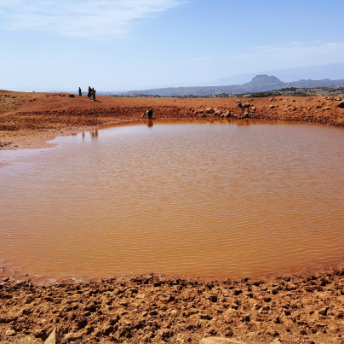
Muddiest point
Most difficult or confusing parts of Session 3 (ESD and constructive alignment)

Slide 6
Presentations of action plans
2

Slide 7

Develop an ESD Action Plan
Task after Session 1- Review of course content Reflect on how Sustainable Development (SD) concepts and topics are currently integrated into your teaching practices. Evaluate your existing course content and syllabi. Identify areas for strengthening the integration of SD into your teaching practices.
Task after Session 2 – Identify opportunities to incorporate SD into your course Identify opportunities to incorporate Sustainable Development concepts and topics. These could include the Sustainable Development Goals (+other relevant frameworks), global sustainability challenges, or different sustainability perspectives. What links does your discipline have with SD?
Task after Session 3 – Session development Find a topic related to SD in your discipline. Develop a lesson/session based on constructive alignment: Formulate at least three learning outcomes, think of suitable learning strategies (that actively engage students in understanding and applying SD and ESD principles) and design an assessment format.
Reflect on how you could integrate SD and ESD principles throughout a course or within a study programme. What content/approaches would you choose? What existing content could you consider through a sustainability lens?

Slide 8
Presentations
Each participant / group presents their action plan.
Focus on key points:
Current state (task after session 1),
Areas for improvement, opportunities identified (task after session 2),
Developed lesson/session (constructive alignment – task after session 3): three learning outcomes, corresponding learning activities, and assessment format (task after session 3).
Listeners take notes and prepare constructive feedback for the presenter.

Slide 9

Presentation of action plans

Slide 10
Synthesis
Key insights from presented action plans (challenges, need for further support identified, etc.)

Slide 11
Collaboration opportunities
2

Slide 12
Group discussion
Discuss collaboration opportunities (with other lecturers, departments, or non-academic stakeholders) based on the presented action plans.
Note down main discussion points.
Notes:
https://miro.com/app/board/uXjVISEq5RY=/

Slide 13

Harvesting of group discussion
Highlights, synergies, commonalities, … of group work

Slide 14

Q&A
3

Slide 15
What are your main learnings of the course?

Slide 16
Evaluation and reflection
4

Slide 17
Evaluation

