Slide 1
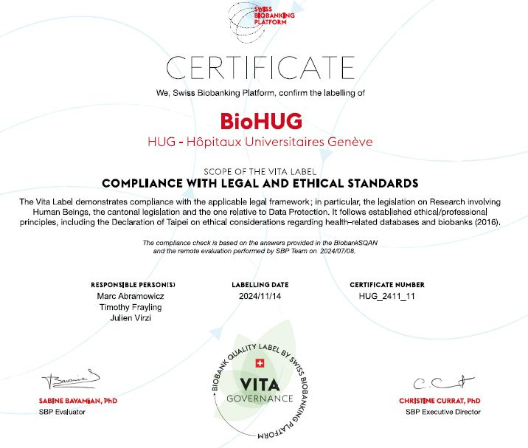
BioHUG: A DNA biobank for research with HUG patients
Individuals sign General consent (anytime since 2017)
Invited 2 weeks before HUG appointment
>150,000 signed early 2026
Routine blood sample HUG (anytime since 2025)
Purple top EDTA tube
HUG Informatics Centre
Patient ID in DPI system -> Diagnostics informatics system
Haematology HUG
Sample flagged if patient has signed general consent
Purple top EDTA tube
Medical Genetics HUG
DNA extracted from 400 ul blood, ~250 per week
BioHUG de-identified DNA Biobank for research

