Slide 1
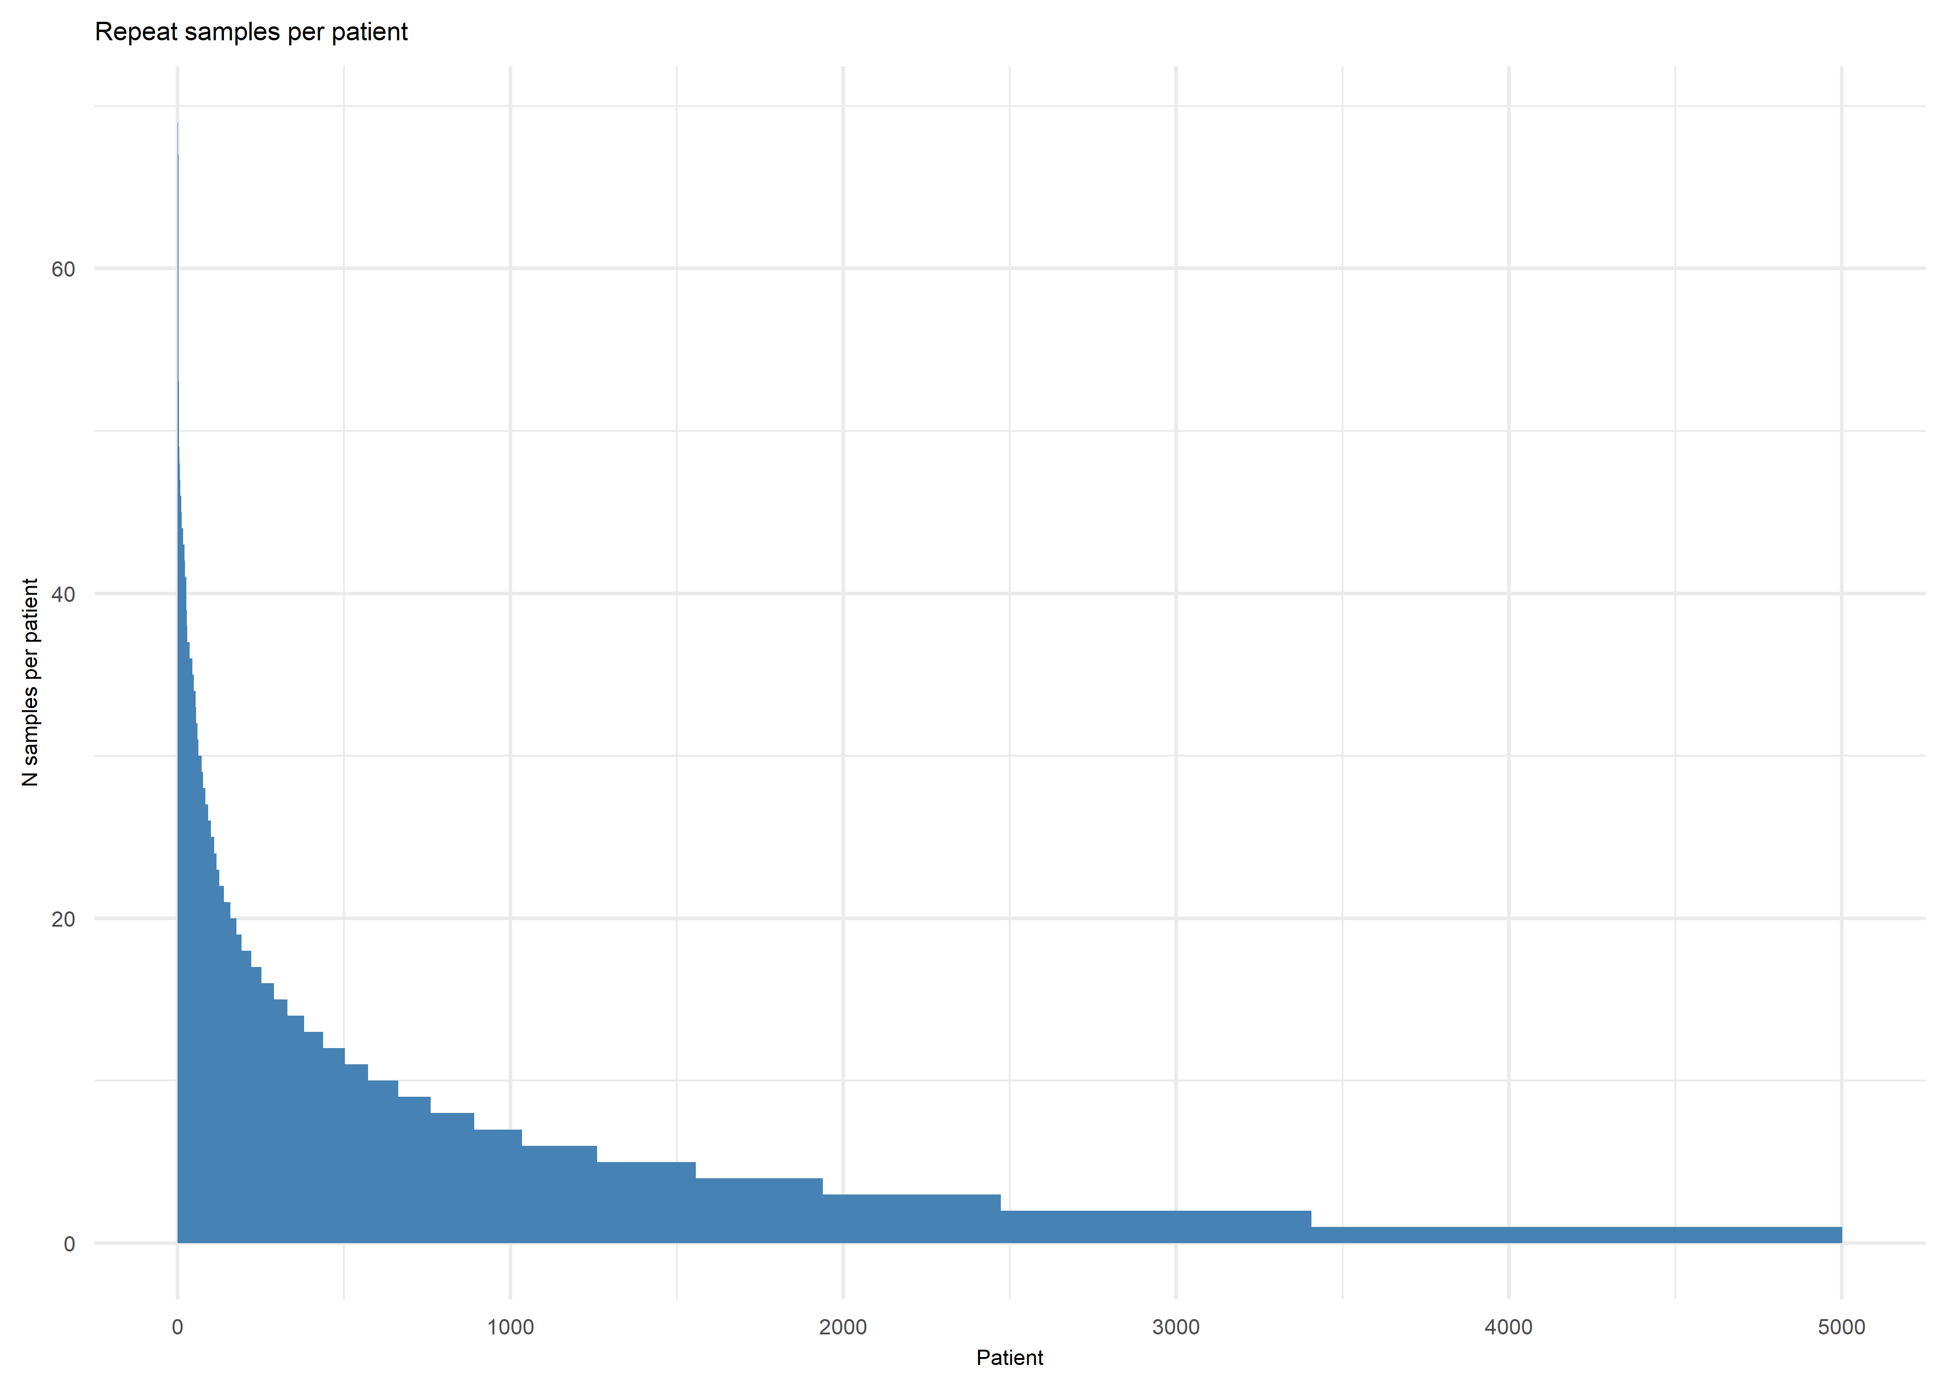
Repeat samples per patient
Number
of samples
per patient
Patients

