Slide 1

CDIF: Cross Domain Interoperability Framework
X-Ray Absorption Data

Slide 2

CDIF Metadata
Provide documentation (a.k.a. metadata) for resources
file-based data sets,
Information to support search applications
Titles, abstracts, authors, keywords, spatial and temporal coverage, described feature, publication dates, licensing…
Information to support initial assessment of a resource
variables reported, quality, provenance.
Information to support usage of a resource
File format, data structure, access protocol.

Slide 3
Serialize using Schema.org, JSON-LD
{"@context": "https://schema.org",
"@id": "ex:URIforNode",
"@type": "Dataset",
"dateModified": "2017-05-23",
"identifier": "ex:URIforDescribedResource",
"name": "unique title for the resource",
"description": "Description of the resource"
lots more... }
Based on JSON, RDF logic
Developer-friendly, lots of tools
Harvested by various metadata aggregators (Google Dataset Search, Ocean Info Hub, EarthCube GeoCODEs…)
Embed in landing pages for data, integrates into web architecture

Slide 4
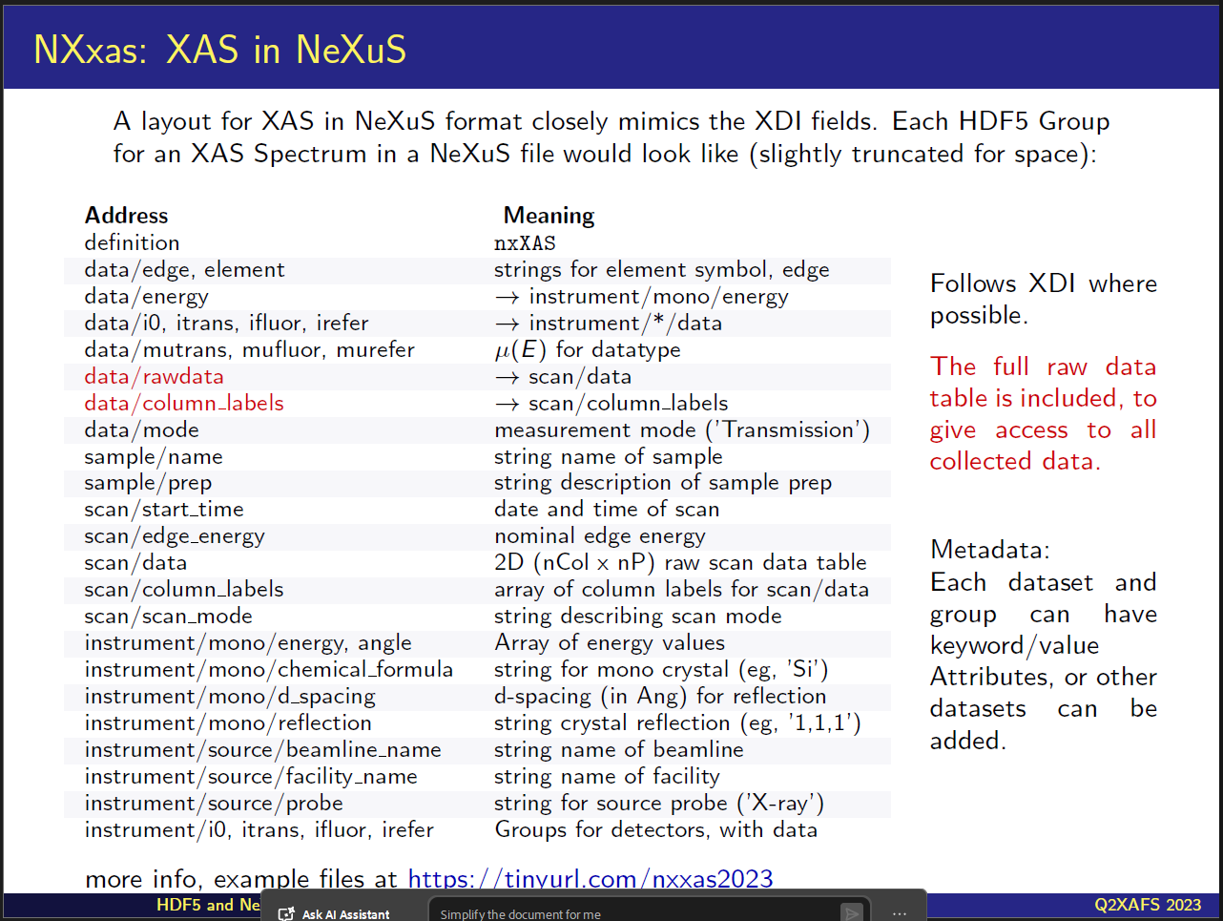
X-Ray Absorption Challenge
How to create metadata records describing data in dramatically different formats to enable frictionless discovery and integration of data
XDI- spectra in columns in a text file, with metadata in comments in a header
NEXUS – spectra as a set of arrays in a binary file with embedded metadata.
The information represented in these formats is closely aligned, but arranged differently
From Matthew Newville, 2023

Slide 5
Proposed solution:
Put data describing the experiment context in the metadata record
Information that is constant over the dataset
Context and configuration important for discovery and initial assessment
Metadata includes sufficient description of data structure to enable software to extract what is needed for analysis (CDI-DDI role)
To start, limit to files containing spectra from a single sample and experiment.

Slide 6
Context, configuration:
nxXAS
source probe ('X-ray’)
target element symbol
target absorption edge
nominal edge energy
measurement mode (e.g. 'Transmission')
name of sample
description of sample prep
name of facility
name of beamline
date and time of scan
string describing scan mode
monochromator crystal composition (eg, 'Si')
monochromator d-spacing
monochromator crystal reflection (eg, '1,1,1')
This information goes in the CDIF metadata:

Slide 7
Spectra Data
Maps incident energy to any of several results: transmitted intensity, fluorescent intensity, absorption coefficient…
Can be represented in tabular form, or as a set of one dimensional arrays with the same dimension.
A raw data array might have multiple values for each incident energy level,
For XDI use DDI-CDI WideDataStructure description
For NEXUS use DDI-CDI DimensionalDataStructure description

Slide 8

Thanks
CDIF recommendations
https://cross-domain-interoperability-framework.github.io/cdifbook
GitHub issues:
https://github.com/Cross-Domain-Interoperability-Framework/Discovery/issues

