Slide 1
Phase 1: what we built
A Unitree Go2 that sees, measures and acts, with safety first
~12%
20 Hz
70
1
distance error at 1 to 3 m on the real robot
control loop with a 0.3 s dead-man stop
automated tests passing
approach-and-sit mission works in simulation
On the real robot
In simulation
On top of both
Live camera and LiDAR
Keyboard driving with limits
YOLO objects with distance
MuJoCo room, camera, depth
Same code as the robot
Object map vs true positions
Go-ahead, then approach
Stops at a safe distance
Sits, then stands again
Notes:
Phase 1 summary. The real-robot numbers come from a tape-measure test: about 1.12 m at 1 m, 1.88 m at 2 m, 3 m at 3 m. The mission has only run in simulation so far.

Slide 2
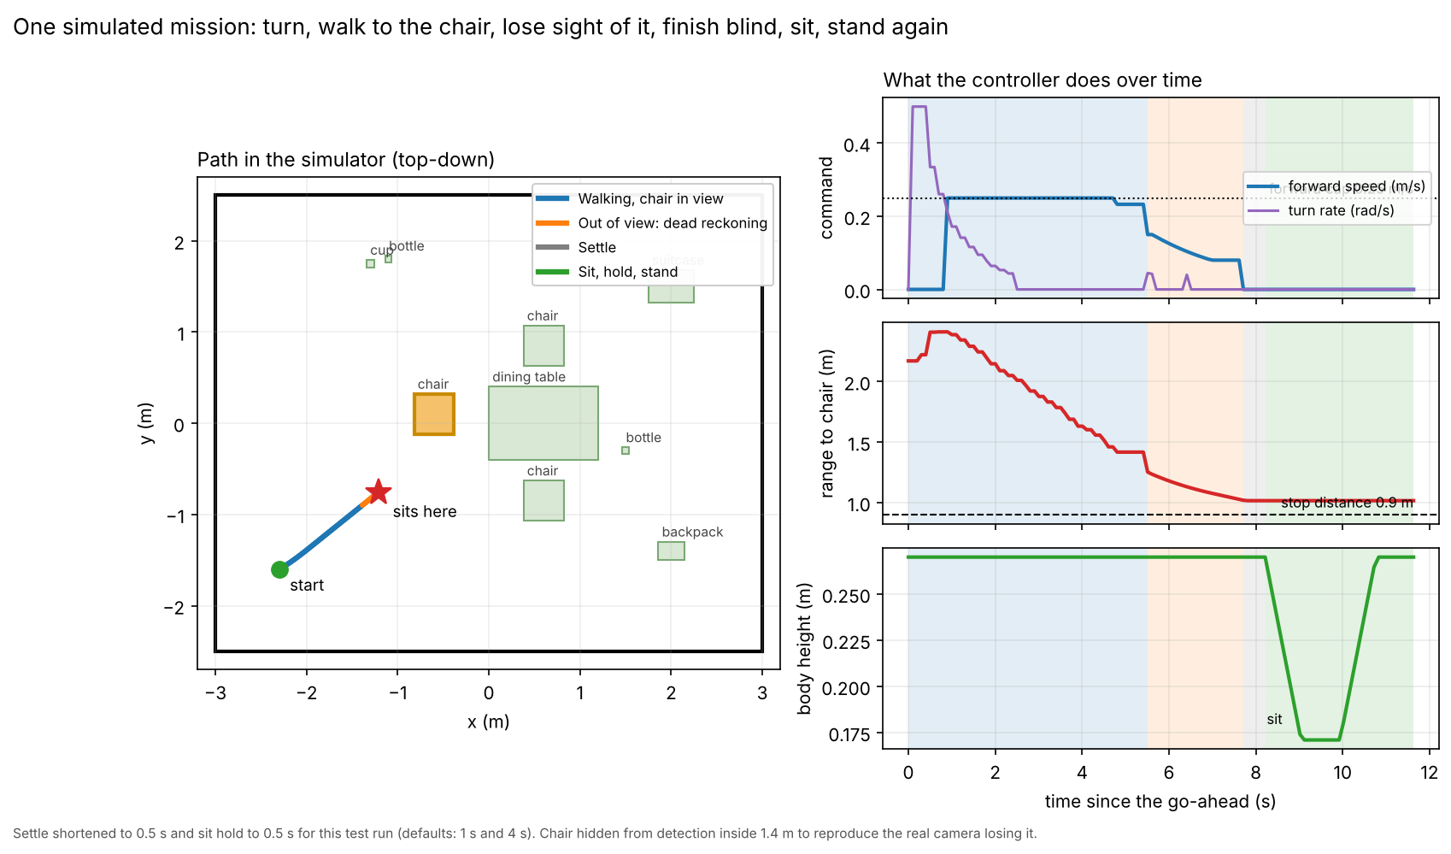
The mission, rehearsed in simulation
Approach the chair, lose sight of it, finish blind, sit, stand up
Starts only on go-ahead
The operator presses B; any key cancels it
Finishes blind
Dead reckoning once the chair leaves the camera view
Stops 1.05 m away
Then sits, holds, and stands up again
Not yet run on the real robot. That is the first job of Phase 2.
Notes:
The chart is one simulated run with a shortened settle and hold time. Chair hidden from detection inside 1.4 m to reproduce the real camera losing it.

Slide 3
Phase 2: toward a scene investigator
Same loop (detect, measure, map, act) aimed at real evidence
1 Real-robot test
2 Search and calibrate
3 Custom detector
4 Record each find
Dry run, then a short approach with the remote in hand
Explore a room alone; calibrate camera and LiDAR
Train on new objects, starting with one class
Photo, position and camera pose saved per detection
Goal
Map evidence such as blood spatter in 3D so software can help detectives estimate how an event happened. Needs specialist review and careful scene handling.
Notes:
Phase 2 order: first prove the mission on the real robot, then add search and calibration, then train a detector on a new object, then log photos and positions. The spatter reconstruction itself is forensic software that would need review by a specialist.

