Slide 1
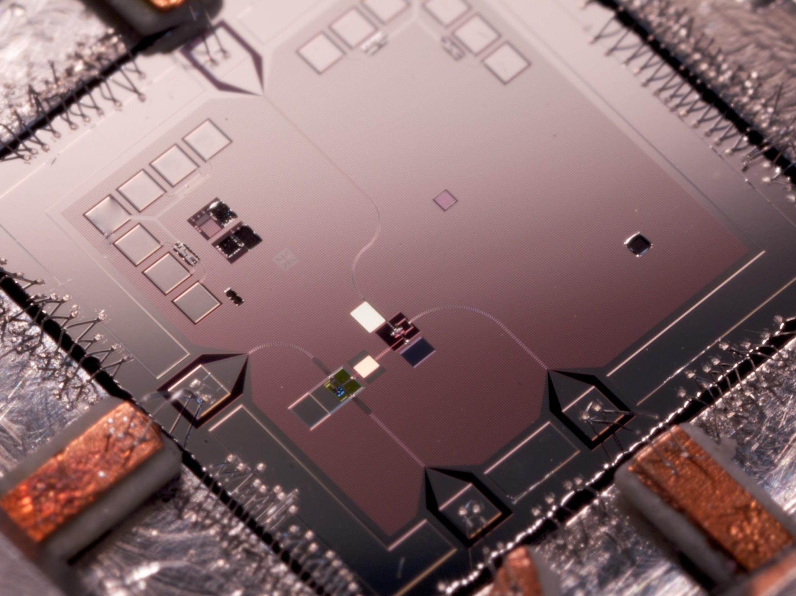
Quantum Random Circuits, certification and sampling
Cohort project Week 1
Team 1 EntroΠ
Notes:
Hi, we will show you how to use quantum random circuit sampling for a real business application

Slide 2
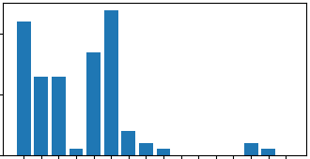
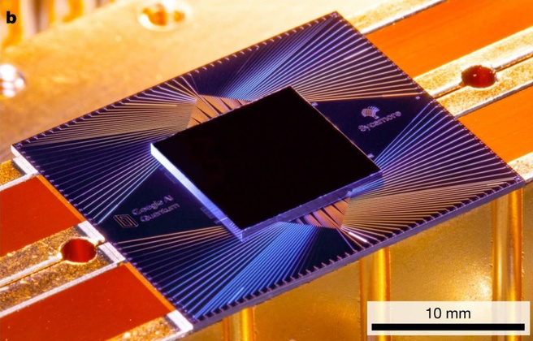
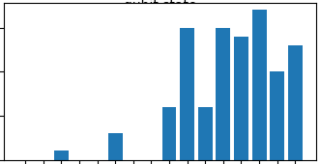
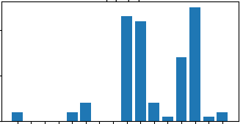
Quantum random circuits: sampling
Notes:
A quantum random circuit is a device that provides a random distribution of outcomes every time we run it.
Google showed in 2018 that quantum computers are much more efficient in sampling from random distributions than classical ones!

Slide 3
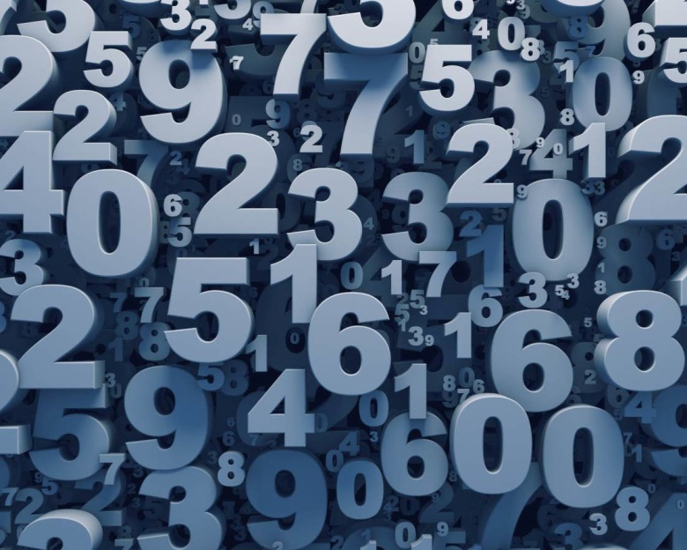

Quantum random circuits: certification
Notes:
A quantum random circuit is a device that provides a random distribution of outcomes every time we run it.
Google showed in 2018 that quantum computers are much more efficient in sampling from random distributions than classical ones!

Slide 4
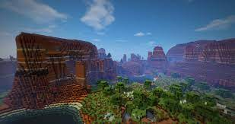
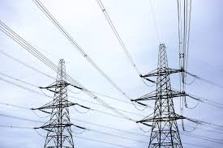



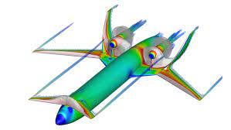


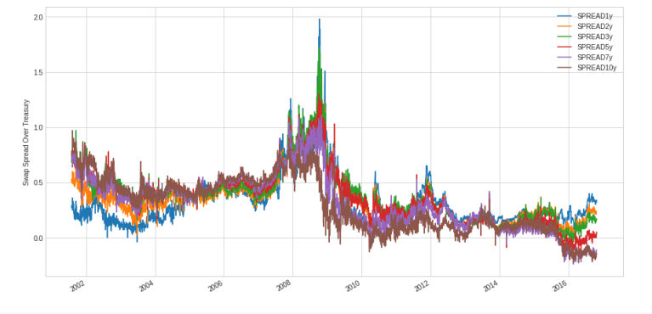

Applications (a few of them)
Virtual environment design for gaming
Random Topology Power Grids for testing
Aircraft modelling with simulating flight in turbulence
Certified random numbers for blockchain
Financial modelling simulation for market drivers
Notes:
Quantum random circuit sampling can be useful to address problems by mapping each gate of the quantum circuit to a specific parameter of the problem.
For instance, by mapping the gates to different environments in a gaming landscape (e.g. desert, water or forest) one could dynamically sample different environments, with a different distribution of resources, to effectively improve the virtual reality of the game!
Similarly this approach can be extended to sample and test power grid topologies, prototype processor architecture or even simulate financial market drivers and atmospheric conditions for aircraft modelling.
The certification

Slide 5
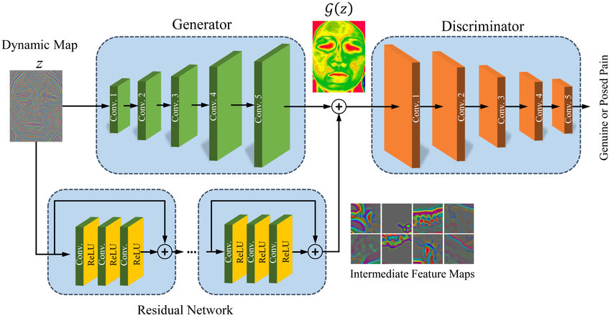


The future is in GANs
Notes:
We have to choose what to focus on and give a reason why.
Generative models are a popular approach to unsupervised machine learning. Generative neural network models are trained to produce data samples that resemble the training set.
We propose for Google a new quantum based method to determine the distribution to be used in the generator of a Generative-Adversarial network. Such distribution can in fact be obtained by efficiently sampling distributions from different quantum random circuits and selecting the best distribution based on the KL distance.

